Slide 2
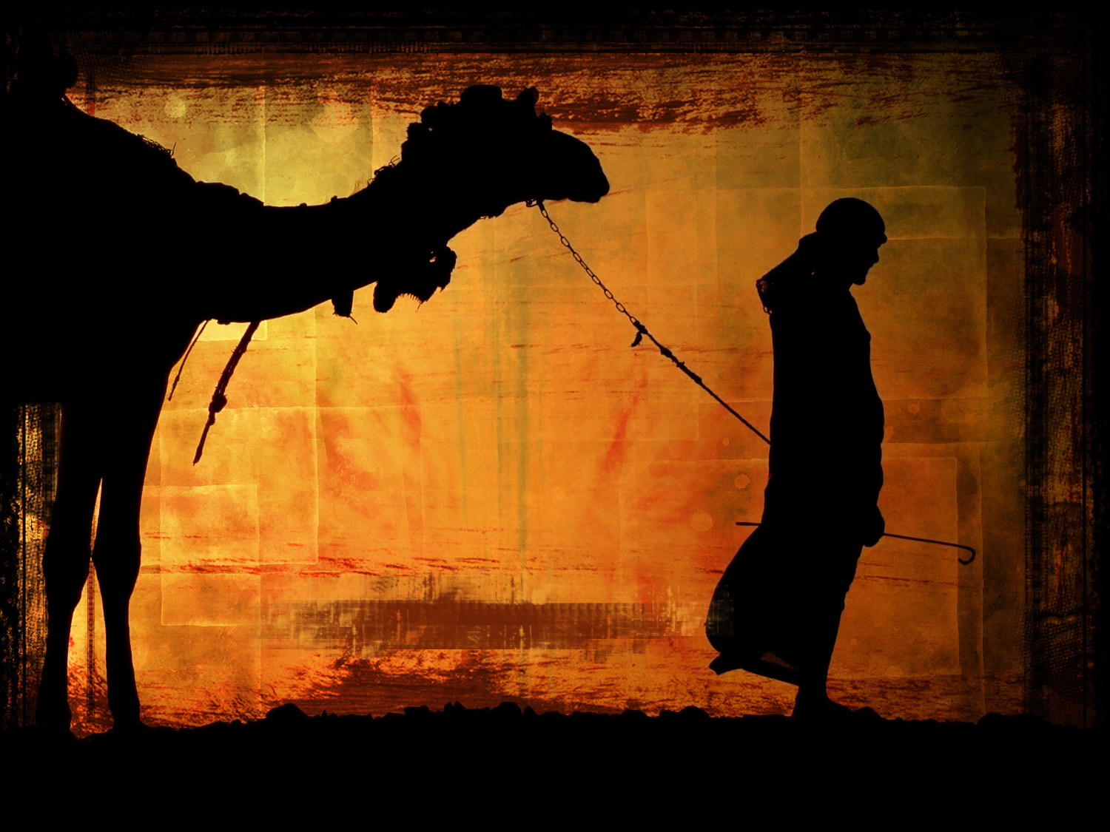
My Camels Also
Genesis 24

Slide 3
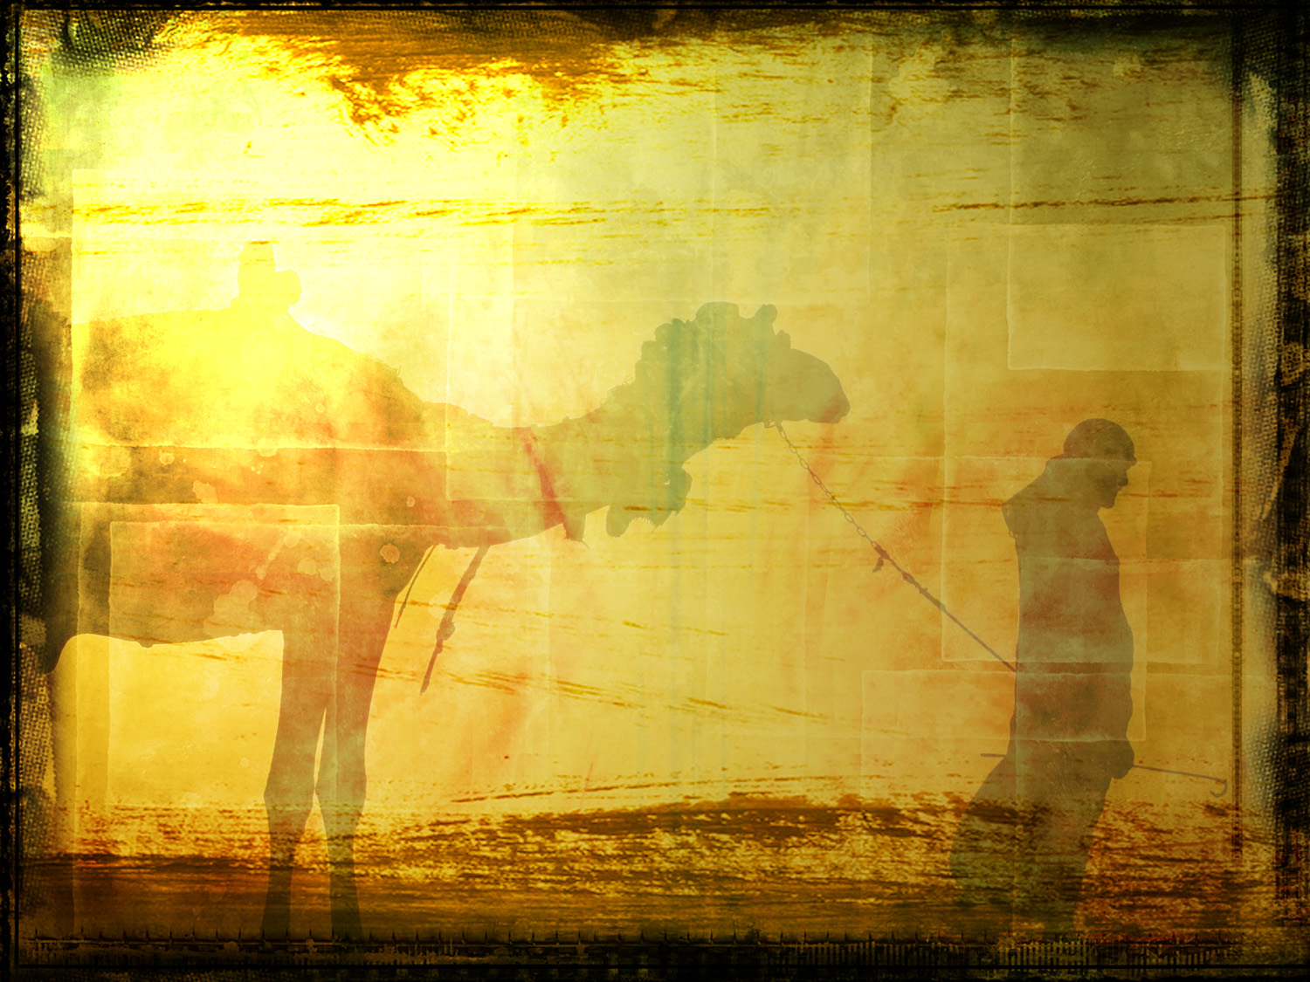
Genesis 24:10-20
10 Then the servant took ten of his master's camels and departed, for all his master's goods were in his hand. And he arose and went to Mesopotamia, to the city of Nahor. 11 And he made his camels kneel down outside the city by a well of water at evening time, the time when women go out to draw water. 12 Then he said, "O LORD God of my master Abraham, please give me success this day, and show kindness to my master Abraham. 13 "Behold, here I stand by the well of water, and the daughters of the men of the city are coming out to draw water.

Slide 4
14 "Now let it be that the young woman to whom I say, 'Please let down your pitcher that I may drink,' and she says, 'Drink, and I will also give your camels a drink' -let her be the one You have appointed for Your servant Isaac. And by this I will know that You have shown kindness to my master." 15 And it happened, before he had finished speaking, that behold, Rebekah, who was born to Bethuel, son of Milcah, the wife of Nahor, Abraham's brother, came out with her pitcher on her shoulder.

Slide 5
15 And it happened, before he had finished speaking, that behold, Rebekah, who was born to Bethuel, son of Milcah, the wife of Nahor, Abraham's brother, came out with her pitcher on her shoulder. 16 Now the young woman was very beautiful to behold, a virgin; no man had known her. And she went down to the well, filled her pitcher, and came up. 17 And the servant ran to meet her and said, "Please let me drink a little water from your pitcher." 18 So she said, "Drink, my lord." Then she quickly let her pitcher down to her hand, and gave him a drink.

Slide 6
19 And when she had finished giving him a drink, she said, "I will draw water for your camels also, until they have finished drinking." 20 Then she quickly emptied her pitcher into the trough, ran back to the well to draw water, and drew for all his camels.

Slide 7
The Servanthood of Rebekah
A “Rebekah spirit” will always capture God’s attention

Slide 8
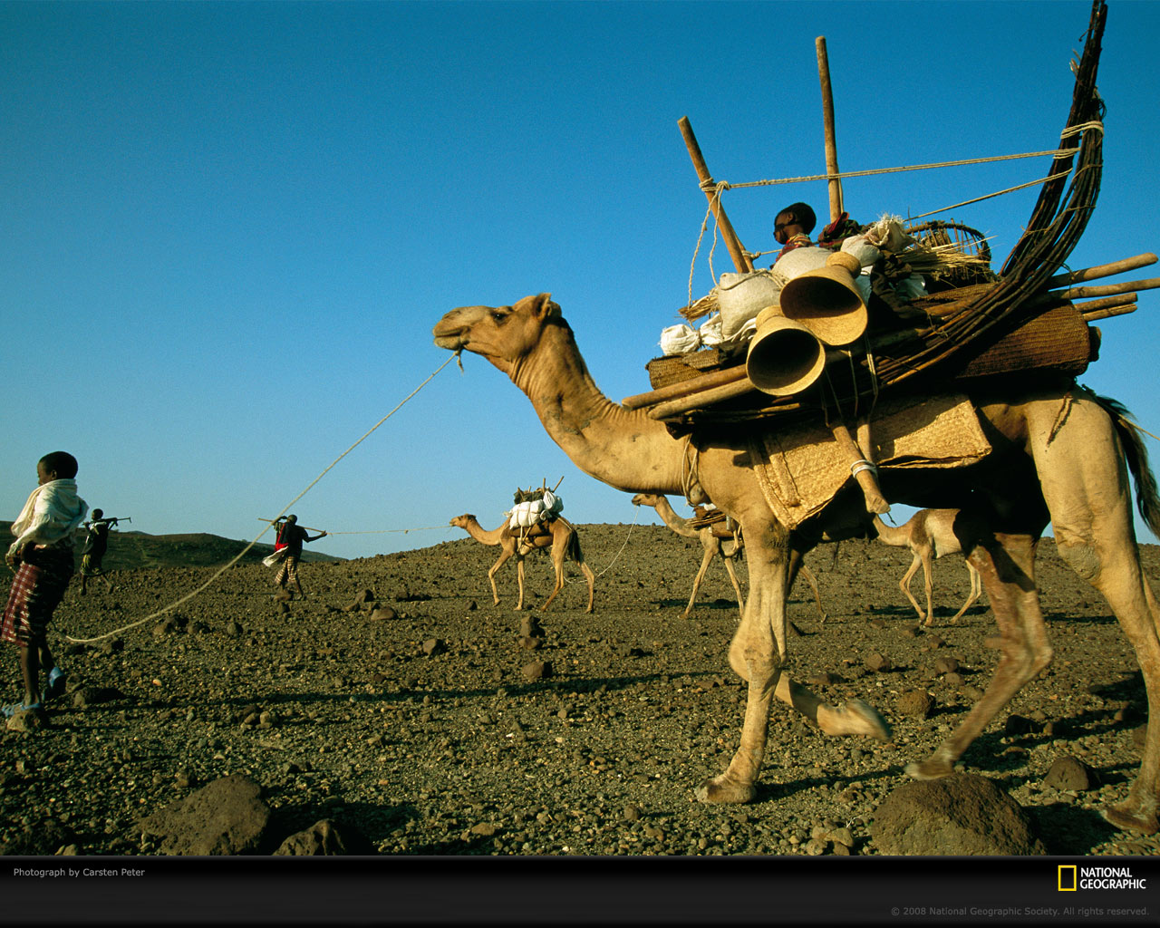

Slide 9
The Servanthood of Rebekah
A “Rebekah spirit” will always capture God’s attention
A “Rebekah spirit” will build great churches
Is it in me?

