Slide 3
Esther 4:13-14
13 And Mordecai told them to answer Esther: "Do not think in your heart that you will escape in the king's palace any more than all the other Jews. 14 "For if you remain completely silent at this time, relief and deliverance will arise for the Jews from another place, but you and your father's house will perish. Yet who knows whether you have come to the kingdom for such a time as this?"

Slide 4
16 "Go, gather all the Jews who are present in Shushan, and fast for me; neither eat nor drink for three days, night or day. My maids and I will fast likewise. And so I will go to the king, which is against the law; and if I perish, I perish!"

Slide 5
Our world is
antagonistic to the things of
God

Slide 6
1 Peter 2:11
Beloved, I beg you as sojourners and pilgrims, abstain from fleshly lusts which war against the soul,

Slide 7
How does all the anti-God,
anti-faith philosophy
and culture make you feel?
Helpless and hopeless?

Slide 8
What can I do?
PRAY

Slide 9
Luke 18:1-8
Then He spoke a parable to them, that men always ought to pray and not lose heart, 2 saying: "There was in a certain city a judge who did not fear God nor regard man. 3 "Now there was a widow in that city; and she came to him, saying, 'Get justice for me from my adversary.' 4 "And he would not for a while; but afterward he said within himself, 'Though I do not fear God nor regard man, 5 'yet because this widow troubles me I will avenge her, lest by her continual coming she weary me.'"

Slide 10
6 Then the Lord said, "Hear what the unjust judge said. 7 "And shall God not avenge His own elect who cry out day and night to Him, though He bears long with them? 8 "I tell you that He will avenge them speedily. Nevertheless, when the Son of Man comes, will He really find faith on the earth?"

Slide 11
The “prayer problem” for most Christians is a “faith problem”

Slide 12
God has the power to change the world;
we do not

Slide 13
Ephesians 1:18-20
the eyes of your understanding being enlightened; that you may know what is the hope of His calling, what are the riches of the glory of His inheritance in the saints, 19 and what is the exceeding greatness of His power toward us who believe, according to the working of His mighty power 20 which He worked in Christ when He raised Him from the dead and seated Him at His right hand in the heavenly places,

Slide 14
Ephesians 3:20
Now to Him who is able to do exceedingly abundantly above all that we ask or think, according to the power that works in us,

Slide 15
What could God do to change the world?
Whatever He wanted!!

Slide 16
James 4:2
You do not have because you do not ask.

Slide 17
Prayer: A favored and consistent request
Romans 15:30
Now I beg you, brethren, through the Lord Jesus Christ, and through the love of the Spirit, that you strive together with me in prayers to God for me,

Slide 18
Prayer: A favored and consistent request
2 Corinthians 1:11
you also helping together in prayer for us, that thanks may be given by many persons on our behalf for the gift granted to us through many.

Slide 19
Prayer: A favored and consistent request
Ephesians 6:19
and for me, that utterance may be given to me, that I may open my mouth boldly to make known the mystery of the gospel,

Slide 20
Prayer: A favored and consistent request
Colossians 4:2-3
Continue earnestly in prayer, being vigilant in it with thanksgiving; 3 meanwhile praying also for us, that God would open to us a door for the word, to speak the mystery of Christ, for which I am also in chains,

Slide 21
Prayer: A favored and consistent request
1 Thessalonians 5:25
Brethren, pray for us.

Slide 22
Prayer: A favored and consistent request
2 Thessalonians 3:1
Finally, brethren, pray for us, that the word of the Lord may run swiftly and be glorified, just as it is with you,

Slide 23
Faith produces prayer
Luke 18:8 “Nevertheless, when the Son of Man comes, will He find faith on the earth?”

Slide 24
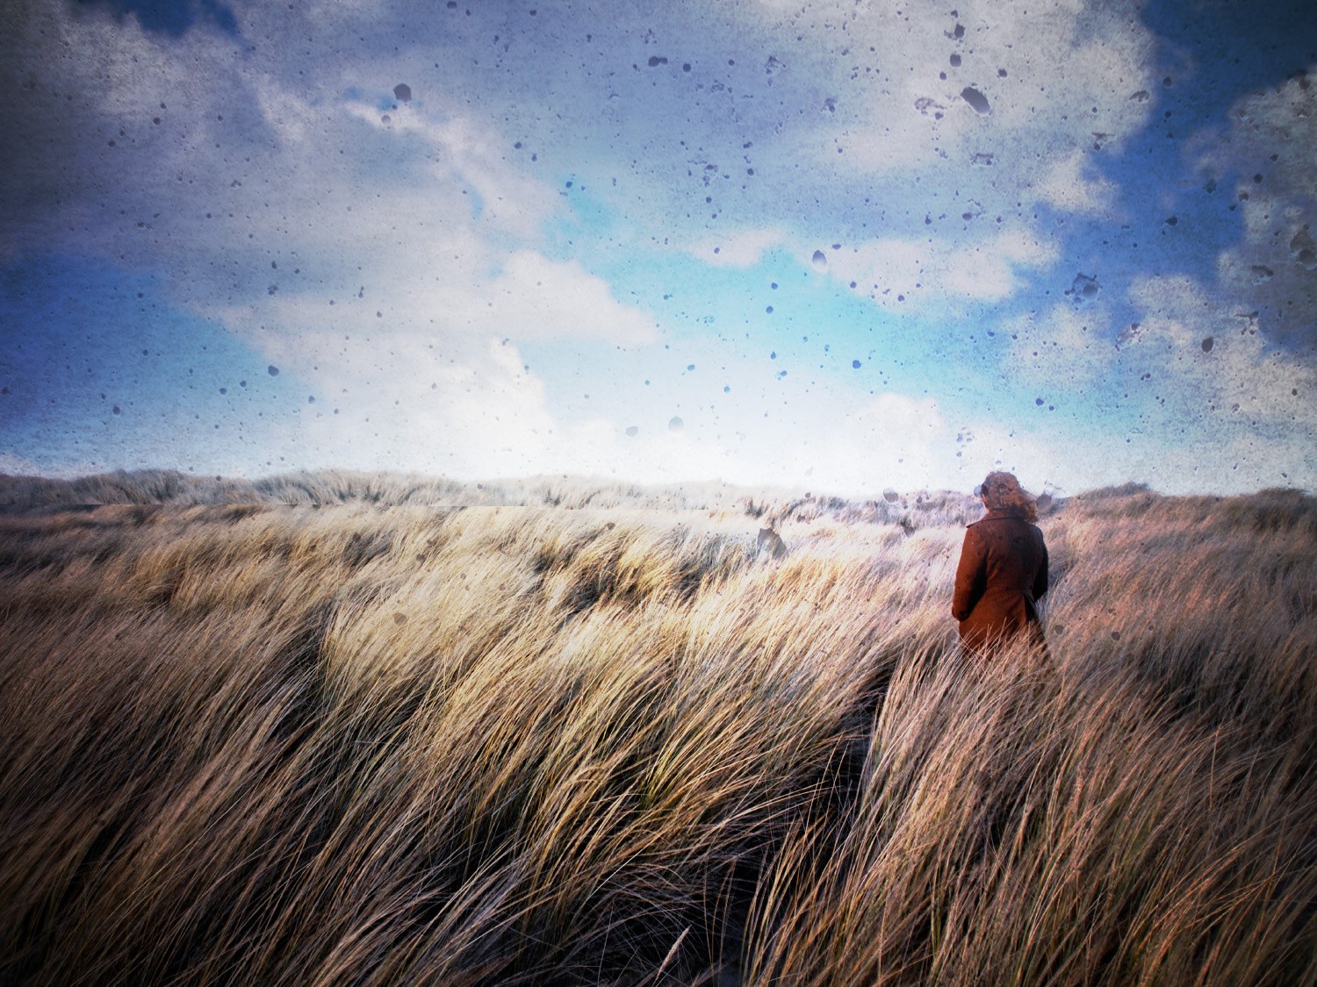
4:14

