Slide 2
ISN’T CHEAP

Slide 3
“For God so loved the world, that He gave His only begotten Son, that whoever believes in Him shall not perish, but have eternal life.”
(John 3:16, NASB95)
DESCRIBED

Slide 4
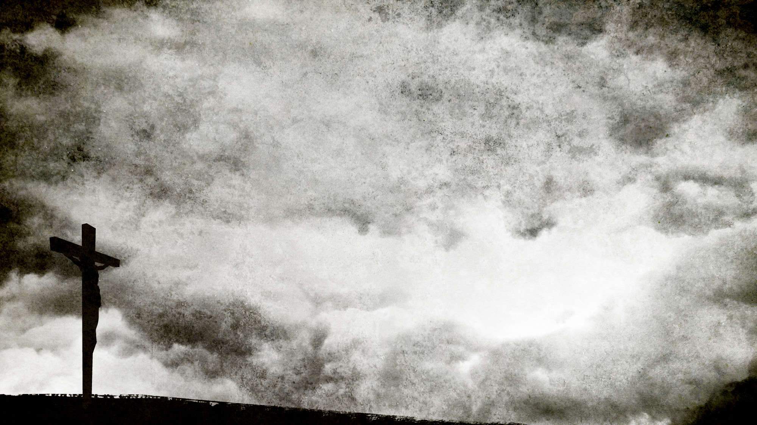
“As Moses lifted up the serpent in the wilderness, even so must the Son of Man be lifted up;”
(John 3:14)
the Cost of Grace

Slide 5
God gave His Son, John 3:16
Jesus gave His life, John 10:17-18
What does grace cost me?
the Cost of Grace

Slide 6
“For God so loved the world, that He gave His only begotten Son, that whoever believes in Him shall not perish, but have eternal life.”
(John 3:16)
the Cost of Grace

