Slide 2
universitychurchofchrist.org

Slide 3
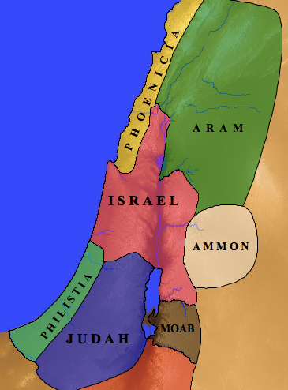

Slide 4
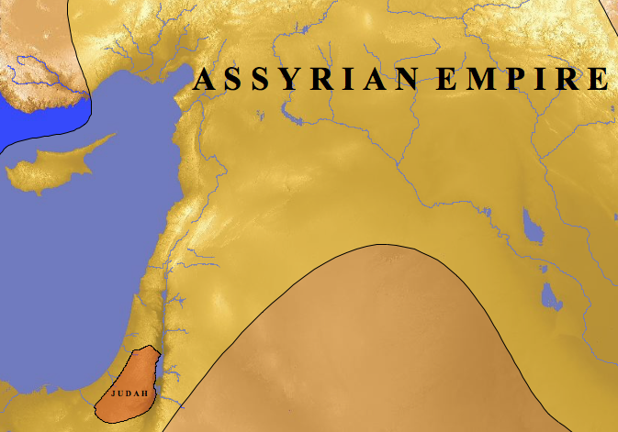

Slide 5
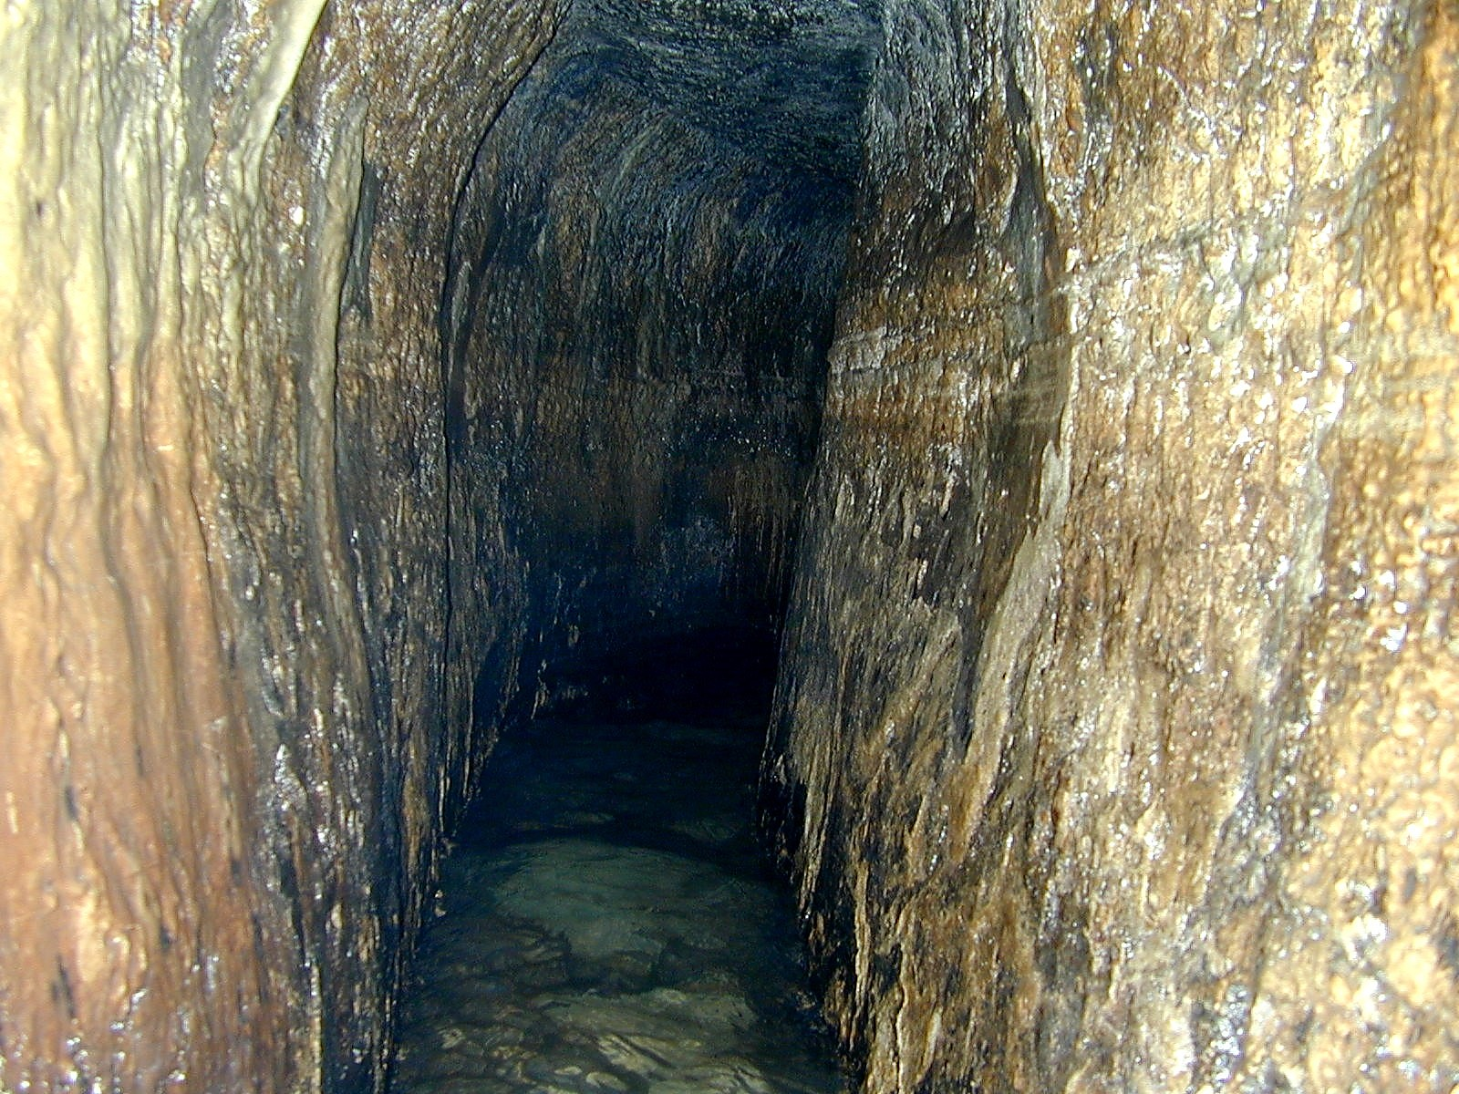

Slide 6
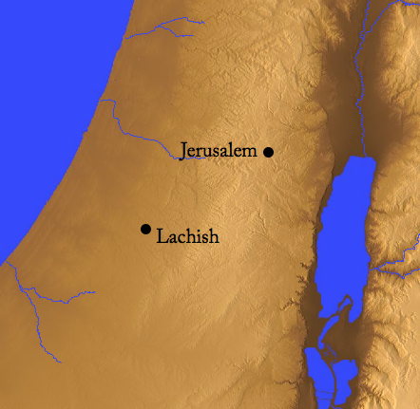
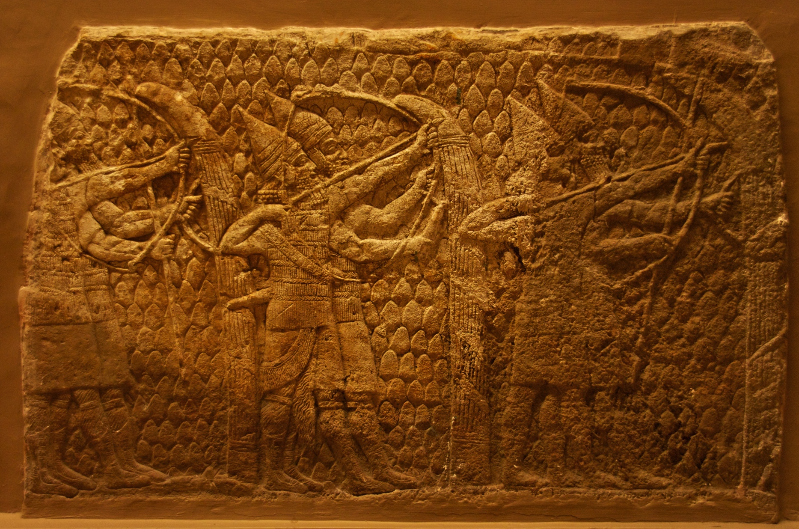
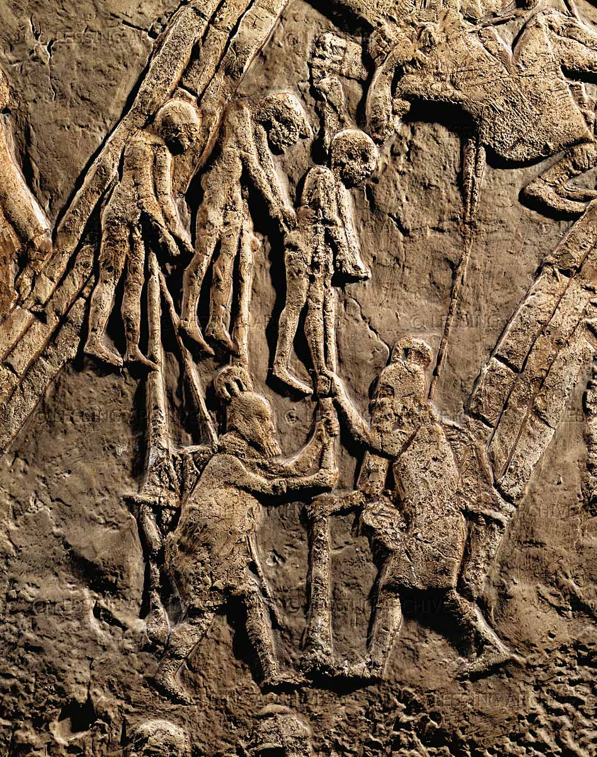
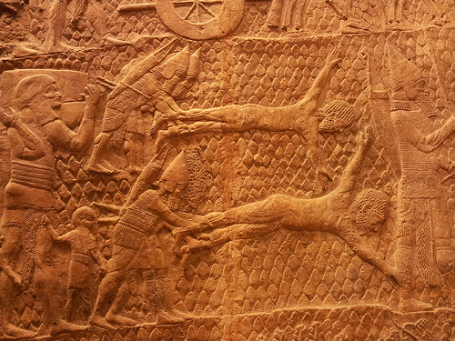

Slide 7
“…though the earth should change And though the mountains slip into the heart of the sea; Though its waters roar and foam, Though the mountains quake at its swelling pride.”
Psalm 46:2–3

Slide 8
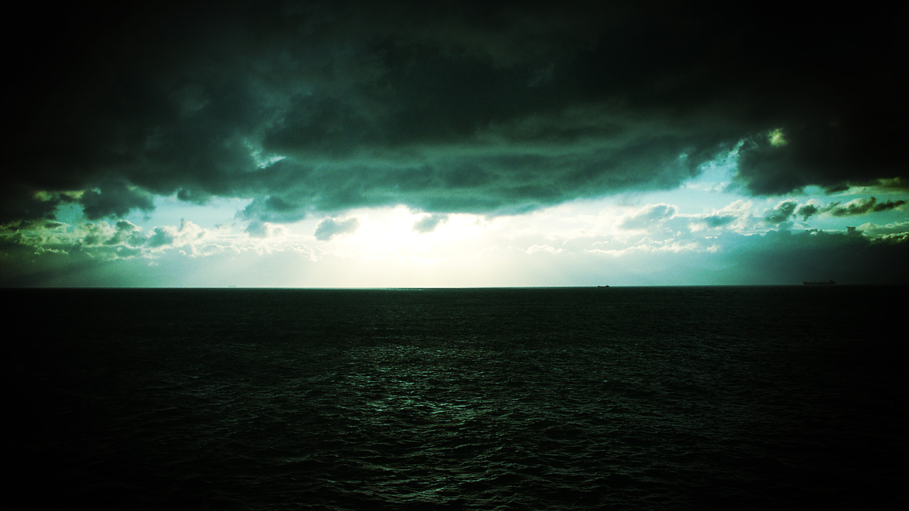
OUR VERY PRESENT HELP
No fear, in spite of circumstances (vss. 1-3)
Peace for God’s people (vss. 4-7)
The call to behold (vss. 8-11)

Slide 9
OUR VERY PRESENT HELP
The only thing that matters: God on our side
It’s time to “cease striving”
The end result: God glorified!

