Slide 2
Creation
The Flood
Patriarchs
Exodus from Egypt
Wilderness Wanderings
Conquest of Canaan
Judges
United Kingdom
Divided Kingdom
Judah Alone
Babylonian Captivity
Return from Captivity
STORY of
the OLD
TESTAMENT

Slide 3
Creation
The Flood
Patriarchs
Exodus from Egypt
Wilderness Wanderings
Conquest of Canaan
Judges
United Kingdom
Divided Kingdom
Judah Alone
Babylonian Captivity
Return from Captivity
STORY of
the OLD
TESTAMENT

Slide 4
Preparation of the people and of Moses (Exodus 1-4)
The Exodus
Exodus 1 – Numbers 12

Slide 5
“Joseph died, and all his brothers and all that generation. But the sons of Israel were fruitful and increased greatly, and multiplied, and became exceedingly mighty, so that the land was filled with them.”
Exodus 1.6-7 NASB
The Exodus
Exodus 1 – Numbers 12

Slide 6
The Exodus
Exodus 1 – Numbers 12

Slide 7
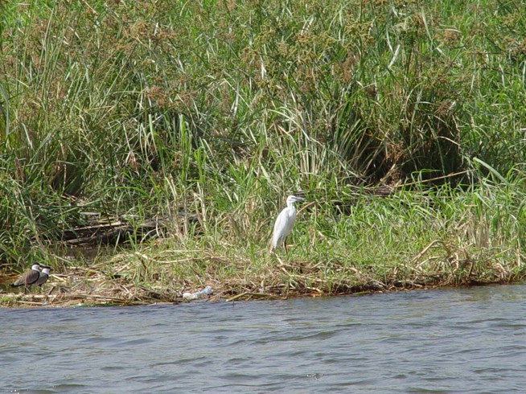
The Exodus
Exodus 1 – Numbers 12

Slide 8
The Exodus
Exodus 1 – Numbers 12

Slide 9
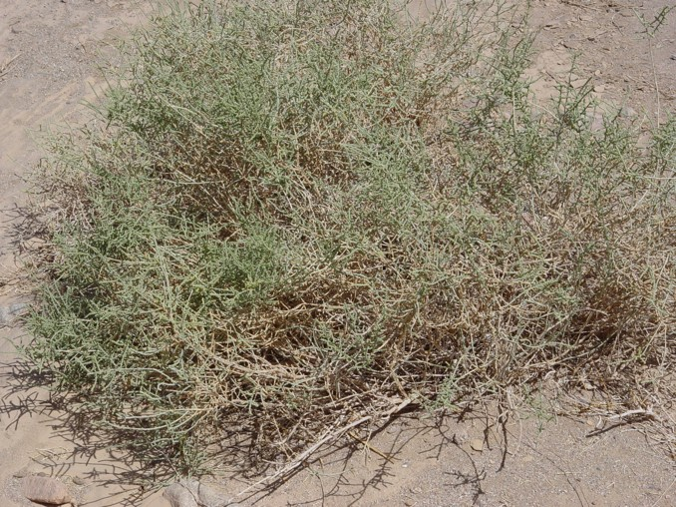
The Exodus
Exodus 1 – Numbers 12

Slide 10
Preparation of the people and of Moses (Exodus 1-4)
Dealings with Pharaoh and the 10 plagues (Exodus 5-12)
The Exodus
Exodus 1 – Numbers 12

Slide 11
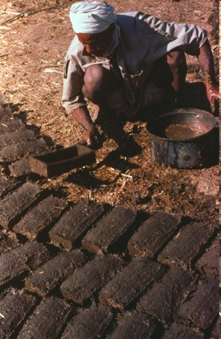
The Exodus
Exodus 1 – Numbers 12

Slide 12
Waters turn to blood
Frogs
Gnats (lice)
Flies
Plagues that kill livestock
Boils on man and beast
Hail
Locusts
Darkness for 3 days
Death of the firstborn
The Plagues

Slide 13
Preparation of the people and of Moses (Exodus 1-4)
Dealings with Pharaoh and the 10 plagues (Exodus 5-12)
The Exodus (Exodus 12-15)
The Exodus
Exodus 1 – Numbers 12

Slide 14
The Exodus
Exodus 1 – Numbers 12

Slide 15
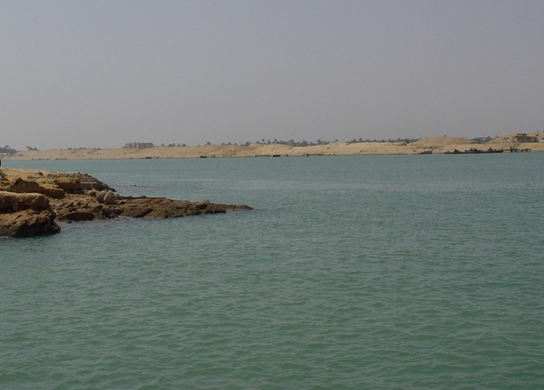
The Exodus
Exodus 1 – Numbers 12

Slide 16
Preparation of the people and of Moses (Exodus 1-4)
Dealings with Pharaoh and the 10 plagues (Exodus 5-12)
The Exodus (Exodus 12-15)
Journey to Sinai (Exodus 15-18)
The Exodus
Exodus 1 – Numbers 12

Slide 17
The Exodus
Exodus 1 – Numbers 12

Slide 18
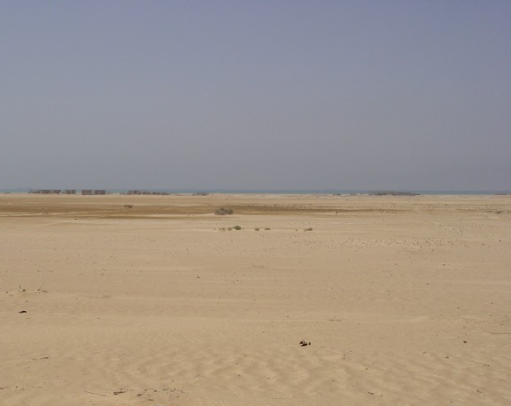
The Exodus
Exodus 1 – Numbers 12

Slide 19
The Exodus
Exodus 1 – Numbers 12

Slide 20
Preparation of the people and of Moses (Exodus 1-4)
Dealings with Pharaoh and the 10 plagues (Exodus 5-12)
The Exodus (Exodus 12-15)
Journey to Sinai (Exodus 15-18)
At Sinai (Exodus 19-Numbers 10)
The Exodus
Exodus 1 – Numbers 12

Slide 21
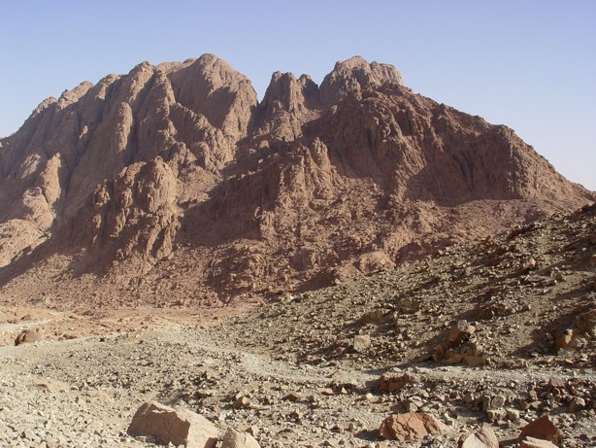
The Exodus
Exodus 1 – Numbers 12

Slide 22
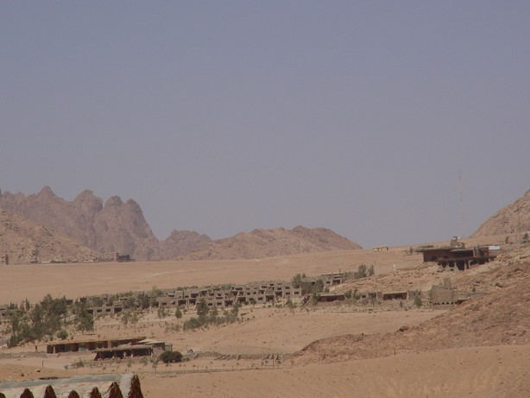
The Exodus
Exodus 1 – Numbers 12

Slide 23
Preparation of the people and of Moses (Exodus 1-4)
Dealings with Pharaoh and the 10 plagues (Exodus 5-12)
The Exodus (Exodus 12-15)
Journey to Sinai (Exodus 15-18)
At Sinai (Exodus 19-Numbers 10)
Journey to Kadesh Barnea (Numbers 11-12)
The Exodus
Exodus 1 – Numbers 12

Slide 24
The Exodus
Exodus 1 – Numbers 12

Slide 25
“And I will make you a great nation, And I will bless you, And make your name great; And so you shall be a blessing;”
(Genesis 12:2)
God Keeps Promises!

Slide 26
“Joseph died, and all his brothers and all that generation. But the sons of Israel were fruitful and increased greatly, and multiplied, and became exceedingly mighty, so that the land was filled with them.”
Exodus 1.6-7 NASB
God Keeps Promises!

Slide 27
Based on grace (Exodus 19.5-6; 23.30-31)
Contain stipulations (Exodus 19.5; 24.3)
Ratified by blood (Exodus 24.5-8)
Require faith (Leviticus 26; Hebrews 4.2)
God’s Covenants

Slide 28
Seek Him in times of trouble (Exodus 2.23)
Forget the help He has given (Exodus 14.10-12; 16.2-3)
Eager to receive His blessings (Exodus 19.5-8)
Fail to follow Him so that they might receive His blessings
How People Treat God

