Slide 1
o

Slide 2
(Acts 20:1-6) And after the uproar ceased, Paul having sent for the disciples and exhorted them, took leave of them, and departed to go into Macedonia. And when he had gone through those parts, and had given them much exhortation, he came into Greece. And when he had spent three months there, and a plot was laid against him by Jews as he was about to set sail for Syria, he determined to return through Macedonia. And there accompanied him as far as Asia, Sopater of Beroea, the son of Pyrrhus; and of the Thessalonians, Aristarchus and Secundus; and Gaius of Derbe, and Timothy; and of Asia, Tychicus and Trophimus. But these had gone before, and were waiting for us at Troas. And we sailed away from Philippi after the days of unleavened bread, and came unto them to Troas in five days, where we tarried seven days.

Slide 3
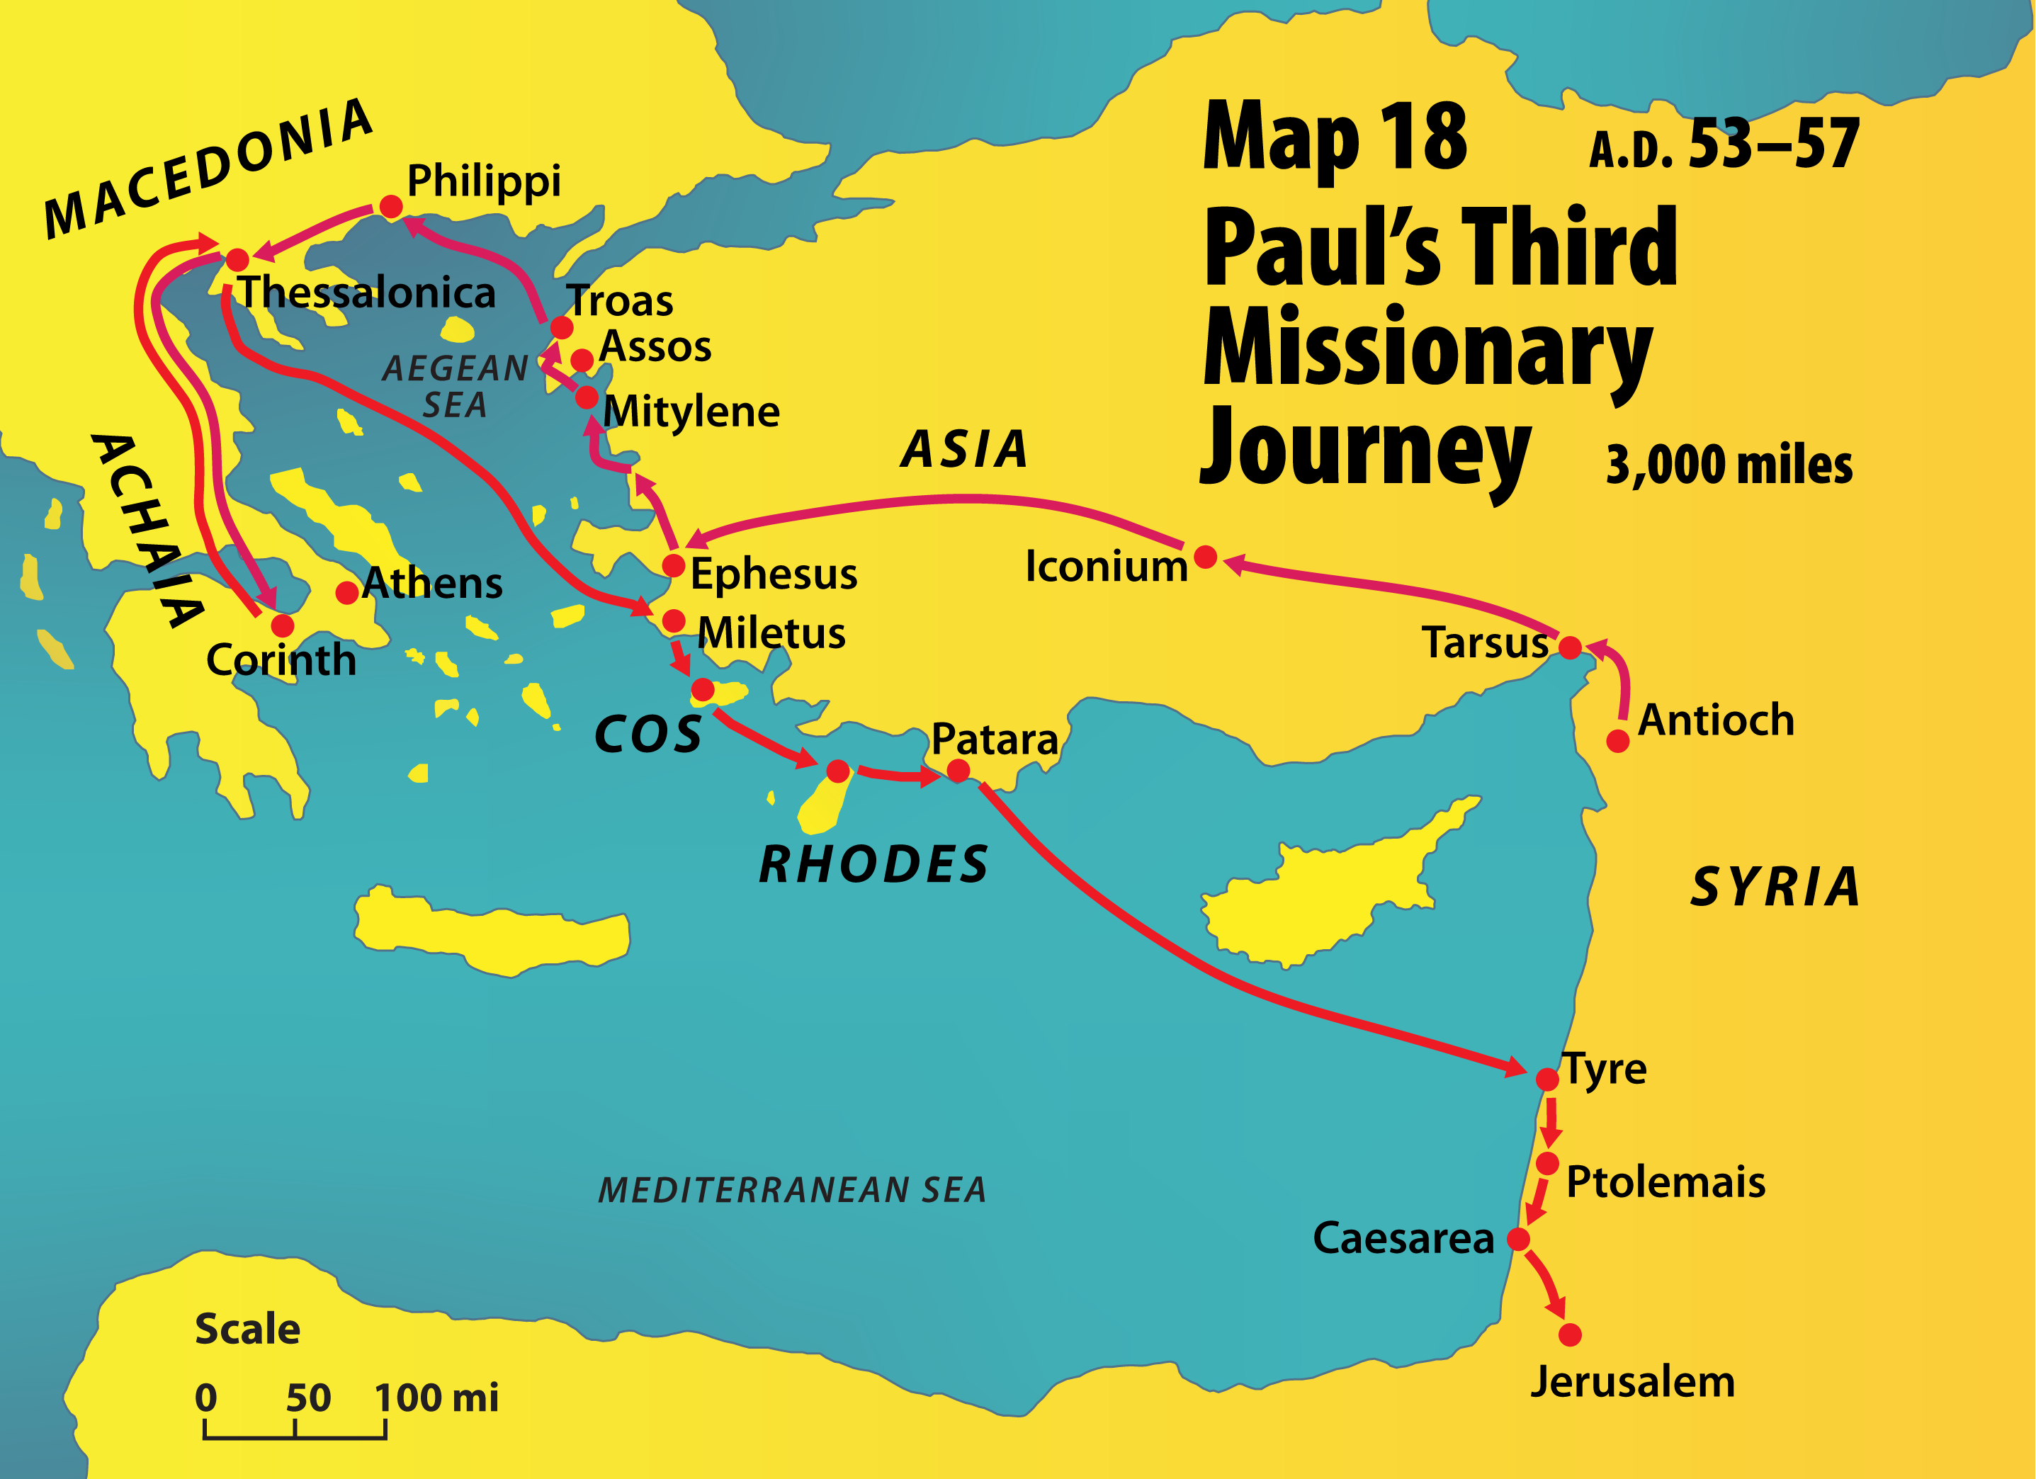

Slide 4
(Acts 20:1-6) And after the uproar ceased, Paul having sent for the disciples and exhorted them, took leave of them, and departed to go into Macedonia. And when he had gone through those parts, and had given them much exhortation, he came into Greece. And when he had spent three months there, and a plot was laid against him by Jews as he was about to set sail for Syria, he determined to return through Macedonia. And there accompanied him as far as Asia, Sopater of Beroea, the son of Pyrrhus; and of the Thessalonians, Aristarchus and Secundus; and Gaius of Derbe, and Timothy; and of Asia, Tychicus and Trophimus. But these had gone before, and were waiting for us at Troas. And we sailed away from Philippi after the days of unleavened bread, and came unto them to Troas in five days, where we tarried seven days.

Slide 5
(Acts 20:1-6) And after the uproar ceased, Paul having sent for the disciples and exhorted them, took leave of them, and departed to go into Macedonia. And when he had gone through those parts, and had given them much exhortation, he came into Greece. And when he had spent three months there, and a plot was laid against him by Jews as he was about to set sail for Syria, he determined to return through Macedonia. And there accompanied him as far as Asia, Sopater of Beroea, the son of Pyrrhus; and of the Thessalonians, Aristarchus and Secundus; and Gaius of Derbe, and Timothy; and of Asia, Tychicus and Trophimus. But these had gone before, and were waiting for us at Troas. And we sailed away from Philippi after the days of unleavened bread, and came unto them to Troas in five days, where we tarried seven days.

Slide 6
(Acts 20:1-6) And after the uproar ceased, Paul having sent for the disciples and exhorted them, took leave of them, and departed to go into Macedonia. And when he had gone through those parts, and had given them much exhortation, he came into Greece. And when he had spent three months there, and a plot was laid against him by Jews as he was about to set sail for Syria, he determined to return through Macedonia. And there accompanied him as far as Asia, Sopater of Beroea, the son of Pyrrhus; and of the Thessalonians, Aristarchus and Secundus; and Gaius of Derbe, and Timothy; and of Asia, Tychicus and Trophimus. But these had gone before, and were waiting for us at Troas. And we sailed away from Philippi after the days of unleavened bread, and came unto them to Troas in five days, where we tarried seven days.

Slide 7
(Acts 20:1-6) And after the uproar ceased, Paul having sent for the disciples and exhorted them, took leave of them, and departed to go into Macedonia. And when he had gone through those parts, and had given them much exhortation, he came into Greece. And when he had spent three months there, and a plot was laid against him by Jews as he was about to set sail for Syria, he determined to return through Macedonia. And there accompanied him as far as Asia, Sopater of Beroea, the son of Pyrrhus; and of the Thessalonians, Aristarchus and Secundus; and Gaius of Derbe, and Timothy; and of Asia, Tychicus and Trophimus. But these had gone before, and were waiting for us at Troas. And we sailed away from Philippi after the days of unleavened bread, and came unto them to Troas in five days, where we tarried seven days.

Slide 9
(Acts 20:1-6) And after the uproar ceased, Paul having sent for the disciples and exhorted them, took leave of them, and departed to go into Macedonia. And when he had gone through those parts, and had given them much exhortation, he came into Greece. And when he had spent three months there, and a plot was laid against him by Jews as he was about to set sail for Syria, he determined to return through Macedonia. And there accompanied him as far as Asia, Sopater of Beroea, the son of Pyrrhus; and of the Thessalonians, Aristarchus and Secundus; and Gaius of Derbe, and Timothy; and of Asia, Tychicus and Trophimus. But these had gone before, and were waiting for us at Troas. And we sailed away from Philippi after the days of unleavened bread, and came unto them to Troas in five days, where we tarried seven days.

Slide 10
(Acts 20:7-16) And upon the first day of the week, when we were gathered together to break bread, Paul discoursed with them, intending to depart on the morrow; and prolonged his speech until midnight. And there were many lights in the upper chamber where we were gathered together. And there sat in the window a certain young man named Eutychus, borne down with deep sleep; and as Paul discoursed yet longer, being borne down by his sleep he fell down from the third story, and was taken up dead. And Paul went down, and fell on him, and embracing him said, Make ye no ado; for his life is in him. And when he was gone up, and had broken the bread, and eaten, and had talked with them a long while, even till break of day, so he departed. And they brought the lad alive, and were not a little comforted. But we going before to the ship set sail for Assos, there intending to take in Paul: for so had he appointed, intending himself to go by land. And when he met us at Assos, we took him in, and came to Mitylene. And sailing from thence, we came the following day over against Chios; and the next day we touched at Samos; and the day after we came to Miletus. For Paul had determined to sail past Ephesus, that he might not have to spend time in Asia; for he was hastening, if it were possible for him, to be at Jerusalem the day of Pentecost.

Slide 11
(Acts 20:4-7) And there accompanied him as far as Asia, Sopater of Beroea, the son of Pyrrhus; and of the Thessalonians, Aristarchus and Secundus; and Gaius of Derbe, and Timothy; and of Asia, Tychicus and Trophimus. But these had gone before, and were waiting for us at Troas. And we sailed away from Philippi after the days of unleavened bread, and came unto them to Troas in five days, where we tarried seven days. And upon the first day of the week, when we were gathered together to break bread, Paul discoursed with them, intending to depart on the morrow; and prolonged his speech until midnight.

Slide 12
(Acts 20:4-7) And there accompanied him as far as Asia, Sopater of Beroea, the son of Pyrrhus; and of the Thessalonians, Aristarchus and Secundus; and Gaius of Derbe, and Timothy; and of Asia, Tychicus and Trophimus.
But these had gone before, and were waiting for us at Troas. And we sailed away from Philippi after the days of unleavened bread, and came unto them to Troas in five days, where we tarried seven days.
And upon the first day of the week, when we were gathered together to break bread, Paul discoursed with them, intending to depart on the morrow; and prolonged his speech until midnight.

Slide 13
(Acts 20:4-7) And there accompanied him as far as Asia, Sopater of Beroea, the son of Pyrrhus; and of the Thessalonians, Aristarchus and Secundus; and Gaius of Derbe, and Timothy; and of Asia, Tychicus and Trophimus.
But these had gone before, and were waiting for us at Troas. And we sailed away from Philippi after the days of unleavened bread, and came unto them to Troas in five days, where we tarried seven days.
And upon the first day of the week, when we were gathered together to break bread, Paul discoursed with them, intending to depart on the morrow; and prolonged his speech until midnight.

Slide 14
(Acts 20:4-7) And there accompanied him as far as Asia, Sopater of Beroea, the son of Pyrrhus; and of the Thessalonians, Aristarchus and Secundus; and Gaius of Derbe, and Timothy; and of Asia, Tychicus and Trophimus.
But these had gone before, and were waiting for us at Troas. And we sailed away from Philippi after the days of unleavened bread, and came unto them to Troas in five days, where we tarried seven days.
And upon the first day of the week, when we were gathered together to break bread, Paul discoursed with them, intending to depart on the morrow; and prolonged his speech until midnight.

Slide 15
(Acts 20:8-12) And there were many lights in the upper chamber where we were gathered together. And there sat in the window a certain young man named Eutychus, borne down with deep sleep; and as Paul discoursed yet longer, being borne down by his sleep he fell down from the third story, and was taken up dead. And Paul went down, and fell on him, and embracing him said, Make ye no ado; for his life is in him. And when he was gone up, and had broken the bread, and eaten, and had talked with them a long while, even till break of day, so he departed. And they brought the lad alive, and were not a little comforted.

Slide 16
(Acts 20:4-7) And there accompanied him as far as Asia, Sopater of Beroea, the son of Pyrrhus; and of the Thessalonians, Aristarchus and Secundus; and Gaius of Derbe, and Timothy; and of Asia, Tychicus and Trophimus.
But these had gone before, and were waiting for us at Troas. And we sailed away from Philippi after the days of unleavened bread, and came unto them to Troas in five days, where we tarried seven days.
And upon the first day of the week, when we were gathered together to break bread, Paul discoursed with them, intending to depart on the morrow; and prolonged his speech until midnight.

Slide 17
(Acts 20:4-7)
But these had gone before, and were waiting for us at Troas. And we sailed away from Philippi after the days of unleavened bread, and came unto them to Troas in five days, where we tarried seven days.
And upon the first day of the week, when we were gathered together to break bread, Paul discoursed with them, intending to depart on the morrow; and prolonged his speech until midnight.
(Eutychus)
(Acts 20:13-14) But we going before to the ship set sail for Assos, there intending to take in Paul: for so had he appointed, intending himself to go by land. And when he met us at Assos, we took him in, and came to Mitylene.

Slide 19
(Acts 20:4-7)
But these had gone before, and were waiting for us at Troas. And we sailed away from Philippi after the days of unleavened bread, and came unto them to Troas in five days, where we tarried seven days.
And upon the first day of the week, when we were gathered together to break bread, Paul discoursed with them, intending to depart on the morrow; and prolonged his speech until midnight.
(Acts 20:13-14) But we going before to the ship set sail for Assos, there intending to take in Paul: for so had he appointed, intending himself to go by land. And when he met us at Assos, we took him in, and came to Mitylene.

Slide 20
(Acts 20:7-12) And upon the first day of the week, when we were gathered together to break bread, Paul discoursed with them, intending to depart on the morrow; and prolonged his speech until midnight. And there were many lights in the upper chamber where we were gathered together. And there sat in the window a certain young man named Eutychus, borne down with deep sleep; and as Paul discoursed yet longer, being borne down by his sleep he fell down from the third story, and was taken up dead. And Paul went down, and fell on him, and embracing him said, Make ye no ado; for his life is in him. And when he was gone up, and had broken the bread, and eaten, and had talked with them a long while, even till break of day, so he departed. And they brought the lad alive, and were not a little comforted.

Slide 21
(Acts 20:7-12) And upon the first day of the week, when we were gathered together to break bread, Paul discoursed with them, intending to depart on the morrow; and prolonged his speech until midnight. And there were many lights in the upper chamber where we were gathered together. And there sat in the window a certain young man named Eutychus, borne down with deep sleep; and as Paul discoursed yet longer, being borne down by his sleep he fell down from the third story, and was taken up dead. And Paul went down, and fell on him, and embracing him said, Make ye no ado; for his life is in him. And when he was gone up, and had broken the bread, and eaten, and had talked with them a long while, even till break of day, so he departed. And they brought the lad alive, and were not a little comforted.
(Acts 20:13-14) But we going before to the ship set sail for Assos, there intending to take in Paul: for so had he appointed, intending himself to go by land. And when he met us at Assos, we took him in, and came to Mitylene.

Slide 22
“tarried seven days . . . upon the first day of the week”
Choice or pattern??
Not “convenient” for Paul or the company
(“lay by in store” – first day 1 Cor. 16)
Time of day
“many lights” -- most likely, night meeting
First day not “holy” to Romans or Jews
Most Christians poor – probably working
Catholics “changed Sabbath to first day”
Traditions that have grown
Sabbath-like restrictions
Multiple meeting times

Slide 23
Observations:
First day of the week was special
Communion was a “purpose” to meet
“preaching and giving” could accompany communion
Time of day not “bound”
Multiple meetings not “bound”
BUT!!!
We should be grateful for the convenience we enjoy!

Slide 24
o

