Slide 2
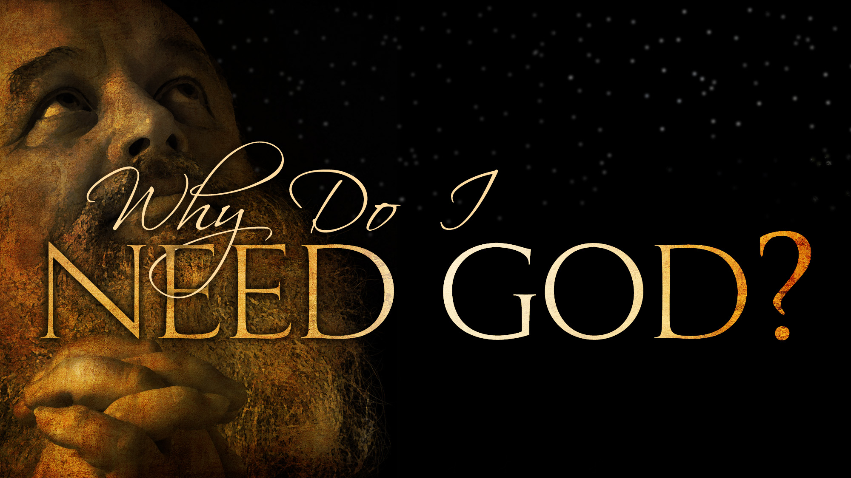

Slide 3
Righteous Wicked
Good Bad
Honest Dishonest
Saved Lost

Slide 4
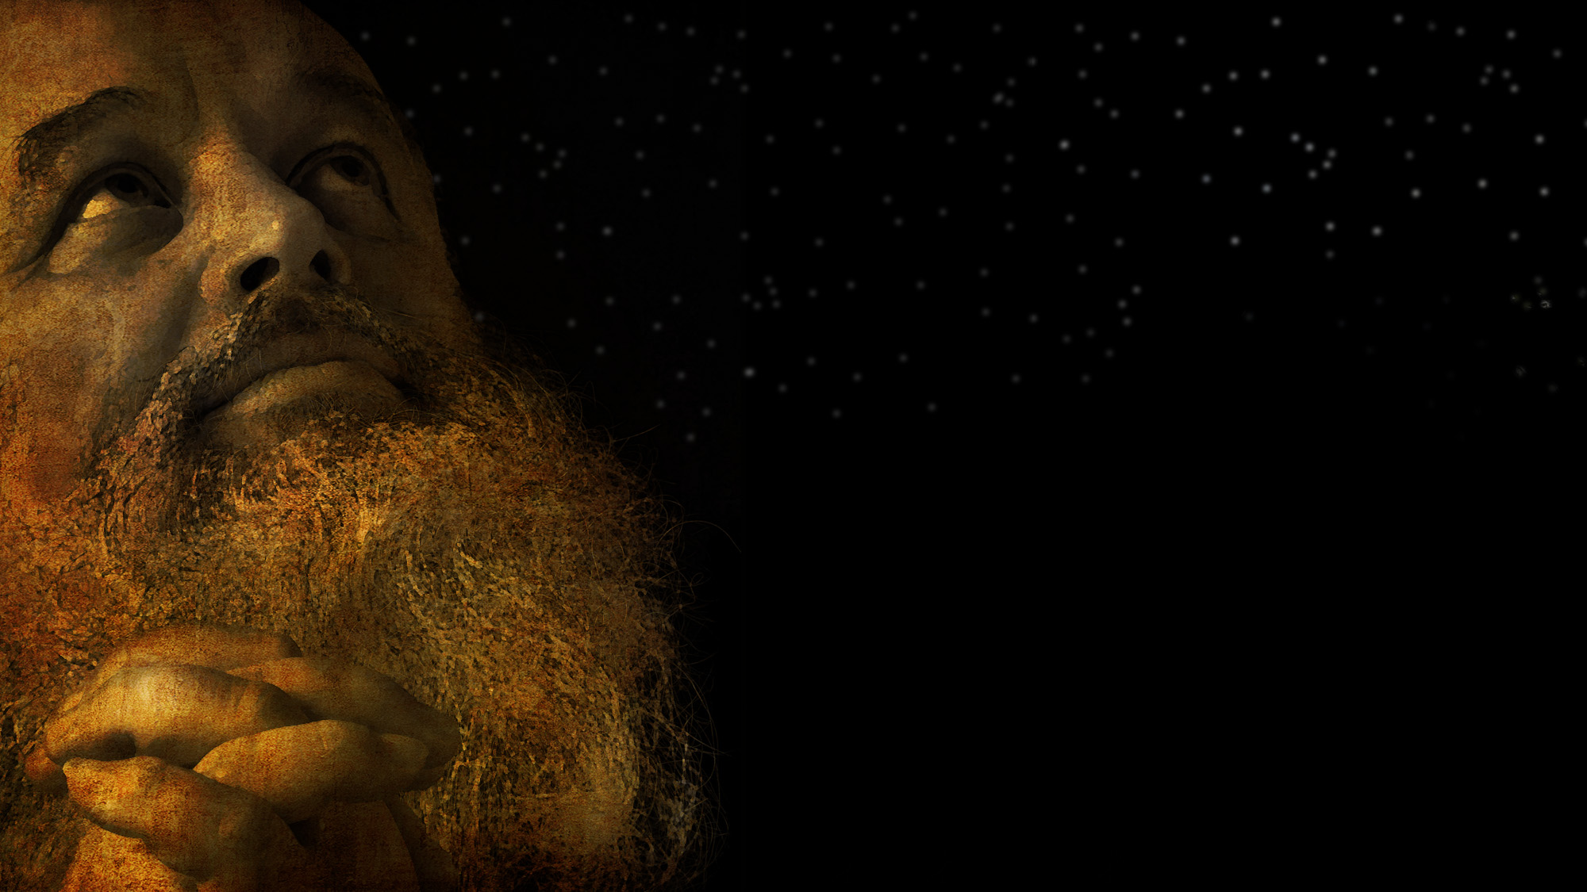
Salvation

Slide 5
Forgiveness of the Wicked Recognized
Jews on Pentecost (Acts 2)
The Corinthians (Acts 18)
Simon the Sorcerer (Acts 8)
Saul of Tarsus (Paul)

Slide 6
But “Good” People Need Forgiveness, Too!
Ethiopian (Acts 8)
Cornelius (Acts 10)
Ephesian Disciples (Acts 19)

Slide 7
The Ephesian Disciples
Acts 19:1-7 “And it came about that while Apollos was at Corinth, Paul having passed through the upper country came to Ephesus, and found some disciples, ² and he said to them, “Did you receive the Holy Spirit when you believed?” And they said to him, “No, we have not even heard whether there is a Holy Spirit.” ³ And he said, “Into what then were you baptized?” And they said, “Into John’s baptism...

Slide 8
⁴ And Paul said, “John baptized with the baptism of repentance, telling the people to believe in Him who was coming after him, that is, in Jesus.” ⁵ And when they heard this, they were baptized in the name of the Lord Jesus. ⁶ And when Paul had laid his hands upon them, the Holy Spirit came on them, and they began speaking with tongues and prophesying. ⁷ And there were in all about twelve men.”
They needed to be baptized for the right reason!

Slide 9
Why you must be Baptized…
To flee the wrath of God (Mt. 3:7)
To acknowledge God as just (Lk. 7:29)
To accept the council of God (Lk. 7:30)
To be born again (Jn. 3:5)
To unite with the name of Father, Son & Holy Spirit (Mt. 28:19)
To become a child of God (Gal. 3:26-27)
To cloth yourself with Christ (Gal. 3:26-27)
To enter into Christ (Gal. 3:27; 1 Cor. 12:13)
To have your sins forgiven (Acts 2:38; 22:16)
To benefit from Christ’s death (Rom. 6:3-4)
To contact the blood of Christ (Rom 6:3-4; Jn. 19:34
To be resurrected to a new life (Rom. 6:4)
To have a clean conscience (1 Pet. 3:21)
To be Saved (1 Pet. 3:21; Mk 16:16)
To obey God’s commands (Acts 10:48; Mk. 16:16)
To be added to Christ’s church (Acts 2:41,47)

Slide 10
We must die in order to be made alive
2 Timothy 2:11 “This is a faithful saying: For if we died with Him, We shall also live with Him.”
2 Corinthians 5:14 “For the love of Christ compels us, because we judge thus: that if One died for all, then all died.”
Romans 7:4 “Therefore, my brethren, you also have become dead to the law through the body of Christ.”
Colossians 3:3 “For you died, and your life is hidden with Christ in God.”
Colossians 2:20 “Therefore, if you died with Christ from the basic principles of the world, why, as though living in the world, do you subject yourselves to regulations.”
Romans 6:6 “…knowing this, that our old man was crucified with Him, that the body of sin might be done away with, that we should no longer be slaves of sin.”
1 Peter 2:24 “…who Himself bore our sins in His own body on the tree, that we, having died to sins, might live for righteousness - by whose stripes you were healed.”
When do we die?

Slide 11
Romans 6:3-11 “Or do you not know that as many of us as were baptized into Christ Jesus were baptized into His death? Therefore we were buried with Him through baptism into death, that just as Christ was raised from the dead by the glory of the Father, even so we also should walk in newness of life. For if we have been united together in the likeness of His death, certainly we also shall be in the likeness of His resurrection, knowing this, that our old man was crucified with Him, that the body of sin might be done away with, that we should no longer be slaves of sin...

Slide 12
For he who has died has been freed from sin. Now if we died with Christ, we believe that we shall also live with Him, knowing that Christ, having been raised from the dead, dies no more. Death no longer has dominion over Him. For the death that He died, He died to sin once for all; but the life that He lives, He lives to God. Likewise you also, reckon yourselves to be dead indeed to sin, but alive to God in Christ Jesus our Lord.
-Romans 6:3-11

Slide 13
Why Do the Good Need Forgiveness?
Romans 3:9,10,23
“What then? Are we better than they? Not at all; for we have already charged that both Jews and Greeks are all under sin; ¹⁰ as it is written, “There is none righteous, not even one.”
3:23 “for all have sinned and fallen short of the glory of God.”

Slide 14
To the Wicked: You are lost without Christ!
“Good” People:
You, too, are lost without Christ!

