Slide 2
Creation
The Flood
Patriarchs
Exodus from Egypt
Wilderness Wanderings
Conquest of Canaan
Judges
United Kingdom
Divided Kingdom
Judah Alone
Babylonian Captivity
Return from Captivity
STORY of
the OLD
TESTAMENT

Slide 3
Creation
The Flood
Patriarchs
Exodus from Egypt
Wilderness Wanderings
Conquest of Canaan
Judges
United Kingdom
Divided Kingdom
Judah Alone
Babylonian Captivity
Return from Captivity
STORY of
the OLD
TESTAMENT

Slide 4
“The Lord your God will clear away these nations before you little by little; you will not be able to put an end to them quickly, for the wild beasts would grow too numerous for you.”
(Deuteronomy 7:22)
Judges
Judges; Ruth; 1Samuel 1-7

Slide 5
Why Judges were needed, Judges 1.1-3.6
Judges
Judges; Ruth; 1Samuel 1-7

Slide 6
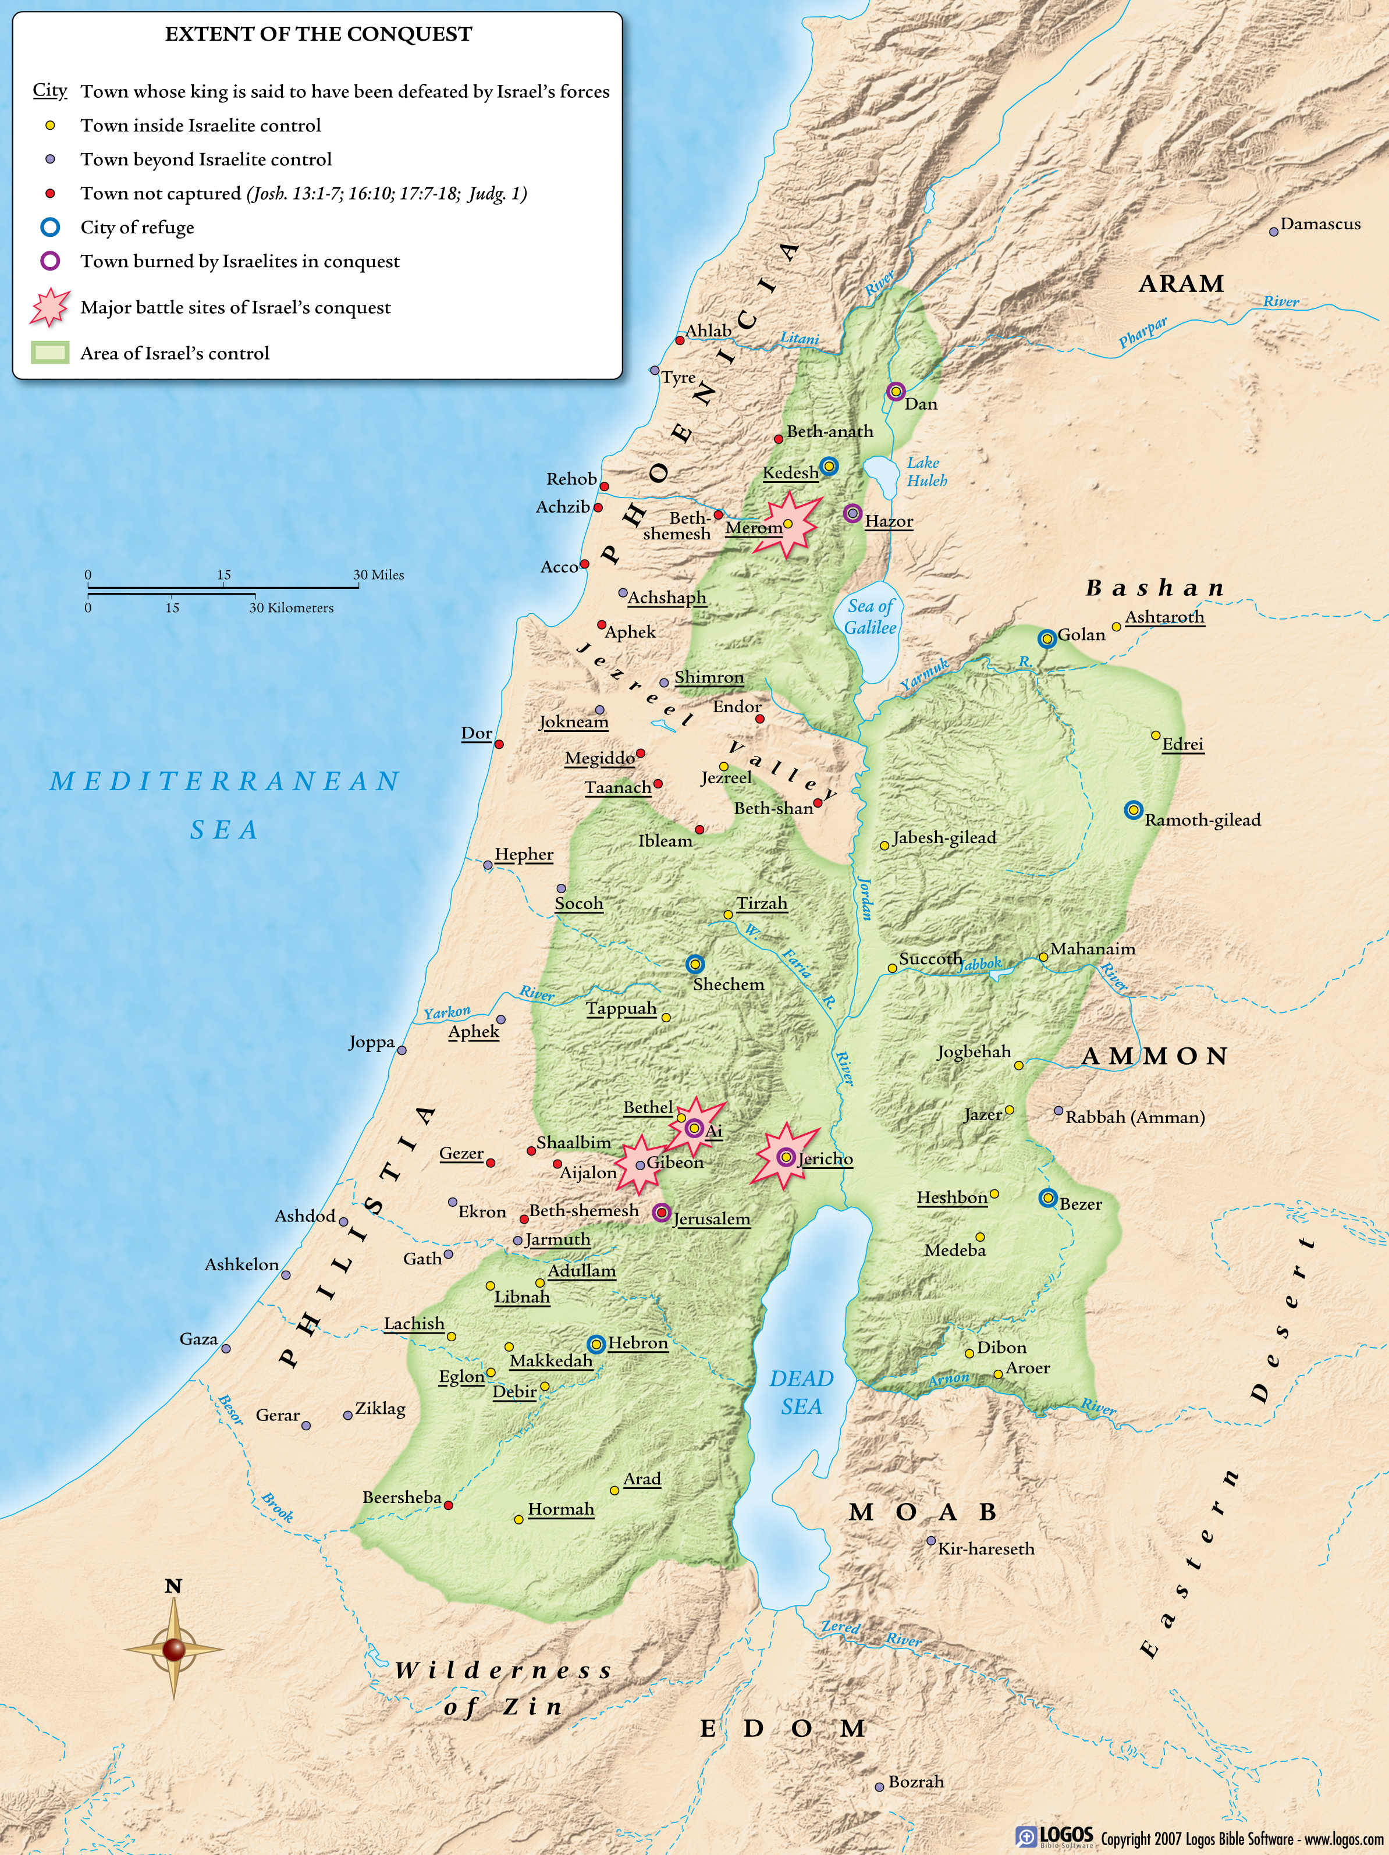
Judges
Judges; Ruth; 1Samuel 1-7

Slide 7
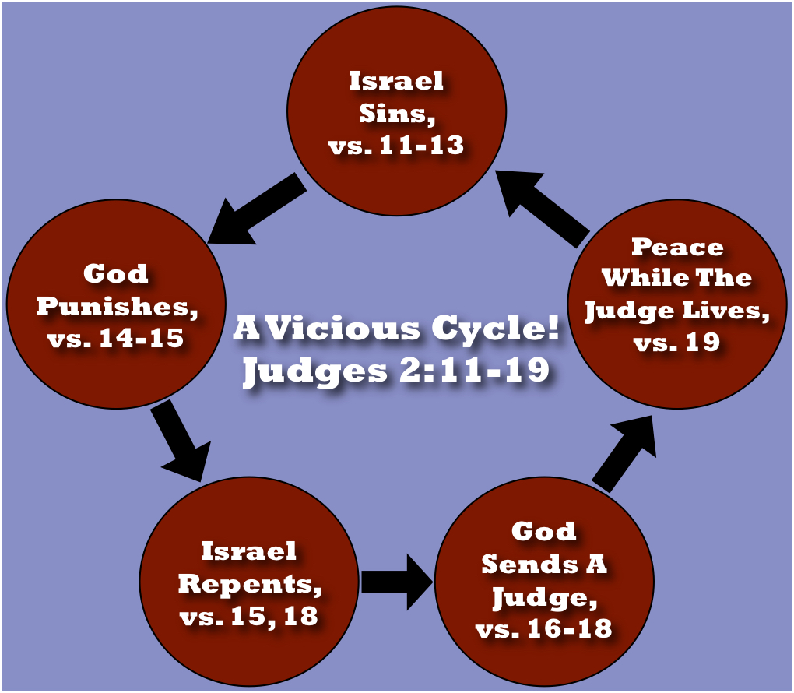
Judges
Judges; Ruth; 1Samuel 1-7

Slide 8
Why Judges were needed, Judges 1.1-3.6
The Judges, Judges 3.7-16.31; 1Samuel 1-7
Judges
Judges; Ruth; 1Samuel 1-7

Slide 9
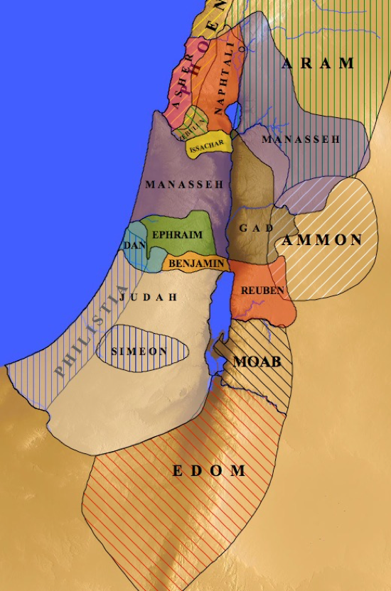
Judges
Judges; Ruth; 1Samuel 1-7

Slide 10
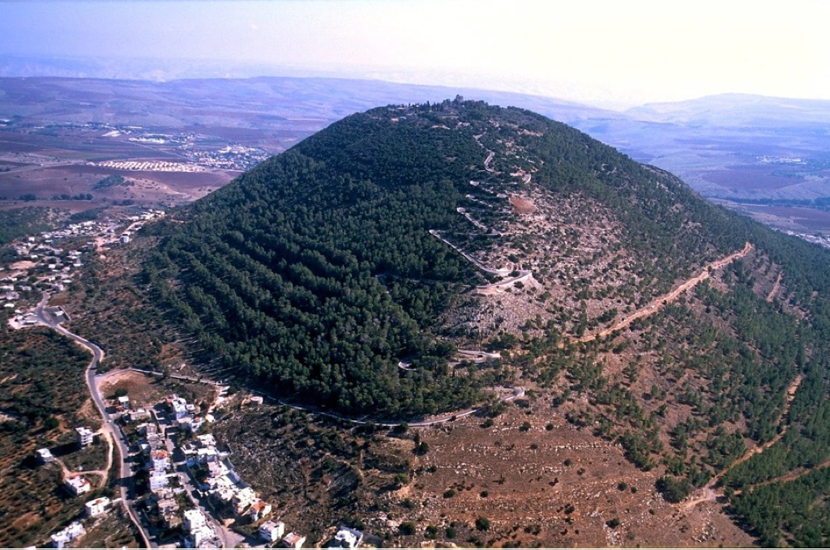
Judges
Judges; Ruth; 1Samuel 1-7

Slide 11
Judges
Judges; Ruth; 1Samuel 1-7

Slide 12
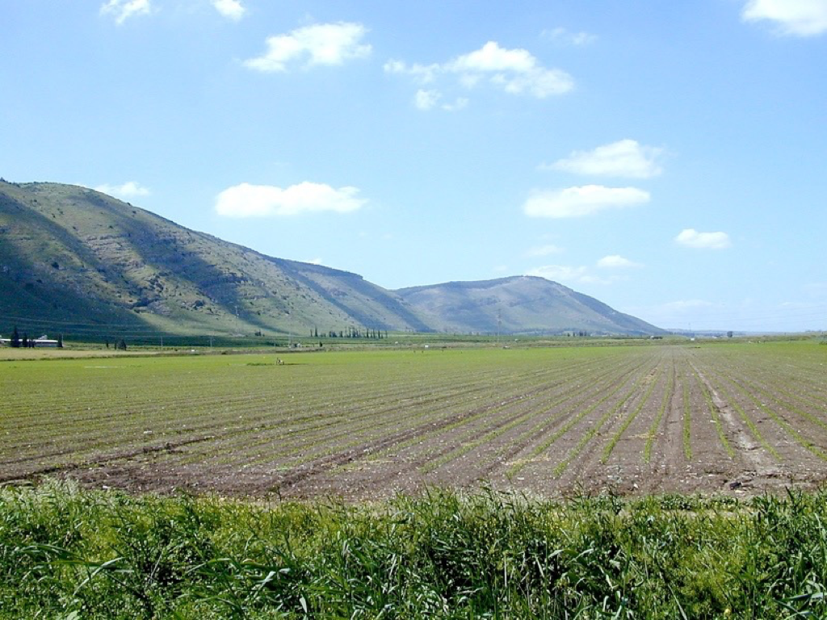
Judges
Judges; Ruth; 1Samuel 1-7

Slide 13
Judges
Judges; Ruth; 1Samuel 1-7

Slide 14
Why Judges were needed, Judges 1.1-3.6
The Judges, Judges 3.7-16.31; 1Samuel 1-7
Description of Israel when they did what was right in their own eyes, Judges 17-21
Ruth and how she fits in the Biblical story, Ruth
Judges
Judges; Ruth; 1Samuel 1-7

