Slide 2
Creation
The Flood
Patriarchs
Exodus from Egypt
Wilderness Wanderings
Conquest of Canaan
Judges
United Kingdom
Divided Kingdom
Judah Alone
Babylonian Captivity
Return from Captivity
STORY of
the OLD
TESTAMENT

Slide 3
Creation
The Flood
Patriarchs
Exodus from Egypt
Wilderness Wanderings
Conquest of Canaan
Judges
United Kingdom
Divided Kingdom
Judah Alone
Babylonian Captivity
Return from Captivity
STORY of
the OLD
TESTAMENT

Slide 4
United Kingdom
1Samuel 8 – 1Kings 11; 1Chron. 10 – 2Chron. 9
“In those days there was no king in Israel; every man did what was right in his own eyes.”
(Judges 17:6)

Slide 5
United Kingdom
1Samuel 8 – 1Kings 11; 1Chron. 10 – 2Chron. 9
“Behold, you have grown old, and your sons do not walk in your ways. Now appoint a king for us to judge us like all the nations.”
(1 Samuel 8:5)

Slide 6
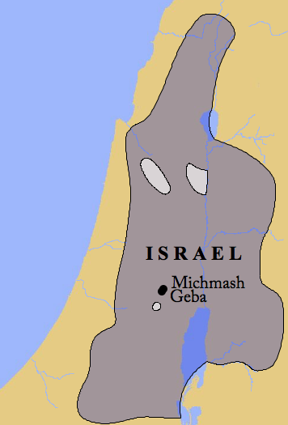
United Kingdom
1Samuel 8 – 1Kings 11; 1Chron. 10 – 2Chron. 9

Slide 7
“Listen to the voice of the people in regard to all that they say to you, for they have not rejected you, but they have rejected Me from being king over them.”
(1 Samuel 8:7)
United Kingdom
1Samuel 8 – 1Kings 11; 1Chron. 10 – 2Chron. 9

Slide 8
He Looked The Part Of King (1Samuel 10.23-24)
He Achieved Military Success (1Samuel 14.47)
He Did Things His Way (1Samuel 13.8-9; 15.1-9)
He Was Jealous For Power (1Samuel 18.8-11)
Saul: The Typical King
1Samuel 8-31; 1Chron. 10

Slide 9
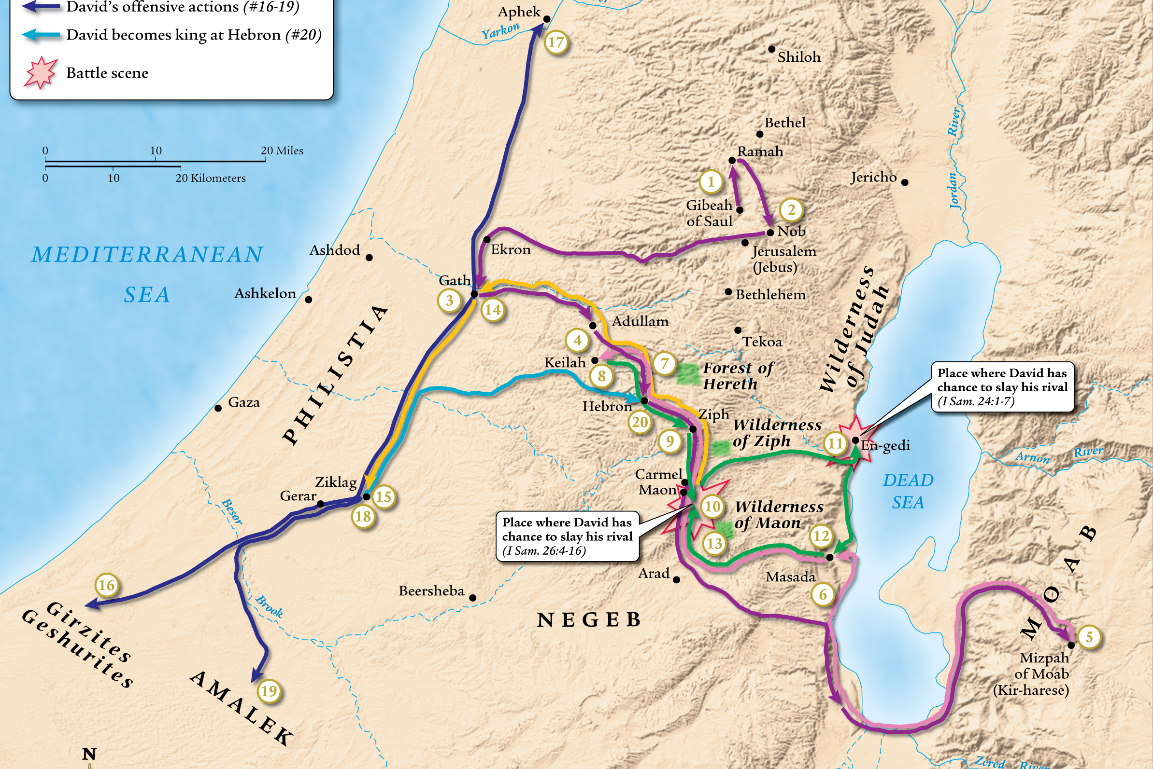
Saul: The Typical King
1Samuel 8-31; 1Chron. 10

Slide 10
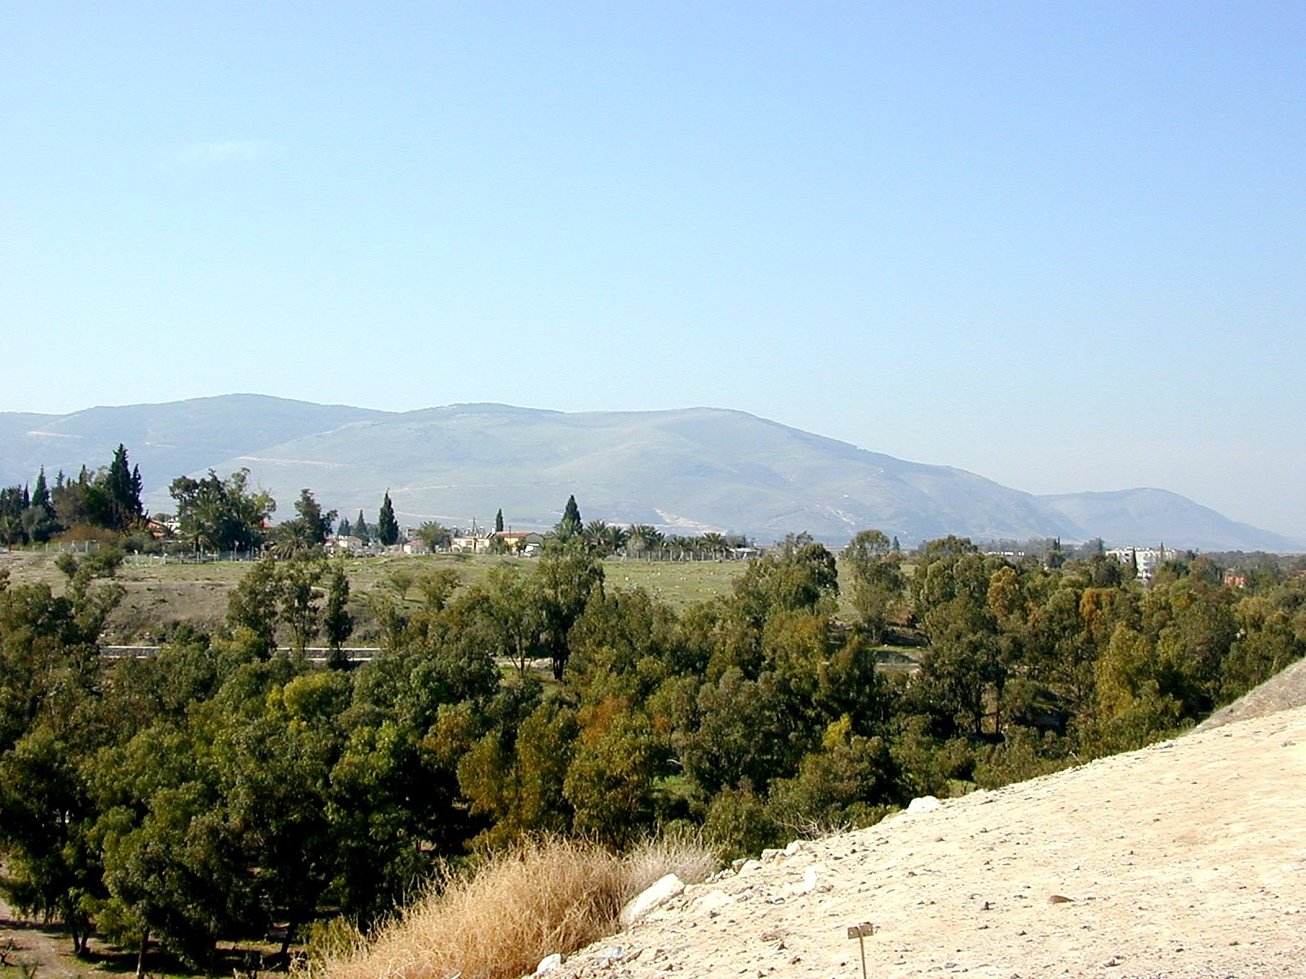
Saul: The Typical King
1Samuel 8-31; 1Chron. 10

Slide 11
Trusted God Completely (1Samuel 17.34-37,45-47)
Made God’s Will, His Will (Psalm19.7-14)
Concerned With The Lord’s House (2Samuel 6-7)
Interested In The Spread Of The Kingdom (Psalm 2)
David: King After God’s Own Heart
2Samuel; 1Chron. 11-29

Slide 12
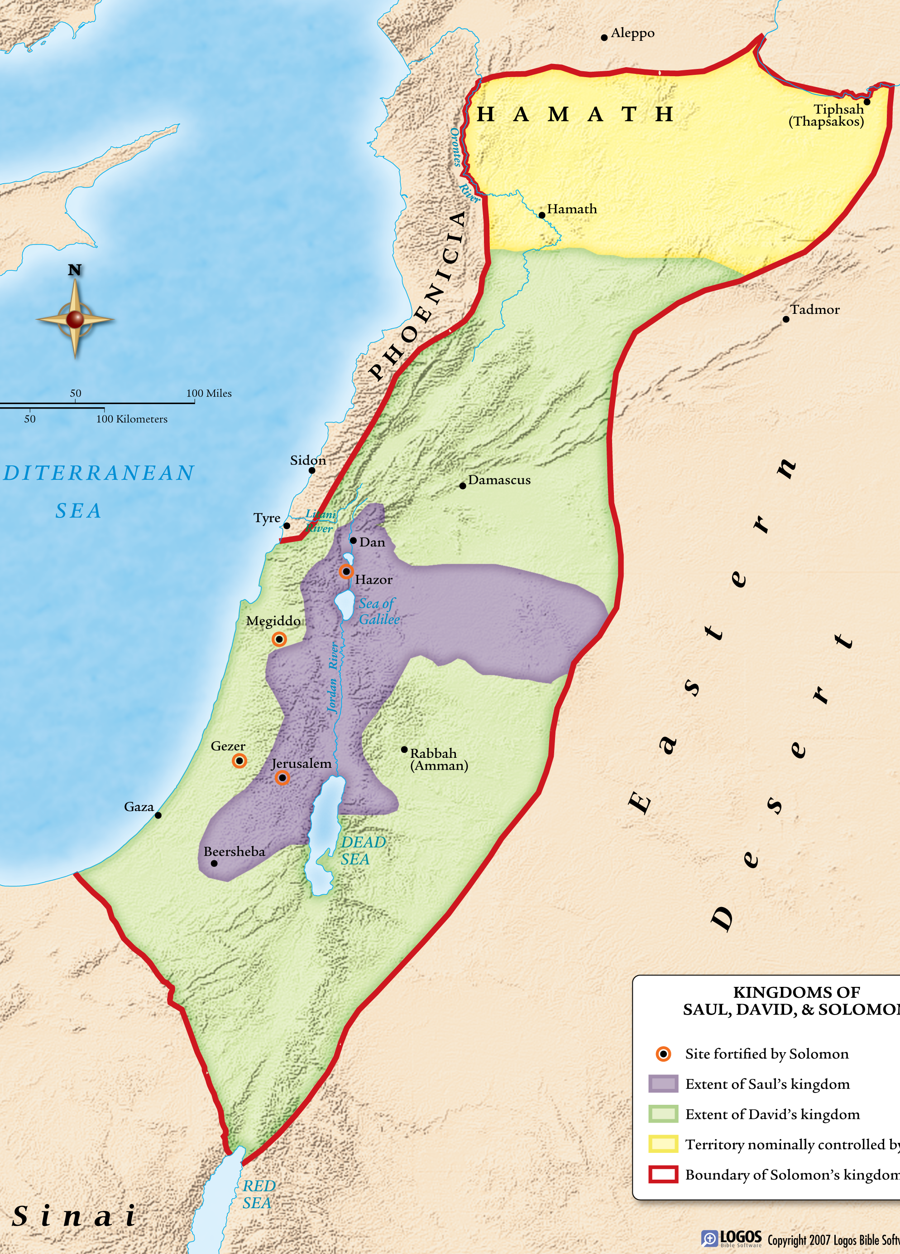
David: King After God’s Own Heart
2Samuel; 1Chron. 11-29

Slide 13
Trusted God Completely (1Samuel 17.34-37,45-47)
Made God’s Will, His Will (Psalm19.7-14)
Concerned With The Lord’s House (2Samuel 6-7)
Interested In The Spread Of The Kingdom (Psalm 2)
When Wrong, Truly Repented (2Samuel 12.13; Psalm 32; 51)
David: King After God’s Own Heart
2Samuel; 1Chron. 11-29

Slide 14
Sought Wisdom From God (1Kings 3)
Exercised Godly Wisdom At Times (1Kings 3.15-28; 8)
Substituted Worldly Wisdom
In Securing The Throne (1Kings 2)
In Oppressing The People (1Kings 12.4)
Solomon: The “Wise” King
1Kings 1-11; 2Chron. 1-9

Slide 15
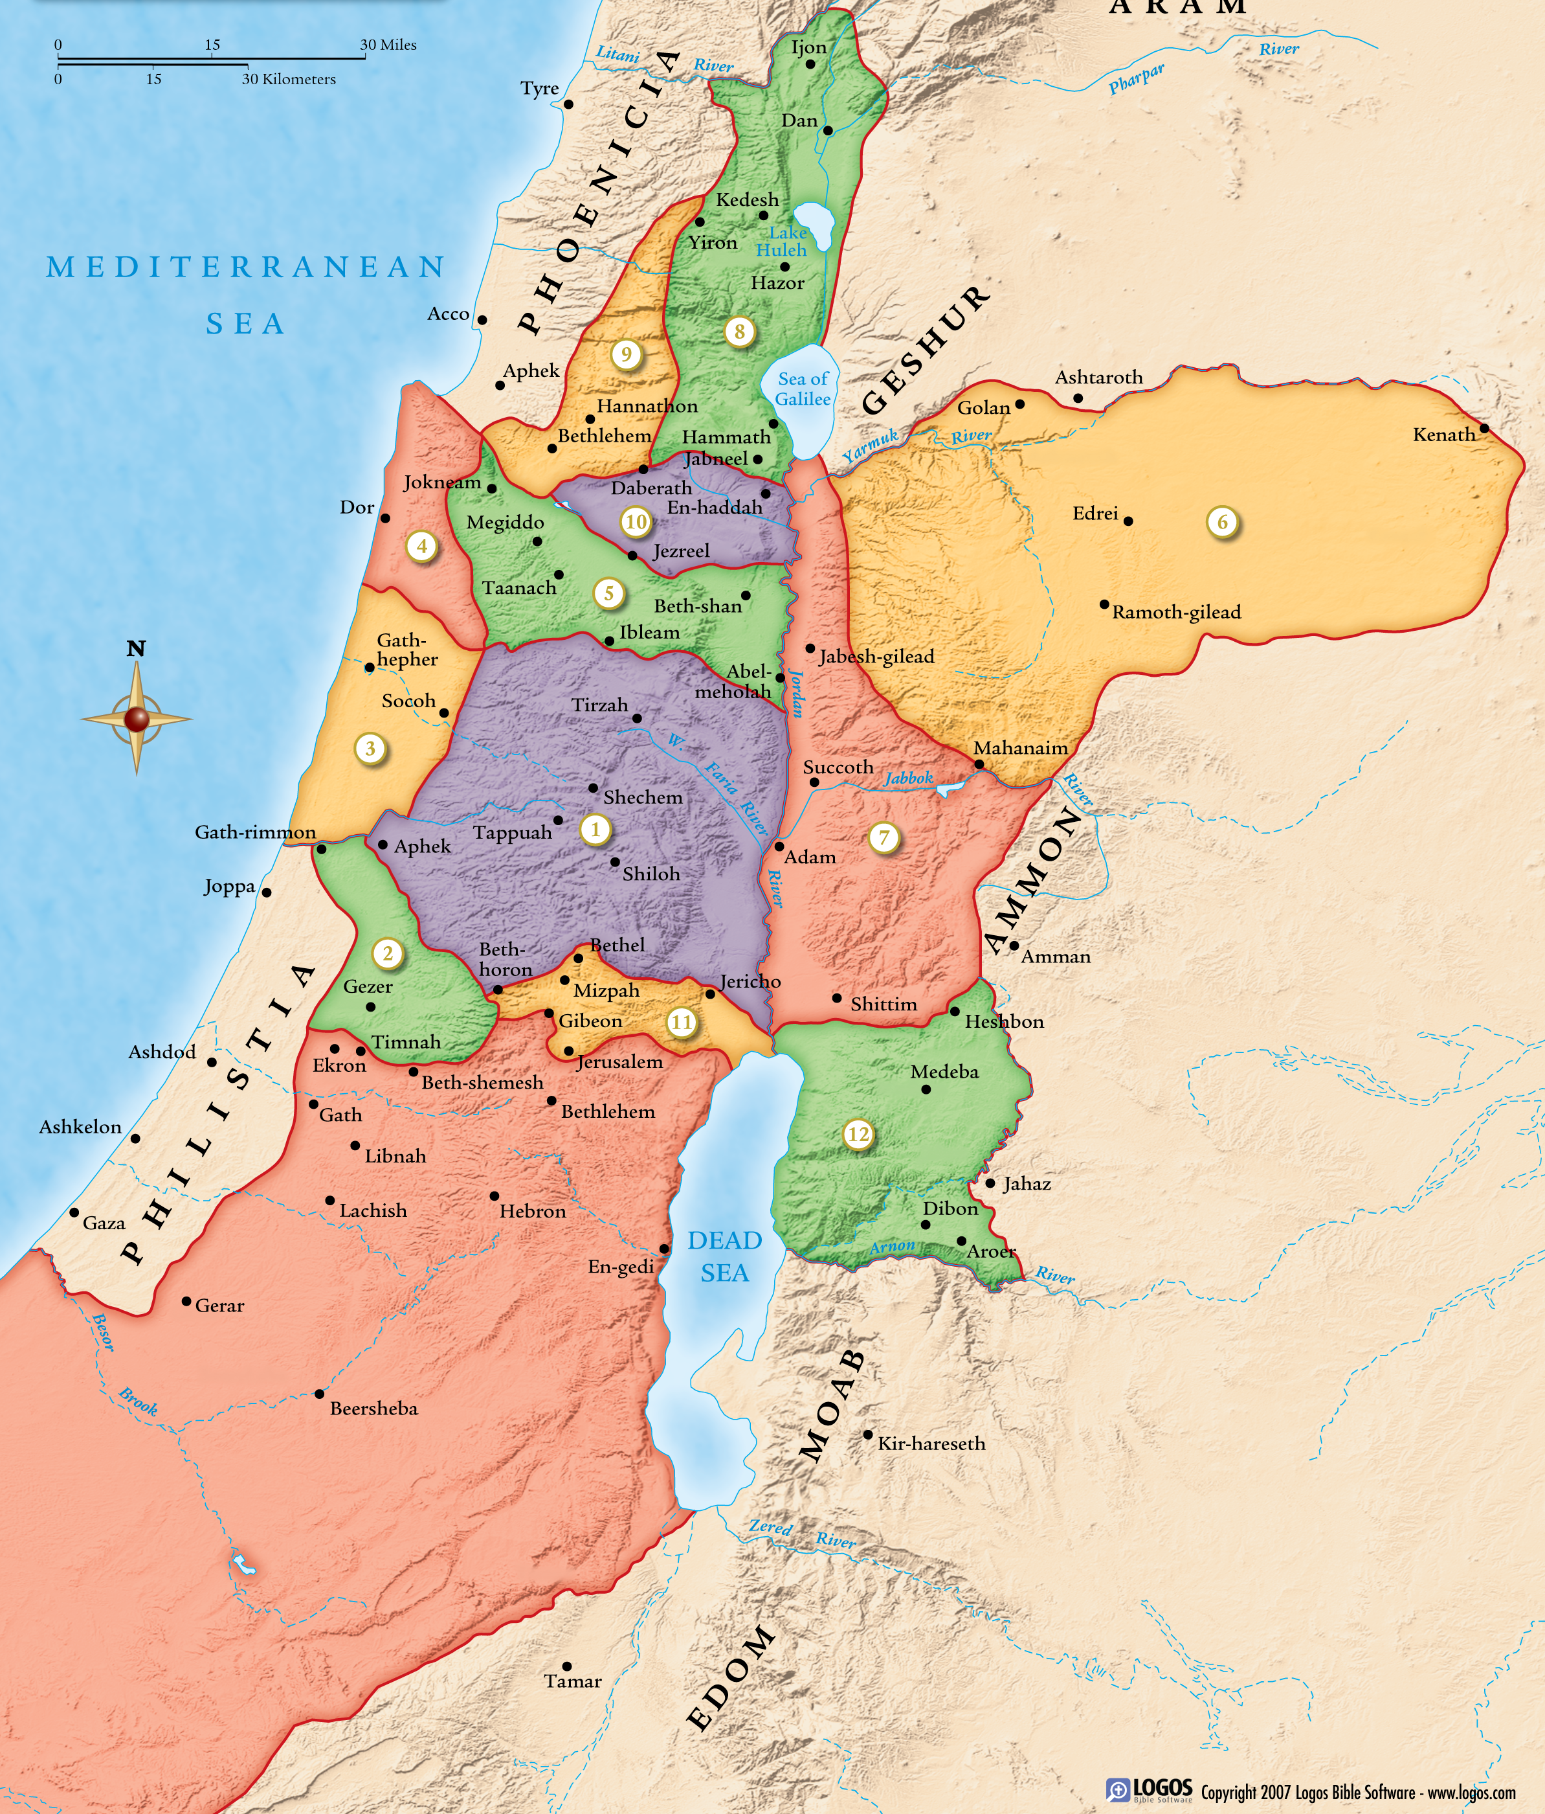
Solomon: The “Wise” King
1Kings 1-11; 2Chron. 1-9

Slide 16
Sought Wisdom From God (1Kings 3)
Exercised Godly Wisdom At Times (1Kings 3.15-28; 8)
Substituted Worldly Wisdom
In Securing The Throne (1Kings 2)
In Oppressing The People (1Kings 12.4)
In Marriage Alliances (1Kings 3.1; 11.1-3)
Solomon: The “Wise” King
1Kings 1-11; 2Chron. 1-9

Slide 17
Complete Trust In God (Matt. 4.1-11)
Made God’s Will, His Will (Matt. 26.39,42)
Concerned With The Lord’s House (Luke 2.49; 19.45-46; John 14.1-6)
Wanted The Kingdom To Spread (Matthew 28.18-20; John 10.16)
Desired For Sins To Be Forgiven (Matthew 20.28; Mark 16.15-16)
Jesus: Son of David

