Slide 1
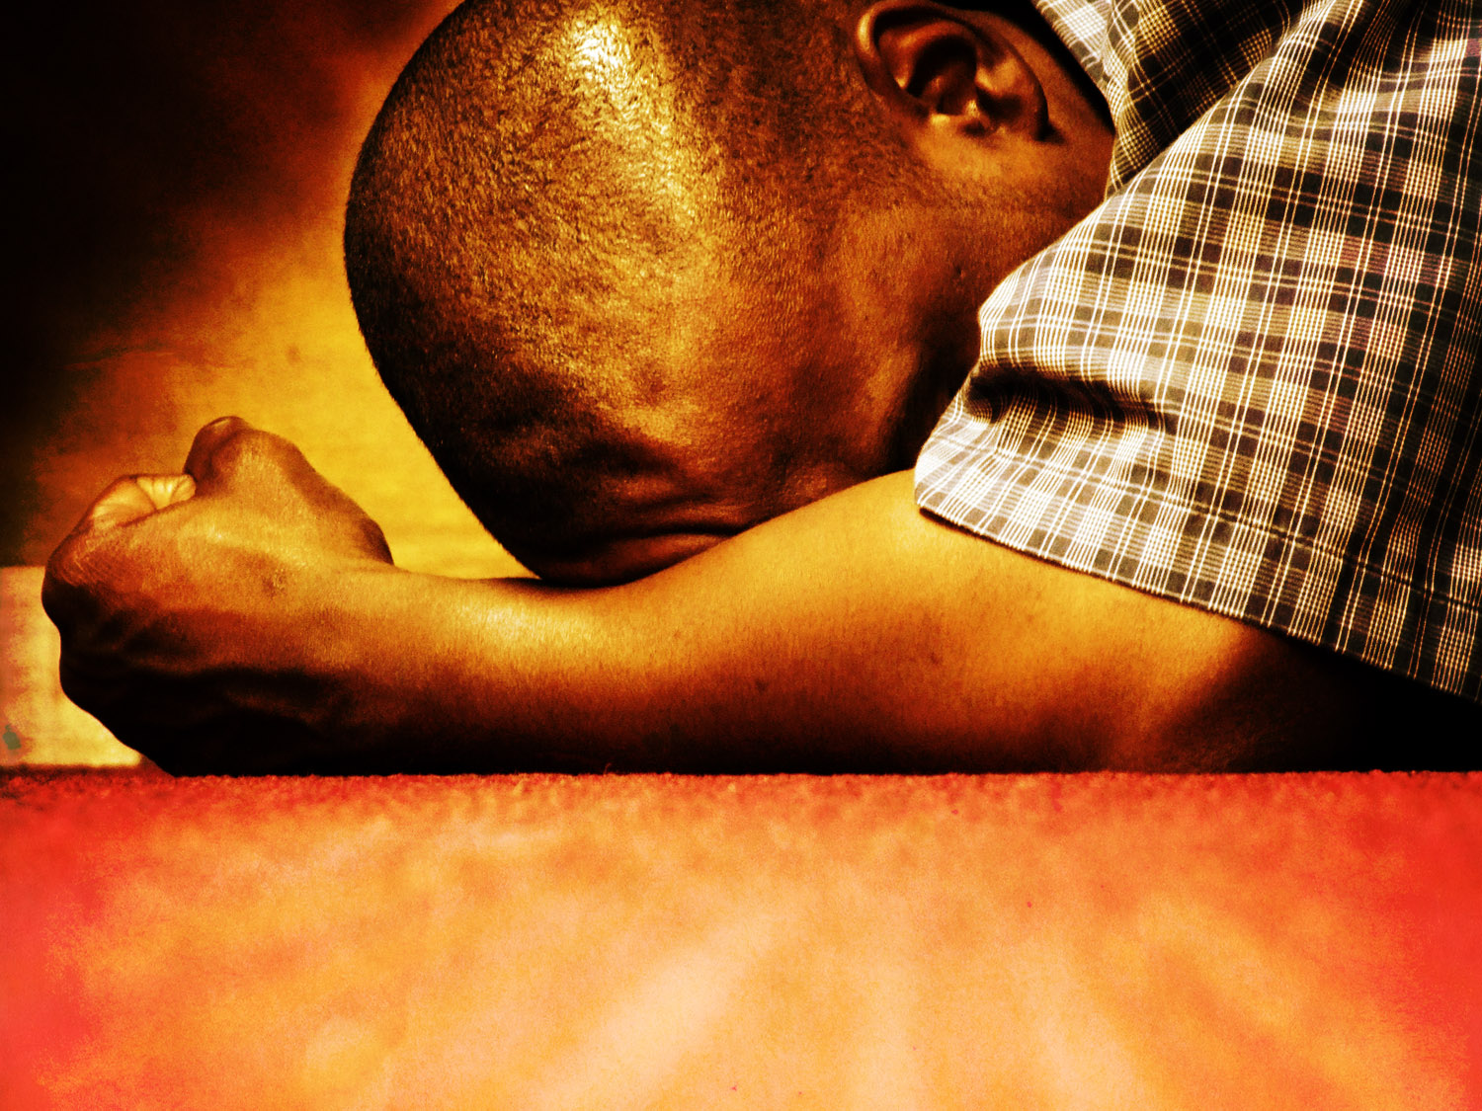
PRAYING LIKE THE PSALMISTS
Be Open, Honest, and Candid

Slide 2
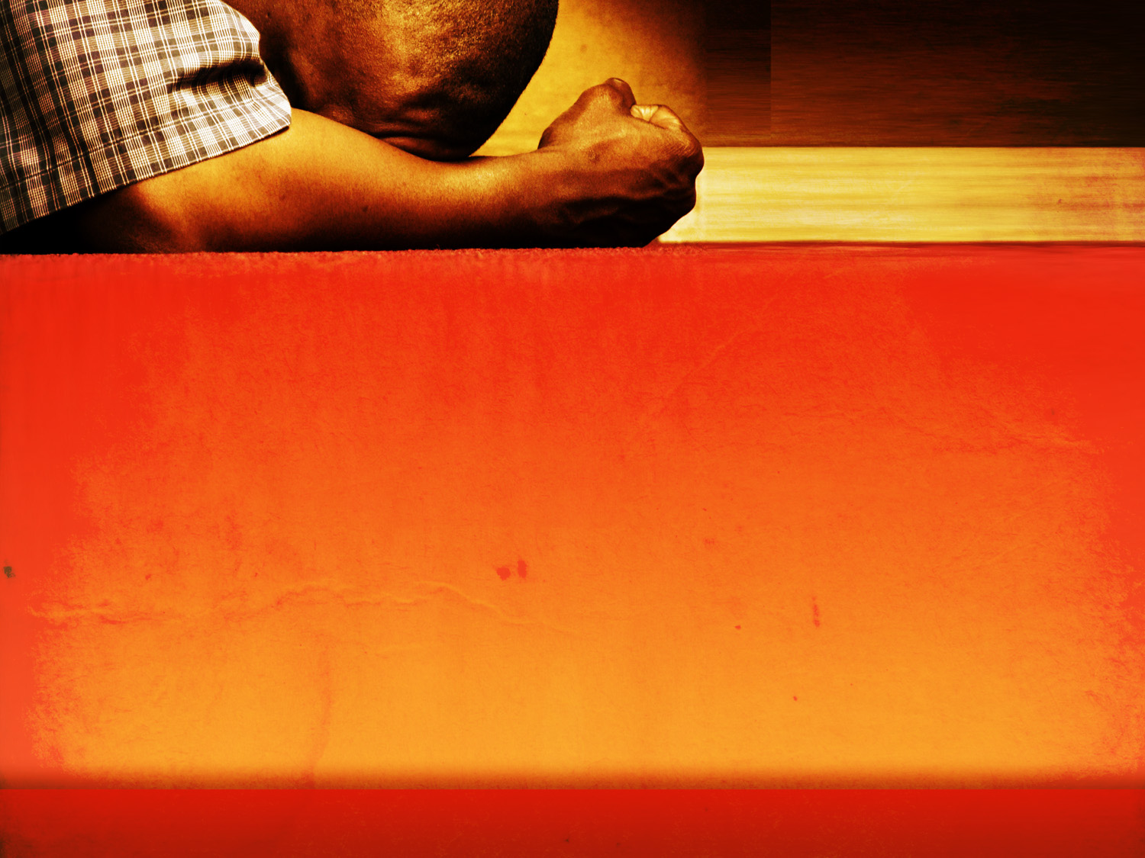
Honesty and Candor
I have chosen the words candor and candid quite deliberately. I might have used the word honest, but I have a specific image in mind…
The book of Psalms is full of candid pictures. It seems never to give us a posed shot. Instead, the psalms show us the writer just as he or she felt at a particular moment. This is one of the loveliest gifts of the book of Psalms. The Bible has preserved for us pictures of saints in some of their least saintly moments.
(J. Ellsworth Kalas, Longing to Pray, p 18).

Slide 3
Honesty and Candor
If I had written some of the psalms, I would have left behind a request: “Please destroy this after I’m gone.” But the Scriptures have saved these pictures. We are privileged to see the spiritual giants who wrote the psalms, not in portraits of their spiritual finery, but in the rags of their candid struggles
(J. Ellsworth Kalas, Longing to Pray, p 18).

Slide 4
Honesty and Candor
Note that the Psalms thus propose to speak about human experience in an honest, freeing way. This is in contrast to much human speech and conduct which is in fact a cover-up. In most arenas where people live, we are expected and required to speak the language of safe orientation and equilibrium, either to find it so or to pretend we find it so. For the normal, conventional functioning of public life, the raw edges of disorientation and reorientation must be…
(Walter Brueggemann, Praying the Psalms, pp 19-20).

Slide 5
Honesty and Candor
…denied or suppressed for purposes of public equilibrium. As a result, our speech is dulled and mundane. Our passion has been stilled and is without imagination. And mostly the Holy One is not addressed, not because we dare not, but because God is far away and hardly seems important. This means that the agenda and intention of the Psalms is considerably at odds with the normal speech of most people, the normal speech of a stable, functioning, self-deceptive culture in which every thing must be kept running young and smooth…
(Praying the Psalms, pp 19-20)

Slide 6
Honesty and Candor
Against that, the speech of the Psalms is abrasive, revolutionary, and dangerous. It announces that life is not like that, that our common experience is not one of well-being and equilibrium, but a churning, disruptive experience of dislocation and relocation. Perhaps in our conventional, routinized prayer life (e.g., the daily practice of the office) that is one of the reasons the Psalter does not yield its power—because out of habit or fatigue or numbness, we try to use the Psalms in our equilibrium.
(Praying the Psalms, pp 19-20).

Slide 7
Honesty and Candor
And when we do that, we miss the point of the Psalms. Moreover, our own experience may be left untapped and inarticulate and therefore not liberated. Such surface use of the Psalms coincides with the denial of the discontinuities in our own experience. Ernest Becker has written of The Denial of Death. But such denial happens not just at the crisis points. It happens daily in the reduction of language to numb conventions.
(Praying the Psalms, pp 19-20).

Slide 8
Honesty and Candor
Thus I suggest that most of the Psalms can only be appropriately prayed by people who are living at the edge of their lives, sensitive to raw hurts, the primitive passions, and the naïve elations that are at the bottom of our life. For most of us, liturgical or devotional entry into the Psalms requires a real change of pace. It asks us to depart from our closely managed world of public survival, to move into the open, frightening, healing world of speech with the Holy One.
(Walter Brueggemann, Praying the Psalms, pp 19-20)

Slide 9
Honesty and Candor
We are allowed to feel
Be candid with God about your feelings

Slide 10
Gladness
Therefore my heart will be glad, and my whole being rejoices; my flesh also dwells secure. For you will not abandon my soul to Sheol, or let your holy one see corruption. You make known to me the path of life; in your presence there is fullness of joy; at your right hand are pleasures forevermore
Psalm 16:9-11

Slide 11
Sadness
My wounds stink and fester because of my foolishness, I am utterly bowed down and prostrate; all the day I go about mourning. For my sides are filled with burning, and there is no soundness in my flesh. I am feeble and crushed; I groan because of the tumult of my heart. O Lord, all my longing is before you; my sighing is not hidden from you. My heart throbs; my strength fails me, and the light of my eyes—it also has gone from me.
Psalm 38:5-10

Slide 12
Hurt
Malicious witnesses rise up; they ask me of things that I do not know. They repay me evil for good; my soul is bereft. But I, when they were sick—I wore sackcloth; I afflicted myself with fasting…as one who laments his mother, I bowed down in mourning.
Psalm 35:11-14

Slide 13
Loneliness
Lord, why do you cast my soul away? Why do you hide your face from me?...You have caused my beloved and my friend to shun me; my companions have become darkness.
Psalm 88:14, 18

Slide 14
Anger
Remember, O Lord, against the Edomites the day of Jerusalem, how they said, ‘Lay it bare, lay it bare, down to its foundations!’ O daughter of Babylon, doomed to be destroyed, blessed shall he be who repays you with what you have done to us! Blessed shall he be who takes your little ones and dashes them against the rock!
Psalm 137:7-9

Slide 15
Fear
My heart is in anguish within me; the terrors of death have fallen upon me. Fear and trembling come upon me and horror overwhelms me.
Psalm 55:4-5

Slide 16
Guilt
For when I kept silent, my bones wasted away through my groaning all day long. For day and night your hand was heavy upon me; my strength was dried up as by the heat of summer. I acknowledged my sin to you and I did not cover my iniquity; I said, ‘I will confess my transgressions to the Lord,’ and you forgave the iniquity of my sin.
Psalm 32:3-5

Slide 17
Shame
For I know my transgressions, and my sin is ever before me. Against you, you only, have I sinned and done what is evil in your sight, so that you may be justified in your words and blameless in your judgment. Behold, I was brought forth in iniquity, and in sin did my mother conceive me.
Psalm 51:3-5

Slide 18
Honesty and Candor
We are allowed to feel
Be candid with God about your feelings
Hang on to your faith
God is big enough to handle your feelings
God will lead us to greater joy

Slide 19
Honesty and Candor
We are not surprised, then, that the Psalter does not present a systematic picture of God and his relationship to the world. The psalms give us theology written in intimate relationship with God and in close touch with life.
(Tremper Longman, How to Read the Psalms, p 53)

Slide 20
Honesty and Candor
A decided shift takes place as we move from the beginning of the book to its end. As we move toward the end, praise overtakes lament until at the very end of the book we have a virtual fireworks of praise. The last seven psalms are not only all hymns of praise but they, for the most part, concentrate on calling the whole world to praise God…
In a real sense, the book of Psalms moves us from mourning to joy. As it says in Psalm 126, “Those who sow in tears will reap with songs of joy” (v.5).
(Tremper Longman, How to Read the Psalms, p 45)

Slide 21
Honesty and Candor
We are allowed to feel
Be candid with God about your feelings
Hang on to your faith
God is big enough to handle your feelings
God will lead us to greater joy

Slide 22
PRAYING LIKE THE PSALMISTS
Be Open, Honest, and Candid

