Slide 3
Dual Nature of the Law
Religious
Civic
"...Everything in their collective and private life was connected with a revealed religion...their ordinary employments were touched at every point by divinely-appointed and significant ceremonies." -Conybeare & Howson

Slide 4
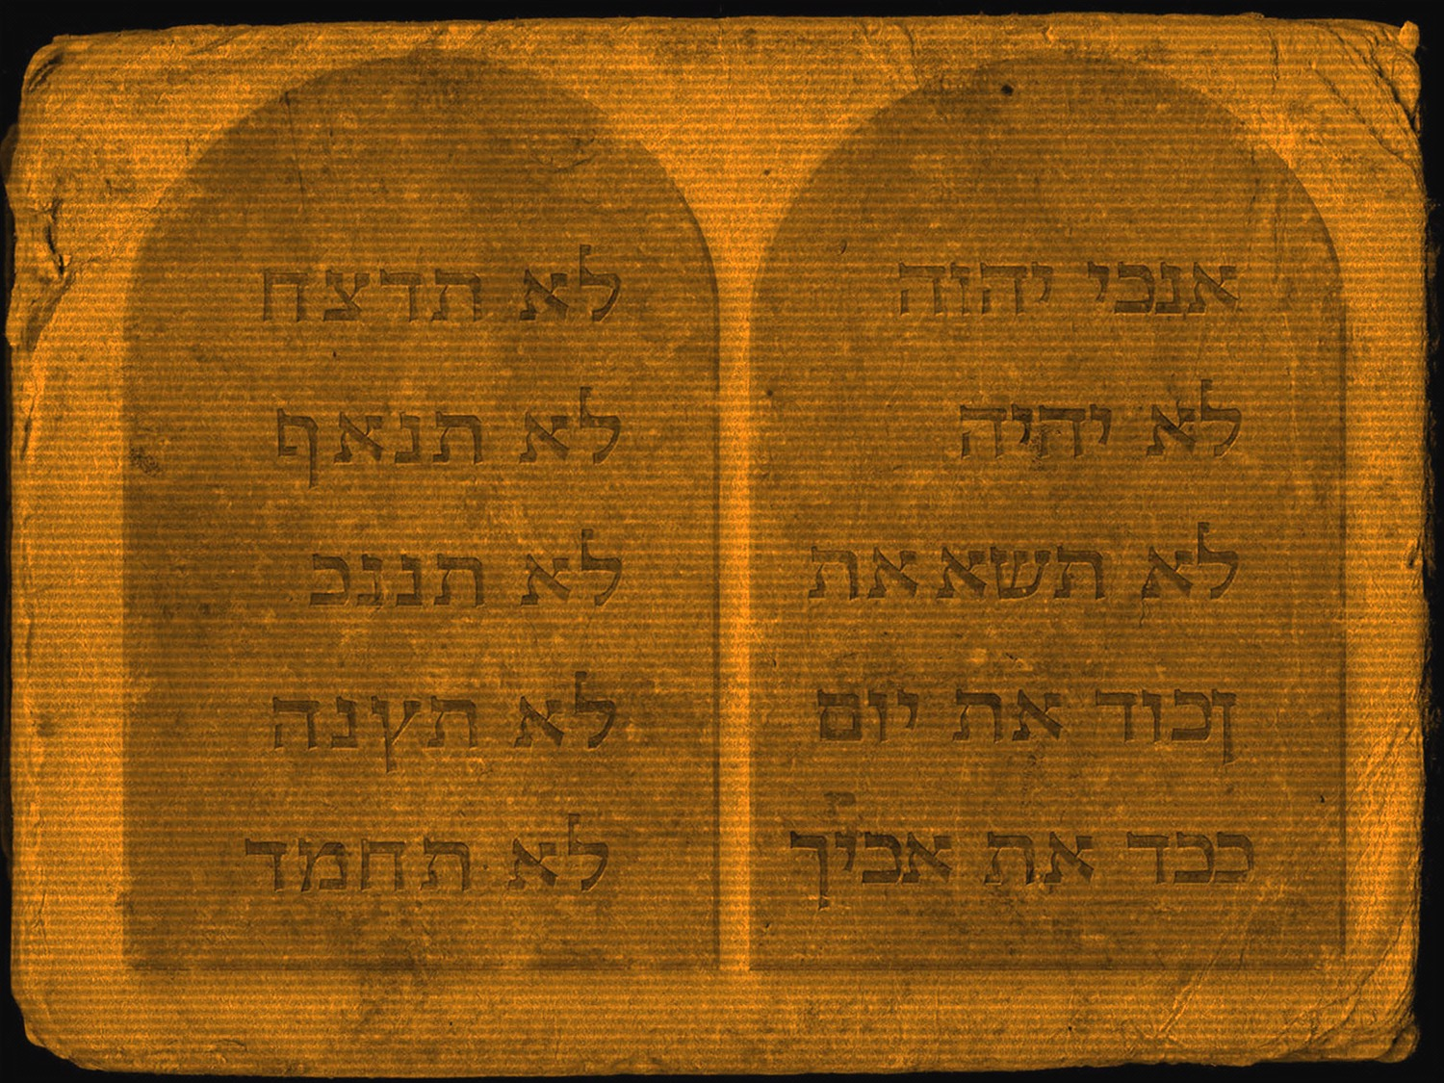
Law of Moses
The Religious Code

Slide 5
Law of Sacrifice
Regulations common to all sacrifices
Where sacrifices to be offered

Slide 6
Kinds of Offerings
Burnt Offering
Meal Offering
Peace Offering
Sin Offering

Slide 7
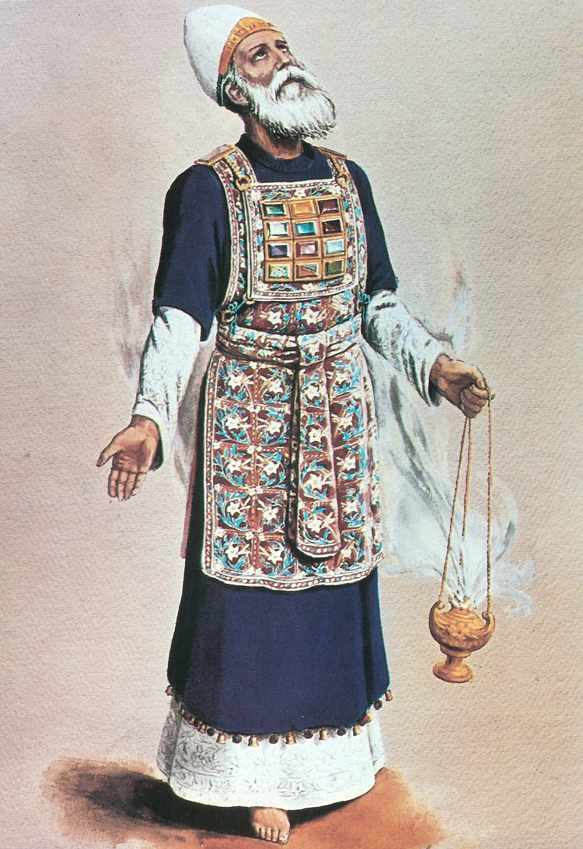
The Priesthood
The Family
The Priest’s Vestments
Priest’s Consecration
Support of the Priesthood
Law of Holiness for the Priesthood.
Law of the Levites

Slide 8
Ceremonial Uncleanness
From childbirth
From leprosy
Cured person’s ceremonial cleansing
From bodily secretion
From a dead body

