Slide 2
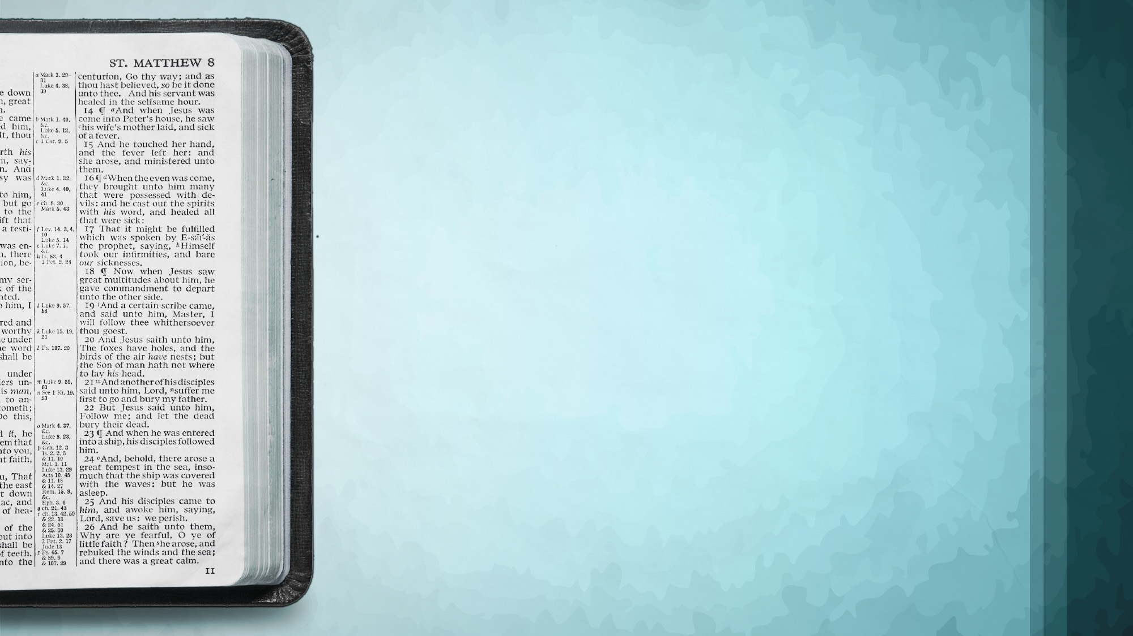
The Most Valuable Book

Slide 3
Psalm 1.1-3
BLESSED IS THE MAN:
Walks Not In the counsel of the ungodly
Nor Stands in the path of sinners
Nor Sits in the seat of the scornful
His “Delight” Is In The Law of the Lord!
BUT THE “CHAFF” ARE NOT SO! Psalm 1:4-6

Slide 4
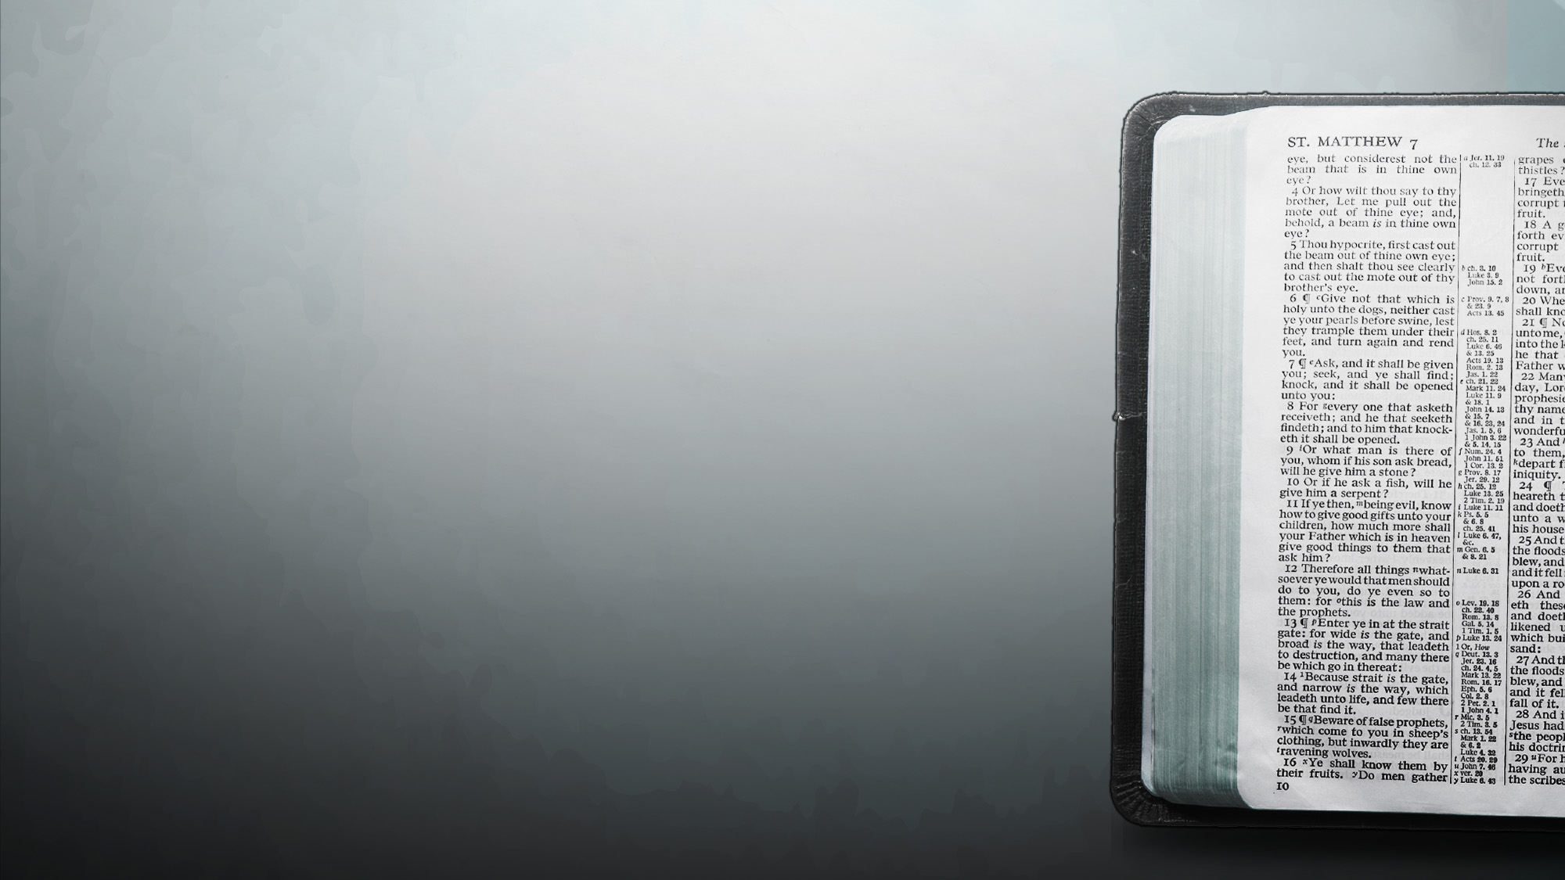
Why Believe The Bible?
Man Would Not Have Written It If He Could Of …
Man Could Not Have Written It If He Would Of…
ITS UNITY
40 Men over 1600 years, different languages
FULFILLED PROPHECY
Micah 5:2 – Jesus to be born in Bethlehem
Psalm 22:16-18 – Crucified; Cast lots for his clothing
ITS CLAIMS
1 Cor. 2:10-13 – Only way to know the mind of God
1 Tim. 3:16-17 – Will equip one for every good work

Slide 5
The Value Of The Bible
“Equipped For Every Good Work”
LIGHT
Psalm 119:105 - Your word is a lamp to my feet And a light to my path.
FOOD
1 Peter 2:2-3 - as newborn babes, desire the pure milk of the word, that you may grow thereby, if indeed you have tasted that the Lord is gracious.

Slide 6
The Value Of The Bible
“Equipped For Every Good Work”
DETERGENT
John 15:3 - You are already clean because of the word which I have spoken to you
Eph 5:26 - that He might sanctify and cleanse her with the washing of water by the word,

Slide 7
The Value Of The Bible
“Equipped For Every Good Work”
MIRROR
James 1:22-25 - But be doers of the word, and not hearers only, deceiving yourselves. 23 For if anyone is a hearer of the word and not a doer, he is like a man observing his natural face in a mirror; 24 for he observes himself, goes away, and immediately forgets what kind of man he was.

Slide 8
The Value Of The Bible
“Equipped For Every Good Work”
SWORD
Ephesians 6:17 - And take the helmet of salvation, and the sword of the Spirit, which is the word of God;
FIRE, HAMMER
Jeremiah 23:29 -"Is not My word like a fire?" says the LORD, "And like a hammer that breaks the rock in pieces?

Slide 9
The Value Of The Bible
“Equipped For Every Good Work”
BLUEPRINT
Hebrews 8:5 - who serve the copy and shadow of the heavenly things, as Moses was divinely instructed when he was about to make the tabernacle. For He said, "See that you make all things according to the pattern shown you on the mountain."

