Slide 1


Slide 2

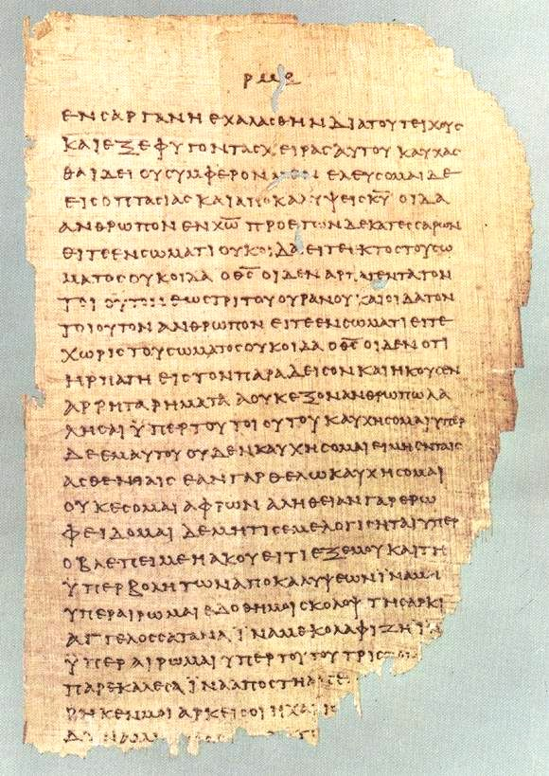
Papyrus 46
150-225 A.D
Contains most of Paul’s Letters.
2nd Cor. 11:33-12:9

Slide 3

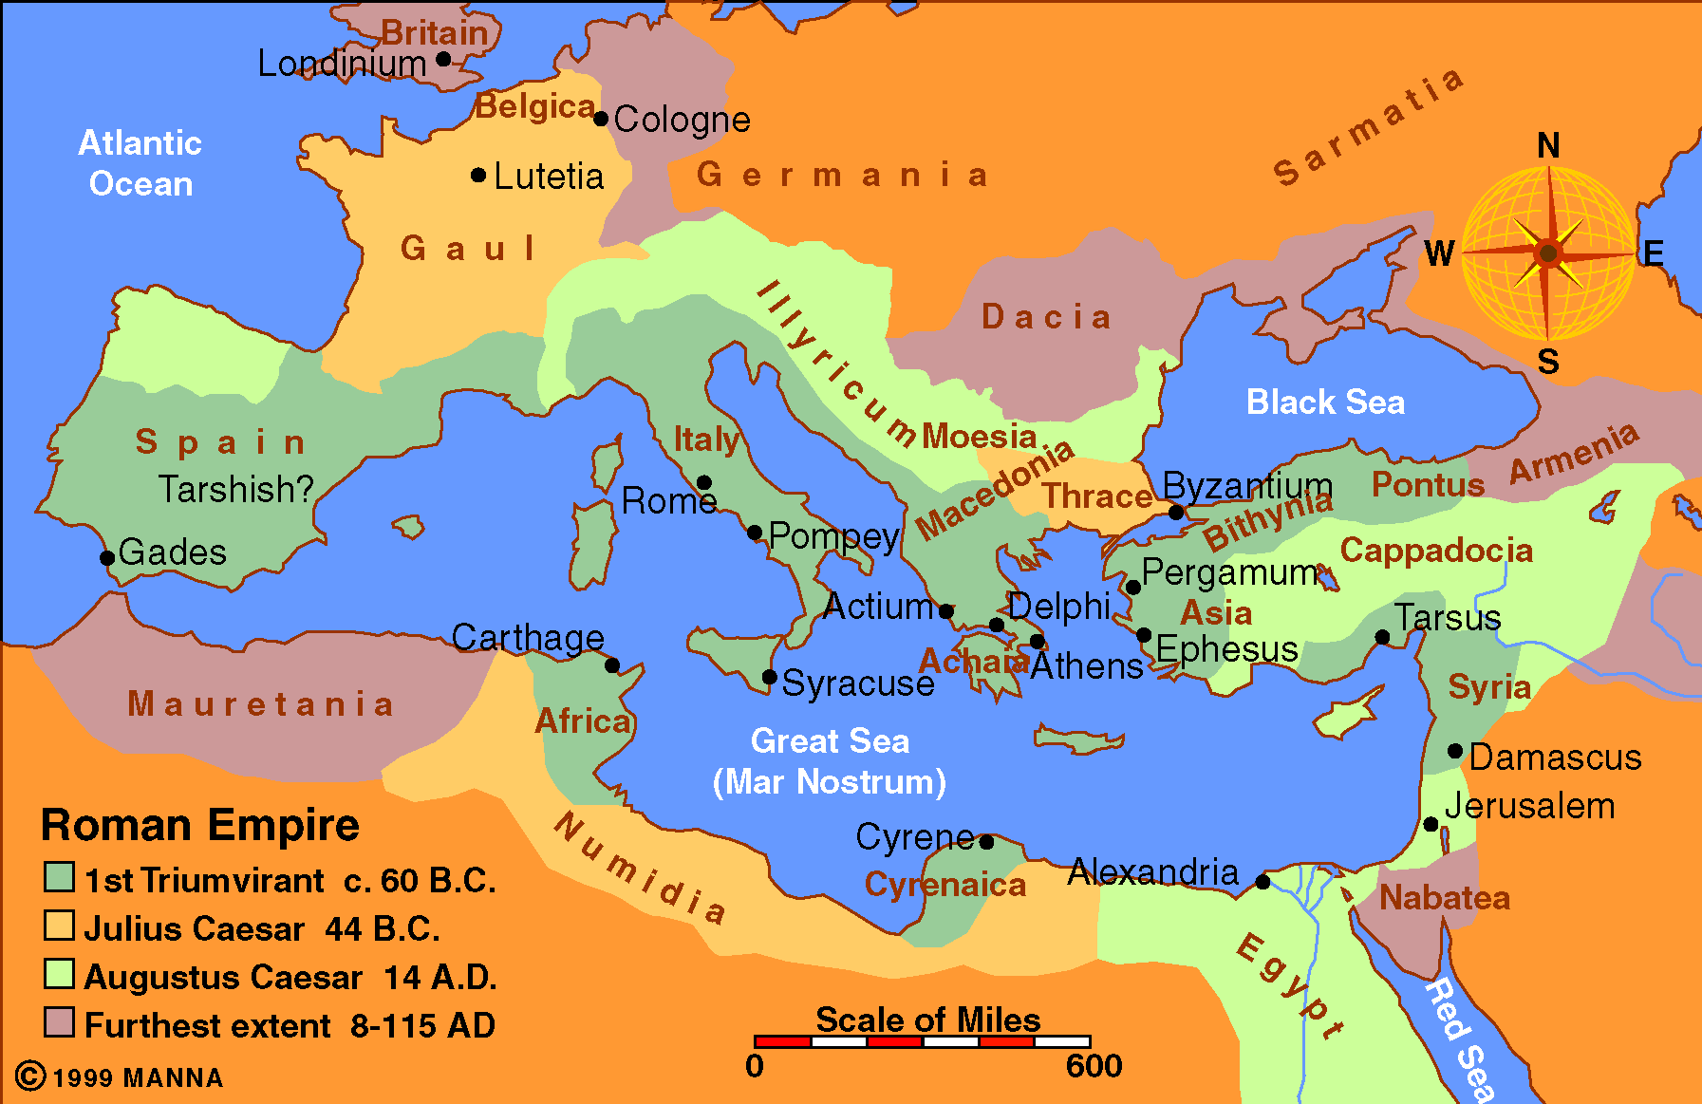

Slide 4
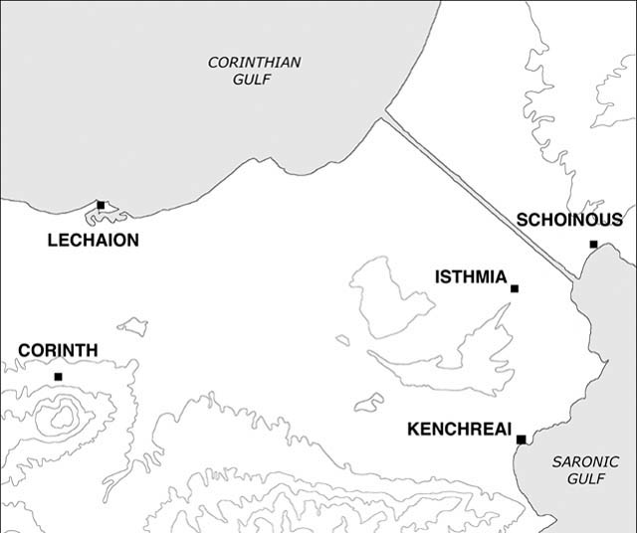
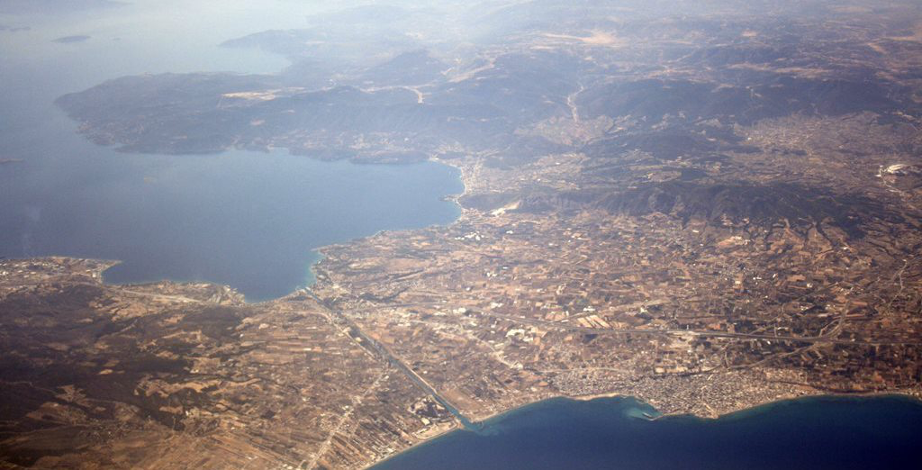

Slide 5
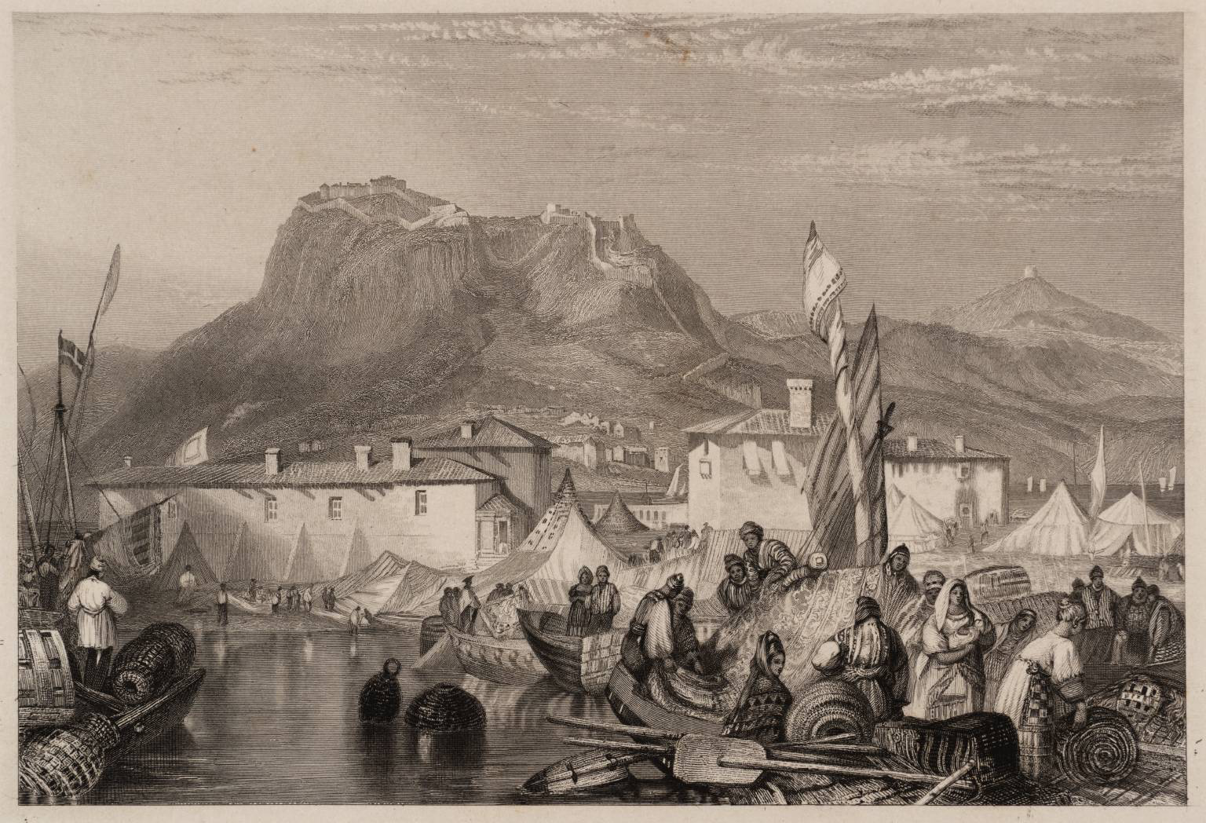

Slide 6
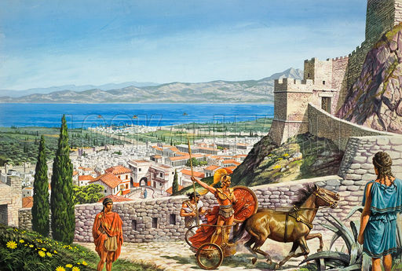

Slide 7
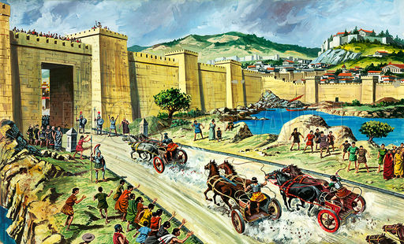
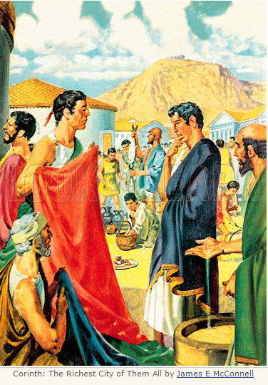

Slide 8
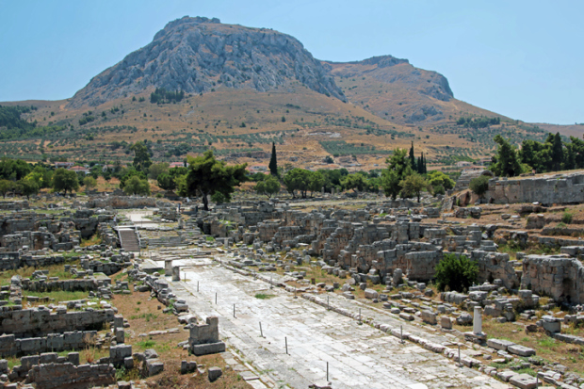
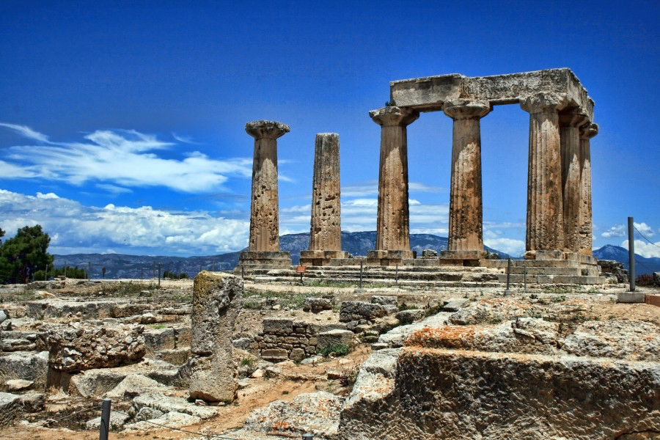

Slide 9
Chronology
Paul establishes the church in Corinth on 2nd Journey
He returns to Antioch.
On 3rd Journey travels through Asia and Ephesus
Writes 1st Corinthians in Ephesus.
Travels to Troas and then Macedonia
Writes 2nd Corinthians
Travels to Greece (and likely Corinth)

Slide 10
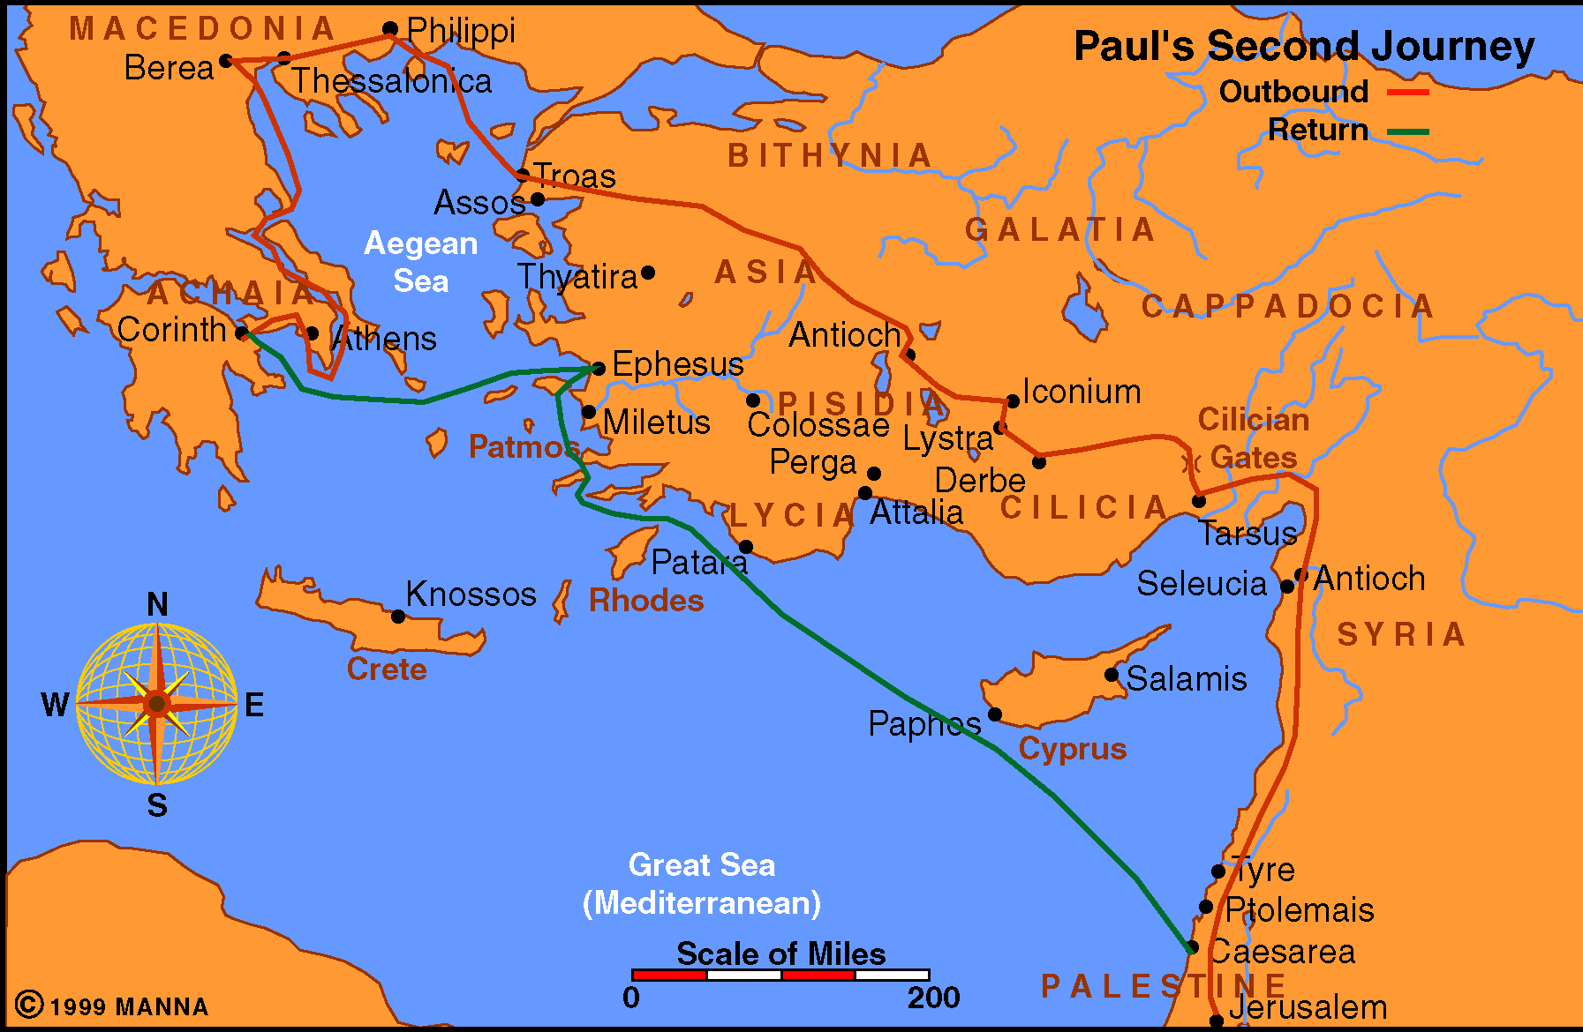

Slide 11
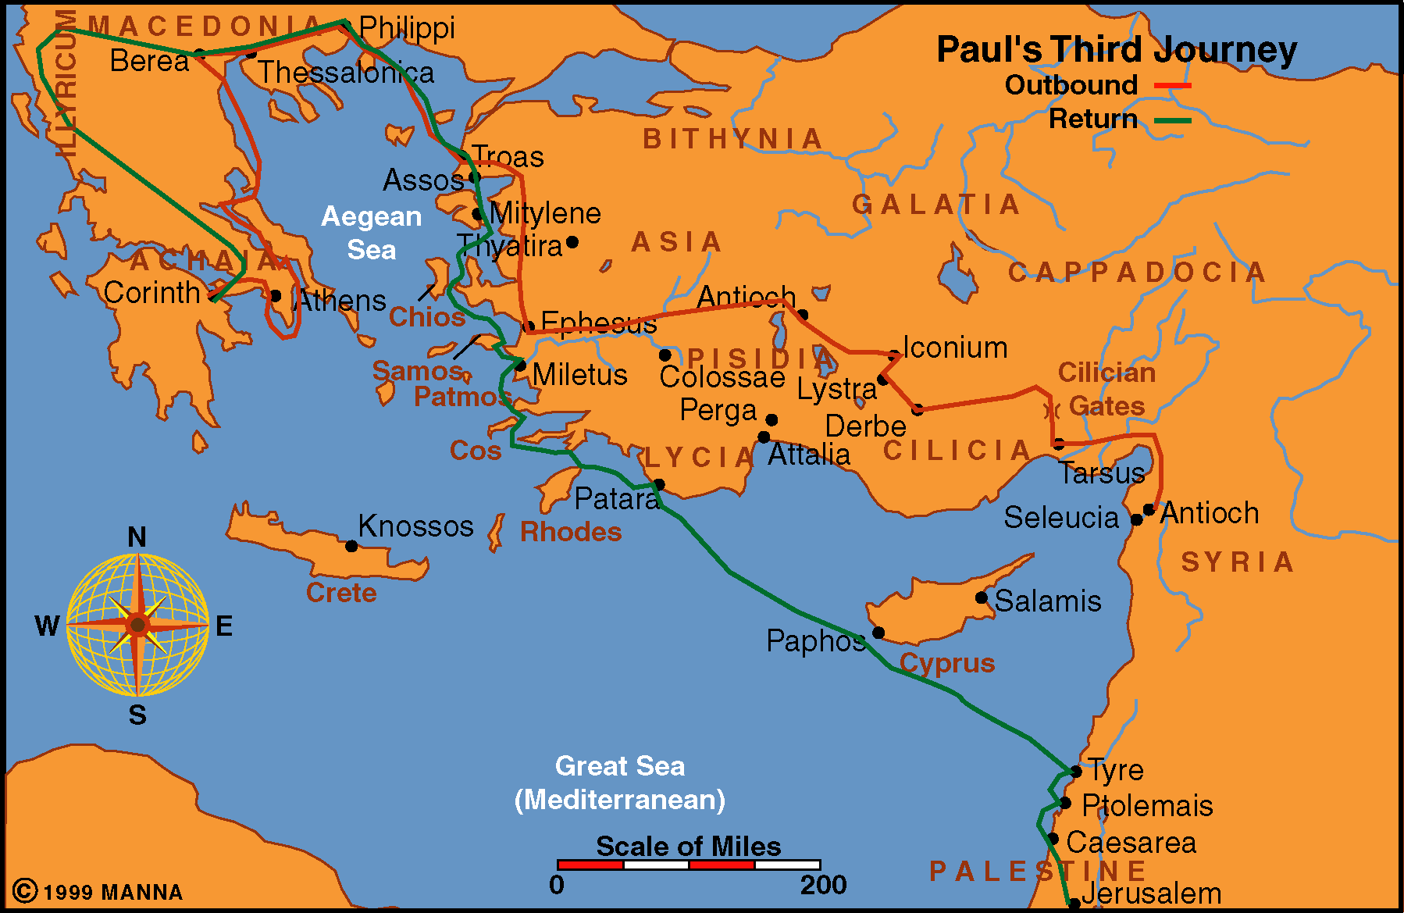
Paul Journey 3

Slide 12
Circumstances in Corinth
First letter received and corrections made
Paul hears from Titus
  Learns he still has strong critics in Corinth
Paul writes 2nd letter to deal with charges and to exhort them
Apparent charges against Paul
  Unreliable and untrustworthy
  Not a true apostle

Slide 13


Chapter One
Greeting
The God of all comfort
Paul’s experiences in Asia

