Slide 2
Paul the Teacher
2nd Corinthians 2

Slide 3
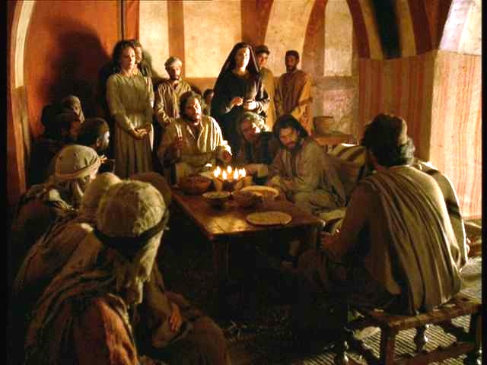
Love those your teach!

Slide 4
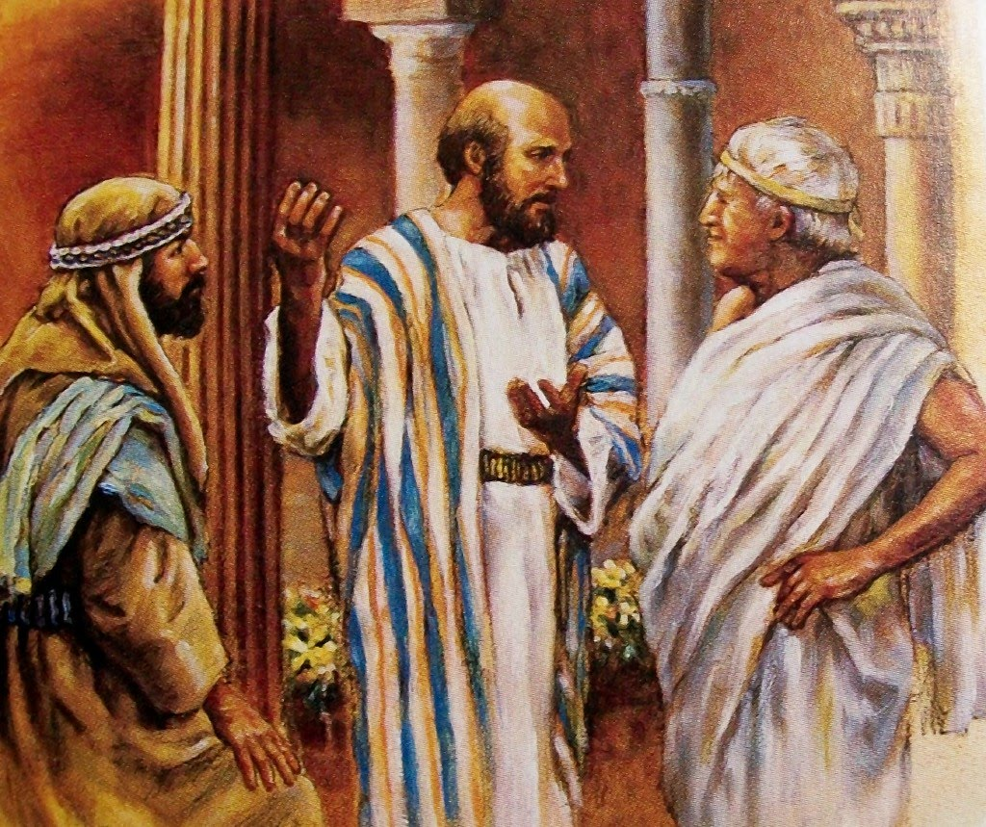
Do not withhold needed truth

Slide 5
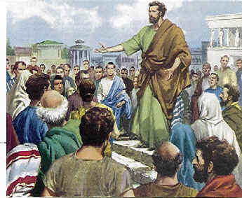
Give attention to attitude

Slide 6
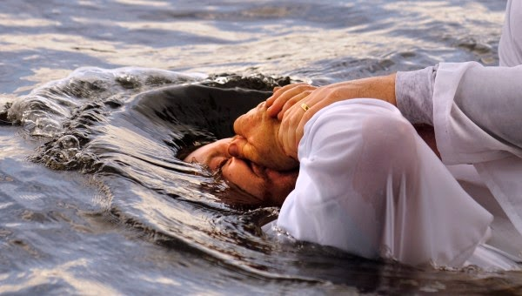
Teach to effect lasting change

