Slide 1


Slide 2


Chapter Eight
Background
Paul’s promise to Jerusalem brethren.
Paul follows through on promise with churches in Asia Minor, Macedonia and Greece.

Slide 3

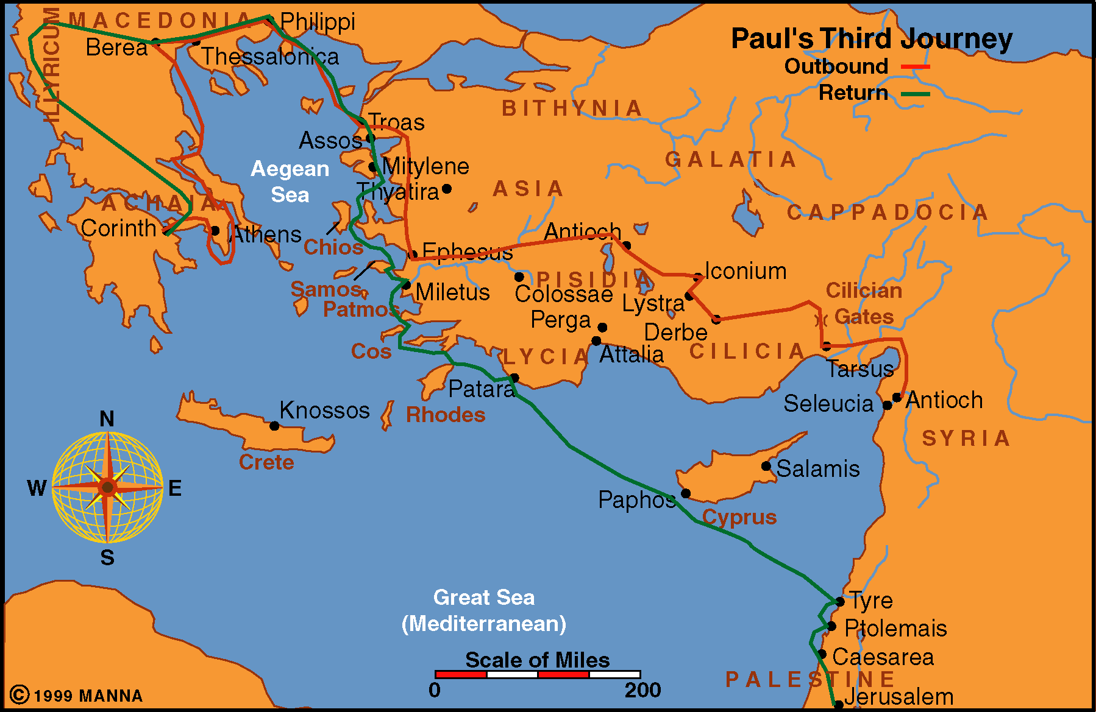
Paul Journey 3

Slide 4
Chapter Eight
Background
Paul’s promise to Jerusalem brethren.
Paul follow through on promise with churches in Asia Minor, Macedonia and Greece.
Paul has given earlier instructions to Corinth.
Now he urges them to complete their gift.

Slide 5
Chapter Three
Paul’s Motivation
Fulfill his promise (Galatians 2:10)
Help truly needy brethren as an act of compassion
Solidify the relationship between Jewish Christians and Gentile Christians

Slide 6
Chapter Eight
The Example of the Macedonians

