Slide 2
“No one can come to Me unless the Father who sent Me draws him; and I will raise him up on the last day.” (John 6:44, NASB95)
How to study
a Bible passage

Slide 3
See what someone else has to say, first.
What NOT To Do…

Slide 7
See what someone else has to say, first.
Rely on word studies.
What NOT To Do…

Slide 11
Read the text
Read it again. How do the thoughts flow together?
Focus On The Text

Slide 12
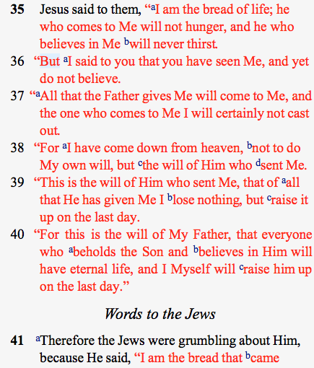
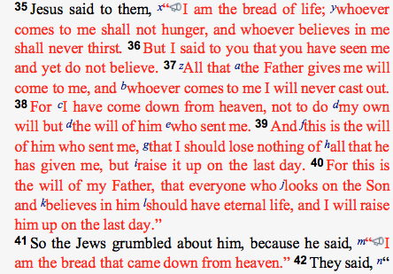
Focus On The Text

Slide 13
Read the text
Read it again. How do the thoughts flow together?
Read in context.
If you’re still stuck…
Focus On The Text

Slide 14
“Now these were more noble-minded than those in Thessalonica, for they received the word with great eagerness, examining the Scriptures daily to see whether these things were so.” (Acts 17:11, NASB95)
Focus On The Text

Slide 15
“The secret things belong to the Lord our God, but the things revealed belong to us and to our sons forever, that we may observe all the words of this law.” (Deuteronomy 29:29, NASB95)
Focus On The Text

Slide 16
“For Ezra had set his heart to study the law of the Lord and to practice it, and to teach His statutes and ordinances in Israel.” (Ezra 7:10, NASB95)
Study to Apply

Slide 17
What commands are there to obey?
What sins are there to avoid?
What examples are there to follow?
What promises are there to receive?
What prayers can I make my own?
What do I learn about God?
Study to Apply

