Slide 2
how the work gets done

Slide 3
how the work gets done
starts with good leadership
Nehemiah 1.3-11; 2.17

Slide 4
how the work gets done
everyone shares the same vision
Nehemiah 2.17-18

Slide 5
how the work gets done
work is done “next to” each other
Nehemiah 3

Slide 6
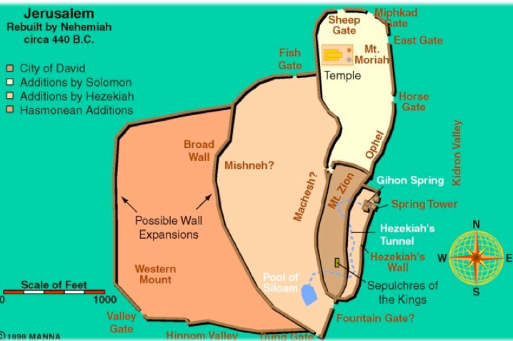

Slide 7
how the work gets done
work is done “next to” each other
Nehemiah 3

Slide 8
how the work gets done
God is trusted more than man is feared
Nehemiah 4.11-14

