Slide 2
The Gospel of Repentance
Luke 3

Slide 3
Demands a separation (vss. 7-9)
The Gospel of Repentance
Luke 3

Slide 4
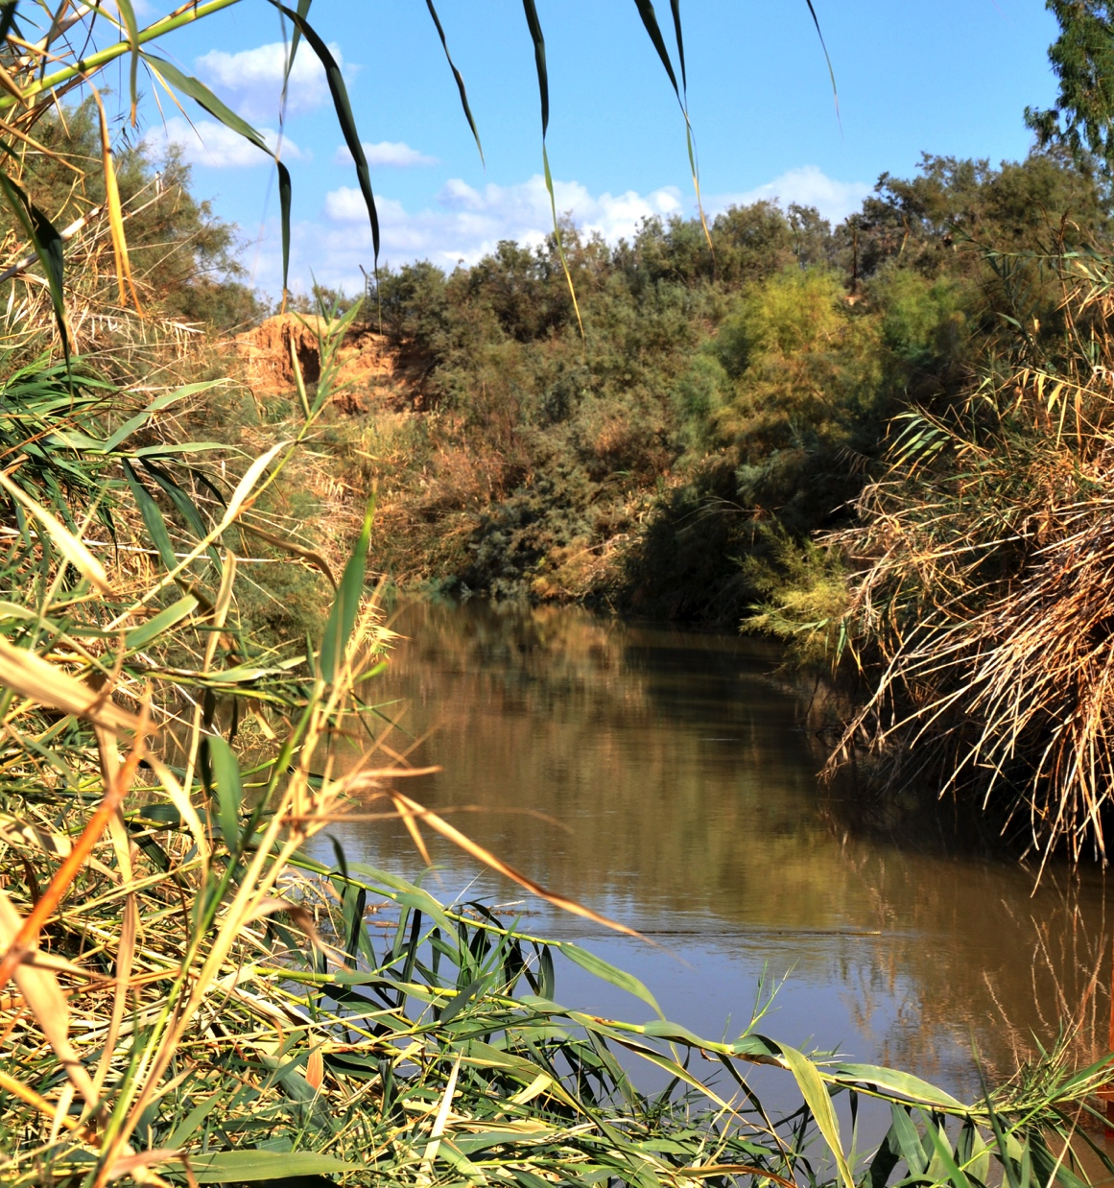
Courtesy of Leon Mauldin

Slide 5
Demands a separation (vss. 7-9)
Focuses more on your future than your past (vss. 10-14)
Means nothing without baptism (vss. 3,15-17)
The Gospel of Repentance
Luke 3

