Slide 3
“The Revelation of Jesus Christ, which God gave Him to show to His bond-servants, the things which must soon take place; and He sent and communicated it by His angel to His bond-servant John,” (Revelation 1:1)

Slide 4
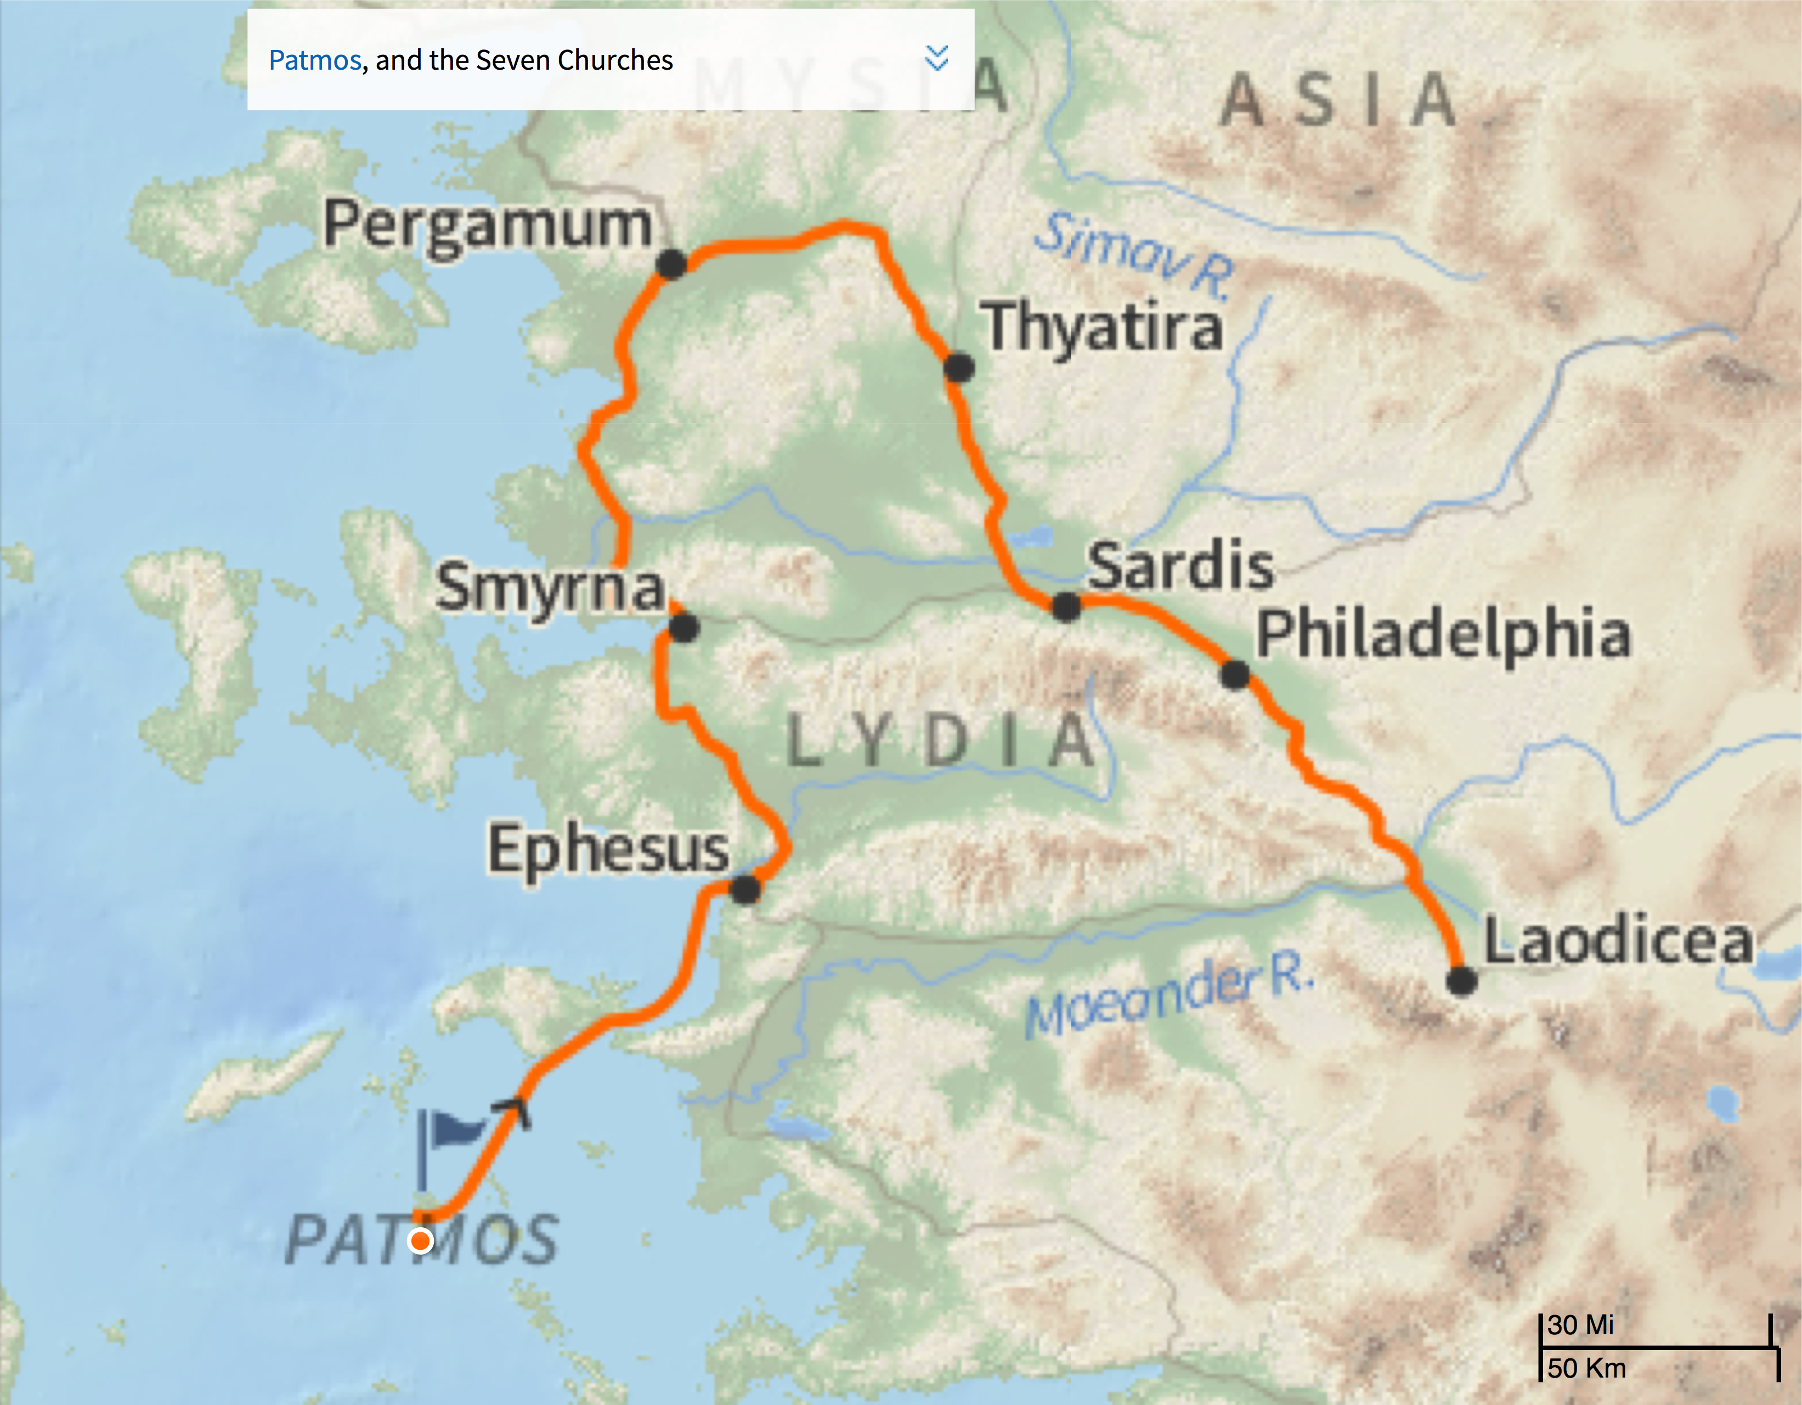

Slide 5
Dating the letter:
Nero? (AD 54-68)
Domitian? (AD 81-96)

Slide 6
Dating the letter:
Nero? (AD 54-68)
Domitian (AD 81-96)

Slide 7
Features of apocalyptic writing:
Written in an hour of need
Draws on OT language & ideas
Esoteric, i.e. reveals secret
Symbolic in language

Slide 8
Approaches To Interpreting:
Historical Approach
Preterist Approach
Futurist Approach
Spiritual Approach

Slide 9
“Behold, He is coming with the clouds, and every eye will see Him, even those who pierced Him; and all the tribes of the earth will mourn over Him. So it is to be. Amen.” (Revelation 1:7)

Slide 10
“The oracle concerning Egypt. Behold, the Lord is riding on a swift cloud and is about to come to Egypt; The idols of Egypt will tremble at His presence, And the heart of the Egyptians will melt within them.” (Isaiah 19:1)

Slide 11
“And then the sign of the Son of Man will appear in the sky, and then all the tribes of the earth will mourn, and they will see the Son of Man coming on the clouds of the sky with power and great glory.” (Matthew 24:30)

Slide 12
“The Revelation of Jesus Christ, which God gave Him to show to His bond-servants, the things which must soon take place; and He sent and communicated it by His angel to His bond-servant John,”
(Revelation 1:1, NASB95)

Slide 13
“The Revelation of Jesus Christ, which God gave Him to show to His bond-servants, the things which must soon take place; and He sent and communicated it by His angel to His bond-servant John,”
(Revelation 1:1, NASB95)

Slide 14
“The Revelation of Jesus Christ, which God gave Him to show to His bond-servants, the things which must soon take place; and He sent and communicated it by His angel to His bond-servant John,”
(Revelation 1:1, NASB95)

