Slide 4
A DISCIPLES GUIDE TO TAKING INSTRUCTIONS
LUKE 17.1-10
Take in all of the instruction (vss. 1-4)
For every “do not” be prepared for a “do”
Know that His instructions may not coincide with what you previously thought or believed
The purpose of His instructions is to make us like Him and the Father (Luke 6.40; Matthew 5.48)

Slide 5
A DISCIPLES GUIDE TO TAKING INSTRUCTIONS
LUKE 17.1-10
Take in all of the instruction (vss. 1-4)
Follow the instructions in faith (vss. 5-6)

Slide 6
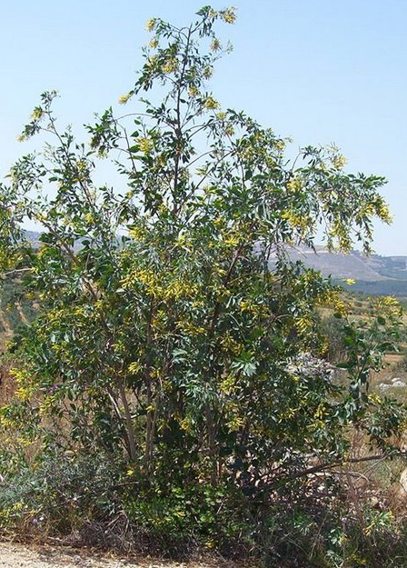

Slide 7
A DISCIPLES GUIDE TO TAKING INSTRUCTIONS
LUKE 17.1-10
Take in all of the instruction (vss. 1-4)
Follow the instructions in faith (vss. 5-6)
Remember why you’re following the instructions (vss. 7-10)

