Slide 2
"And I also say to you that you are Peter, and on this rock I will build My church, and the gates of Hades shall not prevail against it.” -Matthew 16:18

Slide 3
"And I also say to you that you are Peter, and on this rock I will build My church, and the gates of Hades shall not prevail against it.” -Matthew 16:18

Slide 4
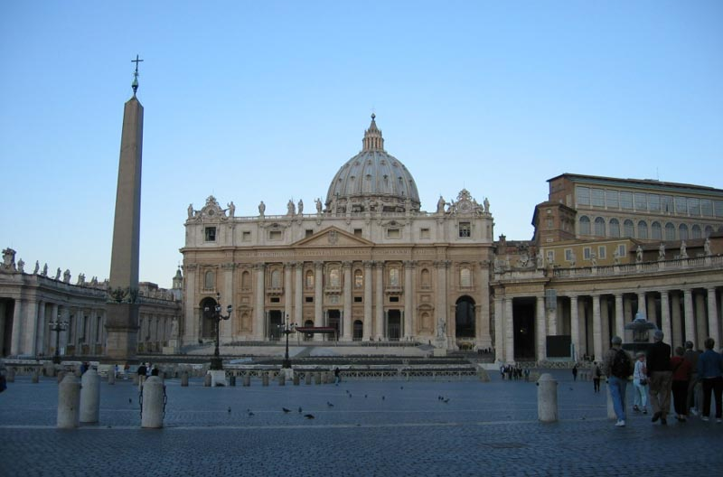
The World’s View of the Church
St. Peter’s - Rome

Slide 5
“I will build my church”
Church – an assembly or group
The church is the Lord’s group
“And the Lord added to the church daily those who were being saved.” (Acts 2:47)

Slide 6
Becoming a part of the group
By being saved
"He who believes and is baptized will be saved; but he who does not believe will be condemned. (Mk. 16:16)
Then Peter said to them, "Repent, and let every one of you be baptized in the name of Jesus Christ for the remission of sins; and you shall receive the gift of the Holy Spirit. (Acts 2:38)

Slide 7
Christians worked together in local congregations
There is no other organization to the Lord’s people

Slide 8
Jesus’ Attitude Toward His Church
John 15:11-17

Slide 9
Jesus Loved His People
"This is My commandment, that you love one another as I have loved you.
-John 15:12

Slide 10
Jesus gave His life for His people
"Greater love has no one than this, than to lay down one's life for his friends.
-John 15:13

Slide 11
Jesus gave His life for His people
Little children, let us not love with word or with tongue, but in deed and truth.
-1 John 3:18

Slide 12
We are to serve one another
Galatians 5:13 “For you, brethren, have been called to liberty; only do not use liberty as an opportunity for the flesh, but through love serve one another.”
John 13:14-15 "If I then, your Lord and Teacher, have washed your feet, you also ought to wash one another's feet. For I have given you an example, that you should do as I have done to you.”

Slide 13
Jesus guided His people
John 15:15 "No longer do I call you servants, for a servant does not know what his master is doing; but I have called you friends, for all things that I heard from My Father I have made known to you.”

Slide 14
Jesus guided His people
John 15:14 "You are My friends if you do whatever I command you.”

Slide 15
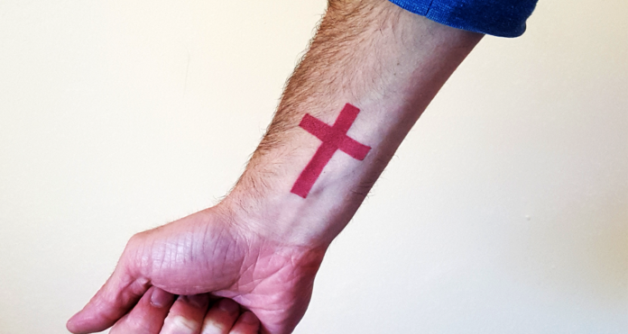
Man Gets Cross Tattoo in Lieu of Sanctification

Slide 16
Jesus wanted them to bear fruit
John 15:16 "You did not choose me, but I chose you and appointed you that you should go and bear fruit and that your fruit should abide…”

Slide 17
Jesus Attitude Toward His Church
He loved His people
He gave His life for His people
He guided His people
He wanted them to bear fruit

Slide 18
“For the grace of God has appeared, bringing salvation for all people, training us to renounce ungodliness and worldly passions, and to live self- controlled, upright, and godly lives in the present age, waiting for our blessed hope, the appearing of the glory of our great God and Savior Jesus Christ, who gave himself for us to redeem us from all lawlessness and to purify for himself a people for his own possession who are zealous for good works.” - Titus 2:11,12

