Slide 1
Mephibosheth
Characters that Build Character

Slide 2
Mephibosheth
me-fib'-o-sheth
Idol Breaker
(1) Son of Saul by his concubine RIZPAH (which see), daughter of Aiah (2 Sam 21:8).
(2) Grandson of Saul, son of Jonathan, and nephew of Mephibosheth (1) (2 Sam 4:4).

Slide 5
Historical 1Sam 23-2Sam
Saul Hunts David David with Philistines
Absalom Uprising
David leaves Jerusalem hears Ziba
17-20 years later
David has peace seeks out Jonathan’s heirs
Mephibosheth Dropped by Nurse
Saul and Jonathan Slain
David Returns hears Mephibosheth
1Sam 31
2Sam 15:13
2Sam19:24

Slide 6
Mephibosheth – Historical setting
1Sam 31: Saul and Jonathan slain in Philistine battle
Turmoil after death
Nurse Flees Samuel 4:4
Samuel 9 – After peace is in the land David seeks to show kindness to house of Saul
Several Sons and Heirs

Slide 7
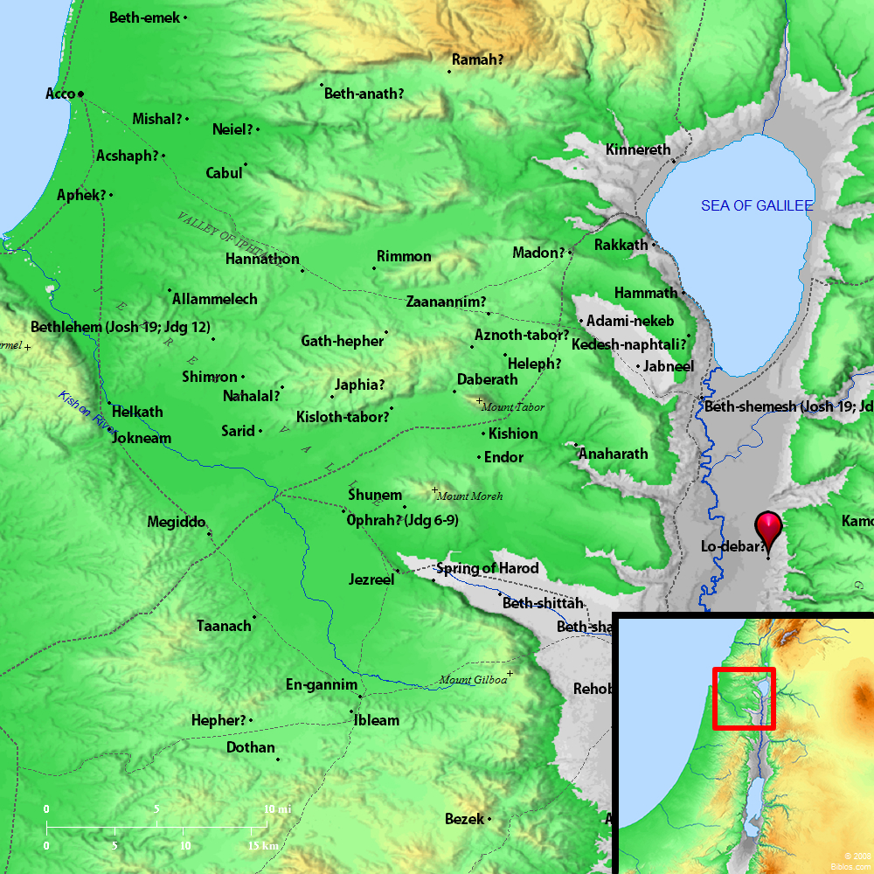

Slide 8
Ziba and Mephibosheth
(2 Samuel 9:1-13)
Vs. 7 – Why is Mephibosheth afraid?
Ziba’s new role?
Vs. 12 Ziba 15 sons and 20 servants now serve Mephibosheth
All of Saul’s land restored to Saul’s Grandson
Ate always at King’s Table
Verse 10 significance

Slide 9
Ziba and Mephibosheth Part 2
2Samuel 16
17 years pass
David and Absalom Rebellion – David is leaving the city 2Sam. 15:13
Vs 3. – Where is your Master?
2 Samuel 19:24-30
Mephibosheth Story
Not trimmed Beard or taken care of feet.
Vs. 29-30
David Divides
Mephibosheth forfeits all
2Samuel 21
David Avenges the Gibeonites
David hands over 7 of Saul’s sons to the Gibeonites(Mephibosheth son of Saul)
David spares Mephibosheth

Slide 10
Mephibosheth Character
Rightfully Heir to the Kingdom
Life full of:
Disaster
Anxiety
Weariness
Sabotage
Humble
Thankful in his position
Relies on others
Forsake all to serve the King

Slide 11
Eleazar
Characters that Build Character

Slide 12
Eleazar
'el-`azar
God is helper
The 3rd son of Aaron by Elisheba (Ex 6:23; Nu 3:2).
Brothers are “Nadab and Abihu” and Ithamar

Slide 15
Historical Exodus 28 – Joshua 21
Eleazar Consecrated with Family to be Priests
Divide land after conquest
Priest for Joshua
Succeeds Aaron
Put in Charge of Levites and Sanctuary
Nadab and Abihu die
Tabernacle Instituted – 40 years of wandering – Canaan conquered – Canaan divided
Lev. 10
Num. 3:32
Lev 10:8 Side note

Slide 16
Eleazar Historical Setting
Exodus 28
Aaron and sons to be priests and to serve
Soon after Tabernacle was built
Now a place to perform duties and worship
Holy
Example for the congregation
Leviticus 9 – Ministry Begins
Leviticus 10- Nadab and Abihu
Leviticus 10- 8- Conduct for Priests

Slide 17
Eleazar Points
Lev. 10:6
Don’t mourn your brothers
Numbers 3:32 – Charge of Leaders of Levites and Oversight of those who kept charge of the sanctuary
Numbers 16:37 – Korah rebellion, censers put on altar for memorial that no outsider offer incense.
Numbers 20:22-29. LORD said that Eleazar take over for Aaron when Aaron died
Priest for Joshua when Moses died Numbers 27
Joshua and Eleazar help divide land in Shiloh

Slide 18
Eleazar Character
Phinehas son had zeal. Numbers 25
Maturity Lev. 10
Leader Num. 20
Respected Joshua 19:51

Slide 19
Next Sunday June 12th
Gomer
Hosea 1:1-11
Hosea 3:1-5
Elizabeth
Luke 1
Jael
Judges 4:17-4:24

