Slide 2
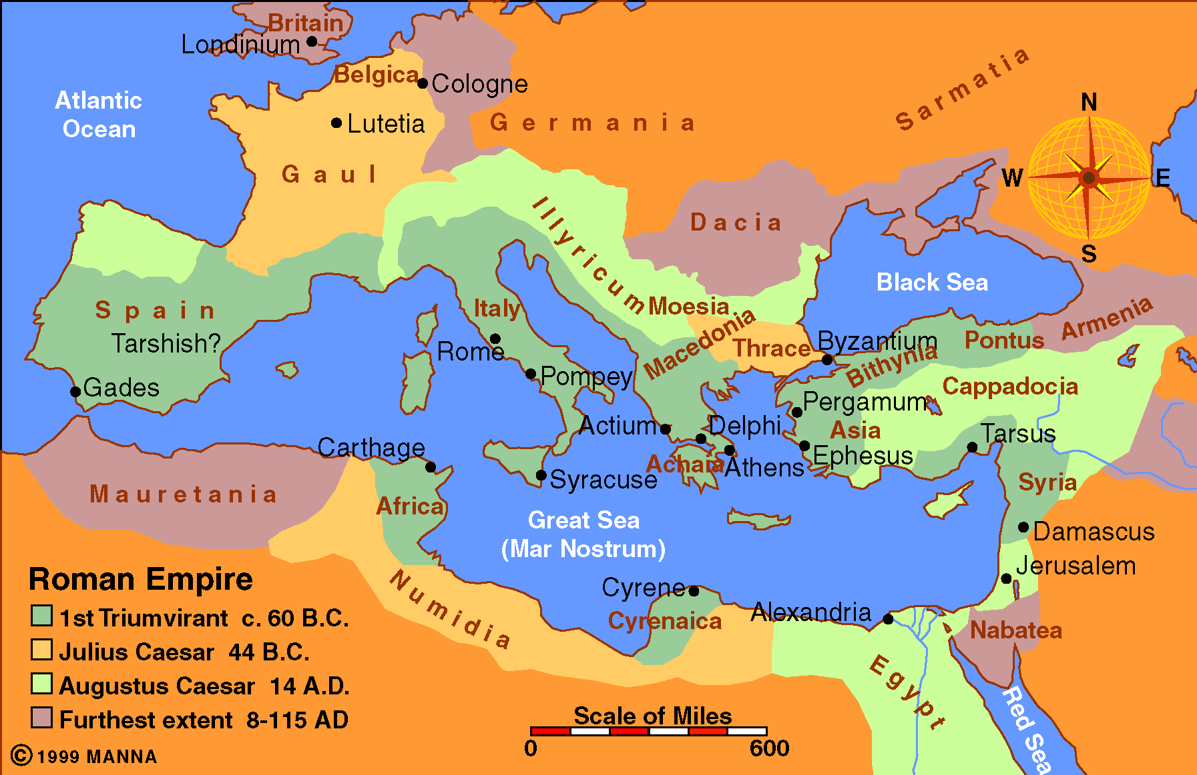

Slide 3
Paul the Apostle
And those who were his partners

Slide 4
The Church at Antioch
Supporters of Paul

Slide 5
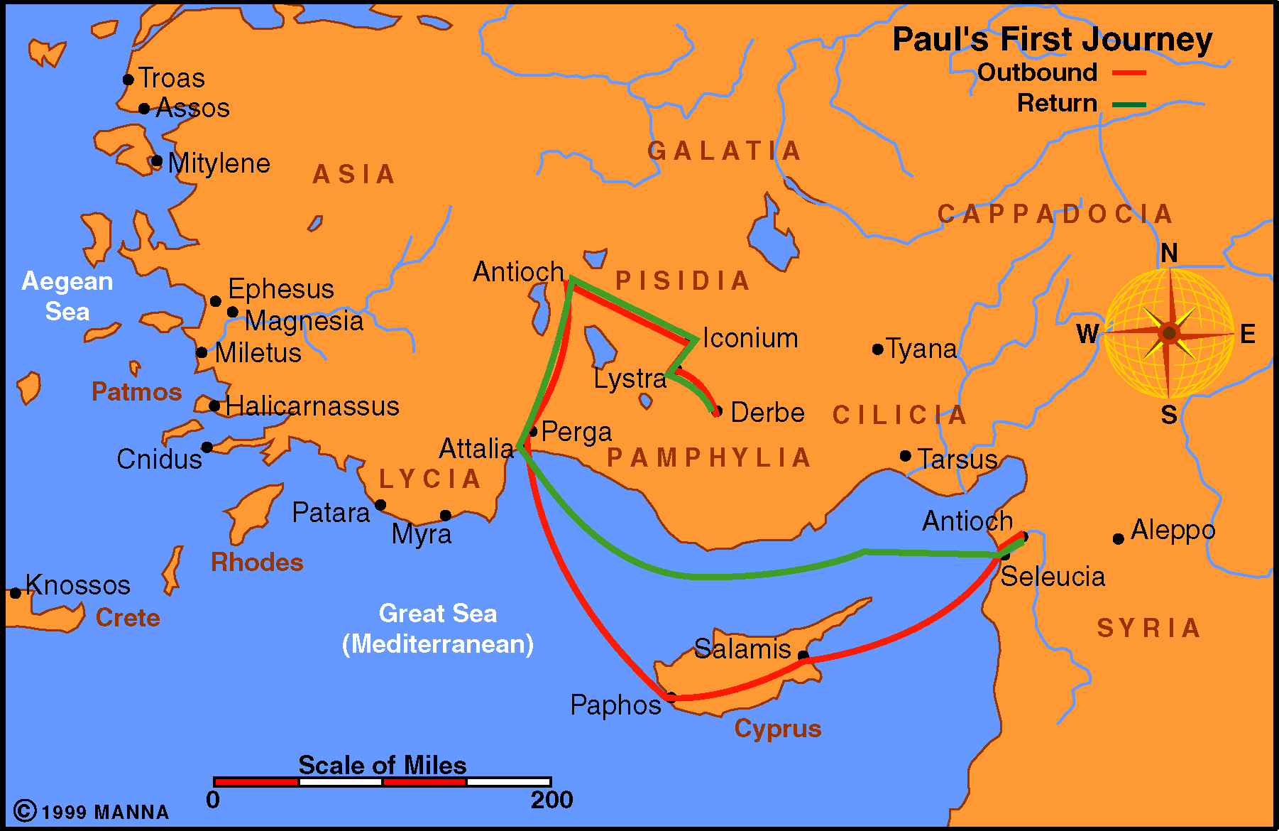

Slide 6
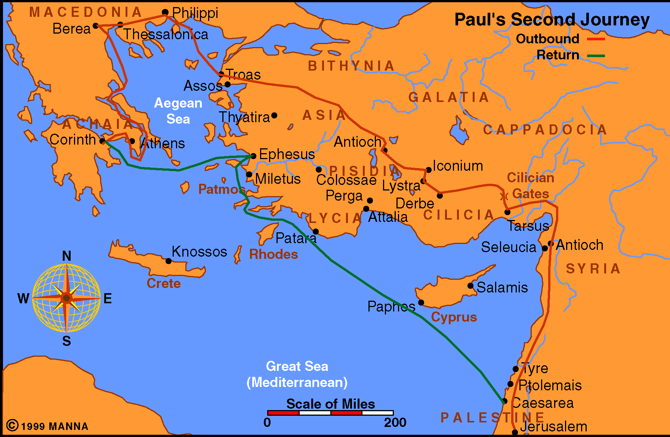

Slide 7
The Church at Corinth
Supporters of Paul

Slide 9
The Church at Philippi
Supporters of Paul

Slide 10
Philemon
Supporter of Paul

Slide 11
Lessons To Learn
Paul’s direct relationship with those who supported him
The intimate relationship between the churches or Christians with those they support.

Slide 12
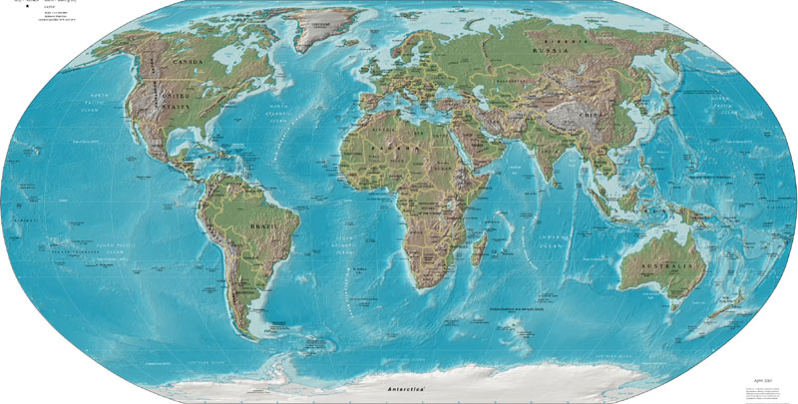
Into All The World
Scotland
Ethiopia
Seychelles

Slide 13
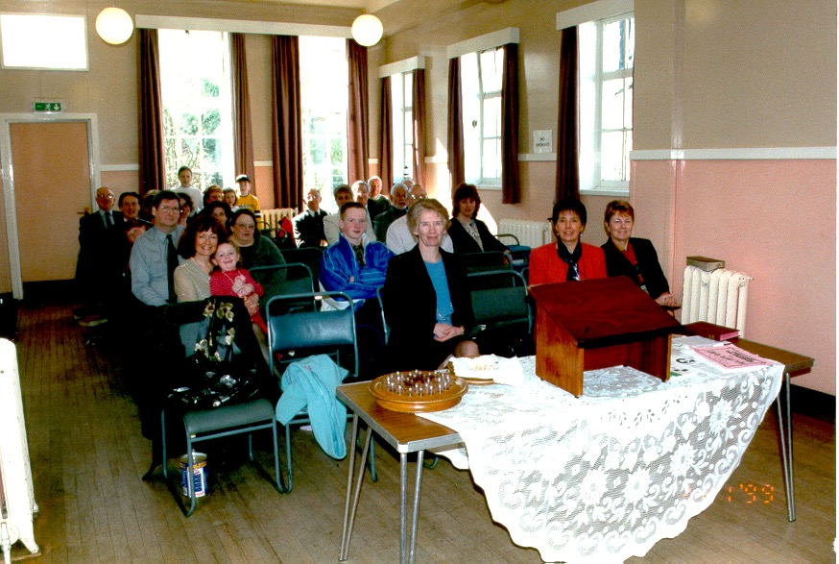
Scotland

Slide 14
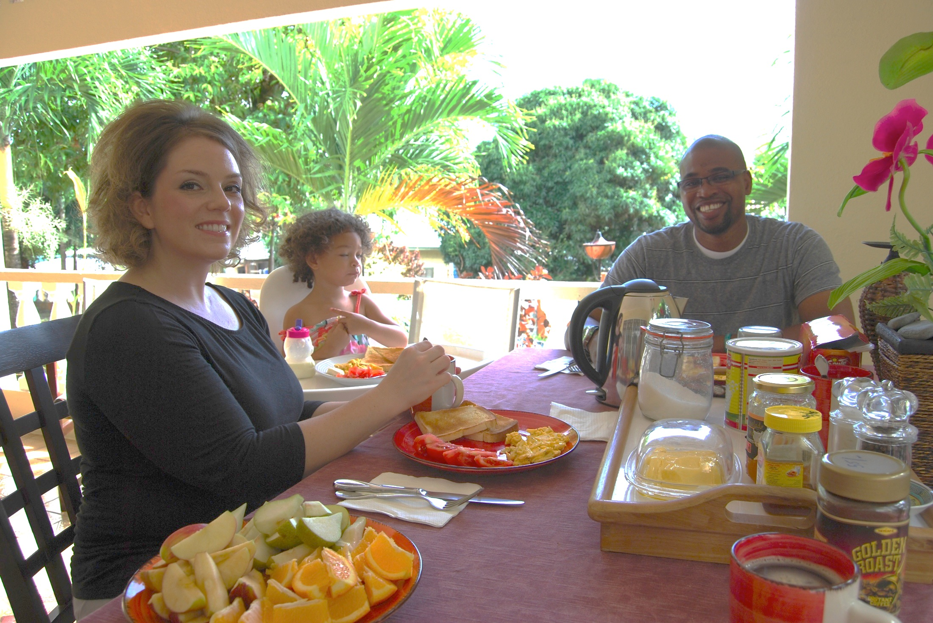
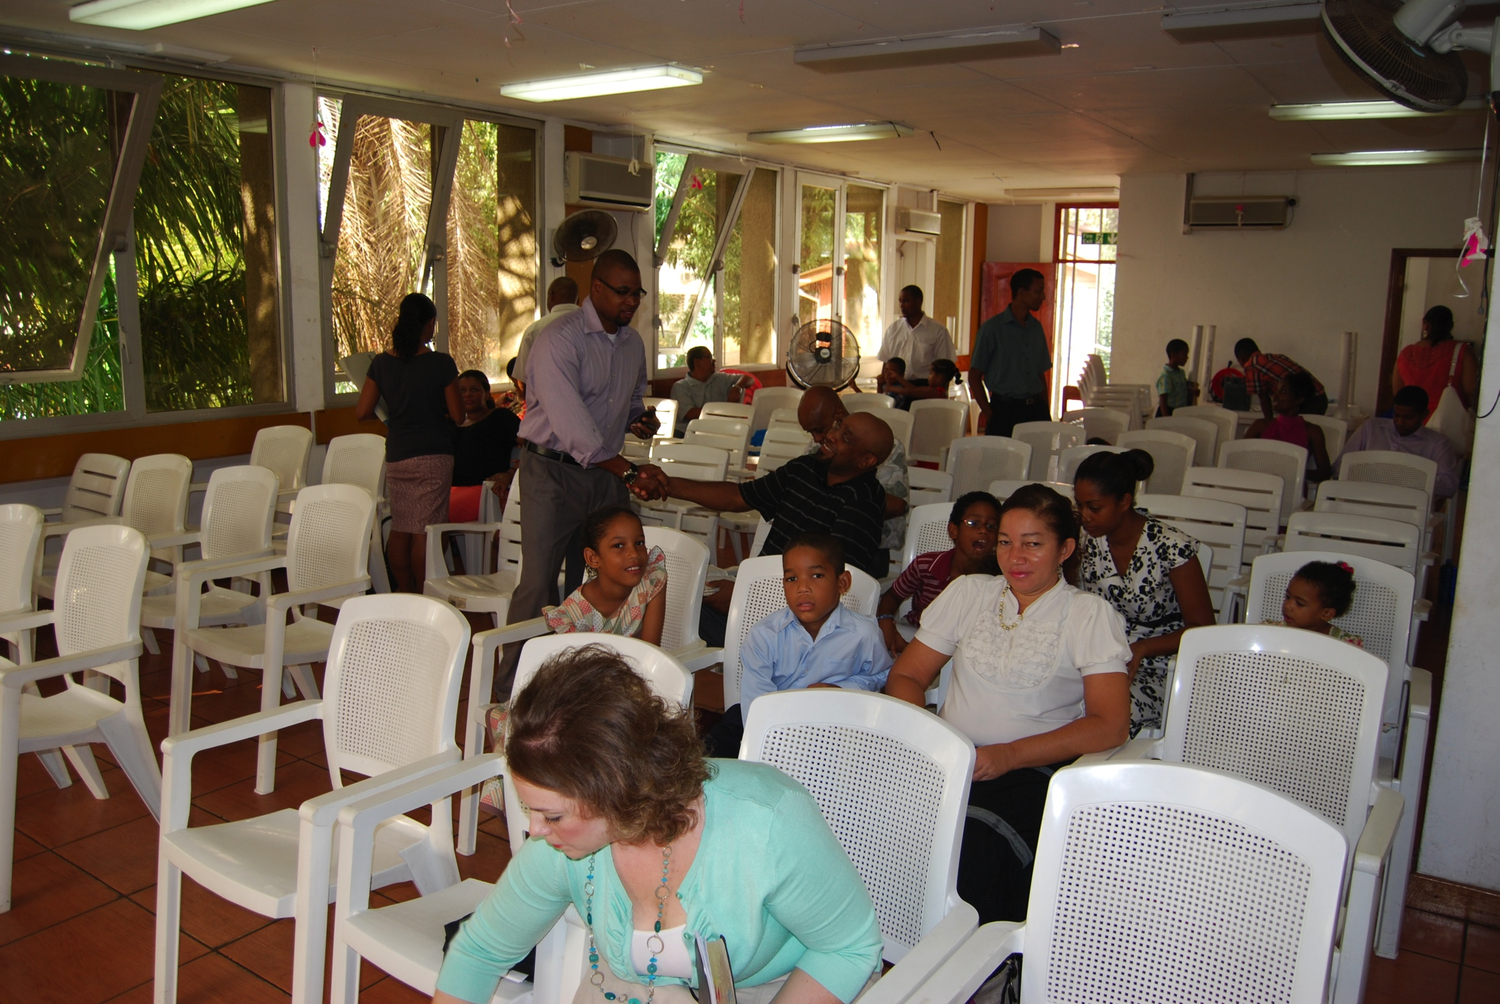
Seychelles

Slide 15
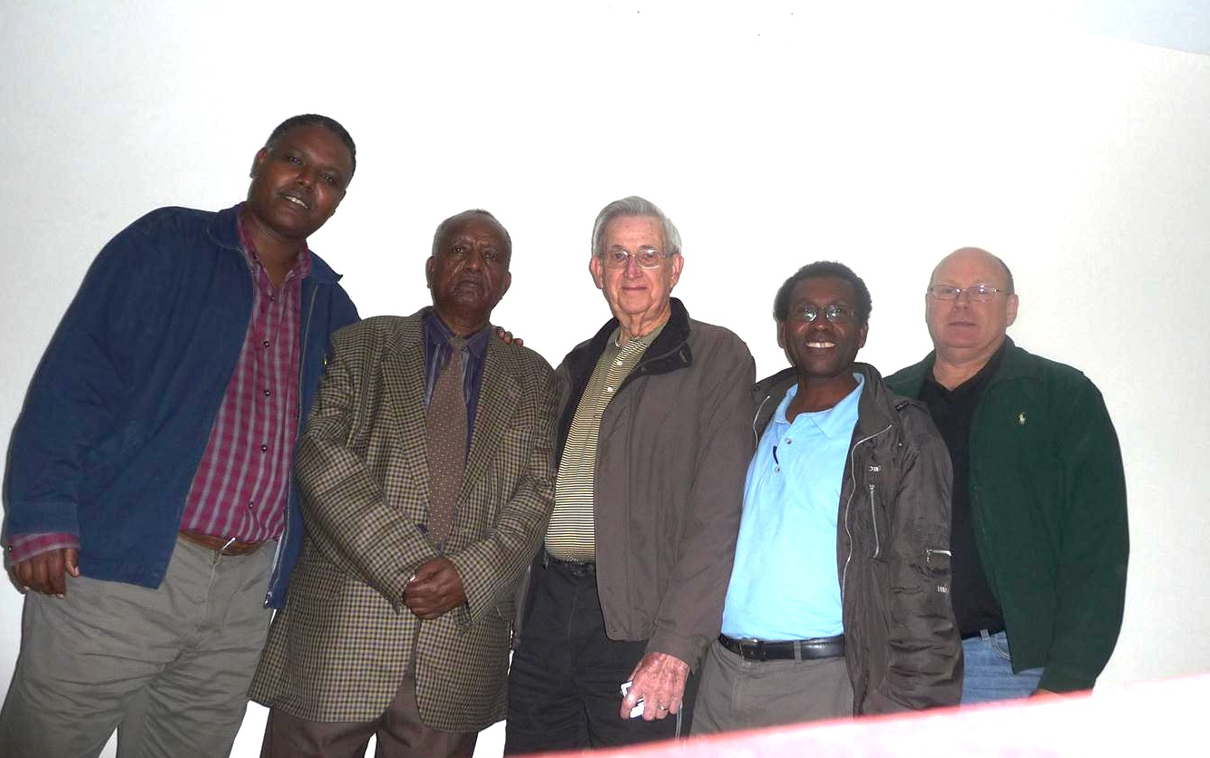
Ethiopia

Slide 16
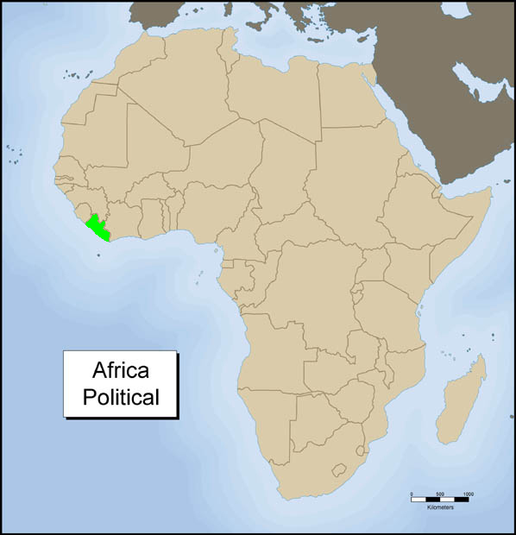
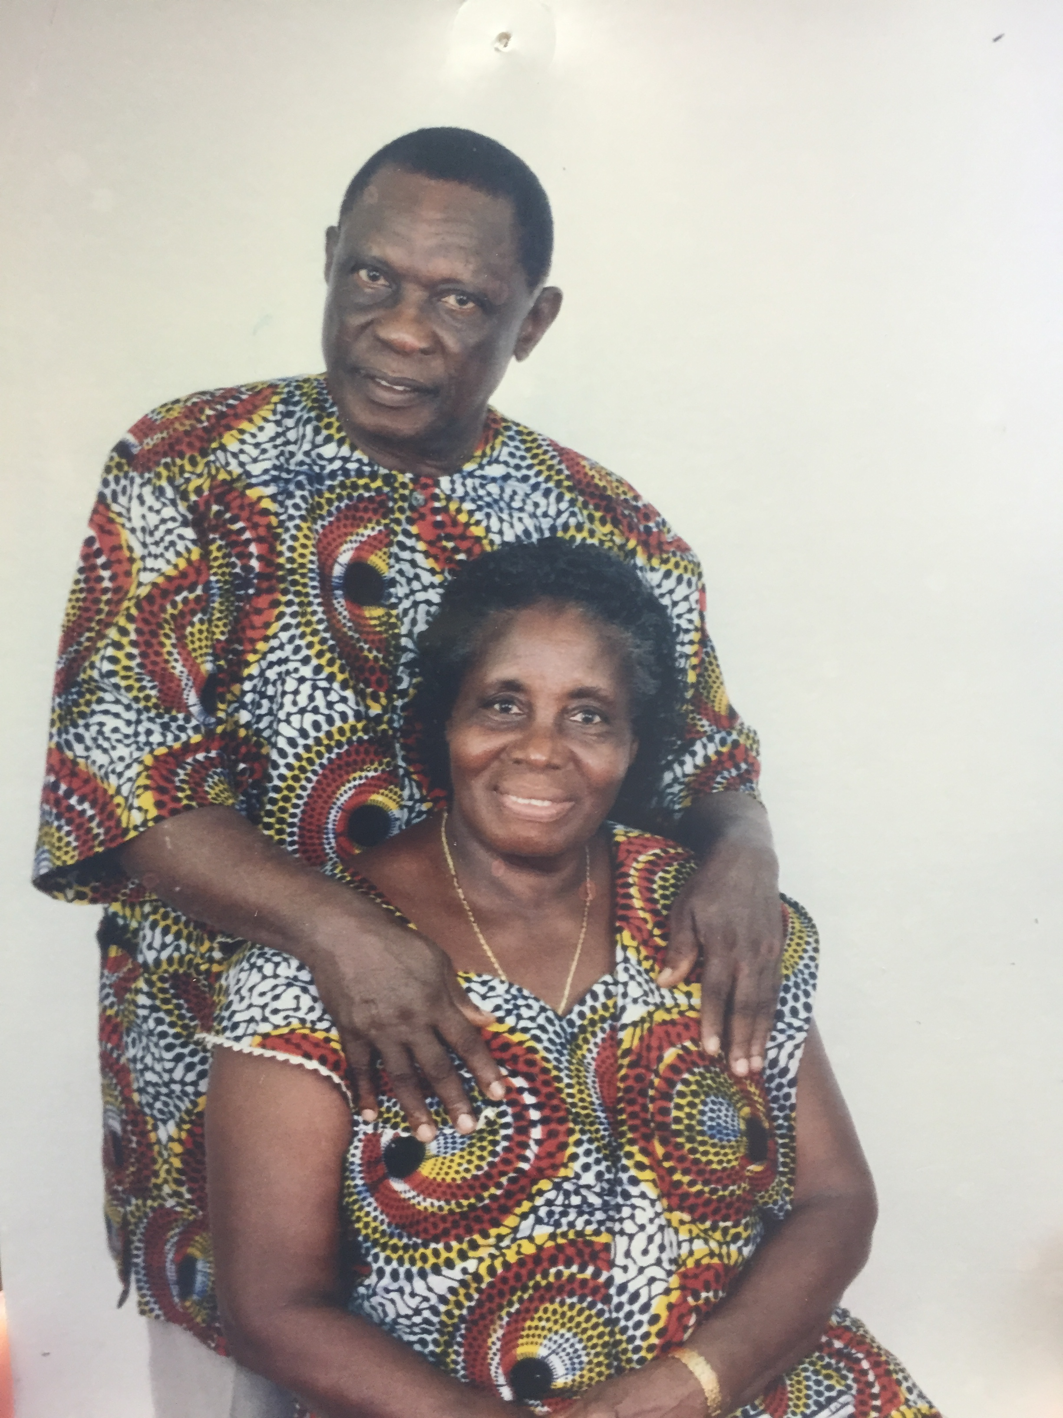
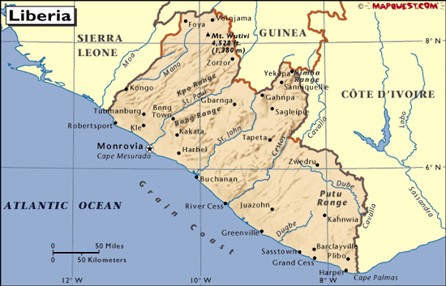
Liberia
Samson Walker
Monrovia, Liberia

Slide 17
Lessons To Learn
Paul’s direct relationship with those who supported him
The intimate relationship between the churches or Christians with those they support
Other ways brethren supported Paul
Fellow Workers
Encouragement and Prayers

Slide 18
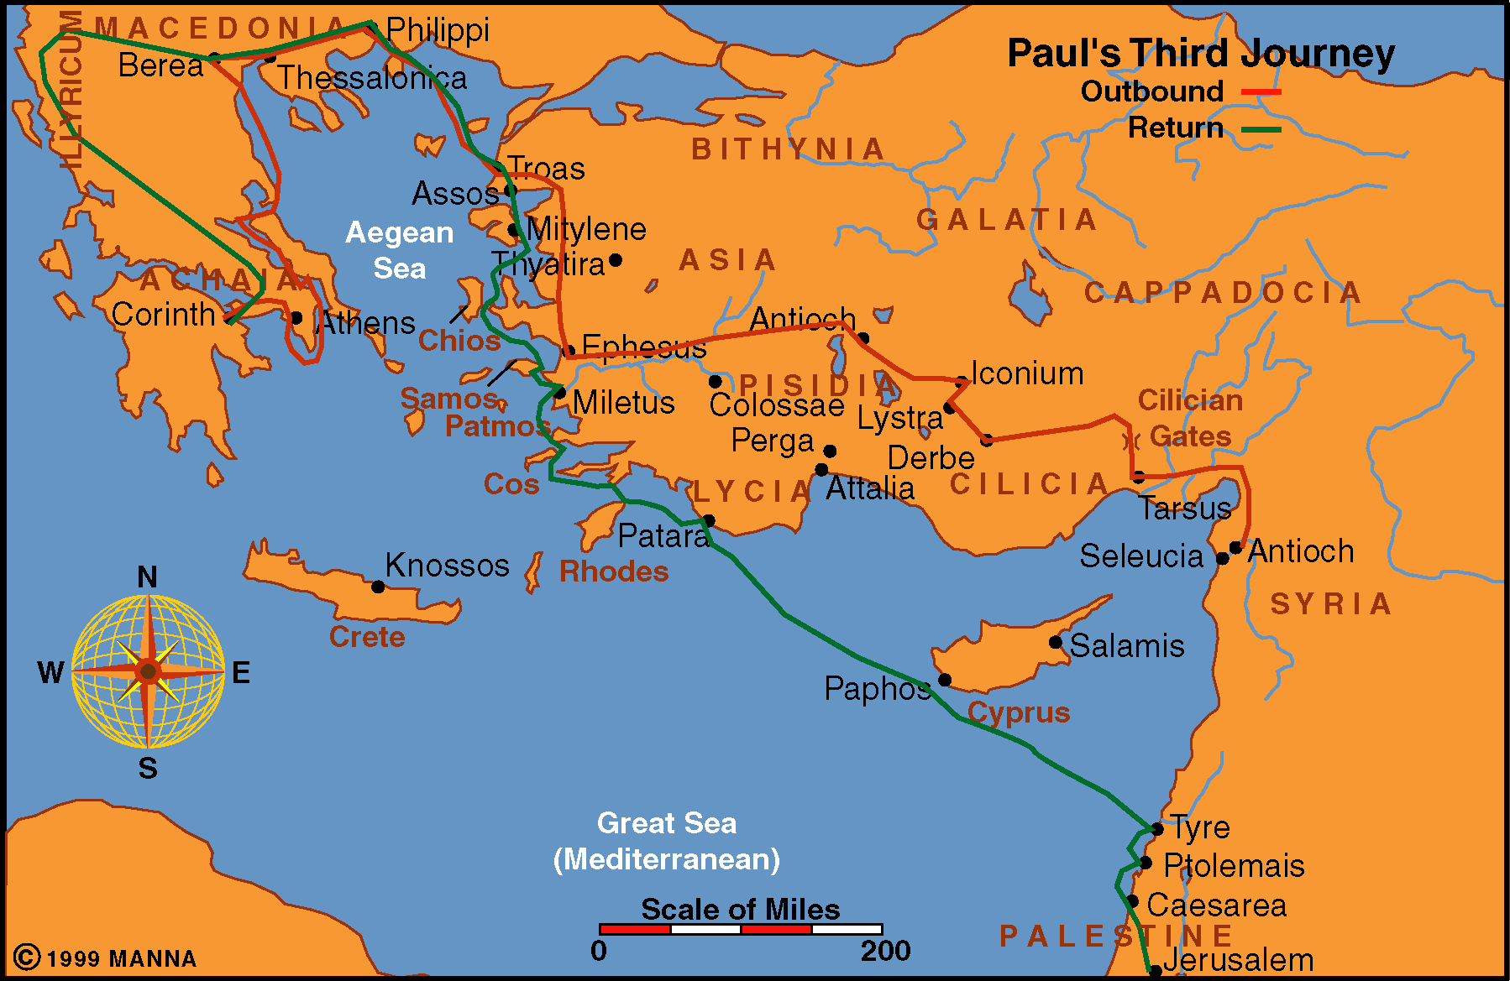

Slide 19
Appius

Slide 20
Lessons To Learn
Paul’s direct relationship with those who supported him
The intimate relationship between the churches or Christians with those they support
Other ways brethren supported Paul
Fellow Workers
Encouragement and Prayers

Slide 21
Into All The World
Scotland
Ethiopia
Costa Rica
Liberia
Seychelles

