Slide 3
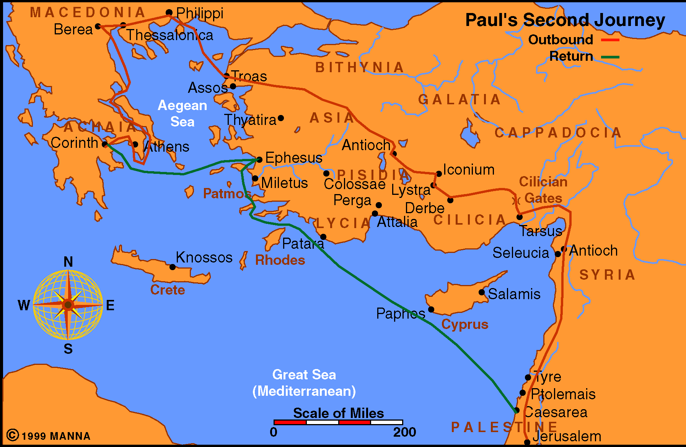
Corinth
What is the situation?

Slide 4
Connection between their manner of life and their rejection of Paul
2nd Corinthians 6:11 – 7:4

Slide 5
Separate Yourself
Lawlessness
Darkness
Belial
Unbelievers
Temples of idols
Righteousness
Light
Christ
Believers
Temple of God

Slide 6
Paul’s Solution
“I will make my dwelling among them and walk among them, and I will be their God, and they shall be my people. Therefore, go out from their midst, and be separate from them, says the lord, and touch no unclean thing.”
-2nd Cor. 6:16,17

Slide 7
Maintaining Peace – A Challenge
Involves cleansing flesh and spirit
Committed to walk by the same rule
Committed to putting away sin
Committed to settling our differences among ourselves.
Committed to stay away from unhealthy situations
Committed to cleanse our spirit

