Slide 1
Isaiah:
Portraits of Jesus

Slide 2
2.) Assyria
takes
captive
part of
Israel
(734/33)
3.) Assyria
defeats
Samaria/
Israel
taken
into exile
(722)
Context of Isaiah
Israel/Northern Kingdom
1.) Syria
& Israel
war with
Judah
(735)
4.) Assyria
attacks
Judah/Fails
to take
Jerusalem
(701)
5.) Assyria
captures
King
Manasseh
(667?)
6.) Assyrian
capital falls/ Babylonian
empire rises
to power
(612)
7.) Babylon
attacks
Jerusalem/
1st
deportation
(605)
8.) Babylon
defeats
Jerusalem/
2nd
deportation
(597)
9.) Babylon
destroys
Jerusalem/
3rd
deportation
(586)
Judah/Southern Kingdom
Kings Uzziah/ Jotham/ Ahaz/ Hezekiah
Isaiah’s prophecy≈ 739-686 BC

Slide 3
Morality During the 4 Reigns
Uzziah:
Righteous
People:
Righteous
Jotham:
People:
Ahaz:
People:
Hezekiah:
People:
Incident of pride/ rebellion

Slide 4
2 Chron. 26:15-16- Uzziah
And his fame spread far, for he was marvelously helped, till he was strong.
But when he was strong, he grew proud, to his destruction. For he was unfaithful to the Lord his God and entered the temple of the Lord to burn incense on the altar of incense.

Slide 5
Reigns of the 4 Kings During Isaiah
Uzziah:
Righteous
People:
Righteous
Jotham:
Righteous
People:
Righteous/
Unrighteous
Ahaz:
People:
Hezekiah:
People:
Incident of pride/ rebellion

Slide 6
2 Chron. 27:2- Jotham
And he did what was right in the eyes of the Lord according to all that his father Uzziah had done, except he did not enter the temple of the Lord. But the people still followed corrupt practices.

Slide 7
Reigns of the 4 Kings During Isaiah
Uzziah:
Righteous
People:
Righteous
Jotham:
Righteous
People:
Righteous/
Unrighteous
Ahaz:
Unrighteous
People:
Unrighteous
Hezekiah:
Righteous
People:
Righteous
Major spiritual reforms
Incident of pride/ rebellion

Slide 8
Breakdown of the Book
Chs. 1-37
-Assyria
-God’s King
Chs. 38-39
-Assyria
-Babylon
Chs. 40-66
-Babylon
-God’s Servant &
Conqueror

Slide 10
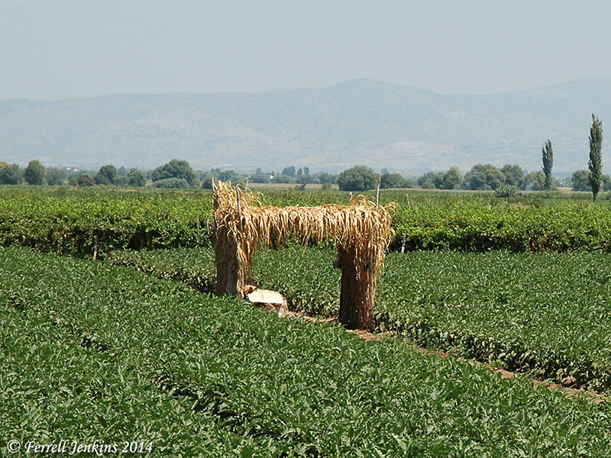
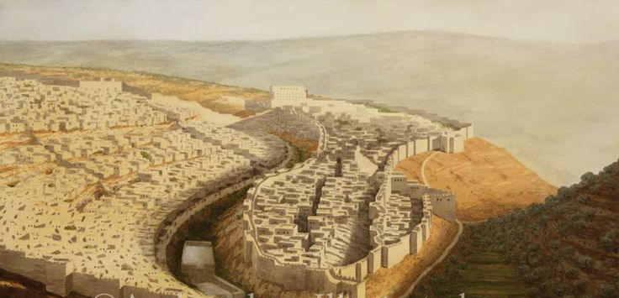
Like a booth in a vineyard, Like a lodge in a cucumber field
If the Lord of hosts had not left us a few survivors, we should have been like Sodom, and become like Gomorrah.

Slide 11
1:18-20
Come now, let us reason together, says the Lord: though your sins are like scarlet, they shall be as white as snow; though they are red like crimson, they shall become like wool. If you are willing and obedient, you shall eat the good of the land; but if you refuse and rebel, you shall be eaten by the sword; for the mouth of the Lord has spoken.”

Slide 12
“The city”- Jerusalem/Zion (1:21-23)
How the faithful city has become a whore, she who was full of justice! Righteousness lodged in her, but now murderers. Your silver has become dross, your best wine mixed with water. Your princes are rebels and companions of thieves.
Everyone loves a bribe and runs after gifts. They do not bring justice to the fatherless, and the widow's cause does not come to them.

Slide 13
1:24-26
Therefore the Lord declares, the Lord of hosts, the Mighty One of Israel: “Ah, I will get relief from my enemies and avenge myself on my foes. I will turn my hand against you and will smelt away your dross as with lye and remove all your alloy. And I will restore your judges as at the first, and your counselors as at the beginning. Afterward you shall be called the city of righteousness, the faithful city.”

Slide 14
1:27-31
Zion shall be redeemed by justice, and those in her who repent, by righteousness. But rebels and sinners shall be broken together, and those who forsake the Lord shall be consumed. For they shall be ashamed of the oaks that you desired; and you shall blush for the gardens that you have chosen. For you shall be like an oak whose leaf withers, and like a garden without water. And the strong shall become tinder, and his work a spark, and both of them shall burn together, with none to quench them.

Slide 15
Isaiah 2:2-4
It shall come to pass in the latter days that the mountain of the house of the Lord shall be established as the highest of the mountains, and shall be lifted up above the hills; and all the nations shall flow to it, and many peoples shall come, and say: “Come, let us go up to the mountain of the Lord, to the house of the God of Jacob, that he may teach us his ways and that we may walk in his paths.” For out of Zion shall go the law, and the word of the Lord from Jerusalem. He shall judge between the nations, and shall decide disputes for many peoples; and they shall beat their swords into plowshares, and their spears into pruning hooks; nation shall not lift up sword against nation, neither shall they learn war anymore.

Slide 16
2:5
O house of Jacob, come, let us walk in the light of the Lord.

Slide 17
2:5-11
For you have rejected your people, the house of Jacob, because they are full of things from the east and of fortune-tellers like the Philistines, and they strike hands with the children of foreigners. Their land is filled with silver and gold, and there is no end to their treasures; their land is filled with horses, and there is no end to their chariots. Their land is filled with idols; they bow down to the work of their hands, to what their own fingers have made. So man is humbled, and each one is brought low— do not forgive them! Enter into the rock and hide in the dust from before the terror of the Lord, and from the splendor of his majesty. The haughty looks of man shall be brought low, and the lofty pride of men shall be humbled, and the Lord alone will be exalted in that day.

Slide 18
2:12-22
For the Lord of hosts has a day

