Slide 2
How To Be Sorry
2Corinthians 7.9-11

Slide 3
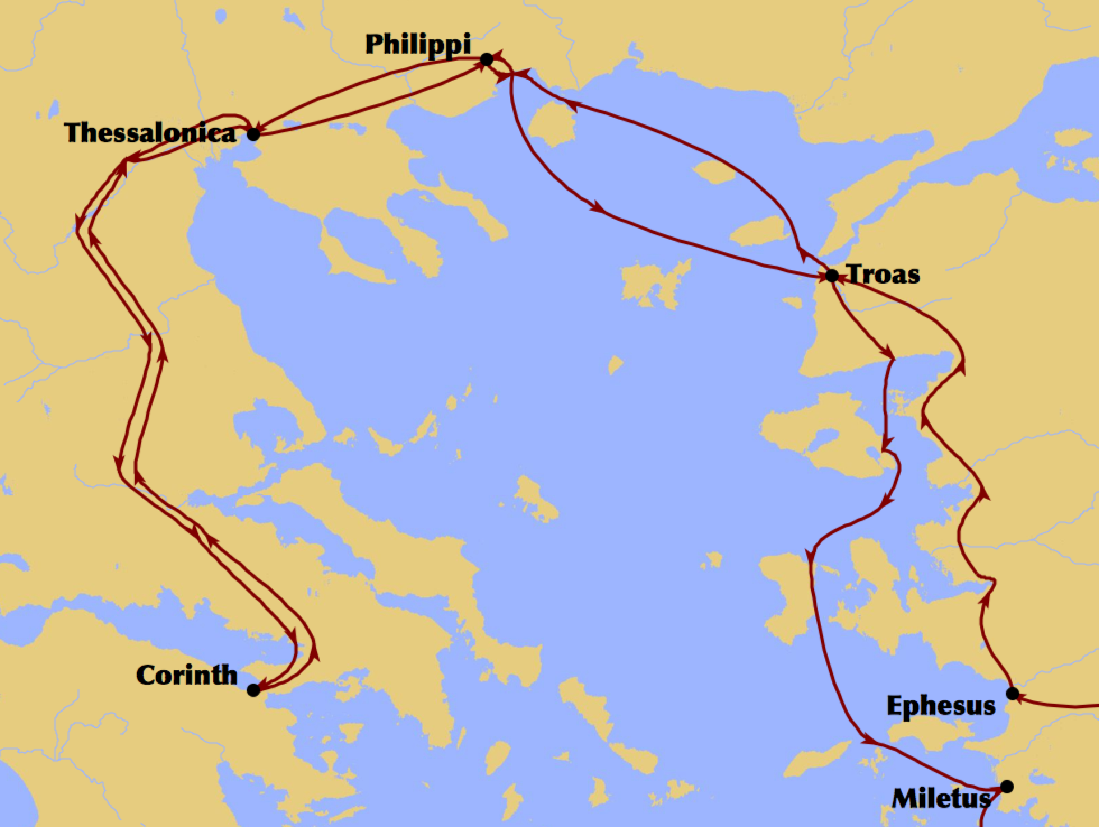

Slide 5
How To Be Sorry
2Corinthians 7.9-11

Slide 6
Be Sorry For The Right Reason
“I now rejoice, not that you were made sorrowful, but that you were made sorrowful to the point of repentance; for you were made sorrowful according to the will of God, so that you might not suffer loss in anything through us. For the sorrow that is according to the will of God produces a repentance without regret, leading to salvation, but the sorrow of the world produces death.” (2 Corinthians 7:9–10)

Slide 7
Be Sorry For The Right Reason
“I now rejoice, not that you were made sorrowful, but that you were made sorrowful to the point of repentance; for you were made sorrowful according to the will of God, so that you might not suffer loss in anything through us. For the sorrow that is according to the will of God produces a repentance without regret, leading to salvation, but the sorrow of the world produces death.” (2 Corinthians 7:9–10)

Slide 8
Be Sorry For The Right Reason
“I now rejoice, not that you were made sorrowful, but that you were made sorrowful to the point of repentance; for you were made sorrowful according to the will of God, so that you might not suffer loss in anything through us. For the sorrow that is according to the will of God produces a repentance without regret, leading to salvation, but the sorrow of the world produces death.” (2 Corinthians 7:9–10)

Slide 9
Be Sorry Enough To Change
“For the sorrow that is according to the will of God produces a repentance without regret, leading to salvation, but the sorrow of the world produces death. For behold what earnestness this very thing, this godly sorrow, has produced in you: what vindication of yourselves, what indignation, what fear, what longing, what zeal, what avenging of wrong! In everything you demonstrated yourselves to be innocent in the matter.” (2 Corinthians 7:10–11)

Slide 10
Be Sorry Enough To Change
“For the sorrow that is according to the will of God produces a repentance without regret, leading to salvation, but the sorrow of the world produces death. For behold what earnestness this very thing, this godly sorrow, has produced in you: what vindication of yourselves, what indignation, what fear, what longing, what zeal, what avenging of wrong! In everything you demonstrated yourselves to be innocent in the matter.” (2 Corinthians 7:10–11)

Slide 11
Be Sorry Enough To Change
“For the sorrow that is according to the will of God produces a repentance without regret, leading to salvation, but the sorrow of the world produces death. For behold what earnestness this very thing, this godly sorrow, has produced in you: what vindication of yourselves, what indignation, what fear, what longing, what zeal, what avenging of wrong! In everything you demonstrated yourselves to be innocent in the matter.” (2 Corinthians 7:10–11)

Slide 12
Be Sorry Enough To Change
“For the sorrow that is according to the will of God produces a repentance without regret, leading to salvation, but the sorrow of the world produces death. For behold what earnestness this very thing, this godly sorrow, has produced in you: what vindication of yourselves, what indignation, what fear, what longing, what zeal, what avenging of wrong! In everything you demonstrated yourselves to be innocent in the matter.” (2 Corinthians 7:10–11)

Slide 13
Be Sorry Enough To Change
“For the sorrow that is according to the will of God produces a repentance without regret, leading to salvation, but the sorrow of the world produces death. For behold what earnestness this very thing, this godly sorrow, has produced in you: what vindication of yourselves, what indignation, what fear, what longing, what zeal, what avenging of wrong! In everything you demonstrated yourselves to be innocent in the matter.” (2 Corinthians 7:10–11)

Slide 14
Be Sorry Enough To Change
“For the sorrow that is according to the will of God produces a repentance without regret, leading to salvation, but the sorrow of the world produces death. For behold what earnestness this very thing, this godly sorrow, has produced in you: what vindication of yourselves, what indignation, what fear, what longing, what zeal, what avenging of wrong! In everything you demonstrated yourselves to be innocent in the matter.” (2 Corinthians 7:10–11)

Slide 15
Be Sorry Enough To Change
“For the sorrow that is according to the will of God produces a repentance without regret, leading to salvation, but the sorrow of the world produces death. For behold what earnestness this very thing, this godly sorrow, has produced in you: what vindication of yourselves, what indignation, what fear, what longing, what zeal, what avenging of wrong! In everything you demonstrated yourselves to be innocent in the matter.” (2 Corinthians 7:10–11)

Slide 16
Be Sorry Enough To Change
“For the sorrow that is according to the will of God produces a repentance without regret, leading to salvation, but the sorrow of the world produces death. For behold what earnestness this very thing, this godly sorrow, has produced in you: what vindication of yourselves, what indignation, what fear, what longing, what zeal, what avenging of wrong! In everything you demonstrated yourselves to be innocent in the matter.” (2 Corinthians 7:10–11)

Slide 17
If You Learn How To Be Sorry…
“For the sorrow that is according to the will of God produces a repentance without regret, leading to salvation, but the sorrow of the world produces death.” (2 Corinthians 7:10)

Slide 18
If You Learn How To Be Sorry…
“For the sorrow that is according to the will of God produces a repentance without regret, leading to salvation, but the sorrow of the world produces death.” (2 Corinthians 7:10)

Slide 19
If You Learn How To Be Sorry…
“For the sorrow that is according to the will of God produces a repentance without regret, leading to salvation, but the sorrow of the world produces death.” (2 Corinthians 7:10)

Slide 20
If You Learn How To Be Sorry…
“For the sorrow that is according to the will of God produces a repentance without regret, leading to salvation, but the sorrow of the world produces death.” (2 Corinthians 7:10)

