Slide 1
Paul’s letter
to the ROMANS

Slide 2
How Israel went wrong (vss. 1-4)
Romans
chapter 10

Slide 3
How Israel went wrong (vss. 1-4)
The righteousness of faith (vss. 5-13)
Righteousness cannot be based on the Law (vs. 5)
Righteousness is based on faith…in Christ (vss. 6-8)
Righteousness and salvation found through belief in and confession of Christ (vss. 9-13)
Romans
chapter 10

Slide 4
“that if you confess with your mouth Jesus as Lord, and believe in your heart that God raised Him from the dead, you will be saved;”
(Romans 10:9)
Romans
chapter 10

Slide 5
How Israel went wrong (vss. 1-4)
The righteousness of faith (vss. 5-13)
Righteousness cannot be based on the Law (vs. 5)
Righteousness is based on faith…in Christ (vss. 6-8)
Righteousness and salvation found through belief in and confession of Christ (vss. 9-13)
Romans
chapter 10

Slide 6
How Israel went wrong (vss. 1-4)
The righteousness of faith (vss. 5-13)
Why Israel had not believed (vss. 14-21)
They needed the word proclaimed (vss. 14-15)
They needed to heed the word (vss. 16-17)
Israel had no excuse (vss. 18-21)
Romans
chapter 10

Slide 7
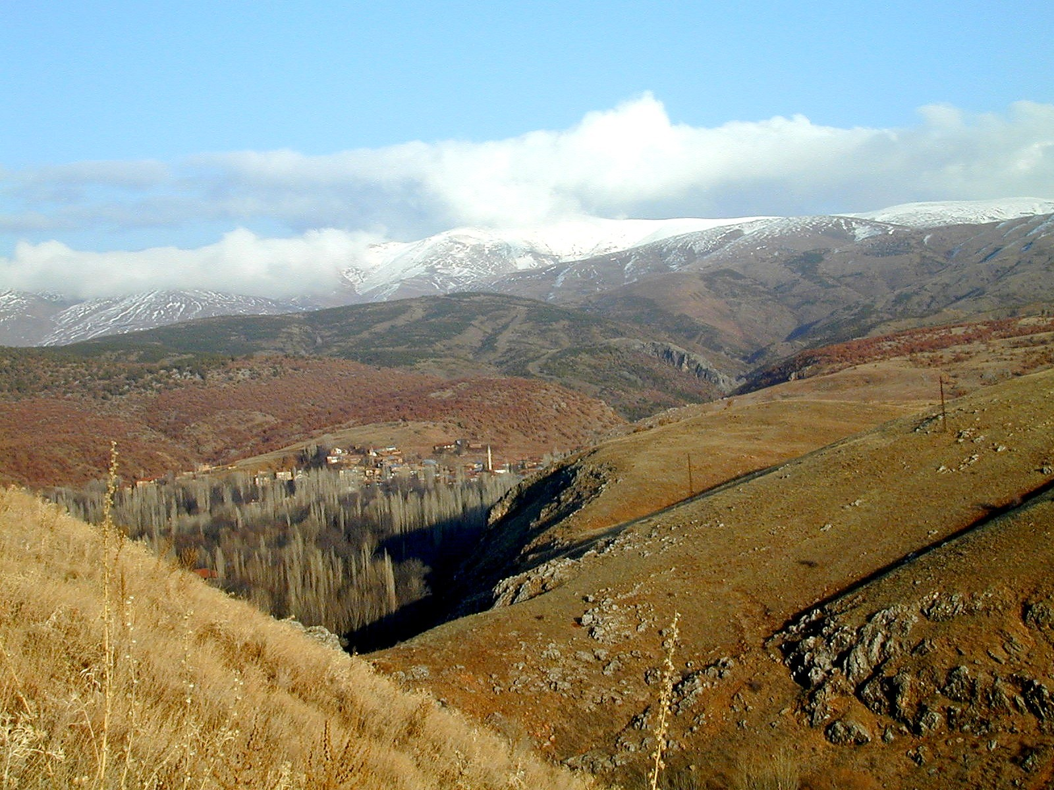

Slide 8
How Israel went wrong (vss. 1-4)
The righteousness of faith (vss. 5-13)
Why Israel had not believed (vss. 14-21)
They needed the word proclaimed (vss. 14-15)
They needed to heed the word (vss. 16-17)
Israel had no excuse (vss. 18-21)
Romans
chapter 10

