Slide 2
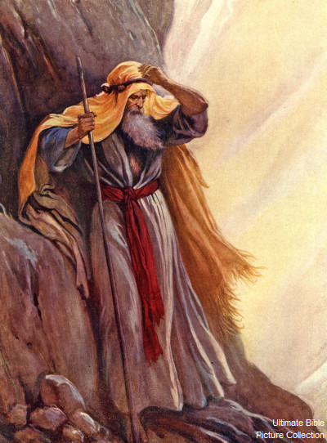
Moses’ Relationship With God
Exodus 33:7-11

Slide 3
“Intimacy” (close familiarity) Latin - “innermost”
Intimacy was lost in the Garden with disobedience

Slide 4
Jesus died to restore intimacy with God (Galatians 4:4-6)
This relationship is available to us (John 15:15)(2 Cor. 3:12-18)

Slide 5
Moses’ Relationship With God
God wants to be close (Exodus 33:9)
Intimacy is a 2-way street (Exodus 33:12-17)
There is always more of God to see (Exodus 33:18-23)
A friend or onlooker? (Exodus 33:8)

