Slide 2
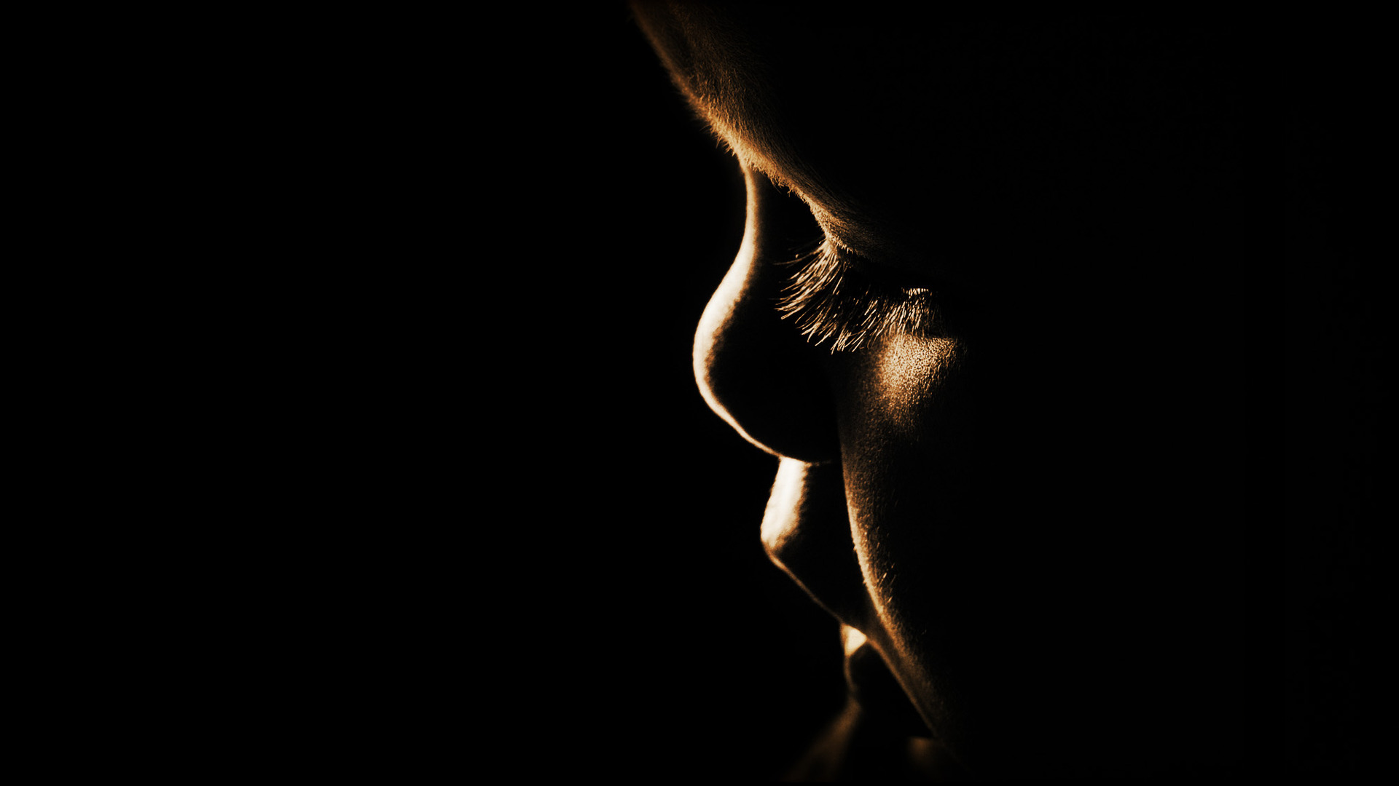
They brought their children to the Lord
Mark 10.13-16

Slide 3
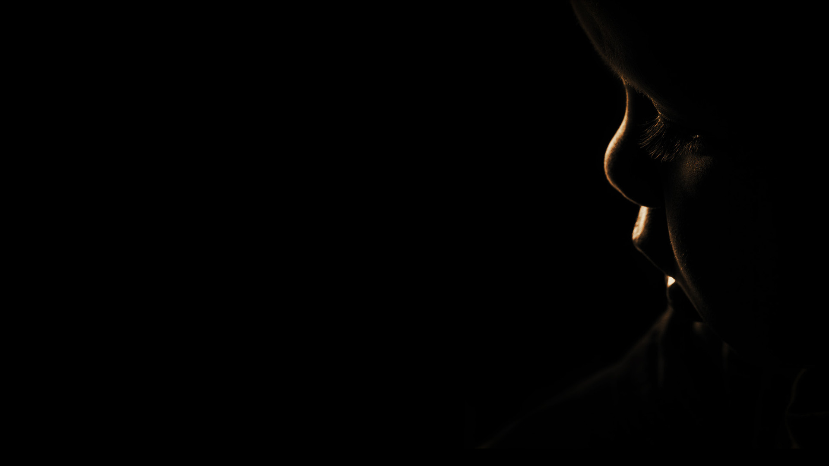
They brought their children to the Lord
Mark 10.13-16
By modeling faith at home
By acting intentionally
By doing right even when you are the only one

Slide 4
“And He took them in His arms and began blessing them, laying His hands on them.”
Mark 10.16

