Slide 2
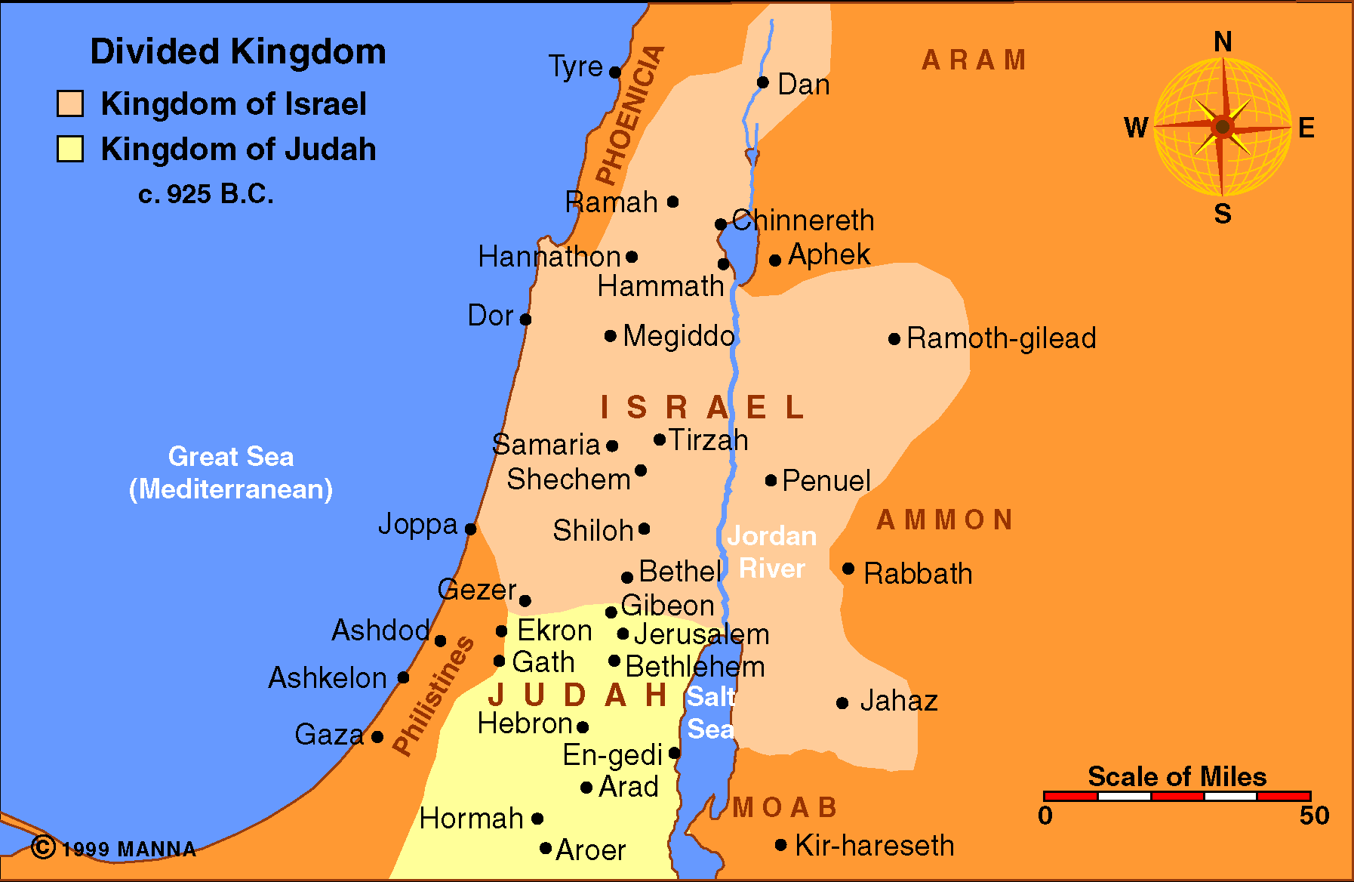

Slide 3
The Role of the Prophets
Call to repentance
Call judgment upon the nations
Prophesy of the Messiah and His Kingdom

