Slide 2
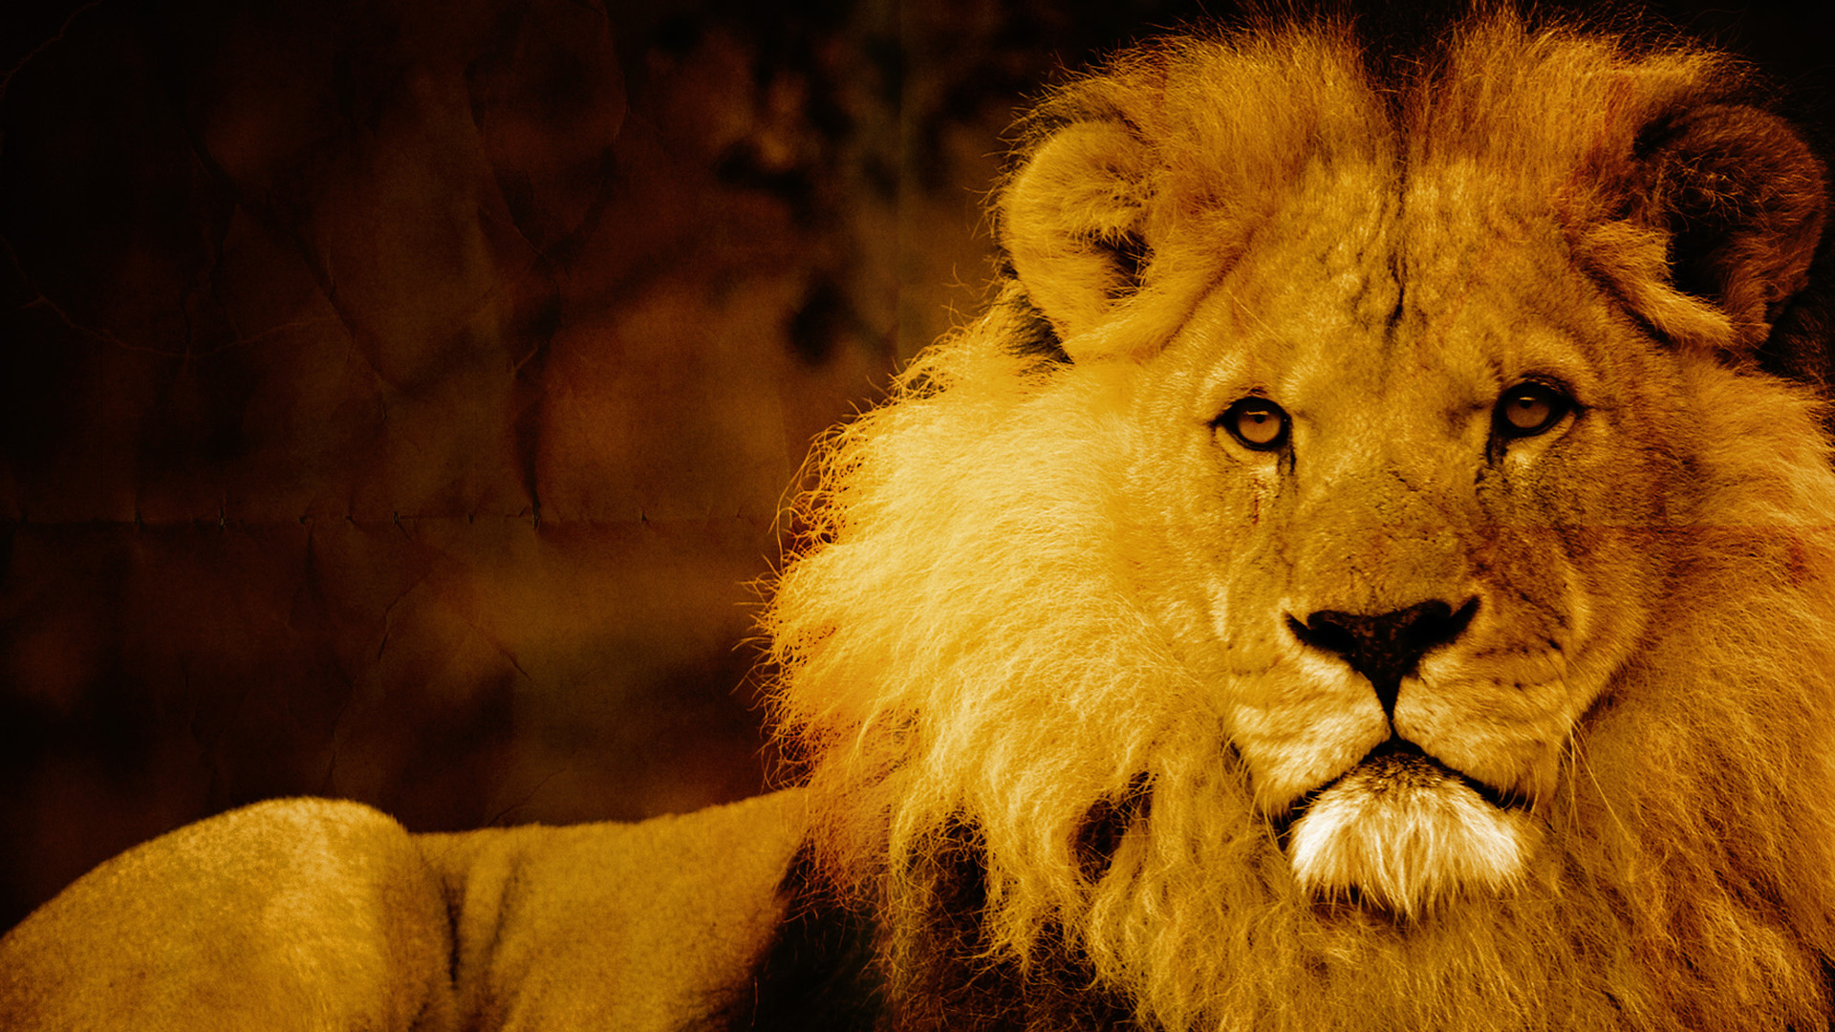
Courage in Captivitiy
to
BELIEVE
University VBS 2017

Slide 3
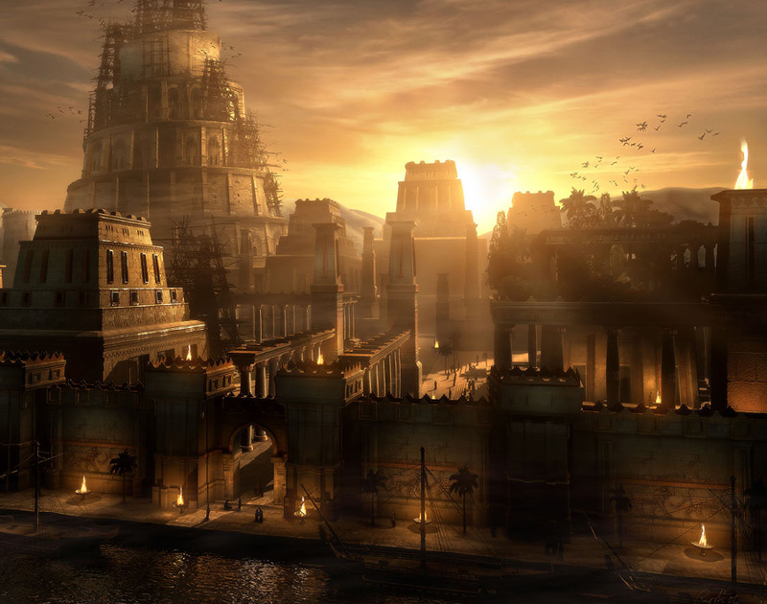

Slide 4
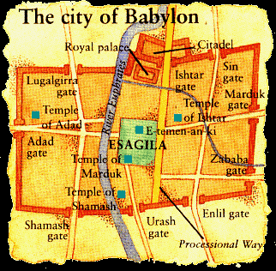

Slide 5
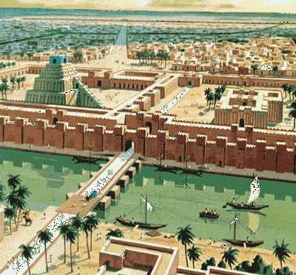

Slide 6
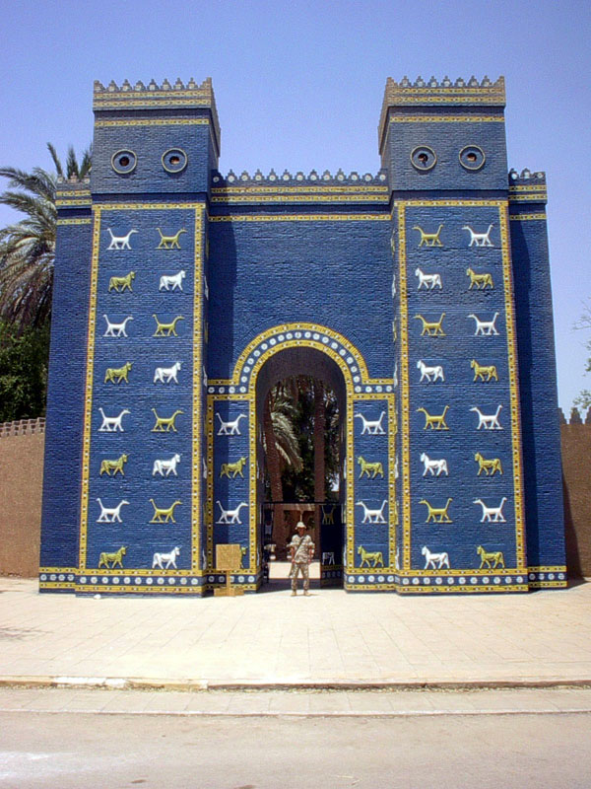

Slide 7
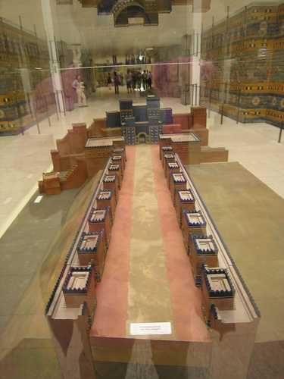

Slide 8
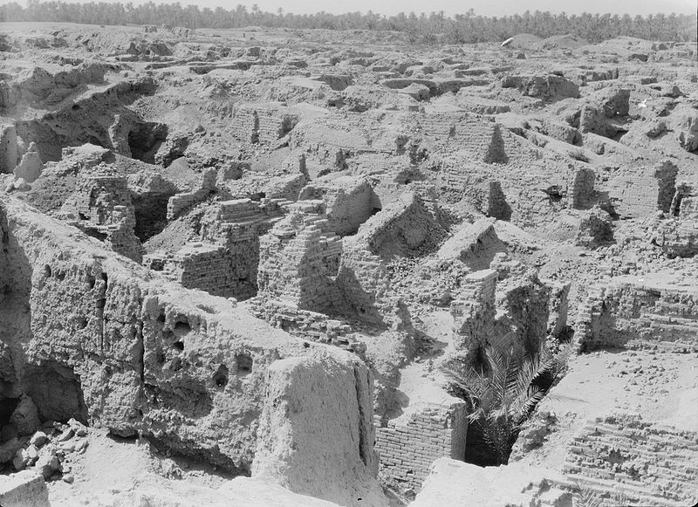

Slide 10
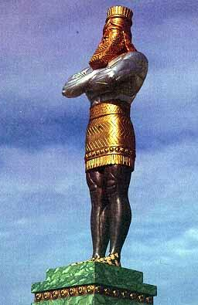

Slide 11
Babylon
Medo-Persia
Greece
Rome

Slide 12
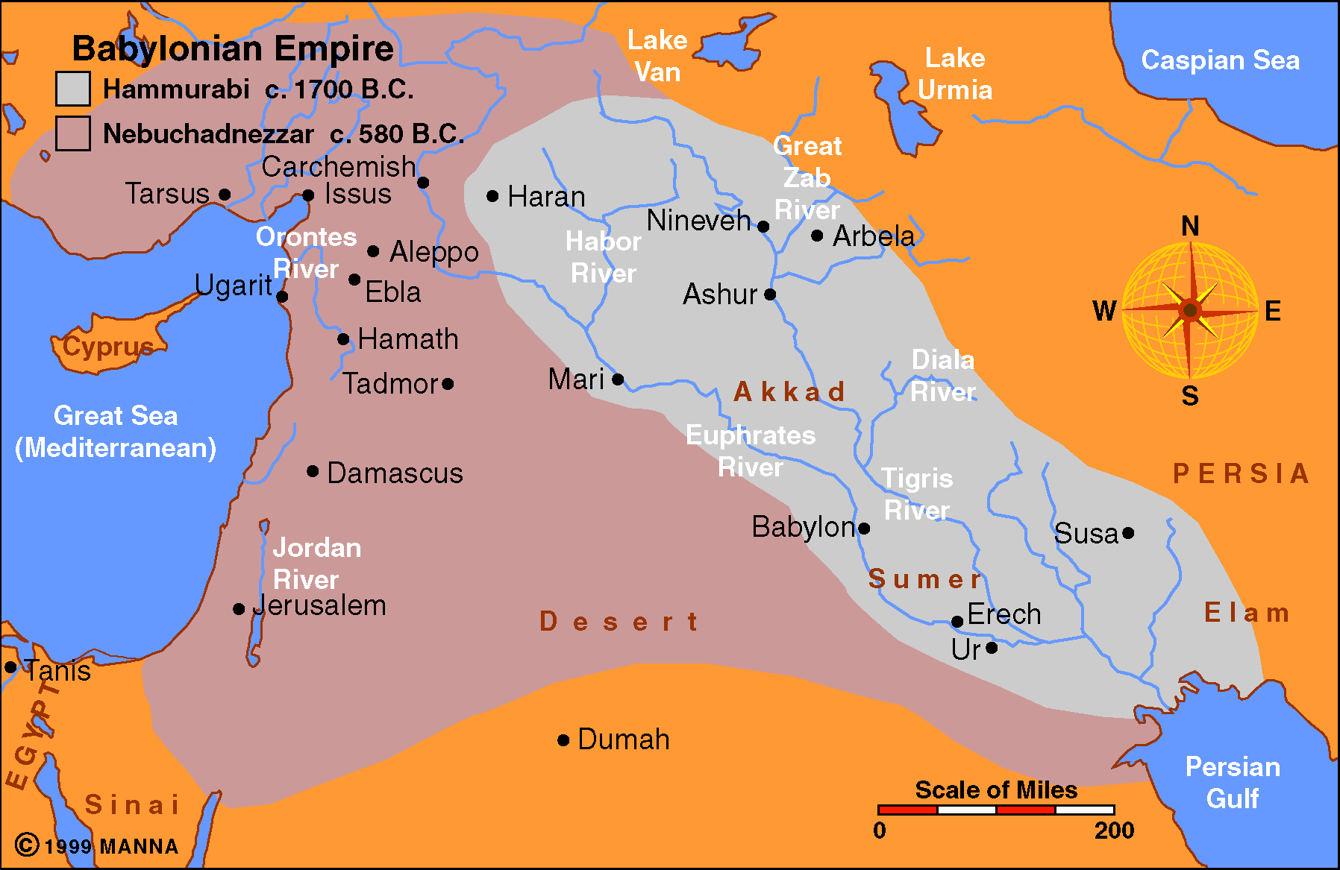

Slide 13
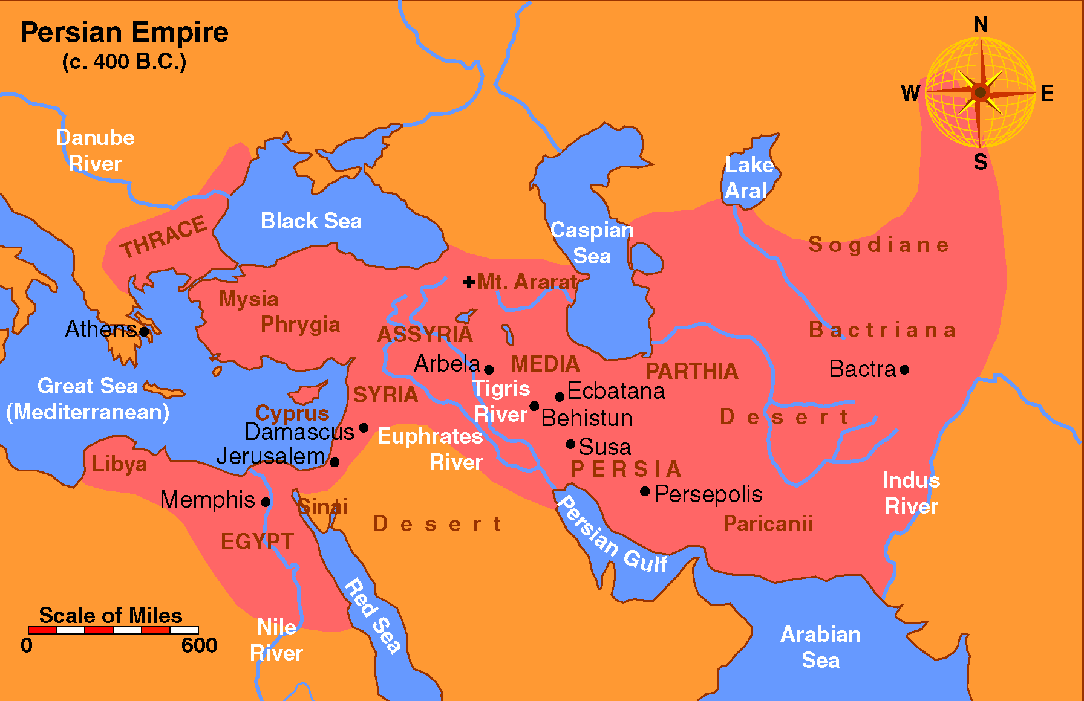

Slide 14
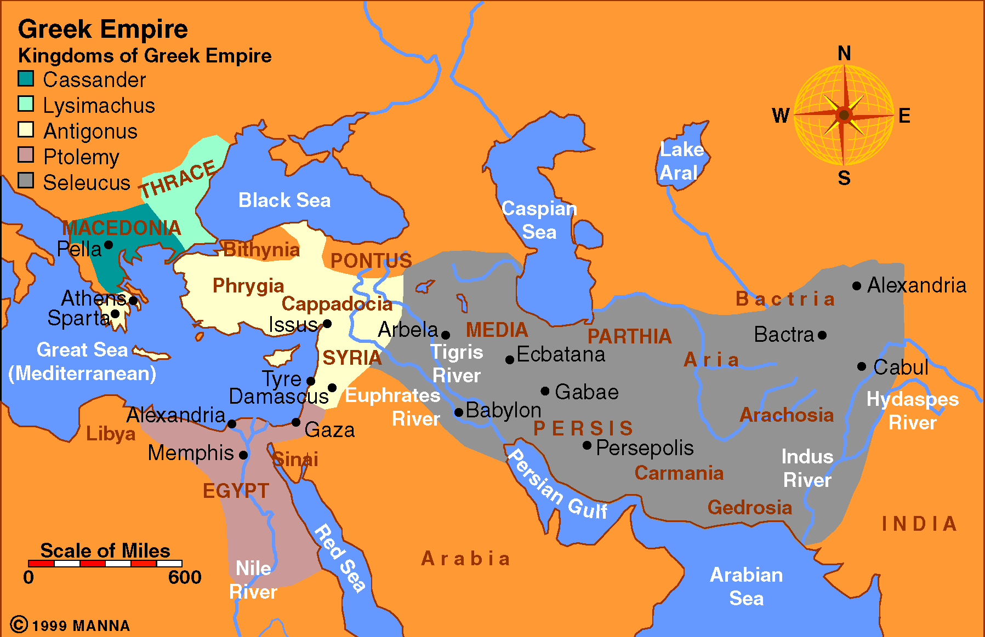

Slide 15
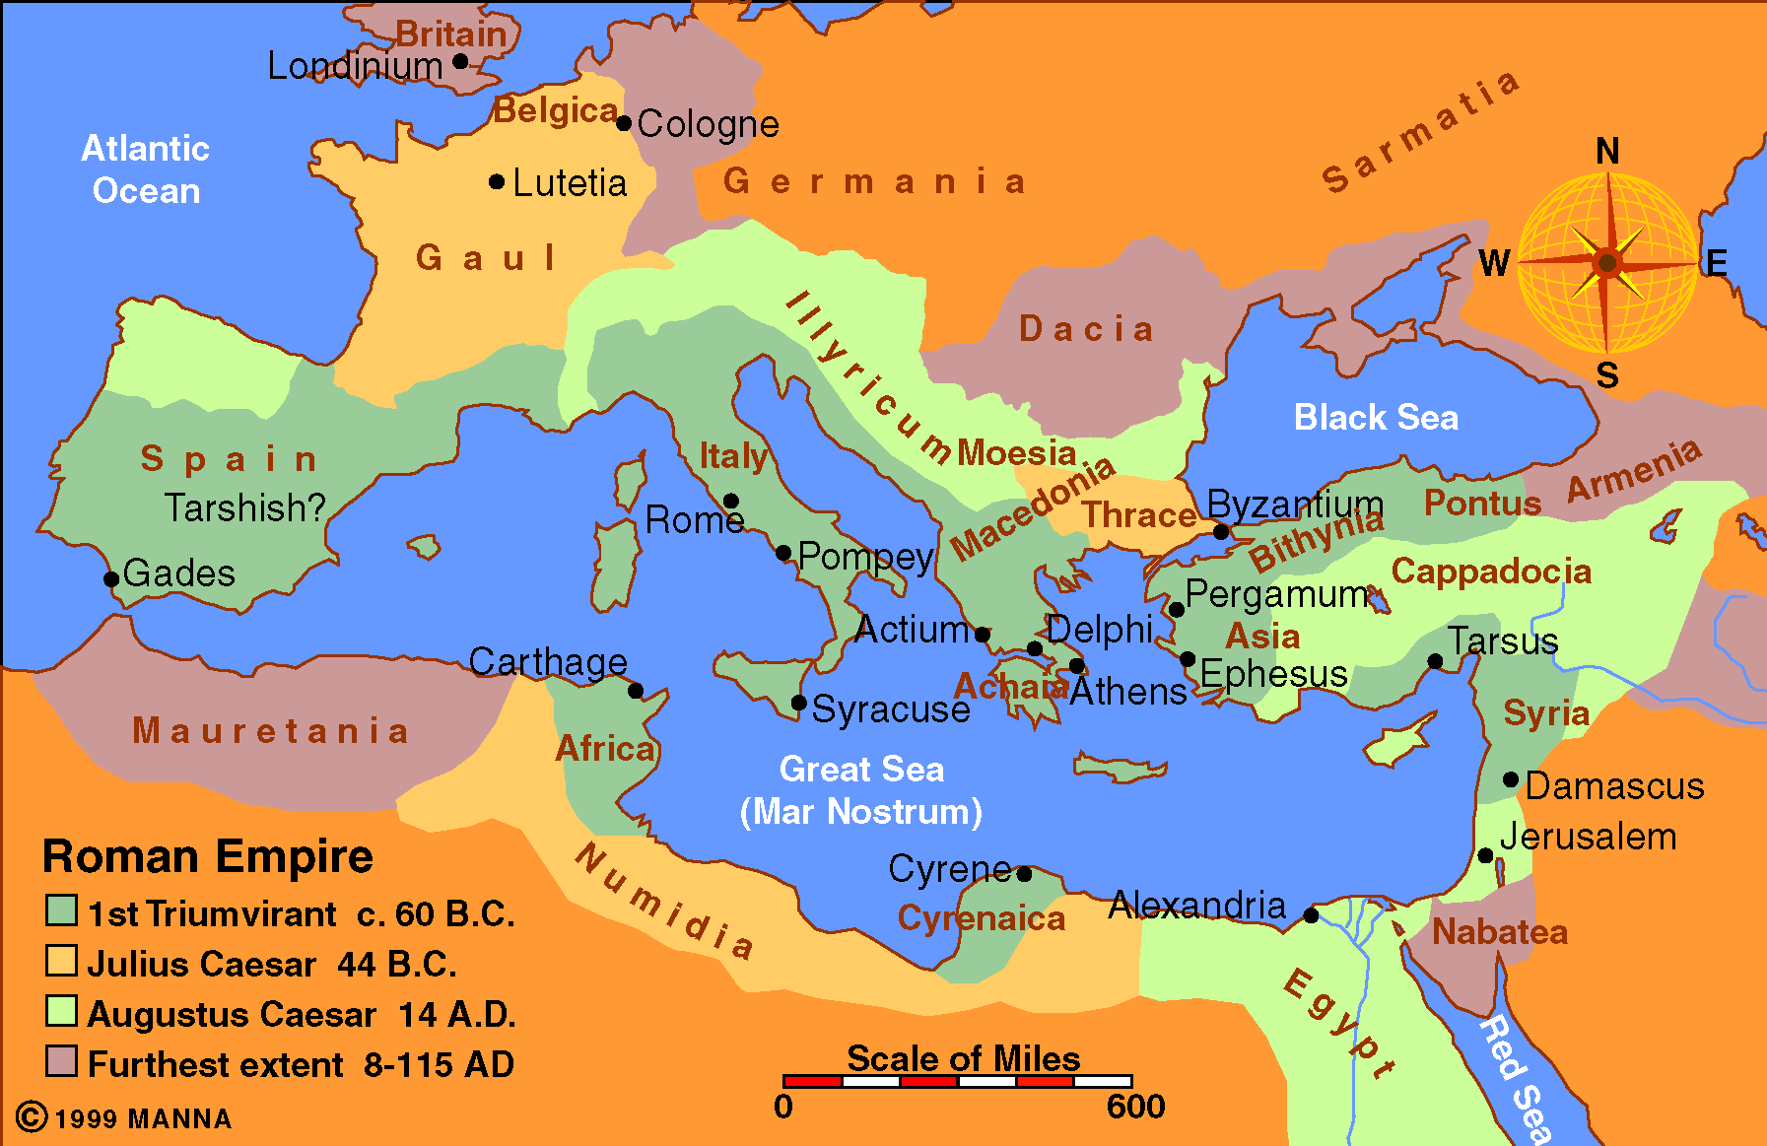

Slide 16
What to do in difficult circumstances?
Pray
God at work in the affairs of man
God knows the unknowable
Points from Daniel 2

Slide 17
Character of Daniel
Confidence in God
Returns good for evil
A true man of prayer
Points from Daniel 2

Slide 19
Courage in Captivitiy
to
BELIEVE
University VBS 2017

Slide 20
My God is so big, so strong and so mighty,
There’s nothing my God cannot do!
My God is so big, so strong and so mighty,
There’s nothing my God cannot do!
The mountains are His.
The valleys are His.
The stars are His handiwork, too.
My God is so big, so strong and so mighty,
There’s nothing my God cannot do!

Slide 21
If I were a butterfly, I’d thank you Lord, for giving me wings
And if I were a robin in a tree, I’d thank you Lord that I could sing
And if I were a fish in the sea, I’d wiggle my tail and I’d giggle with glee;
But I just thank you Father for making me “me.”
For You gave me a heart and you gave me a smile.
You gave me Jesus and You made me Your child.
And I just thank you Father for making me “me.”

Slide 22
If I were an elephant, I’d thank you Lord by raising my trunk.
And if I were a kangaroo, You know I’d hop right up to You.
And if I were an octopus, I’d thank you Lord for my good looks.
But I just thank you Father for making me “me.”
For You gave me a heart and you gave me a smile.
You gave me Jesus and You made me Your child.
And I just thank you Father for making me “me.”

Slide 23
If I were a wiggly worm, I’d thank you Lord that I could squirm
And if I were a crocodile, I’d thank you Lord for my big smile
And if I were a fuzzy, wuzzy bear, I’d thank you Lord for my fuzzy, wuzzy hair;
But I just thank you Father for making me “me.”
For You gave me a heart and you gave me a smile.
You gave me Jesus and You made me Your child.
And I just thank you Father for making me “me.”

Slide 25
Obedience is the very best way
To show that you believe.
Doing exactly what the Lord commands,
Doing it happily.
Action is the key, do it immediately.
Joy you will receive.
Obedience is the very best way
To show that you believe.
O-B-E-D-I-E-N-C-E
Obedience is the very best way
To show that you believe.

