Slide 1
God’s Covenant
Genesis 12-50

Slide 2
Genesis
Chapters 1-11 (God and early mankind)
Chapters 12-50 (God and the family of Abraham)

Slide 3
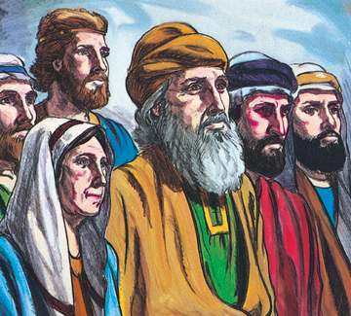
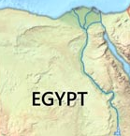
In the beginning…

Slide 4
Genesis 12:1-3
Now the Lord said to Abram, “Go from your country and your kindred and your father's house to the land that I will show you. And I will make of you a great nation, and I will bless you and make your name great, so that you will be a blessing. I will bless those who bless you, and him who dishonors you I will curse, and in you all the families of the earth shall be blessed.”
Notes:
Adam Eve-
-Removed from life in the garden and sent out into the world/ Told to leave the world and come with God
-Childbirth is cursed/ father of nation
-ground is cursed/ given a land
-Mankind cursed/ every nation blessed
-Offspring of woman to defeat the serpent/ Abrams offspring chosen
Babel-
Nations created and dispersed
Nations blessed

Slide 5
Ur
Abram
Canaan
Egypt
Israelites
Canaan

Slide 6
Genesis 12:1-3
Now the Lord said to Abram, “Go from your country and your kindred and your father's house to the land that I will show you. And I will make of you a great nation, and I will bless you and make your name great, so that you will be a blessing. I will bless those who bless you, and him who dishonors you I will curse, and in you all the families of the earth shall be blessed.”

Slide 7
Romans 4:13
For the promise to Abraham and his offspring that he would be heir of the world did not come through the law but through the righteousness of faith.

Slide 8
12:10-20
Notes:
Cursing those who dishonor Abram
Also, foreshadowing of Egypt

Slide 9
Read Ch. 13-15

Slide 10
God’s Covenant
Genesis 12-50

