Slide 1
God’s Covenant
Genesis 12-50

Slide 2
God’s Promises
I will give you this land
I will make of you a great nation
I will bless you and make your name great/ you will be a blessing.
I will bless those who bless you, and him who dishonors you I will curse
In you all the families of the earth shall be blessed.
Heir of the world (Rom. 4:13)

Slide 3
15:7-21
Notes:
Jeremiah 34

Slide 4
15:13-16
Then the Lord said to Abram, “Know for certain that your offspring will be sojourners in a land that is not theirs and will be servants there, and they will be afflicted for four hundred years. But I will bring judgment on the nation that they serve, and afterward they shall come out with great possessions. As for you, you shall go to your fathers in peace; you shall be buried in a good old age. And they shall come back here in the fourth generation, for the iniquity of the Amorites is not yet complete.”
Notes:
God is going to further explain the promises, and it is going to get a lot more specific and a lot more incredible
Romans 4:3; Gal 3:6
James 2
Israel hearing this is numerous, and has increased in population

Slide 5
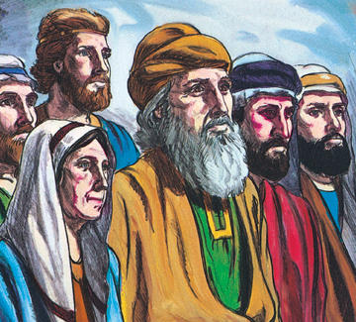
In the beginning…
Notes:
They are standing there as free people with great possessions.

Slide 6
15:13-16
Then the Lord said to Abram, “Know for certain that your offspring will be sojourners in a land that is not theirs and will be servants there, and they will be afflicted for four hundred years. But I will bring judgment on the nation that they serve, and afterward they shall come out with great possessions. As for you, you shall go to your fathers in peace; you shall be buried in a good old age. And they shall come back here in the fourth generation, for the iniquity of the Amorites is not yet complete.”
Notes:
God is going to further explain the promises, and it is going to get a lot more specific and a lot more incredible
Romans 4:3; Gal 3:6
James 2
Israel hearing this is numerous, and has increased in population

Slide 7
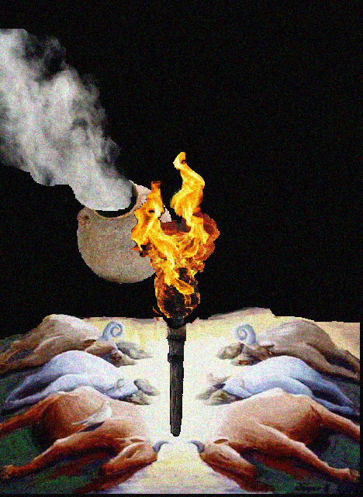
He said to him, “Bring me a heifer three years old, a female goat three years old, a ram three years old, a turtledove, and a young pigeon.” And he brought Him all these, cut them in half, and laid each half over against the other.
When the sun had gone down and it was dark, behold, a smoking fire pot and a flaming torch passed between these pieces. On that day the Lord made a covenant with Abram
Notes:
Jeremiah 34
Extrabiblical- Hittite treaties 2nd millennium- it seems like if the oath was violated, the oath-breaker should expect the same fate as the cut up animal.
1st millennium BC Aramean covenant between king and another individual. “As this cald is cut up, so shall _______ and his nobles be cut up.”
Smoke and fire represent God/ Mount Sinai very recent for Genesis readers. Exo 19
Abram’s question led God to formalize these promises into a covenant, which meant deity was entering into an agreement with man. Unbelievable.

Slide 8
“To your offspring I give this land, from the river of Egypt to…the river Euphrates, the land of the Kenites, the Kenizzites, the Kadmonites, the Hittites, the Perizzites, the Rephaim, the Amorites, the Canaanites, the Girgashites and the Jebusites.”
Notes:
Land isn’t just about the ground or the dirt
-A home, an identity, protection
Abraham’s request causes God to be more specific, and reveal that the promise is more astonishing
Hams offspring will be displaced by Shems
1 Kings 4:21- Solomon’s reign had these borders

Slide 10
Genesis 16
Now Sarai, Abram's wife, had borne him no children. She had a female Egyptian servant whose name was Hagar. And Sarai said to Abram, “Behold now, the Lord has prevented me from bearing children. Go in to my servant; it may be that I shall obtain children by her.”
And when she saw that she had conceived, she looked with contempt on her mistress.
The angel of the Lord said to her, “Return to your mistress and submit to her.” The angel of the Lord also said to her, “I will surely multiply your offspring so that they cannot be numbered for multitude.”
So she called the name of the Lord who spoke to her, “You are a God of seeing,” for she said, “Truly here I have seen Him who looks after me.”
Notes:
Israel was created by God. They are God’s son even more directly because they were miraculously brought into existence through God’s power in Abraham and Sarah.
Circumcision- Not uncommon, especially for priests/ sign of covenant/ sign of the procreation that the offspring would have

Slide 11
Genesis 17
“When Abram was 99 years old…”
Abram- Exalted father
Abraham- Father of a multitude

Slide 12
Notes:
Circumcision
Something they were committing to as a sign of their covenant with God, even though God’s promises don’t look possible (from an earthly standpoint).

Slide 13
Genesis 17
And God said to Abraham, “As for Sarai your wife, you shall not call her name Sarai, but Sarah shall be her name. I will bless her, and moreover, I will give you a son by her. I will bless her, and she shall become nations; kings of peoples shall come from her.”
Then Abraham fell on his face and laughed and said to himself, “Shall a child be born to a man who is a hundred years old? Shall Sarah, who is ninety years old, bear a child?”
And Abraham said to God, “Oh that Ishmael might live before you!” God said, “No, but Sarah your wife shall bear you a son, and you shall call his name Isaac. I will establish My covenant with him as an everlasting covenant for his offspring after him.

Slide 14
Genesis 17:22-27
When he had finished talking with him, God went up from Abraham. Then Abraham took Ishmael his son and all those born in his house or bought with his money, every male among the men of Abraham's house, and he circumcised the flesh of their foreskins that very day, as God had said to him. Abraham was ninety-nine years old when he was circumcised in the flesh of his foreskin. And Ishmael his son was thirteen years old when he was circumcised in the flesh of his foreskin. That very day Abraham and his son Ishmael were circumcised. And all the men of his house, those born in the house and those bought with money from a foreigner, were circumcised with him.
Notes:
Israel was created by God. They are God’s son even more directly because they were miraculously brought into existence through God’s power in Abraham and Sarah.
Circumcision- Not uncommon, especially for priests/ sign of covenant/ sign of the procreation that the offspring would have

Slide 15
In the beginning…

