Slide 2
HOW TO HELP
SOMONE IN
DANGER

Slide 3
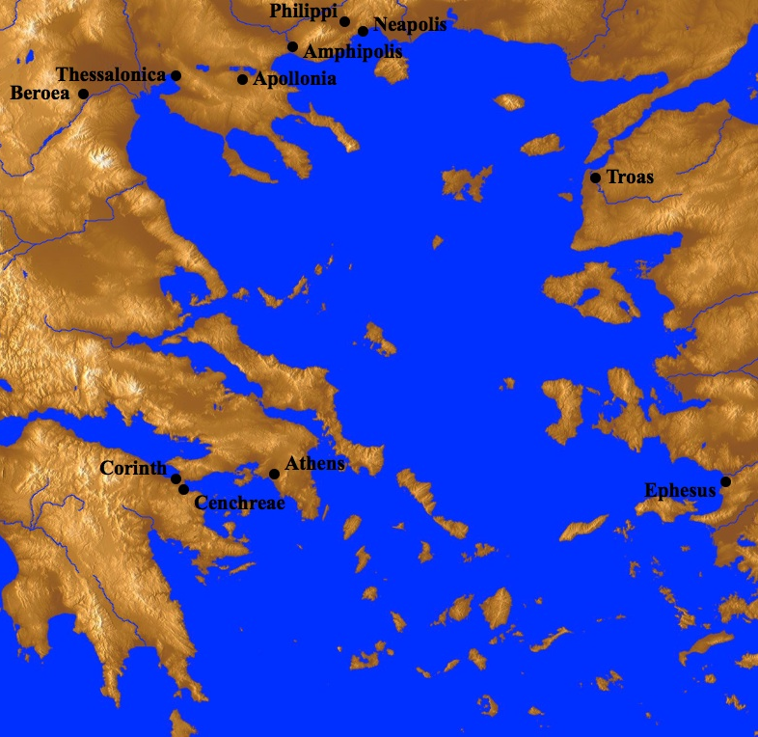
Paul spends 18 months in Corinth during 2nd Journey (Acts 18.1-17)
While in Ephesus receives report from Chloe’s people (1Cor. 1.11)
Paul dispatches Timothy (1Cor. 4.17-21)
Paul writes 1 Corinthians (1Cor. 16.8-9; 2Cor. 2.4)
Paul sets out for Corinth, filled with concern (2Cor. 2.12-13; 7.5-6)

Slide 4
Be interested in the person, not just their problems
HOW TO HELP
SOMONE IN
DANGER
2 CORINTHIANS 13.7

Slide 5
Be interested in the person, not just their problems.
Be ready to invest.
HOW TO HELP
SOMONE IN
DANGER
2 CORINTHIANS 12.15

Slide 6
Be interested in the person, not just their problems.
Be ready to invest.
Don’t compromise God’s values.
HOW TO HELP
SOMONE IN
DANGER
2 CORINTHIANS 5.14-15

Slide 7
Be interested in the person, not just their problems.
Be ready to invest.
Don’t compromise God’s values.
Be willing to let them go.
HOW TO HELP
SOMONE IN
DANGER
2 CORINTHIANS 12.19-21

