Slide 2
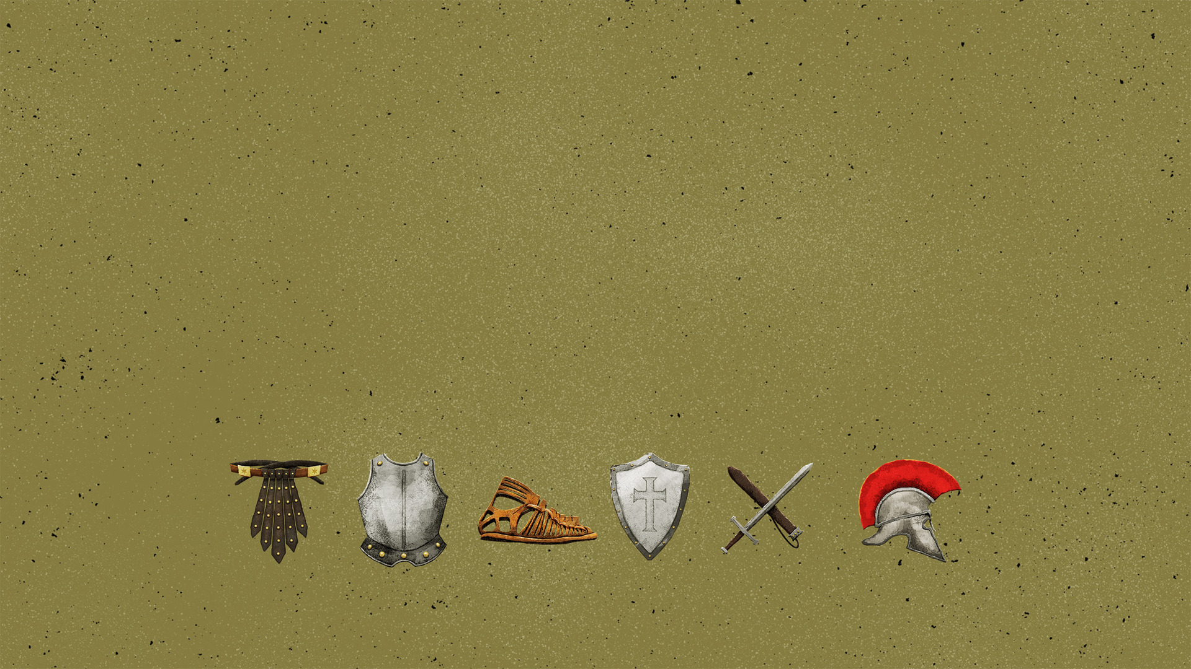
A Victory Won
A Victory To Be Defended
Ephesians 6.10-17

Slide 3
“He put on righteousness like a breastplate, And a helmet of salvation on His head; And He put on garments of vengeance for clothing And wrapped Himself with zeal as a mantle.”
- Isaiah 59:17
Our Defense: Become Like God

Slide 4
“How lovely on the mountains Are the feet of him who brings good news, Who announces peace And brings good news of happiness, Who announces salvation, And says to Zion, ‘Your God reigns!’”
- Isaiah 52:7
Our Defense: Become Like God

Slide 5
Righteousness = doing what is right
God is “righteous” because He does what is right for His people
Righteousness must protect the heart
“having put on the breastplate of righteousness”

Slide 6
God desires peace for man (Isaiah 52.3-7; Ephesians 2.14-18)
We go to others with the gospel?
We stand firm because of the gospel!
“having shod your feet with… the gospel of peace”

