Slide 2
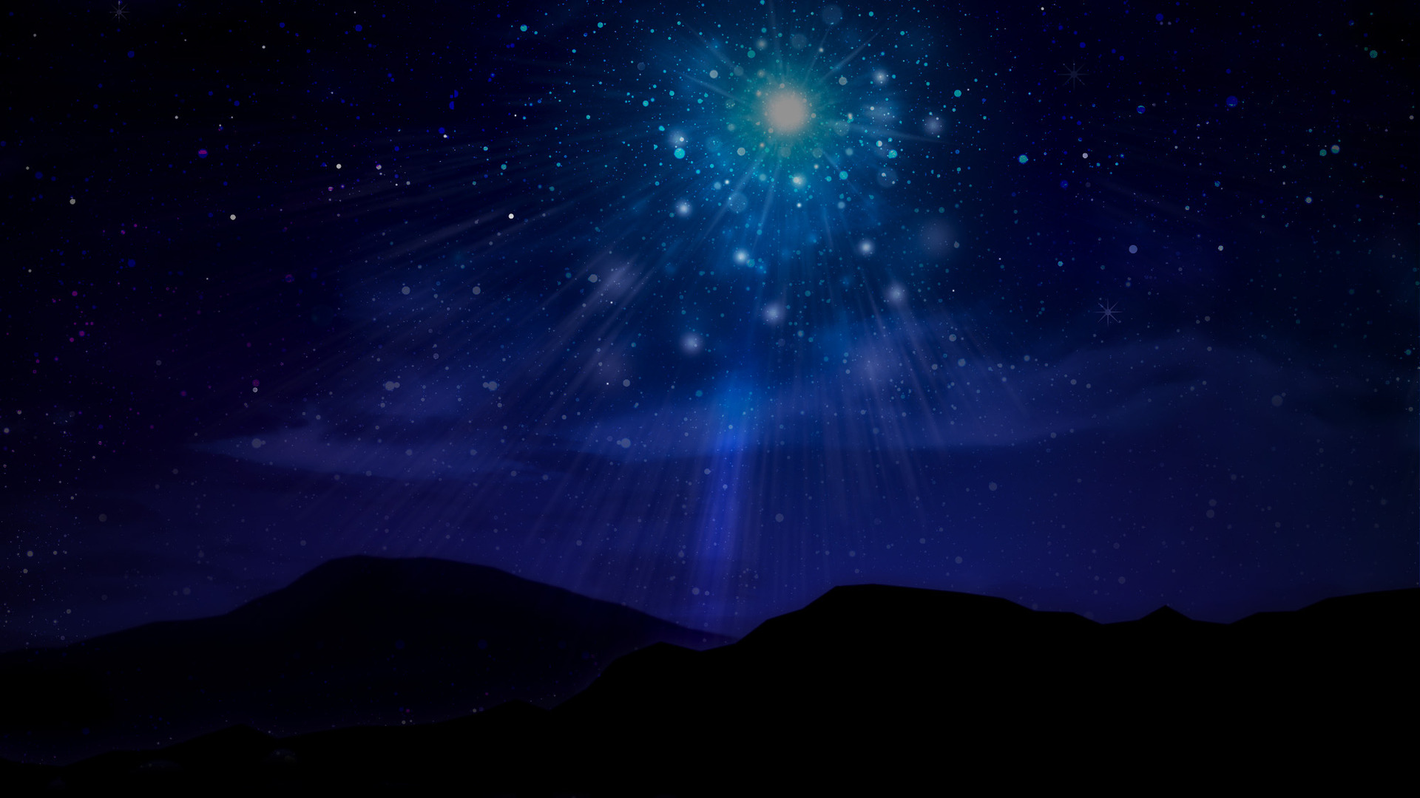
Why we’ve come…

Slide 3
Our assemblies are always special…
Because of what we represent (Ephesians 3.6,10)
Because of what we do (Acts 2.46-47)
Not because today is “special”

Slide 4
“But the angel said to them, ‘Do not be afraid; for behold, I bring you good news of great joy which will be for all the people; for today in the city of David there has been born for you a Savior, who is Christ the Lord.’” (Luke 2:10–11)
Because He is worthy

Slide 5
Our worship proclaims His worth (Revelation 5.9-13)
Our lives proclaim His worth (Romans 12.1-2; 2Corinthians 5.9)
Because He is worthy

Slide 6
Because He came

