Slide 3
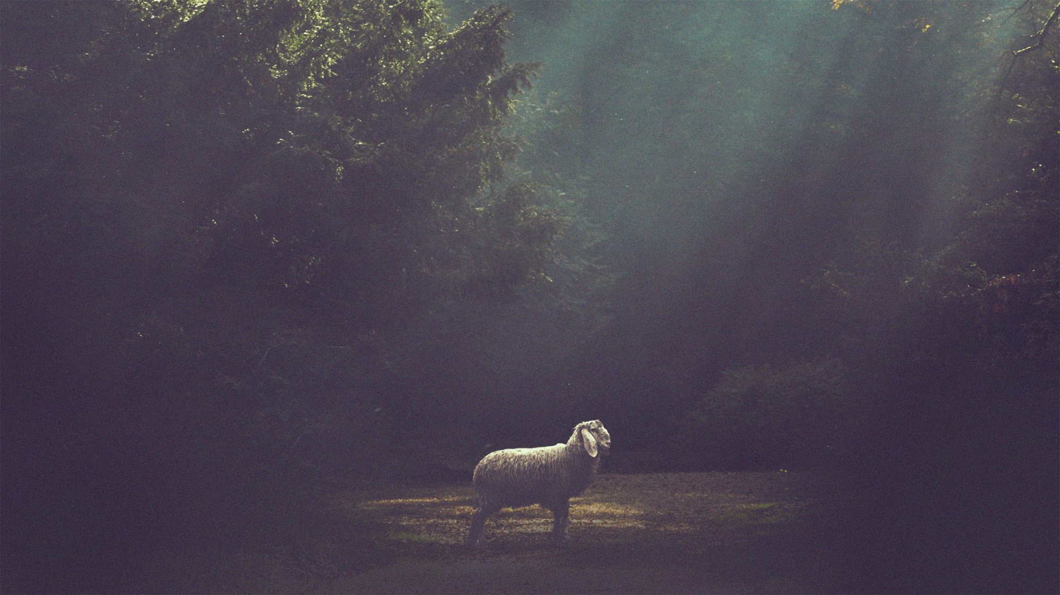
Who Can Be A Shepherd?

Slide 4
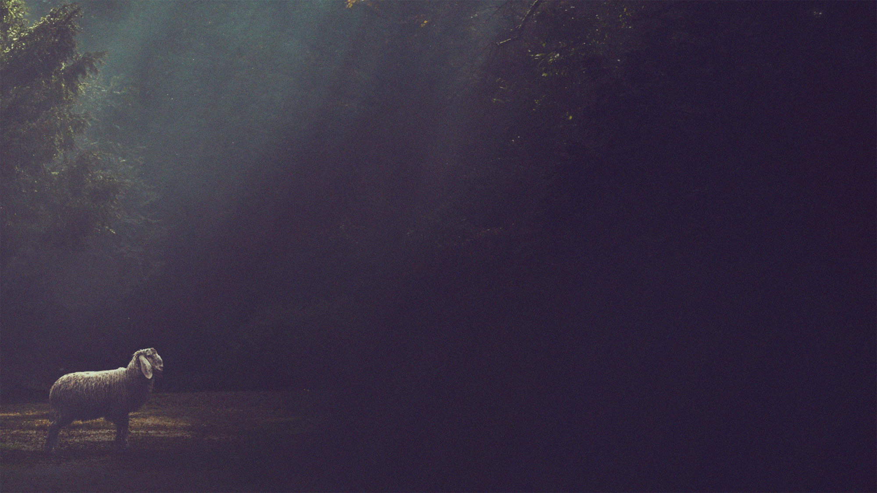
They will know the flock (John 10.4,14)
They will feed the flock (Psalm 23.1-3)
They will protect the flock (John 10.10-11)
They will be concerned for the flock (Ezekiel 34.16)
Only men of great character can shepherd God’s flock

Slide 5
Only men of great character can shepherd God’s flock
Titus 3.1-7; Titus 1.5-9

Slide 6
not a drunkard
not violent
not quarrelsome
not a lover of money
not arrogant
not quick-tempered
Some qualities make a man unfit to shepherd God’s people

Slide 7
respectable
hospitable
gentle
self-controlled
lover of good
upright
Some qualities are essential for God’s shepherds to better know and show concern for His flock

Slide 8
sober-minded
able to teach
holy
disciplined
holds fast to the trustworthy word
Some qualities are essential for God’s shepherds to feed and protect His flock

Slide 9
not a new convert
good reputation with those outside the church
husband of one wife
children who believe
Some qualities emphasize the development and demonstration of character necessary to shepherd the flock.

Slide 10
Don’t look at worldly success
Don’t assume it’s “his time”
Don’t lazily judge the criteria
As you consider who can shepherd the flock…

Slide 11
Who has made an effort to know me?
Who has the qualities to feed me?
Who has the qualities to protect me?
Who has shown concern for my well-being?
As you consider who can shepherd the flock…

