Slide 1
“All Scripture is…Profitable”
2 Timothy 3:16

Slide 2
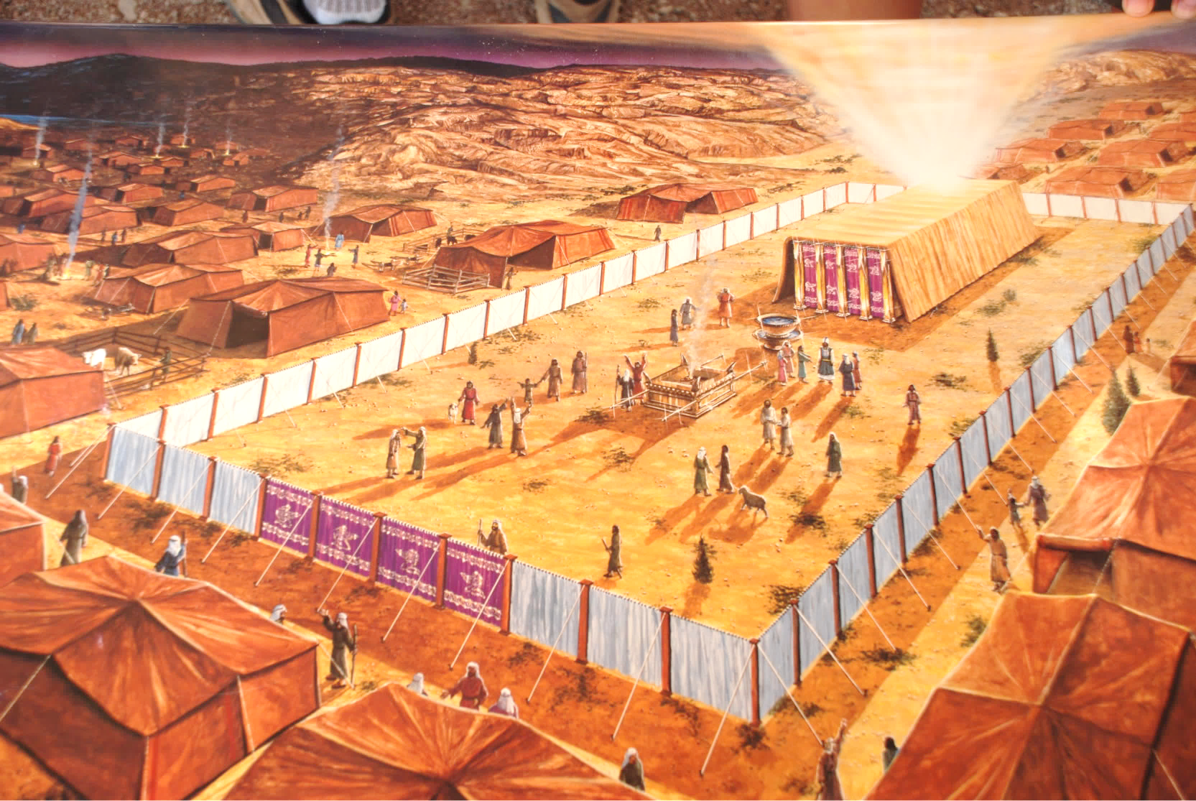
The Tabernacle

Slide 3
The Tabernacle
Exo. 25:8-9 “And let them make Me a sanctuary, that I may dwell in their midst. Exactly as I show you concerning the pattern of the tabernacle, and of all its furniture, so you shall make it.”
God wanted to dwell among His people
The tabernacle was how He would do that
Notes:
Tabernacle and temple are similar, same points could be made
God’s specifics teach how uncommon the tabernacle was, which really is an indication of how uncommon God is.

Slide 4
The Tabernacle
How is the tabernacle profitable for us today?
Shadow
Reality
God dwelling among His people then
God dwells among His people now
High priest served as intercessor
Jesus is our High Priest/ Intercessor
High priest entered into Most Holy Place to God’s presence
Jesus entered into Heaven to the Father’s presence
High priest offered blood regularly for the sins of himself and the people
Jesus offered His own blood as the permanent atonement for the sins of the people
Barriers, guards, limited access, fear
Openness, entering, great access, confidence
Notes:
Tabernacle and temple are similar, same points could be made
God’s specifics teach how uncommon the tabernacle was, which really is an indication of how uncommon God is.

Slide 5
The Tabernacle
vs.
How are the details about the materials and the construction of the tabernacle profitable for us today?
How is the tabernacle profitable for us today?
Notes:
Tabernacle and temple are similar, same points could be made
God’s specifics teach how uncommon the tabernacle was, which really is an indication of how uncommon God is.

Slide 6
Exodus 26 & 27- the Tabernacle
“…You shall make the tabernacle with ten curtains of fine twined linen and blue and purple and scarlet yarns…The length of each curtain shall be twenty-eight cubits, and the breadth of each curtain four cubits…Five curtains shall be coupled to one another, and the other five curtains shall be coupled to one another. And you shall make loops of blue on the edge of the outermost curtain in the first set. Likewise you shall make loops on the edge of the outermost curtain in the second set. Fifty loops you shall make on the one curtain, and fifty loops you shall make on the edge of the curtain that is in the second set; the loops shall be opposite one another. And you shall make fifty clasps of gold, and couple the curtains one to the other with the clasps, so that the tabernacle may be a single whole.”

Slide 7
Exodus 26 & 27- the Tabernacle
“You shall make the court of the tabernacle. On the south side the court shall have hangings of fine twined linen a hundred cubits long for one side. Its twenty pillars and their twenty bases shall be of bronze, but the hooks of the pillars and their fillets shall be of silver…For the gate of the court there shall be a screen twenty cubits long, of blue and purple and scarlet yarns and fine twined linen, embroidered with needlework. It shall have four pillars and with them four bases. All the pillars around the court shall be filleted with silver. Their hooks shall be of silver, and their bases of bronze…All the utensils of the tabernacle for every use, and all its pegs and all the pegs of the court, shall be of bronze.”
Notes:
Dimensions 150’ x 75’
45’ long
15 high
15 wide

Slide 8
Exodus 26 & 27- the Tabernacle
God wanted to dwell among Israel
Why couldn’t it just happen quickly and easily?
-The holiness of God
-The atrocity of sin
Notes:
Tabernacle and temple are similar, same points could be made
God’s specifics teach how uncommon the tabernacle was, which really is an indication of how uncommon God is.
“I will dwell with God on my terms” “This is God”
6-9 months
Emphasizes how Holy Jesus’ blood must be, that it can instantly make us a dwelling place for God.
15 x 15 mhp
30x 15 hp
150 x 75 courtyard

Slide 9
Exodus 26 & 27- the Tabernacle
God gives Moses all of these instructions
Then what happens?
-Israel builds a golden calf
We decide who God is
God will dwell with us on our terms
Notes:
Tabernacle and temple are similar, same points could be made
God’s specifics teach how uncommon the tabernacle was, which really is an indication of how uncommon God is.
“I will dwell with God on my terms” “This is God”
6-9 months
Emphasizes how Holy Jesus’ blood must be, that it can instantly make us a dwelling place for God.

Slide 10
Ephesians 1:4-10
“…He chose us in Him before the foundation of the world, that we should be holy and blameless before Him. In love He predestined us for adoption to Himself as sons through Jesus Christ, according to the purpose of His will, to the praise of His glorious grace, with which He has blessed us in the Beloved. In Him we have redemption through His blood, the forgiveness of our trespasses, according to the riches of His grace, which He lavished upon us, in all wisdom and insight making known to us the mystery of His will, according to His purpose, which He set forth in Christ as a plan for the fullness of time, to unite all things in Him, things in heaven and things on earth.”
Notes:
If I decide how God is going to dwell with me, and I ignore His plans and His purposes
I have changed God, and created Him in my image. I have made a golden calf and said, this is God and He dwells among me.
Do the details matter? They mattered with the tabernacle, and that was only a shadow of greater spiritual things to come.

Slide 11
Ephesians 1:4-10
“…He chose us in Him before the foundation of the world, that we should be holy and blameless before Him. In love He predestined us for adoption to Himself as sons through Jesus Christ, according to the purpose of His will, to the praise of His glorious grace, with which He has blessed us in the Beloved. In Him we have redemption through His blood, the forgiveness of our trespasses, according to the riches of His grace, which He lavished upon us, in all wisdom and insight making known to us the mystery of His will, according to His purpose, which He set forth in Christ as a plan for the fullness of time, to unite all things in Him, things in heaven and things on earth.”
Notes:
If I decide how God is going to dwell with me, and I ignore His plans and His purposes
I have changed God, and created Him in my image. I have made a golden calf and said, this is God and He dwells among me.
Do the details matter? They mattered with the tabernacle, and that was only a shadow of greater spiritual things to come.

Slide 12
Ephesians 1:4-10
“…He chose us in Him before the foundation of the world, that we should be holy and blameless before Him. In love He predestined us for adoption to Himself as sons through Jesus Christ, according to the purpose of His will, to the praise of His glorious grace, with which He has blessed us in the Beloved. In Him we have redemption through His blood, the forgiveness of our trespasses, according to the riches of His grace, which He lavished upon us, in all wisdom and insight making known to us the mystery of His will, according to His purpose, which He set forth in Christ as a plan for the fullness of time, to unite all things in Him, things in heaven and things on earth.”
We decide who God is
God will dwell with us on our terms
Notes:
If I decide how God is going to dwell with me, and I ignore His plans and His purposes
I have changed God, and created Him in my image. I have made a golden calf and said, this is God and He dwells among me.
Do the details matter? They mattered with the tabernacle, and that was only a shadow of greater spiritual things to come.

Slide 13
The intricate details of the tabernacle/temple taught Israel:
God’s dwelling place must be treated as holy,
because God is Holy
“Do you not know that you are God's temple and that God's Spirit dwells in you?” (1 Cor. 3:16)
“Or do you not know that your body is a temple of the Holy Spirit within you, whom you have from God?” (1 Cor. 6:19)
Notes:
We sometimes take for granted that such a holy God would dwell among us, especially when we understand how despicable sin is
Just like Israel had to be committed to making the tabernacle how God wanted it,
We have to be committed to making God’s temple how He wants it to be
Go back and learn what it means to be committed to keeping God’s dwelling place holy

Slide 14
The intricate details of the tabernacle/temple taught Israel:
God’s dwelling place must be treated as holy,
because God is Holy
God dwells within us!
Notes:
We sometimes take for granted that such a holy God would dwell among us, especially when we understand how despicable sin is
Just like Israel had to be committed to making the tabernacle how God wanted it,
We have to be committed to making God’s temple how He wants it to be
Go back and learn what it means to be committed to keeping God’s dwelling place holy
Go back and look at what I taught about my dwelling place so that you understand what it means for you to be my dwelling place.

Slide 15
Leviticus (chs. 8-16)
Notes:
If I decide how God is going to dwell with me, and I ignore His plans and His purposes
I have changed God, and created Him in my image. I have made a golden calf and said, this is God and He dwells among me.
Do the details matter? They mattered with the tabernacle, and that was only a shadow of greater spiritual things to come.

Slide 16
The Blood of Jesus
Notes:
If I decide how God is going to dwell with me, and I ignore His plans and His purposes
I have changed God, and created Him in my image. I have made a golden calf and said, this is God and He dwells among me.
Do the details matter? They mattered with the tabernacle, and that was only a shadow of greater spiritual things to come.

