Slide 2
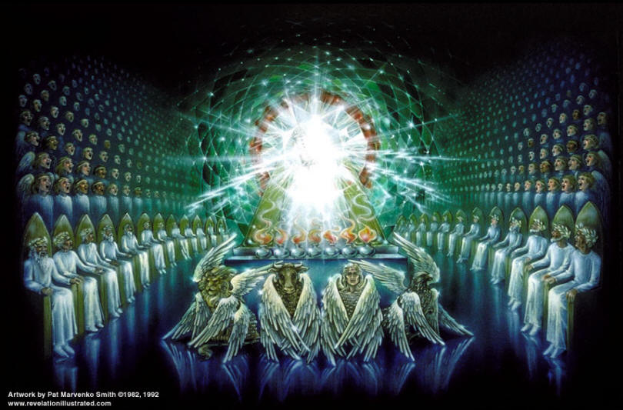

Slide 4
I AM THE ALPHA AND THE OMEGA
1:8 - “I am the Alpha and the Omega,” says the Lord God, “who is, and who was, and who is to come, the Almighty.”
21:6 – “He said to me: “It is done. I am the Alpha and the Omega, the Beginning and the End.
22:13 - I am the Alpha and the Omega, the First and the Last, the Beginning and the End.

Slide 5
Who Is “The Alpha and the Omega?”
God the Father?
God the Son?

Slide 6
I AM THE ALPHA AND THE OMEGA
1:8 - “I am the Alpha and the Omega,” says the Lord God, “who is, and who was, and who is to come, the Almighty.”
21:6 – “He said to me: “It is done. I am the Alpha and the Omega, the Beginning and the End.
22:13 - I am the Alpha and the Omega, the First and the Last, the Beginning and the End.

Slide 7
Who Is “The Alpha and the Omega?”
He is GOD
The one true Deity

Slide 8
I AM THE ALPHA AND THE OMEGA
He is the one true Sovereign God
He is the Eternal God
He is the God Who is Coming Back
He is the God Worthy to Receive our Honor and Obedience
He is the Great I AM Who Will Stand Forever

