Slide 2
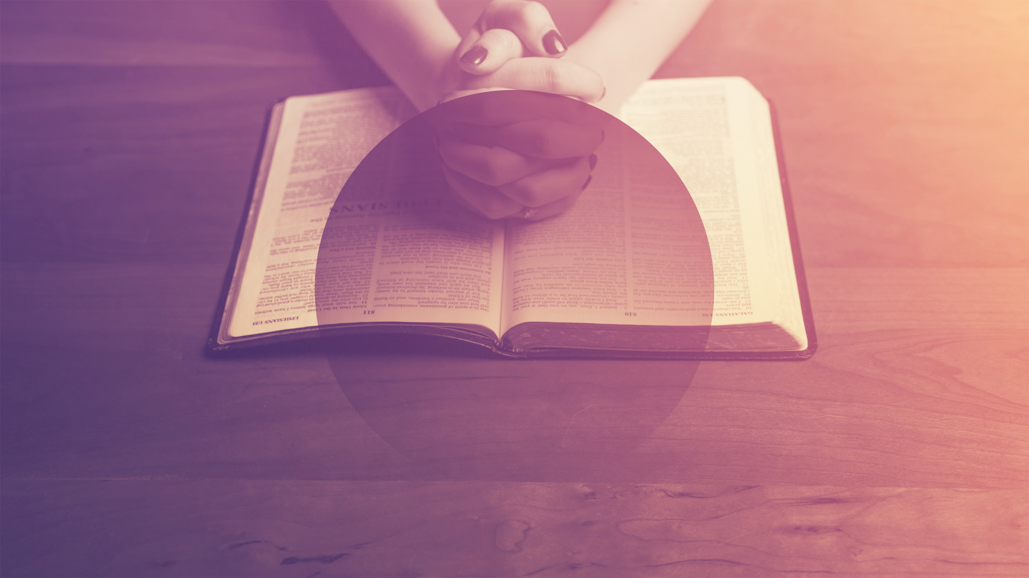
the school of
PRAYER

Slide 3
the school of
PRAYER
assurance He hears

Slide 4
Praise to the Lord who keeps covenant (vss. 14-15)
Petition that the Lord would confirm His word (vss. 16-17)
The Temple: assurance that God hears (vss. 18-42)
2Chronicles 6

Slide 5
Prayer is both a time to thank God for His faithfulness to the covenant AND a time to petition that He will continue to fulfill His word.
We have assurance that God hears our prayers
lessons in prayer

Slide 6
We are called by His name (Isaiah 43.1-7; Amos 9.11-12)
We are His temple (1Corinthians 3.16; 6.19; 2Corinthians 6.16)
We pray in Jesus’ name (John 14.13-14)
assurance He hears

