Slide 1
o

Slide 2
Ephesians
Paul’s statement of salvation to all
through Jesus Christ

Slide 3
1 Paul, an apostle of Christ Jesus through the will of God, to the saints that are at Ephesus, and the faithful in Christ Jesus: 2 Grace to you and peace from God our Father and the Lord Jesus Christ.
Ephesians 1:1-2

Slide 4
1 Paul, an apostle of Christ Jesus through the will of God, to the saints that are at Ephesus, and the faithful in Christ Jesus: 2 Grace to you and peace from God our Father and the Lord Jesus Christ.
Ephesians 1:1-2
Colossians 4:16 ASV 16 And when this epistle hath been read among you, cause that it be read also in the church of the Laodiceans; and that ye also read the epistle from Laodicea.

Slide 5
1 Paul, an apostle of Christ Jesus through the will of God, to the saints that are at Ephesus, and the faithful in Christ Jesus: 2 Grace to you and peace from God our Father and the Lord Jesus Christ.
Ephesians 1:1-2

Slide 8
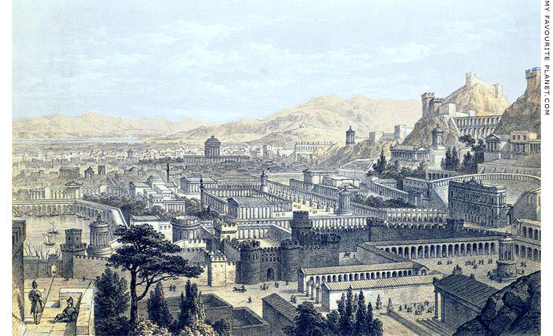
Artist Concept

Slide 9
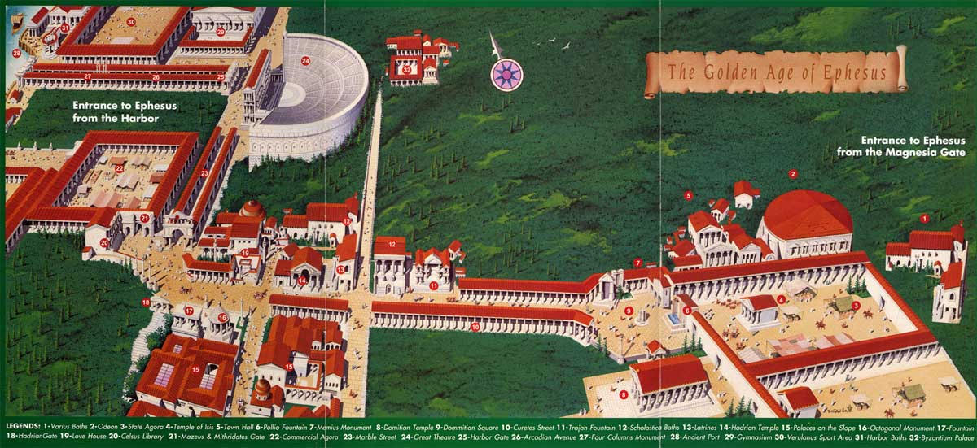
Golden Age of Ephesus

Slide 10
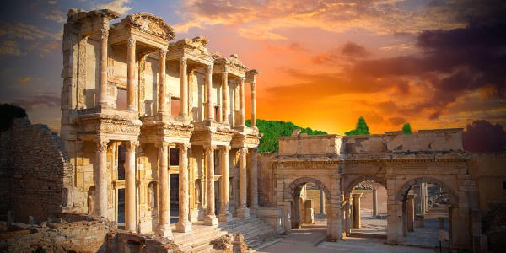
Library of Celsus

Slide 11
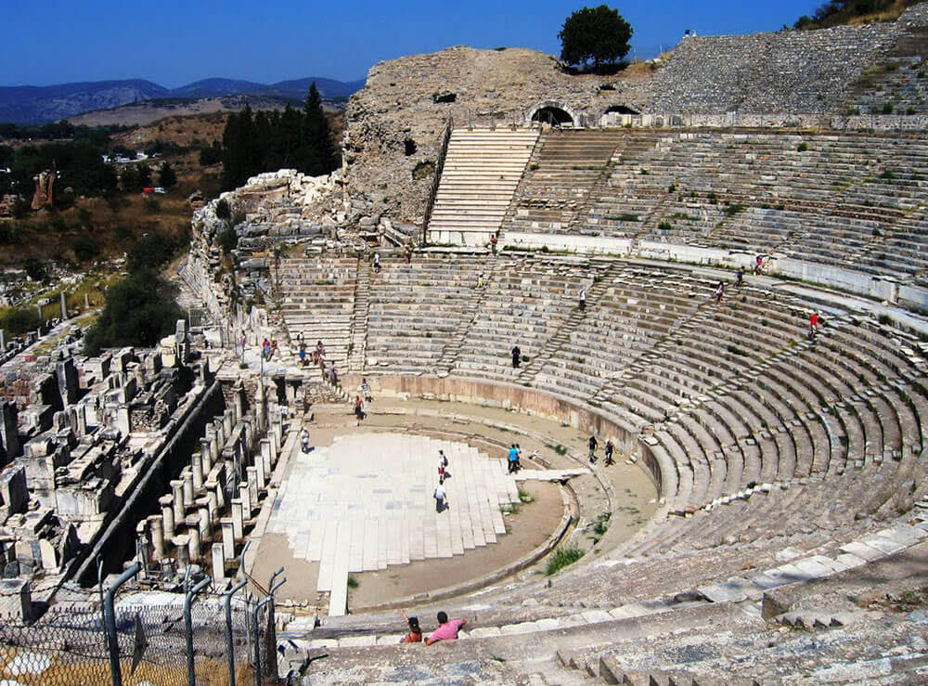
The Grand Theatre

Slide 12
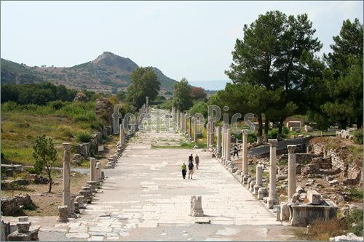
Ephesus Harbor Road

Slide 13
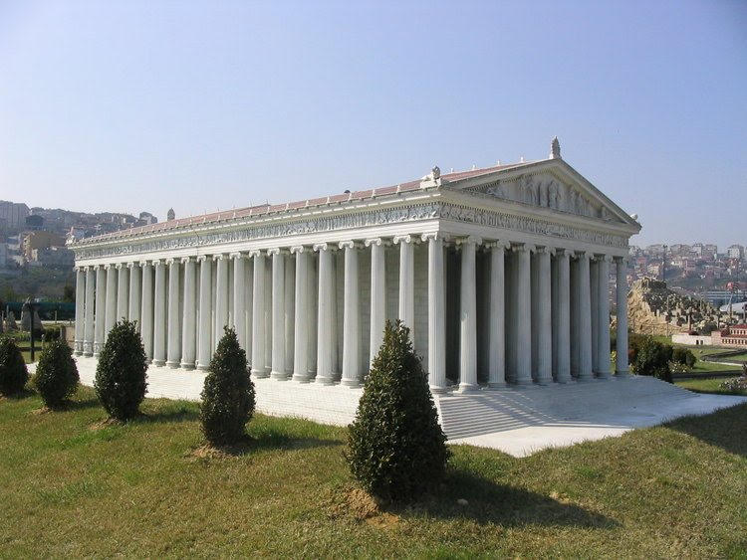
Temple of Artemis

Slide 14
Culture of Ephesus
Artemis (Diana) Cult

Slide 15
Culture of Ephesus
Artemis (Diana) Cult
Acts 19:34-40 ASV 34 But when they perceived that he was a Jew, all with one voice about the space of two hours cried out, Great is Diana of the Ephesians. 35 And when the townclerk had quieted the multitude, he saith, Ye men of Ephesus, what man is there who knoweth not that the city of the Ephesians is temple-keeper of the great Diana, and of the image which fell down from Jupiter? 36 Seeing then that these things cannot be gainsaid, ye ought to be quiet, and to do nothing rash. 37 For ye have brought hither these men, who are neither robbers of temples nor blasphemers of our goddess. 38 If therefore Demetrius, and the craftsmen that are with him, have a matter against any man, the courts are open, and there are proconsuls: let them accuse one another. 39 But if ye seek anything about other matters, it shall be settled in the regular assembly. 40 For indeed we are in danger to be accused concerning this day's riot, there being no cause for it: and as touching it we shall not be able to give account of this concourse.

Slide 16
Culture of Ephesus
Artemis (Diana) Cult
Imperial Cult
Jewish Community

Slide 17
1 Paul, an apostle of Christ Jesus through the will of God, to the saints that are at Ephesus, and the faithful in Christ Jesus: 2 Grace to you and peace from God our Father and the Lord Jesus Christ.
Ephesians 1:1-2

Slide 18
Ephesians 1:3-14 ASV 3 Blessed be the God and Father of our Lord Jesus Christ, who hath blessed us with every spiritual blessing in the heavenly places in Christ: 4 even as he chose us in him before the foundation of the world, that we should be holy and without blemish before him in love: 5 having foreordained us unto adoption as sons through Jesus Christ unto himself, according to the good pleasure of his will, 6 to the praise of the glory of his grace, which he freely bestowed on us in the Beloved: 7 in whom we have our redemption through his blood, the forgiveness of our trespasses, according to the riches of his grace, 8 which he made to abound toward us in all wisdom and prudence, 9 making known unto us the mystery of his will, according to his good pleasure which he purposed in him 10 unto a dispensation of the fulness of the times, to sum up all things in Christ, the things in the heavens, and the things upon the earth; in him, I say, 11 in whom also we were made a heritage, having been foreordained according to the purpose of him who worketh all things after the counsel of his will; 12 to the end that we should be unto the praise of his glory, we who had before hoped in Christ: 13 in whom ye also, having heard the word of the truth, the gospel of your salvation,-- in whom, having also believed, ye were sealed with the Holy Spirit of promise, 14 which is an earnest of our inheritance, unto the redemption of God's own possession, unto the praise of his glory.

Slide 19
Ephesians 1:3-14 ASV 3 Blessed be the God and Father of our Lord Jesus Christ, who hath blessed us with every spiritual blessing in the heavenly places in Christ: 4 even as he chose us in him before the foundation of the world, that we should be holy and without blemish before him in love: 5 having foreordained us unto adoption as sons through Jesus Christ unto himself, according to the good pleasure of his will, 6 to the praise of the glory of his grace, which he freely bestowed on us in the Beloved: 7 in whom we have our redemption through his blood, the forgiveness of our trespasses, according to the riches of his grace, 8 which he made to abound toward us in all wisdom and prudence, 9 making known unto us the mystery of his will, according to his good pleasure which he purposed in him 10 unto a dispensation of the fulness of the times, to sum up all things in Christ, the things in the heavens, and the things upon the earth; in him, I say, 11 in whom also we were made a heritage, having been foreordained according to the purpose of him who worketh all things after the counsel of his will; 12 to the end that we should be unto the praise of his glory, we who had before hoped in Christ: 13 in whom ye also, having heard the word of the truth, the gospel of your salvation,-- in whom, having also believed, ye were sealed with the Holy Spirit of promise, 14 which is an earnest of our inheritance, unto the redemption of God's own possession, unto the praise of his glory.

Slide 20
“ . . . In heavenly places . . .”
Ephesians 1:3 ASV 3 Blessed be the God and Father of our Lord Jesus Christ, who hath blessed us with every spiritual blessing in the heavenly places in Christ:
Ephesians 1:20 ASV 20 which he wrought in Christ, when he raised him from the dead, and made him to sit at his right hand in the heavenly places,
Ephesians 2:6 ASV 6 and raised us up with him, and made us to sit with him in the heavenly places, in Christ Jesus:

Slide 21
“ . . . In heavenly places . . .”
Ephesians 3:10 ASV 10 to the intent that now unto the principalities and the powers in the heavenly places might be made known through the church the manifold wisdom of God,
Ephesians 6:12 ASV 12 For our wrestling is not against flesh and blood, but against the principalities, against the powers, against the world-rulers of this darkness, against the spiritual hosts of wickedness in the heavenly places.

Slide 22
Ephesians 1:3-14 ASV 3 Blessed be the God and Father of our Lord Jesus Christ, who hath blessed us with every spiritual blessing in the heavenly places in Christ: 4 even as he chose us in him before the foundation of the world, that we should be holy and without blemish before him in love: 5 having foreordained us unto adoption as sons through Jesus Christ unto himself, according to the good pleasure of his will, 6 to the praise of the glory of his grace, which he freely bestowed on us in the Beloved: 7 in whom we have our redemption through his blood, the forgiveness of our trespasses, according to the riches of his grace, 8 which he made to abound toward us in all wisdom and prudence, 9 making known unto us the mystery of his will, according to his good pleasure which he purposed in him 10 unto a dispensation of the fulness of the times, to sum up all things in Christ, the things in the heavens, and the things upon the earth; in him, I say, 11 in whom also we were made a heritage, having been foreordained according to the purpose of him who worketh all things after the counsel of his will; 12 to the end that we should be unto the praise of his glory, we who had before hoped in Christ: 13 in whom ye also, having heard the word of the truth, the gospel of your salvation,-- in whom, having also believed, ye were sealed with the Holy Spirit of promise, 14 which is an earnest of our inheritance, unto the redemption of God's own possession, unto the praise of his glory.

Slide 23
Ephesians 1:3-14 ASV 3 Blessed be the God and Father of our Lord Jesus Christ, who hath blessed us with every spiritual blessing in the heavenly places in Christ: 4 even as he chose us in him before the foundation of the world, that we should be holy and without blemish before him in love: 5 having foreordained us unto adoption as sons through Jesus Christ unto himself, according to the good pleasure of his will, 6 to the praise of the glory of his grace, which he freely bestowed on us in the Beloved: 7 in whom we have our redemption through his blood, the forgiveness of our trespasses, according to the riches of his grace, 8 which he made to abound toward us in all wisdom and prudence, 9 making known unto us the mystery of his will, according to his good pleasure which he purposed in him 10 unto a dispensation of the fulness of the times, to sum up all things in Christ, the things in the heavens, and the things upon the earth; in him, I say, 11 in whom also we were made a heritage, having been foreordained according to the purpose of him who worketh all things after the counsel of his will; 12 to the end that we should be unto the praise of his glory, we who had before hoped in Christ: 13 in whom ye also, having heard the word of the truth, the gospel of your salvation,-- in whom, having also believed, ye were sealed with the Holy Spirit of promise, 14 which is an earnest of our inheritance, unto the redemption of God's own possession, unto the praise of his glory.

Slide 24
IN CHRIST
In him
Through Jesus Christ
In the beloved
Through his blood
Riches of his grace
All spiritual blessings
Chose us
Adoption as sons
Grace
Redemption
Forgiveness

Slide 25
: 13 in whom ye also, having heard the word of the truth, the gospel of your salvation,-- in whom, having also believed, ye were sealed with the Holy Spirit of promise, 14 which is an earnest of our inheritance, unto the redemption of God's own possession, unto the praise of his glory.

Slide 26
Romans 8:5-14 ASV 5 For they that are after the flesh mind the things of the flesh; but they that are after the Spirit the things of the Spirit. 6 For the mind of the flesh is death; but the mind of the Spirit is life and peace: 7 because the mind of the flesh is enmity against God; for it is not subject to the law of God, neither indeed can it be: 8 and they that are in the flesh cannot please God. 9 But ye are not in the flesh but in the Spirit, if so be that the Spirit of God dwelleth in you. But if any man hath not the Spirit of Christ, he is none of his. 10 And if Christ is in you, the body is dead because of sin; but the spirit is life because of righteousness. 11 But if the Spirit of him that raised up Jesus from the dead dwelleth in you, he that raised up Christ Jesus from the dead shall give life also to your mortal bodies through his Spirit that dwelleth in you. 12 So then, brethren, we are debtors, not to the flesh, to live after the flesh: 13 for if ye live after the flesh, ye must die; but if by the Spirit ye put to death the deeds of the body, ye shall live. 14 For as many as are led by the Spirit of God, these are sons of God.

Slide 27
the Spirit (v. 9)
the Spirit of God (v. 9)
The Spirit of Christ (v. 9)
Christ is in you (v. 10)

Slide 28
walk according; to the Spirit (v. 4)
the mind set on the Spirit (v. 5)
in the Spirit (v. 9)

Slide 29
the Spirit of God dwells in you (vv. 9, 11)
. 14)
have the Spirit of Christ (v. 9)
led by the Spirit of God (v. 14)

Slide 30
Hebrews 4:12 ASV 12 For the word of God is living, and active, and sharper than any two-edged sword, and piercing even to the dividing of soul and spirit, of both joints and marrow, and quick to discern the thoughts and intents of the heart.
Hebrews 11:3 ASV 3 By faith we understand that the worlds have been framed by the word of God, so that what is seen hath not been made out of things which appear.
Cf. Dry bones of Ez. 37
Col 3:16 Let the word of Christ dwell in you richly . . . .
Romans 10:17 ASV 17 So belief cometh of hearing, and hearing by the word of Christ.

Slide 31
Paul’s Prayer Ephesians 1:15-19

Slide 32
15 For this cause I also, having heard of the faith in the Lord Jesus which is among you, and the love which ye show toward all the saints, 16 cease not to give thanks for you, making mention of you in my prayers; 17 that the God of our Lord Jesus Christ, the Father of glory, may give unto you a spirit of wisdom and revelation in the knowledge of him; 18 having the eyes of your heart enlightened, that ye may know what is the hope of his calling, what the riches of the glory of his inheritance in the saints, 19 and what the exceeding greatness of his power to us-ward who believe, according to that working of the strength of his might

Slide 33
15 For this cause I also, having heard of the faith in the Lord Jesus which is among you, and the love which ye show toward all the saints, 16 cease not to give thanks for you, making mention of you in my prayers; 17 that the God of our Lord Jesus Christ, the Father of glory, may give unto you a spirit of wisdom and revelation in the knowledge of him; 18 having the eyes of your heart enlightened, that ye may know what is the hope of his calling, what the riches of the glory of his inheritance in the saints, 19 and what the exceeding greatness of his power to us-ward who believe, according to that working of the strength of his might

Slide 34
15 For this cause I also, having heard of the faith in the Lord Jesus which is among you, and the love which ye show toward all the saints, 16 cease not to give thanks for you, making mention of you in my prayers; 17 that the God of our Lord Jesus Christ, the Father of glory, may give unto you a spirit of wisdom and revelation in the knowledge of him; 18 having the eyes of your heart enlightened, that ye may know what is the hope of his calling, what the riches of the glory of his inheritance in the saints, 19 and what the exceeding greatness of his power to us-ward who believe, according to that working of the strength of his might

Slide 35
Ephesians 1:19-23 ASV 19 and what the exceeding greatness of his power to us-ward who believe, according to that working of the strength of his might 20 which he wrought in Christ, when he raised him from the dead, and made him to sit at his right hand in the heavenly places, 21 far above all rule, and authority, and power, and dominion, and every name that is named, not only in this world, but also in that which is to come: 22 and he put all things in subjection under his feet, and gave him to be head over all things to the church, 23 which is his body, the fulness of him that filleth all in all.
.

Slide 36
Ephesians 1:19-23 ASV 19 and what the exceeding greatness of his power to us-ward who believe, according to that working of the strength of his might 20 which he wrought in Christ, when he raised him from the dead . . . and he put all things in subjection under his feet, and gave him to be head over all things to the church, 23 which is his body, the fulness of him that filleth all in all.
1 And you did he make alive, when ye were dead through your trespasses and sins, 2 wherein ye once walked according to the course of this world, according to the prince of the powers of the air, of the spirit that now worketh in the sons of disobedience; 3 among whom we also all once lived in the lust of our flesh, doing the desires of the flesh and of the mind, and were by nature children of wrath, even as the rest:--
.

Slide 37
Ephesians 1:19-23 ASV 19 and what the exceeding greatness of his power to us-ward who believe, according to that working of the strength of his might 20 which he wrought in Christ, when he raised him from the dead . . . and he put all things in subjection under his feet, and gave him to be head over all things to the church, 23 which is his body, the fulness of him that filleth all in all.
1 And you did he make alive, when ye were dead through your trespasses and sins, 2 wherein ye once walked according to the course of this world, according to the prince of the powers of the air, of the spirit that now worketh in the sons of disobedience; 3 among whom we also all once lived in the lust of our flesh, doing the desires of the flesh and of the mind, and were by nature children of wrath, even as the rest:--
.

Slide 38
Ephesians 2:11-16 11 Wherefore remember, that once ye, the Gentiles in the flesh, who are called Uncircumcision by that which is called Circumcision, in the flesh, made by hands; 12 that ye were at that time separate from Christ, alienated from the commonwealth of Israel, and strangers from the covenants of the promise, having no hope and without God in the world. 13 But now in Christ Jesus ye that once were far off are made nigh in the blood of Christ. 14 For he is our peace, who made both one, and brake down the middle wall of partition, 15 having abolished in the flesh the enmity, even the law of commandments contained in ordinances; that he might create in himself of the two one new man, so making peace; 16 and might reconcile them both in one body unto God through the cross, having slain the enmity thereby:

Slide 39
Ephesians 2:1-9 1 And you did he make alive, when ye were dead through your trespasses and sins, 2 wherein ye once walked according to the course of this world, according to the prince of the powers of the air, of the spirit that now worketh in the sons of disobedience; 3 among whom we also all once lived in the lust of our flesh, doing the desires of the flesh and of the mind, and were by nature children of wrath, even as the rest:-- 4 but God, being rich in mercy, for his great love wherewith he loved us, 5 even when we were dead through our trespasses, made us alive together with Christ (by grace have ye been saved), 6 and raised us up with him, and made us to sit with him in the heavenly places, in Christ Jesus: 7 that in the ages to come he might show the exceeding riches of his grace in kindness toward us in Christ Jesus: 8 for by grace have ye been saved through faith; and that not of yourselves, it is the gift of God; 9 not of works, that no man should glory.

Slide 40
Ephesians 2:5-10 ASV 5 even when we were dead through our trespasses, made us alive together with Christ (by grace have ye been saved), 6 and raised us up with him, and made us to sit with him in the heavenly places, in Christ Jesus: 7 that in the ages to come he might show the exceeding riches of his grace in kindness toward us in Christ Jesus: 8 for by grace have ye been saved through faith; and that not of yourselves, it is the gift of God; 9 not of works, that no man should glory.
10 For we are his workmanship, created in Christ Jesus for good works, which God afore prepared that we should walk in them.

Slide 41
o

Slide 42
Ephesians 2:11-16 11 Wherefore remember, that once ye, the Gentiles in the flesh, who are called Uncircumcision by that which is called Circumcision, in the flesh, made by hands; 12 that ye were at that time separate from Christ, alienated from the commonwealth of Israel, and strangers from the covenants of the promise, having no hope and without God in the world. 13 But now in Christ Jesus ye that once were far off are made nigh in the blood of Christ. 14 For he is our peace, who made both one, and brake down the middle wall of partition, 15 having abolished in the flesh the enmity, even the law of commandments contained in ordinances; that he might create in himself of the two one new man, so making peace; 16 and might reconcile them both in one body unto God through the cross, having slain the enmity thereby:

Slide 43
Ephesians 2:11-16 11 Wherefore remember, that once ye, the Gentiles in the flesh, who are called Uncircumcision by that which is called Circumcision, in the flesh, made by hands; 12 that ye were at that time separate from Christ, alienated from the commonwealth of Israel, and strangers from the covenants of the promise, having no hope and without God in the world. 13 But now in Christ Jesus ye that once were far off are made nigh in the blood of Christ. 14 For he is our peace, who made both one, and brake down the middle wall of partition, 15 having abolished in the flesh the enmity, even the law of commandments contained in ordinances; that he might create in himself of the two one new man, so making peace; 16 and might reconcile them both in one body unto God through the cross, having slain the enmity thereby:

Slide 44
Peace ??
Early church:
Acts 6:1 1 Now in these days, when the number of the disciples was multiplying, there arose a murmuring of the Grecian Jews against the Hebrews, because their widows were neglected in the daily ministration.

Slide 45
Peace ??
Early church:
Acts 6:1
Acts 11:2-3 2 And when Peter was come up to Jerusalem, they that were of the circumcision contended with him, 3 saying, Thou wentest in to men uncircumcised, and didst eat with them.

Slide 46
Peace ??
Early church:
Acts 6:1
Acts 11:2-3
Galatians 2:11-12 ASV 11 But when Cephas came to Antioch, I resisted him to the face, because he stood condemned. 12 For before that certain came from James, he ate with the Gentiles; but when they came, he drew back and separated himself, fearing them that were of the circumcision.

Slide 47
Peace ??
Early church:
Acts 6:1
Acts 11:2-3
Galatians 2:11-12
Major topic in two books: Romans and Galatians. Mentioned in others
Notes:
And

Slide 48
Ephesians 2:11-16 11 Wherefore remember, that once ye, the Gentiles in the flesh, who are called Uncircumcision by that which is called Circumcision, in the flesh, made by hands; 12 that ye were at that time separate from Christ, alienated from the commonwealth of Israel, and strangers from the covenants of the promise, having no hope and without God in the world. 13 But now in Christ Jesus ye that once were far off are made nigh in the blood of Christ. 14 For he is our peace, who made both one, and brake down the middle wall of partition, 15 having abolished in the flesh the enmity, even the law of commandments contained in ordinances; that he might create in himself of the two one new man, so making peace; 16 and might reconcile them both in one body unto God through the cross, having slain the enmity thereby:

Slide 49
Romans 7:1-12 ASV 1 Or are ye ignorant, brethren (for I speak to men who know the law), that the law hath dominion over a man for so long time as he liveth? 2 For the woman that hath a husband is bound by law to the husband while he liveth; but if the husband die, she is discharged from the law of the husband. 3 So then if, while the husband liveth, she be joined to another man, she shall be called an adulteress: but if the husband die, she is free from the law, so that she is no adulteress, though she be joined to another man. 4 Wherefore, my brethren, ye also were made dead to the law through the body of Christ; that ye should be joined to another, even to him who was raised from the dead, that we might bring forth fruit unto God. 5 For when we were in the flesh, the sinful passions, which were through the law, wrought in our members to bring forth fruit unto death. 6 But now we have been discharged from the law, having died to that wherein we were held; so that we serve in

Slide 50
newness of the spirit, and not in oldness of the letter. 7 What shall we say then? Is the law sin? God forbid. Howbeit, I had not known sin, except through the law: for I had not known coveting, except the law had said, Thou shalt not covet: 8 but sin, finding occasion, wrought in me through the commandment all manner of coveting: for apart from the law sin is dead

Slide 51
YE
LAW
W
M
W
M
CHRIST

Slide 53
Ephesians 2:11-16 11 Wherefore remember, that once ye, the Gentiles in the flesh, who are called Uncircumcision by that which is called Circumcision, in the flesh, made by hands; 12 that ye were at that time separate from Christ, alienated from the commonwealth of Israel, and strangers from the covenants of the promise, having no hope and without God in the world. 13 But now in Christ Jesus ye that once were far off are made nigh in the blood of Christ. 14 For he is our peace, who made both one, and brake down the middle wall of partition, 15 having abolished in the flesh the enmity, even the law of commandments contained in ordinances; that he might create in himself of the two one new man, so making peace; 16 and might reconcile them both in one body unto God through the cross, having slain the enmity thereby:

Slide 54
Ephesians 2:11-16 11 Wherefore remember, that once ye, the Gentiles in the flesh, who are called Uncircumcision by that which is called Circumcision, in the flesh, made by hands; 12 that ye were at that time separate from Christ, alienated from the commonwealth of Israel, and strangers from the covenants of the promise, having no hope and without God in the world. 13 But now in Christ Jesus ye that once were far off are made nigh in the blood of Christ. 14 For he is our peace, who made both one, and brake down the middle wall of partition, 15 having abolished in the flesh the enmity, even the law of commandments contained in ordinances; that he might create in himself of the two one new man, so making peace; 16 and might reconcile them both in one body unto God through the cross, having slain the enmity thereby:

Slide 55
Ephesians 2:17-22 ASV 17 and he came and preached peace to you that were far off, and peace to them that were nigh: 18 for through him we both have our access in one Spirit unto the Father. 19 So then ye are no more strangers and sojourners, but ye are fellow-citizens with the saints, and of the household of God, 20 being built upon the foundation of the apostles and prophets, Christ Jesus himself being the chief corner stone; 21 in whom each several building, fitly framed together, groweth into a holy temple in the Lord; 22 in whom ye also are builded together for a habitation of God in the Spirit.
“Church” i.e., “group”
. . . Body . . . Household . . . temple

Slide 56
“ SO THEN . . .” Eph. 2:19
Ephesians 2:19-22 19 So then ye are no more strangers and sojourners, but ye are fellow-citizens with the saints, and of the household of God, 20 being built upon the foundation of the apostles and prophets, Christ Jesus himself being the chief corner stone; 21 in whom each several building, fitly framed together, groweth into a holy temple in the Lord; 22 in whom ye also are builded together for a habitation of God in the Spirit.

Slide 57
Role of the apostles
Matthew 19:23-27 ASV 23 And Jesus said unto his disciples, Verily I say unto you, It is hard for a rich man to enter into the kingdom of heaven. 24 And again I say unto you, It is easier for a camel to go through a needle's eye, than for a rich man to enter into the kingdom of God. 25 And when the disciples heard it, they were astonished exceedingly, saying, Who then can be saved? 26 And Jesus looking upon them said to them, With men this is impossible; but with God all things are possible. 27 Then answered Peter and said unto him, Lo, we have left all, and followed thee; what then shall we have?
:28 And Jesus said unto them, Verily I say unto you, that ye who have followed me, in the regeneration when the Son of man shall sit on the throne of his glory, ye also shall sit upon twelve thrones, judging the twelve tribes of Israel.

Slide 58
Matthew 16:15-19 15 He saith unto them, But who say ye that I am? 16 And Simon Peter answered and said, Thou art the Christ, the Son of the living God. 17 And Jesus answered and said unto him, Blessed art thou, Simon Bar-jonah: for flesh and blood hath not revealed it unto thee, but my Father who is in heaven. 18 And I also say unto thee, that thou art Peter, and upon this rock I will build my church; and the gates of Hades shall not prevail against it. 19 I will give unto thee the keys of the kingdom of heaven: and whatsoever thou shalt bind on earth shall be bound in heaven; and whatsoever thou shalt loose on earth shall be loosed in heaven.

Slide 59
Matthew 16:15-19 15 He saith unto them, But who say ye that I am? 16 And Simon Peter answered and said, Thou art the Christ, the Son of the living God. 17 And Jesus answered and said unto him, Blessed art thou, Simon Bar-jonah: for flesh and blood hath not revealed it unto thee, but my Father who is in heaven. 18 And I also say unto thee, that thou art Peter, and upon this rock I will build my church; and the gates of Hades shall not prevail against it. 19 I will give unto thee the keys of the kingdom of heaven: and whatsoever thou shalt bind on earth shall be bound in heaven; and whatsoever thou shalt loose on earth shall be loosed in heaven.
Literal: “shall have been bound”

Slide 60
Matthew 18:18-20 18 Verily I say unto you, what things soever ye shall bind on earth shall be bound in heaven; and what things soever ye shall loose on earth shall be loosed in heaven.
19 Again I say unto you, that if two of you shall agree on earth as touching anything that they shall ask, it shall be done for them of my Father who is in heaven. 20 For where two or three are gathered together in my name, there am I in the midst of them.

Slide 61
1 Corinthians 2:1-13 1 And I, brethren, when I came unto you, came not with excellency of speech or of wisdom, proclaiming to you the testimony of God. 2 For I determined not to know anything among you, save Jesus Christ, and him crucified. 3 And I was with you in weakness, and in fear, and in much trembling. 4 And my speech and my preaching were not in persuasive words of wisdom, but in demonstration of the Spirit and of power: 5 that your faith should not stand in the wisdom of men, but in the power of God. 6 We speak wisdom, however, among them that are fullgrown: yet a wisdom not of this world, nor of the rulers of this world, who are coming to nought: 7 but we speak God's wisdom in a mystery, even the wisdom that hath been hidden, which God foreordained before the worlds unto our glory: 8 which none of the rulers of this world hath known: for had they known it, they would not have crucified the Lord of glory:

Slide 62
9 but as it is written, Things which eye saw not, and ear heard not, And which entered not into the heart of man, Whatsoever things God prepared for them that love him. 10 But unto us God revealed them through the Spirit: for the Spirit searcheth all things, yea, the deep things of God. 11 For who among men knoweth the things of a man, save the spirit of the man, which is in him? even so the things of God none knoweth, save the Spirit of God. 12 But we received, not the spirit of the world, but the spirit which is from God; that we might know the things that were freely given to us of God. 13 Which things also we speak, not in words which man's wisdom teacheth, but which the Spirit teacheth; combining spiritual things with spiritual words.

Slide 63
Ephesians 3:1-7 1 For this cause I Paul, the prisoner of Christ Jesus in behalf of you Gentiles,-- 2 if so be that ye have heard of the dispensation of that grace of God which was given me to you-ward; 3 how that by revelation was made known unto me the mystery, as I wrote before in few words, 4 whereby, when ye read, ye can perceive my understanding in the mystery of Christ; 5 which in other generation was not made known unto the sons of men, as it hath now been revealed unto his holy apostles and prophets in the Spirit; 6 to wit, that the Gentiles are fellow-heirs, and fellow-members of the body, and fellow-partakers of the promise in Christ Jesus through the gospel, 7 whereof I was made a minister, according to the gift of that grace of God which was given me according to the working of his power.

Slide 64
Ephesians 3:8-13 8 Unto me, who am less than the least of all saints, was this grace given, to preach unto the Gentiles the unsearchable riches of Christ; 9 and to make all men see what is the dispensation of the mystery which for ages hath been hid in God who created all things; 10 to the intent that now unto the principalities and the powers in the heavenly places might be made known through the church the manifold wisdom of God, 11 according to the eternal purpose which he purposed in Christ Jesus our Lord: 12 in whom we have boldness and access in confidence through our faith in him. 13 Wherefore I ask that ye may not faint at my tribulations for you, which are your glory.

Slide 65
Ephesians 3:14-21 14 For this cause I bow my knees unto the Father, 15 from whom every family in heaven and on earth is named, 16 that he would grant you, according to the riches of his glory, that ye may be strengthened with power through his Spirit in the inward man; 17 that Christ may dwell in your hearts through faith; to the end that ye, being rooted and grounded in love, 18 may be strong to apprehend with all the saints what is the breadth and length and height and depth, 19 and to know the love of Christ which passeth knowledge, that ye may be filled unto all the fulness of God. 20 Now unto him that is able to do exceeding abundantly above all that we ask or think, according to the power that worketh in us, 21 unto him be the glory in the church and in Christ Jesus unto all generations for ever and ever. Amen.

Slide 66
o

Slide 68
Ephesians 4:1-6 1 I therefore, the prisoner in the Lord, beseech you to walk worthily of the calling wherewith ye were called, 2 with all lowliness and meekness, with longsuffering, forbearing one another in love; 3 giving diligence to keep the unity of the Spirit in the bond of peace. 4 There is one body, and one Spirit, even as also ye were called in one hope of your calling; 5 one Lord, one faith, one baptism, 6 one God and Father of all, who is over all, and through all, and in all.

Slide 69
Ephesians 4:7-16 ASV 7 But unto each one of us was the grace given according to the measure of the gift of Christ. 8 Wherefore he saith, When he ascended on high, he led captivity captive, And gave gifts unto men. 9 (Now this, He ascended, what is it but that he also descended into the lower parts of the earth? 10 He that descended is the same also that ascended far above all the heavens, that he might fill all things.) 11 And he gave some to be apostles; and some, prophets; and some, evangelists; and some, pastors and teachers; 12 for the perfecting of the saints, unto the work of ministering, unto the building up of the body of Christ:

Slide 70
12 for the perfecting of the saints, unto the work of ministering, unto the building up of the body of Christ: 13 till we all attain unto the unity of the faith, and of the knowledge of the Son of God, unto a fullgrown man, unto the measure of the stature of the fulness of Christ: 14 that we may be no longer children, tossed to and fro and carried about with every wind of doctrine, by the sleight of men, in craftiness, after the wiles of error; 15 but speaking truth in love, we may grow up in all things into him, who is the head, even Christ; 16 from whom all the body fitly framed and knit together through that which every joint supplieth, according to the working in due measure of each several part, maketh the increase of the body unto the building up of itself in love.

Slide 71
Ephesians 4:17-24 17 This I say therefore, and testify in the Lord, that ye no longer walk as the Gentiles also walk, in the vanity of their mind, 18 being darkened in their understanding, alienated from the life of God, because of the ignorance that is in them, because of the hardening of their heart; 19 who being past feeling gave themselves up to lasciviousness, to work all uncleanness with greediness. 20 But ye did not so learn Christ; 21 if so be that ye heard him, and were taught in him, even as truth is in Jesus: 22 that ye put away, as concerning your former manner of life, the old man, that waxeth corrupt after the lusts of deceit; 23 and that ye be renewed in the spirit of your mind, 24 and put on the new man, that after God hath been created in righteousness and holiness of truth.

Slide 72
Ephesians 4:25-32 25 Wherefore, putting away falsehood, speak ye truth each one with his neighbor: for we are members one of another. 26 Be ye angry, and sin not: let not the sun go down upon your wrath: 27 neither give place to the devil. 28 Let him that stole steal no more: but rather let him labor, working with his hands the thing that is good, that he may have whereof to give to him that hath need. 29 Let no corrupt speech proceed out of your mouth, but such as is good for edifying as the need may be, that it may give grace to them that hear. 30 And grieve not the Holy Spirit of God, in whom ye were sealed unto the day of redemption. 31 Let all bitterness, and wrath, and anger, and clamor, and railing, be put away from you, with all malice: 32 and be ye kind one to another, tenderhearted, forgiving each other, even as God also in Christ forgave you.

Slide 75
o

