Slide 1
o

Slide 2
Ephesians
Paul’s statement of salvation to all
through Jesus Christ

Slide 3
1 Paul, an apostle of Christ Jesus through the will of God, to the saints that are at Ephesus, and the faithful in Christ Jesus: 2 Grace to you and peace from God our Father and the Lord Jesus Christ.
Ephesians 1:1-2

Slide 4
1 Paul, an apostle of Christ Jesus through the will of God, to the saints that are at Ephesus, and the faithful in Christ Jesus: 2 Grace to you and peace from God our Father and the Lord Jesus Christ.
Ephesians 1:1-2
Colossians 4:16 ASV 16 And when this epistle hath been read among you, cause that it be read also in the church of the Laodiceans; and that ye also read the epistle from Laodicea.

Slide 5
1 Paul, an apostle of Christ Jesus through the will of God, to the saints that are at Ephesus, and the faithful in Christ Jesus: 2 Grace to you and peace from God our Father and the Lord Jesus Christ.
Ephesians 1:1-2

Slide 8
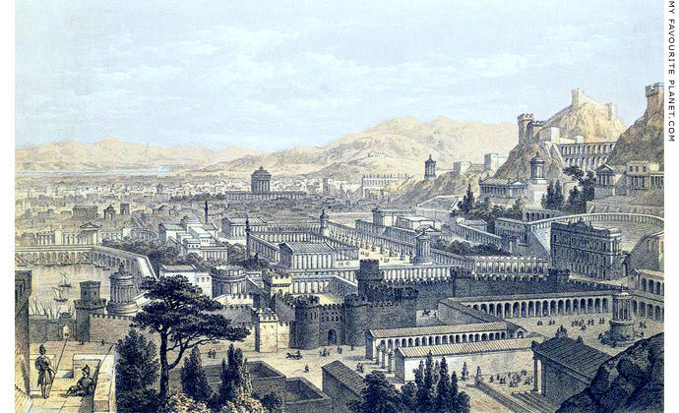
Artist Concept

Slide 9
Golden Age of Ephesus

Slide 10
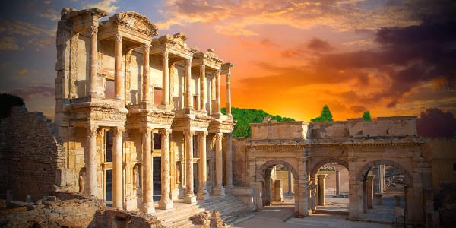
Library of Celsus

Slide 11
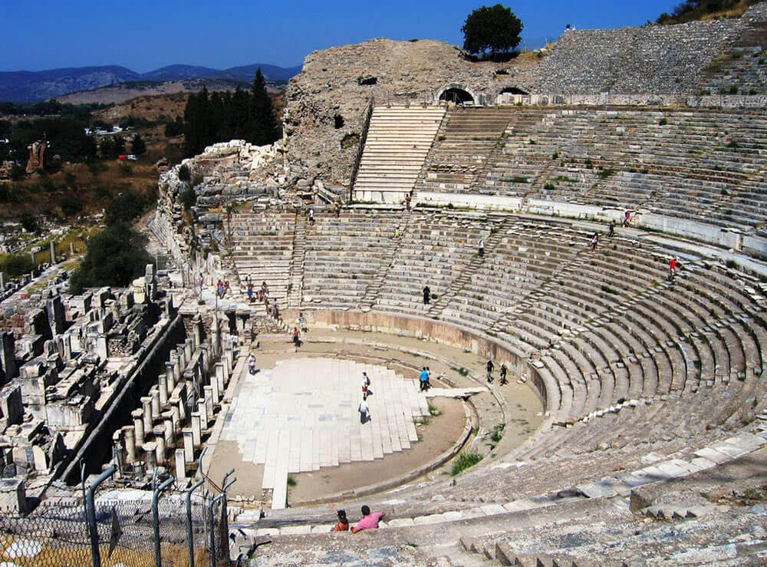
The Grand Theatre

Slide 12
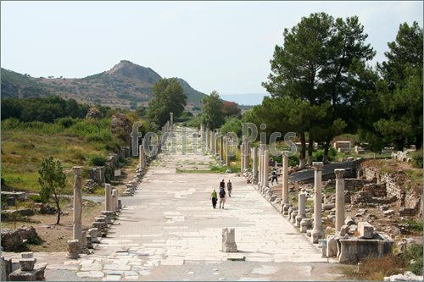
Ephesus Harbor Road

Slide 13
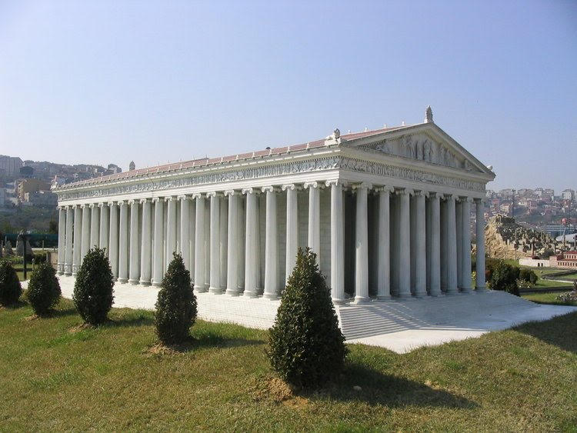
Temple of Artemis

Slide 14
Culture of Ephesus
Artemis (Diana) Cult

Slide 15
Culture of Ephesus
Artemis (Diana) Cult
Acts 19:34-40 ASV 34 But when they perceived that he was a Jew, all with one voice about the space of two hours cried out, Great is Diana of the Ephesians. 35 And when the townclerk had quieted the multitude, he saith, Ye men of Ephesus, what man is there who knoweth not that the city of the Ephesians is temple-keeper of the great Diana, and of the image which fell down from Jupiter? 36 Seeing then that these things cannot be gainsaid, ye ought to be quiet, and to do nothing rash. 37 For ye have brought hither these men, who are neither robbers of temples nor blasphemers of our goddess. 38 If therefore Demetrius, and the craftsmen that are with him, have a matter against any man, the courts are open, and there are proconsuls: let them accuse one another. 39 But if ye seek anything about other matters, it shall be settled in the regular assembly. 40 For indeed we are in danger to be accused concerning this day's riot, there being no cause for it: and as touching it we shall not be able to give account of this concourse.

Slide 16
Culture of Ephesus
Artemis (Diana) Cult
Imperial Cult
Jewish Community

Slide 17
1 Paul, an apostle of Christ Jesus through the will of God, to the saints that are at Ephesus, and the faithful in Christ Jesus: 2 Grace to you and peace from God our Father and the Lord Jesus Christ.
Ephesians 1:1-2

Slide 18
Ephesians 1:3-14 ASV 3 Blessed be the God and Father of our Lord Jesus Christ, who hath blessed us with every spiritual blessing in the heavenly places in Christ: 4 even as he chose us in him before the foundation of the world, that we should be holy and without blemish before him in love: 5 having foreordained us unto adoption as sons through Jesus Christ unto himself, according to the good pleasure of his will, 6 to the praise of the glory of his grace, which he freely bestowed on us in the Beloved: 7 in whom we have our redemption through his blood, the forgiveness of our trespasses, according to the riches of his grace, 8 which he made to abound toward us in all wisdom and prudence, 9 making known unto us the mystery of his will, according to his good pleasure which he purposed in him 10 unto a dispensation of the fulness of the times, to sum up all things in Christ, the things in the heavens, and the things upon the earth; in him, I say, 11 in whom also we were made a heritage, having been foreordained according to the purpose of him who worketh all things after the counsel of his will; 12 to the end that we should be unto the praise of his glory, we who had before hoped in Christ: 13 in whom ye also, having heard the word of the truth, the gospel of your salvation,-- in whom, having also believed, ye were sealed with the Holy Spirit of promise, 14 which is an earnest of our inheritance, unto the redemption of God's own possession, unto the praise of his glory.

Slide 19
Ephesians 1:3-14 ASV 3 Blessed be the God and Father of our Lord Jesus Christ, who hath blessed us with every spiritual blessing in the heavenly places in Christ: 4 even as he chose us in him before the foundation of the world, that we should be holy and without blemish before him in love: 5 having foreordained us unto adoption as sons through Jesus Christ unto himself, according to the good pleasure of his will, 6 to the praise of the glory of his grace, which he freely bestowed on us in the Beloved: 7 in whom we have our redemption through his blood, the forgiveness of our trespasses, according to the riches of his grace, 8 which he made to abound toward us in all wisdom and prudence, 9 making known unto us the mystery of his will, according to his good pleasure which he purposed in him 10 unto a dispensation of the fulness of the times, to sum up all things in Christ, the things in the heavens, and the things upon the earth; in him, I say, 11 in whom also we were made a heritage, having been foreordained according to the purpose of him who worketh all things after the counsel of his will; 12 to the end that we should be unto the praise of his glory, we who had before hoped in Christ: 13 in whom ye also, having heard the word of the truth, the gospel of your salvation,-- in whom, having also believed, ye were sealed with the Holy Spirit of promise, 14 which is an earnest of our inheritance, unto the redemption of God's own possession, unto the praise of his glory.

Slide 20
“ . . . In heavenly places . . .”
Ephesians 1:3 ASV 3 Blessed be the God and Father of our Lord Jesus Christ, who hath blessed us with every spiritual blessing in the heavenly places in Christ:
Ephesians 1:20 ASV 20 which he wrought in Christ, when he raised him from the dead, and made him to sit at his right hand in the heavenly places,
Ephesians 2:6 ASV 6 and raised us up with him, and made us to sit with him in the heavenly places, in Christ Jesus:

Slide 21
“ . . . In heavenly places . . .”
Ephesians 3:10 ASV 10 to the intent that now unto the principalities and the powers in the heavenly places might be made known through the church the manifold wisdom of God,
Ephesians 6:12 ASV 12 For our wrestling is not against flesh and blood, but against the principalities, against the powers, against the world-rulers of this darkness, against the spiritual hosts of wickedness in the heavenly places.

Slide 22
Ephesians 1:3-14 ASV 3 Blessed be the God and Father of our Lord Jesus Christ, who hath blessed us with every spiritual blessing in the heavenly places in Christ: 4 even as he chose us in him before the foundation of the world, that we should be holy and without blemish before him in love: 5 having foreordained us unto adoption as sons through Jesus Christ unto himself, according to the good pleasure of his will, 6 to the praise of the glory of his grace, which he freely bestowed on us in the Beloved: 7 in whom we have our redemption through his blood, the forgiveness of our trespasses, according to the riches of his grace, 8 which he made to abound toward us in all wisdom and prudence, 9 making known unto us the mystery of his will, according to his good pleasure which he purposed in him 10 unto a dispensation of the fulness of the times, to sum up all things in Christ, the things in the heavens, and the things upon the earth; in him, I say, 11 in whom also we were made a heritage, having been foreordained according to the purpose of him who worketh all things after the counsel of his will; 12 to the end that we should be unto the praise of his glory, we who had before hoped in Christ: 13 in whom ye also, having heard the word of the truth, the gospel of your salvation,-- in whom, having also believed, ye were sealed with the Holy Spirit of promise, 14 which is an earnest of our inheritance, unto the redemption of God's own possession, unto the praise of his glory.

Slide 23
Ephesians 1:3-14 ASV 3 Blessed be the God and Father of our Lord Jesus Christ, who hath blessed us with every spiritual blessing in the heavenly places in Christ: 4 even as he chose us in him before the foundation of the world, that we should be holy and without blemish before him in love: 5 having foreordained us unto adoption as sons through Jesus Christ unto himself, according to the good pleasure of his will, 6 to the praise of the glory of his grace, which he freely bestowed on us in the Beloved: 7 in whom we have our redemption through his blood, the forgiveness of our trespasses, according to the riches of his grace, 8 which he made to abound toward us in all wisdom and prudence, 9 making known unto us the mystery of his will, according to his good pleasure which he purposed in him 10 unto a dispensation of the fulness of the times, to sum up all things in Christ, the things in the heavens, and the things upon the earth; in him, I say, 11 in whom also we were made a heritage, having been foreordained according to the purpose of him who worketh all things after the counsel of his will; 12 to the end that we should be unto the praise of his glory, we who had before hoped in Christ: 13 in whom ye also, having heard the word of the truth, the gospel of your salvation,-- in whom, having also believed, ye were sealed with the Holy Spirit of promise, 14 which is an earnest of our inheritance, unto the redemption of God's own possession, unto the praise of his glory.

Slide 24
IN CHRIST
In him
Through Jesus Christ
In the beloved
Through his blood
Riches of his grace
All spiritual blessings
Chose us
Adoption as sons
Grace
Redemption
Forgiveness

Slide 25
: 13 in whom ye also, having heard the word of the truth, the gospel of your salvation,-- in whom, having also believed, ye were sealed with the Holy Spirit of promise, 14 which is an earnest of our inheritance, unto the redemption of God's own possession, unto the praise of his glory.

Slide 26
Romans 8:5-14 ASV 5 For they that are after the flesh mind the things of the flesh; but they that are after the Spirit the things of the Spirit. 6 For the mind of the flesh is death; but the mind of the Spirit is life and peace: 7 because the mind of the flesh is enmity against God; for it is not subject to the law of God, neither indeed can it be: 8 and they that are in the flesh cannot please God. 9 But ye are not in the flesh but in the Spirit, if so be that the Spirit of God dwelleth in you. But if any man hath not the Spirit of Christ, he is none of his. 10 And if Christ is in you, the body is dead because of sin; but the spirit is life because of righteousness. 11 But if the Spirit of him that raised up Jesus from the dead dwelleth in you, he that raised up Christ Jesus from the dead shall give life also to your mortal bodies through his Spirit that dwelleth in you. 12 So then, brethren, we are debtors, not to the flesh, to live after the flesh: 13 for if ye live after the flesh, ye must die; but if by the Spirit ye put to death the deeds of the body, ye shall live. 14 For as many as are led by the Spirit of God, these are sons of God.

Slide 27
the Spirit (v. 9)
the Spirit of God (v. 9)
The Spirit of Christ (v. 9)
Christ is in you (v. 10)

Slide 28
walk according; to the Spirit (v. 4)
the mind set on the Spirit (v. 5)
in the Spirit (v. 9)

Slide 29
the Spirit of God dwells in you (vv. 9, 11)
. 14)
have the Spirit of Christ (v. 9)
led by the Spirit of God (v. 14)

Slide 30
Hebrews 4:12 ASV 12 For the word of God is living, and active, and sharper than any two-edged sword, and piercing even to the dividing of soul and spirit, of both joints and marrow, and quick to discern the thoughts and intents of the heart.
Hebrews 11:3 ASV 3 By faith we understand that the worlds have been framed by the word of God, so that what is seen hath not been made out of things which appear.
Cf. Dry bones of Ez. 37
Col 3:16 Let the word of Christ dwell in you richly . . . .
Romans 10:17 ASV 17 So belief cometh of hearing, and hearing by the word of Christ.

Slide 31
o

