Slide 1
ARE YOU HOLY?

Slide 2
ARE YOU HOLY?

Slide 3
ARE YOU HOLY?
Set apart for the Lord’s service

Slide 4
1 Corinthians 6:11
But you were washed, you were sanctified, you were justified in the name of the Lord Jesus Christ and by the Spirit of our God.

Slide 5
Exodus 19:4-6
You yourselves have seen what I did to the Egyptians, and how I bore you on eagles' wings and brought you to myself. Now therefore, if you will indeed obey my voice and keep my covenant, you shall be my treasured possession among all peoples, for all the earth is mine; and you shall be to me a kingdom of priests and a holy nation.

Slide 6
Leviticus 19:1-2
And the Lord spoke to Moses, saying, “Speak to all the congregation of the people of Israel and say to them, You shall be holy, for I the Lord your God am holy.”

Slide 7
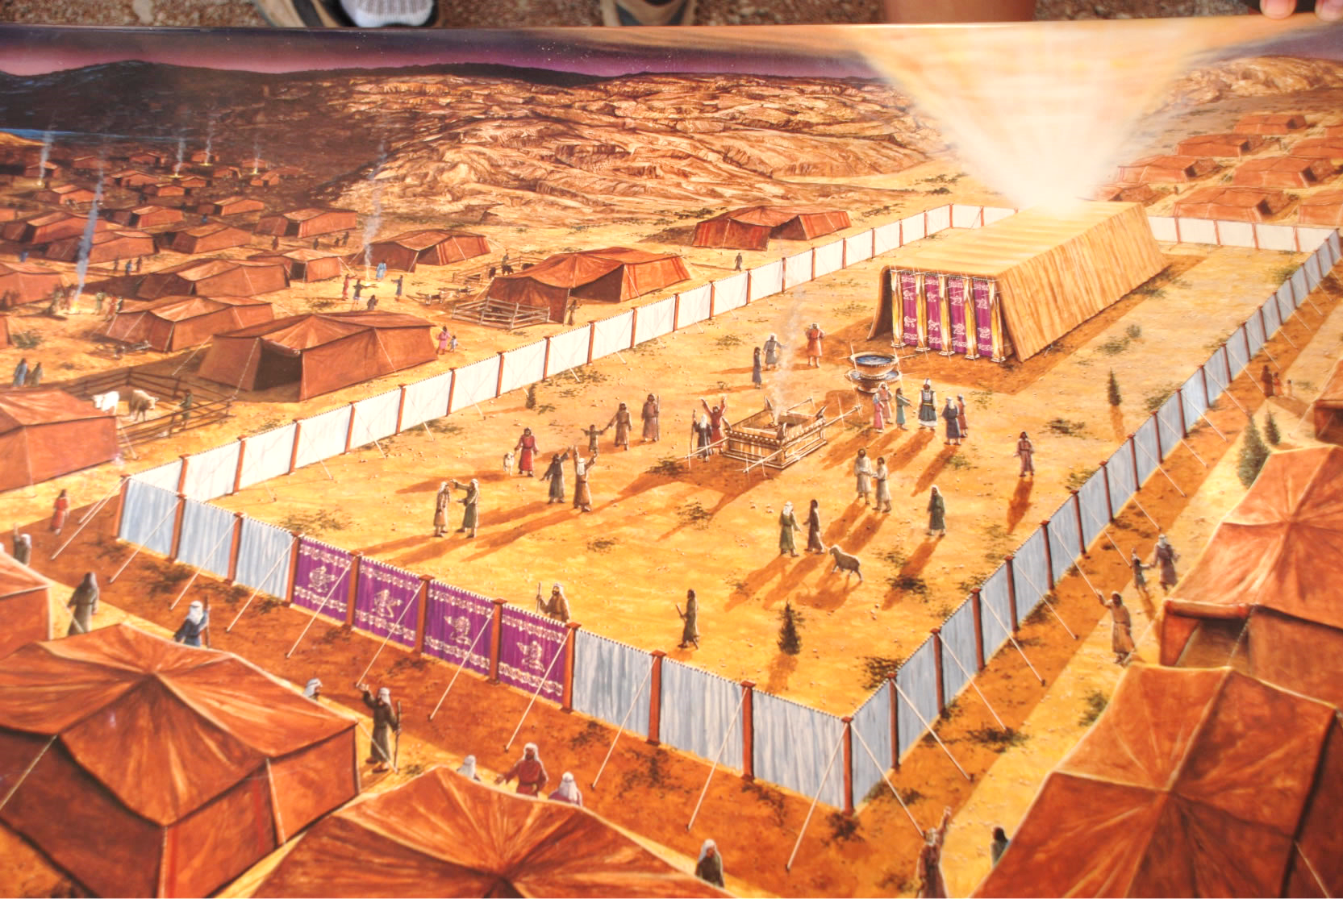

Slide 8
Leviticus 20:24-26
I am the Lord your God, who has separated you from the peoples. You shall therefore separate the clean beast from the unclean, and the unclean bird from the clean. You shall not make yourselves detestable by beast or by bird or by anything with which the ground crawls, which I have set apart for you to hold unclean. You shall be holy to me, for I the Lord am holy and have separated you from the peoples, that you should be mine.

Slide 9
Numbers 18:5-7
“And you shall keep guard over the sanctuary and over the altar…And you and your sons with you shall guard your priesthood for all that concerns the altar and that is within the veil; and you shall serve. I give your priesthood as a gift, and any outsider who comes near shall be put to death.”

Slide 10
Present your bodies as a living sacrifice, holy and acceptable to God (Rom. 12:1)
You are a chosen race, a royal priesthood, a holy nation (1 Pet. 2:9)
God's temple is holy, and you are that temple (1 Cor. 3:17)

Slide 11
1.) We are the holy sacrifice
2.) We are the holy priesthood
3.) We are the holy temple

Slide 12
1 Peter 1:15-16
As He who called you is holy, you also be holy in all your conduct, since it is written, “You shall be holy, for I am holy.”
ARE YOU HOLY?
Does holiness just happen automatically?

Slide 13
Is He Holy?
He goes to church
He’s got
a good heart
He’s a Christian
He does
a lot of good things
He’s a great guy
He’s not engaging in sin
Notes:
Well, I’m a Christian
Well, I come to worship
Well, he’s got a good heart
Well, he’s a great guy
Well, he’s done a lot of good things

Slide 14
1 John 1:9
If we confess our sins, He is faithful and just to forgive us our sins and to cleanse us from all unrighteousness.

Slide 15
Philippians 2:13-16
“…it is God who works in you, both to will and to work for His good pleasure. Do all things without grumbling or disputing, that you may be blameless and innocent, children of God without blemish in the midst of a crooked and twisted generation, among whom you shine as lights in the world, holding fast to the word of life”

