Slide 1
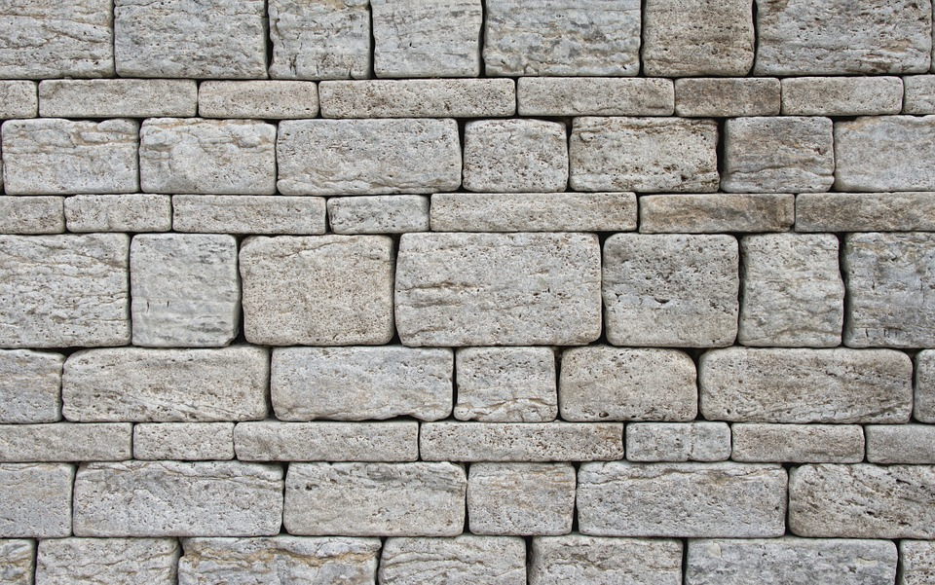
EZRA & NEHEMIAH

Slide 2
Ezra 1

Slide 3
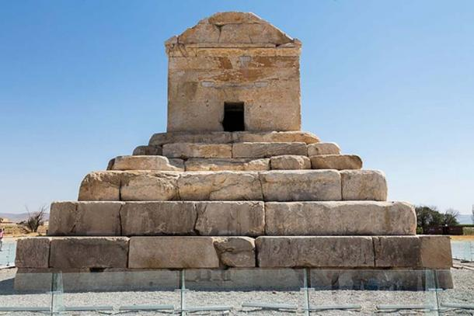
Notes:
11 meters high
Cyrus died in summer of 530 (9 years after)
Pasargadae, capital of Persia

Slide 4
Ezra-Nehemiah
Ezra 1-6 Zerubbabel’s expedition
Rebuilding the temple in Jerusalem
Notes:
Number of Jews taken into captivity: Jer 52- 4600 total (just the men) Probably 14,000-18,000 total were actually deported

Slide 5
Ezra 2
“Now these were the people of the province who came up out of the captivity of those exiles whom Nebuchadnezzar the king of Babylon had carried captive to Babylonia. They returned to Jerusalem and Judah, each to his own town. They came with Zerubbabel, Jeshua, Nehemiah, Seraiah, Reelaiah, Mordecai, Bilshan, Mispar, Bigvai, Rehum, and Baanah.
The number of the men of the people of Israel: …”

Slide 6
“The number of the men of the people of Israel:”
Laity
Priests
Levites
Singers
Gatekeepers
Other temple servants
Those whose genealogies couldn’t be proven
Totals
Gifts of gold/silver/garments
--50,000

Slide 7
“The number of the men of the people of Israel:”
Laity
Priests
Levites
Singers
Gatekeepers
Other temple servants
Those whose genealogies couldn’t be proven
Totals
Gifts of gold/silver/garments
Why this list???
--50,000

Slide 8
“The number of the men of the people of Israel:”
Laity
Priests
Levites
Singers
Gatekeepers
Other temple servants
Those whose genealogies couldn’t be proven
Totals
Gifts of gold/silver/garments
--50,000

Slide 9
National identity
Promises to Abraham
Treasured possession/holy nation
Covenant with David
Promises to bring the Israelites back from exile

Slide 10
National identity
Respect for roles
Priests, Levites, Singers, Gatekeepers, Temple servants

Slide 11
National identity
Respect for roles
Respect for the priesthood
“…These sought their registration among those enrolled in the genealogies, but they were not found there, and so they were excluded from the priesthood as unclean. The governor told them that they were not to partake of the most holy food, until there should be a priest to consult Urim and Thummim.”

Slide 12
National identity
Respect for roles
Respect for the priesthood
Documenting the remnant
Reclaiming land
“Now the priests, the Levites, some of the people, the singers, the gatekeepers, and the temple servants lived in their towns, and all the rest of Israel in their towns.”

Slide 13
Ezra 2:68-69
Some of the heads of families, when they came to the house of the Lord that is in Jerusalem, made freewill offerings for the house of God, to erect it on its site. According to their ability they gave to the treasury of the work 61,000 darics of gold, 5,000 minas of silver, and 100 priests' garments.

Slide 14
Ezra 2

Slide 15
Ezra 3

