Slide 2
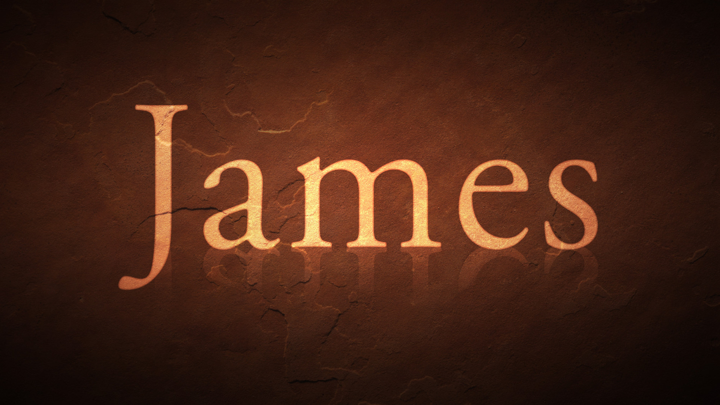
The Call To True Commitment

Slide 3
Commitment to the Word (1.19-2.13)

Slide 4
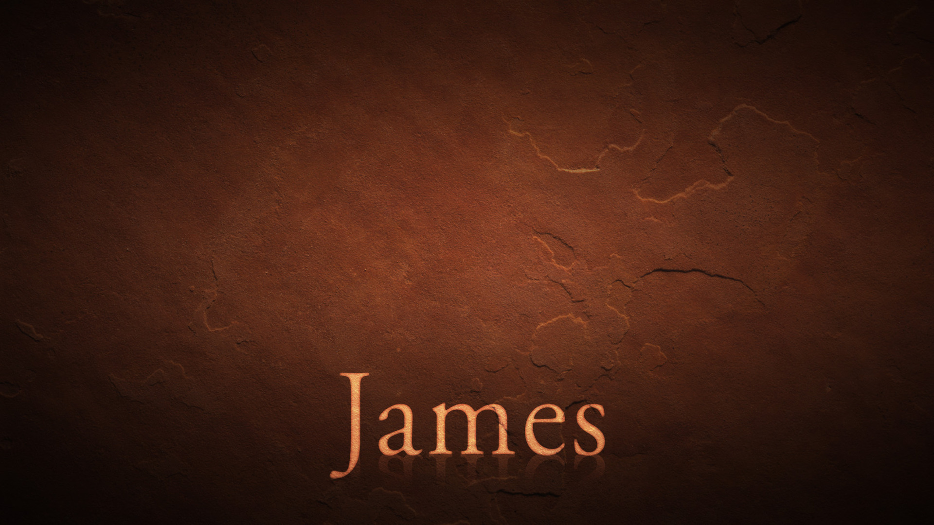
We are brought forth by the word (1.18)
The word continues to save us… if it’s implanted (1.21)
The word is perfect and gives us liberty (1.25)
The word is the law of the King (2.8,1)
All of God’s word must be kept (2.10-11)
Essential Truths About The Word

Slide 5
“But prove yourselves doers of the word, and not merely hearers who delude themselves. For if anyone is a hearer of the word and not a doer, he is like a man who looks at his natural face in a mirror; for once he has looked at himself and gone away, he has immediately forgotten what kind of person he was. But one who looks intently at the perfect law, the law of liberty, and abides by it, not having become a forgetful hearer but an effectual doer, this man will be blessed in what he does.” (James 1:22–25, NASB95)
Knowing The Word Is Not Enough… Doing Is Essential

Slide 6
Commitment to the Word (1.19-2.13)

