Slide 2
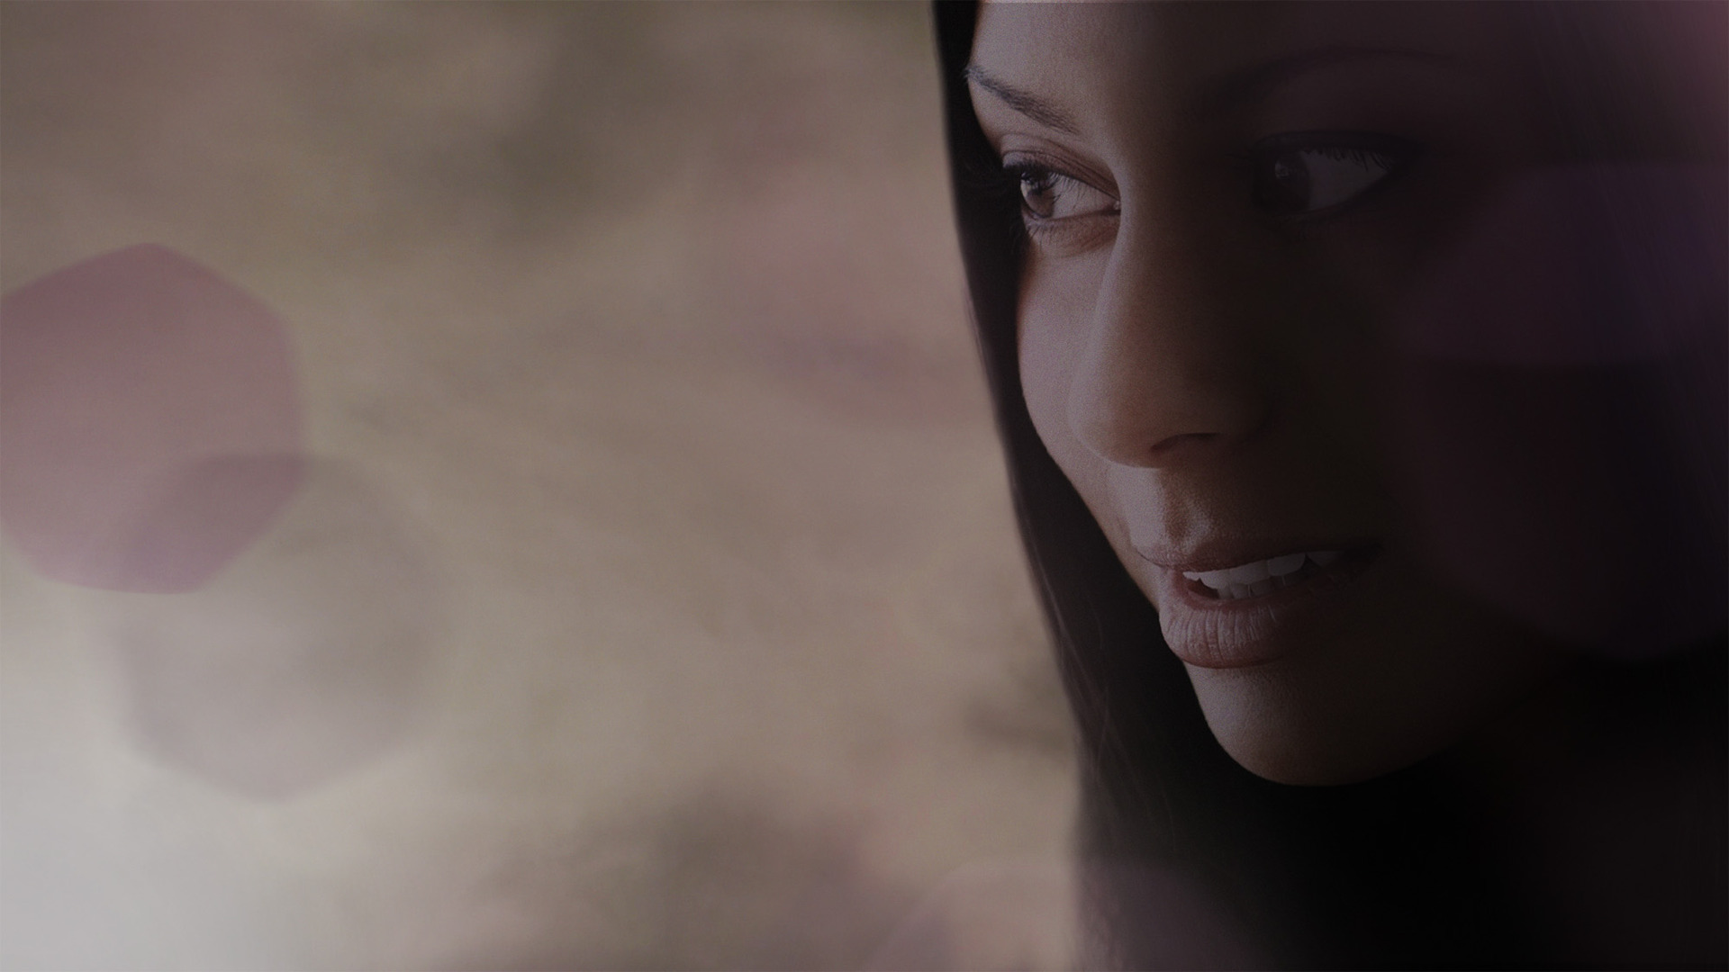
THE FAITH OF RAHAB

Slide 3
Why Joshua Was Troubled…
Past experience
Attitude of the people
Death of Moses
The first hurdle: Jericho

Slide 4
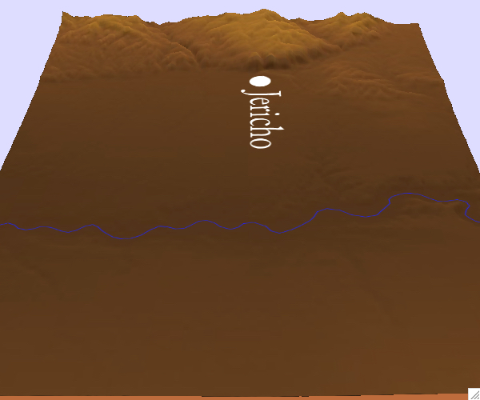

Slide 5
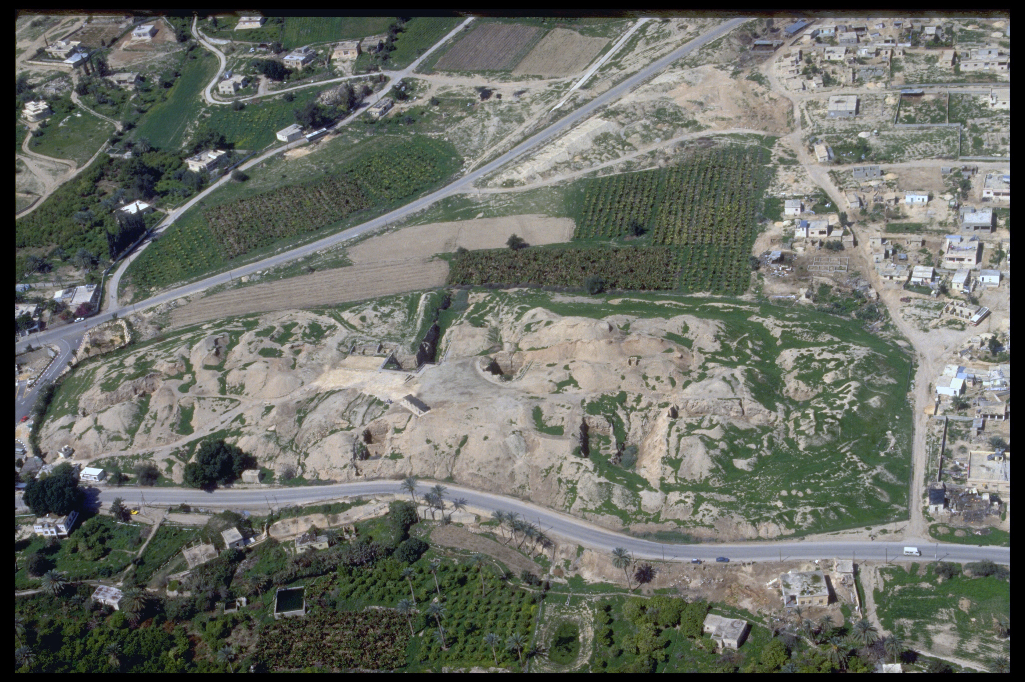

Slide 6
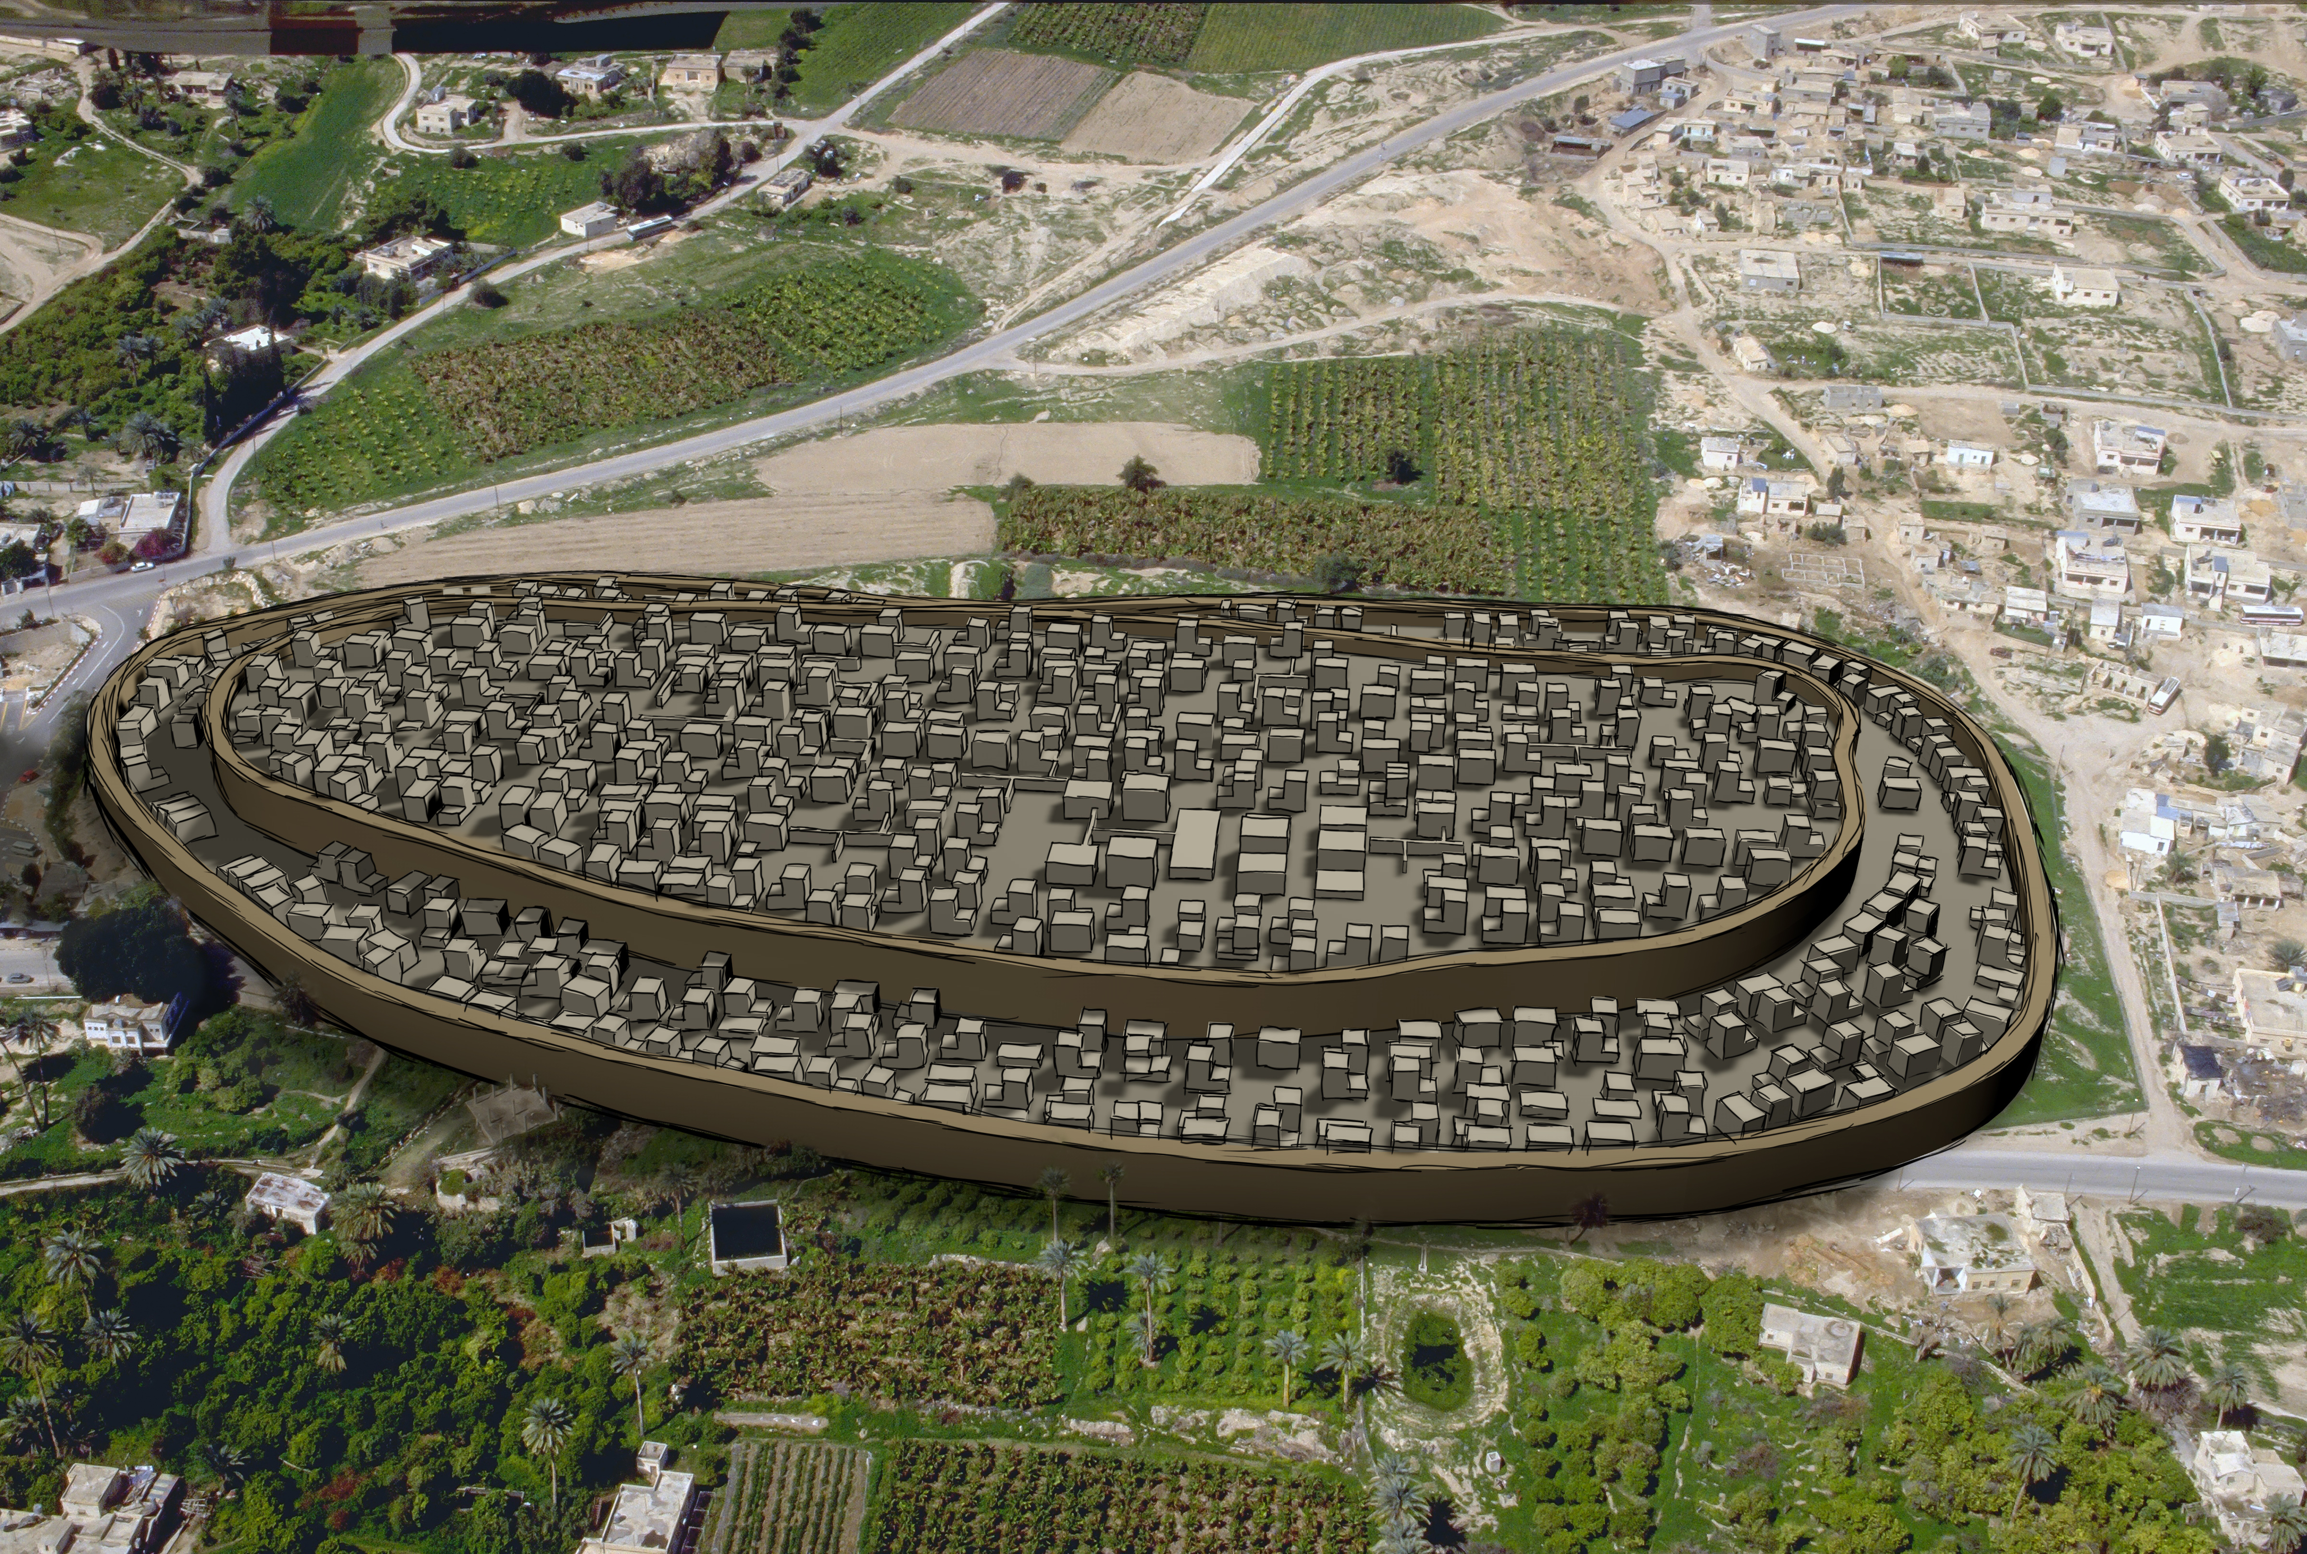

Slide 8
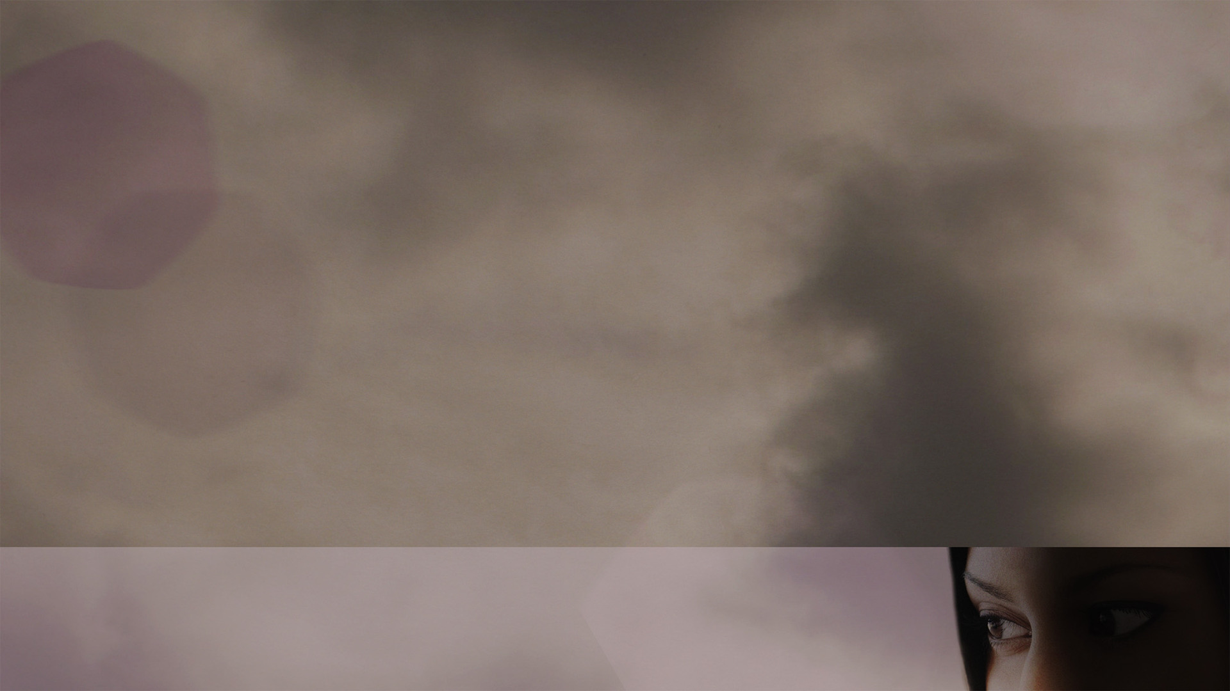
Rahab feared God more than anything (Joshua 2.1-11)
Rahab not only believed there is a God, but also that He rewards those who seek Him (Joshua 2.12-21)
Rahab’s faith made her a full member of God’s people and of His family (Joshua 6.22-25)
THE FAITH OF RAHAB

