Slide 1
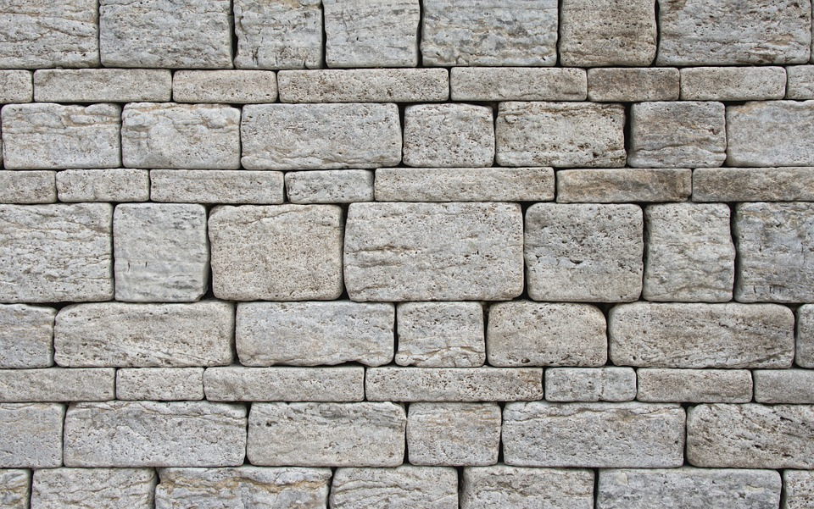
EZRA & NEHEMIAH

Slide 3
You can’t really know where you are going until...

Slide 4
You can’t really know where you are going until you know where you have been.

Slide 5
Old Testament History
Ezra & Nehemiah

Slide 6
Old Testament History
The
Exodus
Moses’ warnings
The covenant with David
Corrupt kings
Ezra & Nehemiah
Priesthood established
Canaan Settled
Temple built by Solomon
Words of the prophets
Jerusalem’s destruction & the exile

Slide 7
Biblical History
Events & Facts
Lessons & Application

Slide 8
Biblical History

Slide 9
Biblical History is selective

Slide 10
Ezra-Nehemiah
The exile in Babylon is over
The Jews are allowed to return home to the promised land
They re-establish their laws
They rebuild the temple in Jerusalem
They rebuild the walls of Jerusalem

Slide 11
Ezra-Nehemiah

Slide 12
Deuteronomy 30

Slide 13
1 Kings 8

