Slide 2
We are in this together – and we will get through this, together.

Slide 3
We are in this together – and we will get through this, together?

Slide 4
Protecting our Children from Hidden Dangers

Slide 5
The Danger of Frustration

Slide 6
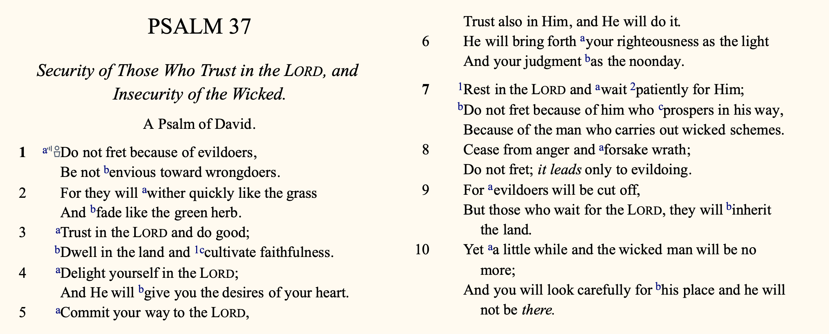

Slide 7
Not by pretending problems don’t exist
By looking ahead
Avoiding
Frustration

Slide 10
Not by pretending problems don’t exist
By looking ahead
By looking up
Avoiding
Frustration

Slide 12
Not by pretending problems don’t exist
By looking ahead
By looking up
By being constructive
Avoiding
Frustration

Slide 14
“But the humble will inherit the land And will delight themselves in abundant prosperity.”
- Psalm 37.11
Avoiding
Frustration

Slide 15
“Blessed are the gentle, for they shall inherit the earth.”
- Matthew 5:5
Avoiding
Frustration

