Slide 1
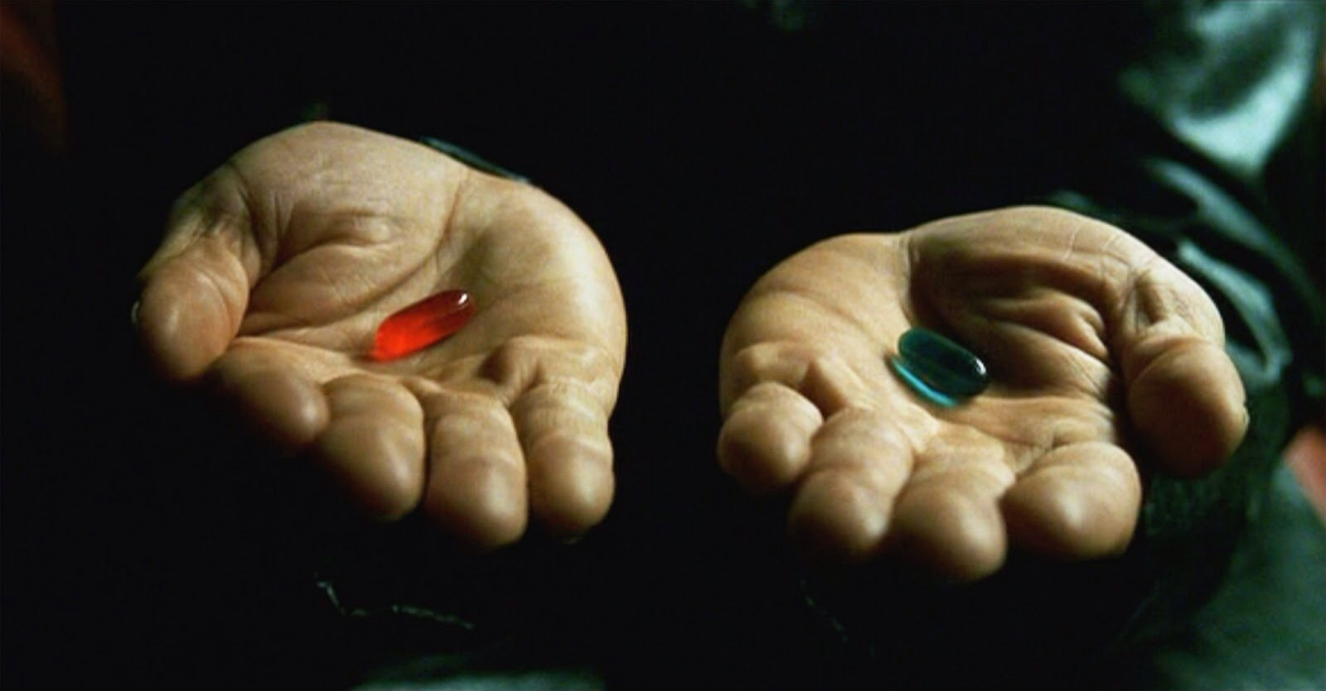

Slide 2
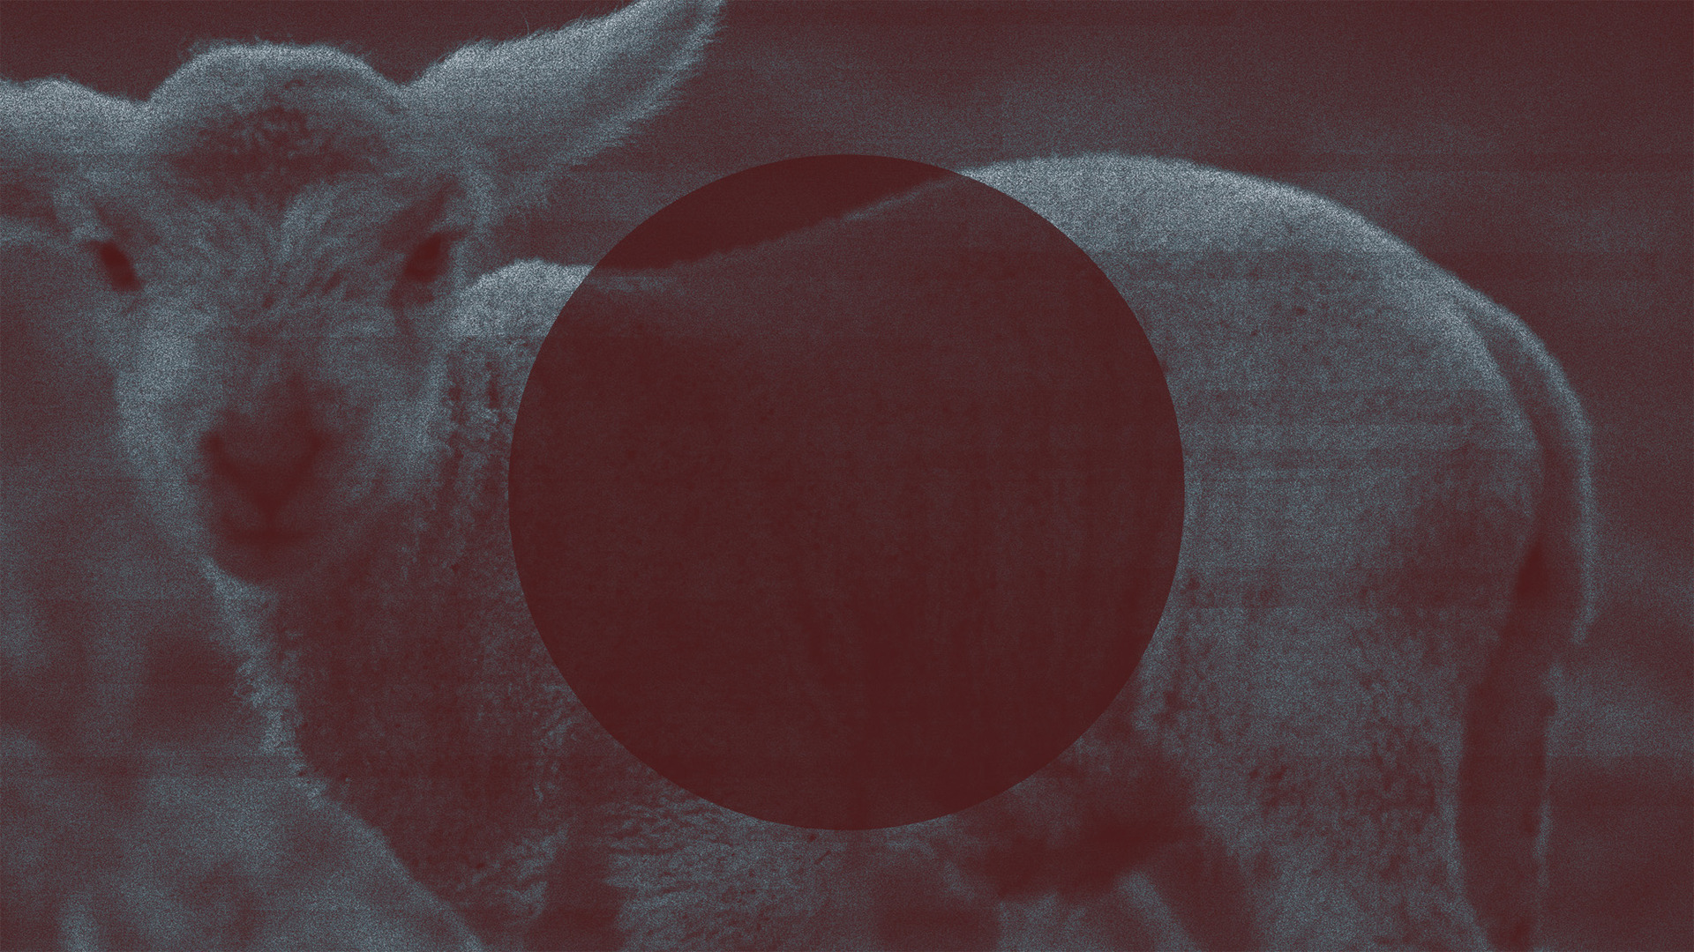
Don’t be a sheep

Slide 3
You’re a sheep

Slide 4
Genesis 2-3
Ephesians 2.1-3
Matthew 18.11
You’re a sheep

Slide 5
Sheep trust… and that’s a good quality
But we must be careful that we don’t trust the wrong shepherds (Matthew 9.36)
You’re a sheep

Slide 6
Jesus’ sheep trust Him and won’t follow another (vss. 2-5)
Jesus’ sheep trust Him because He is trustworthy (vss. 7-15)
John 10

Slide 7
About leadership in a local congregation (1Peter 5.1-5)
About how we conduct ourselves in this world (1Peter 2.11-12, 13-17; 4.8)
Think like a sheep…

Slide 9
“My sheep hear My voice, and I know them, and they follow Me; and I give eternal life to them, and they will never perish; and no one will snatch them out of My hand.”
(John 10:27–28)
You’re a sheep

