Slide 2
Don’t Waste A Good Crisis

Slide 5
Don’t blame and complain (1.27)
Trust in God and His promises (1.30-33)
Don’t Waste A Good Crisis

Slide 8
Don’t blame and complain (1.27)
Trust in God and His promises (1.30-33)
Remember what you’ve seen (4.1-9)
Don’t Waste A Good Crisis

Slide 9
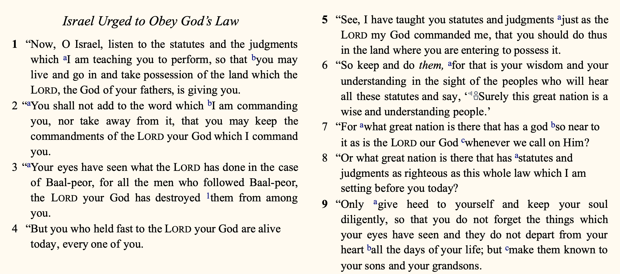

Slide 10
Don’t blame and complain (1.27)
Trust in God and His promises (1.30-33)
Remember what you’ve seen (4.1-9)
Pass the lessons on (4.9)
Don’t Waste A Good Crisis

